Slide 1
Access for All:
Responsive and Accessible IDS and ILLiAD Web pages
Leah M. Root
Milne Library, SUNY Geneseo
rootl@geneseo.edu
Twitter: @rootleah
Github: @rootl
Notes:
This presentation will discuss the importance of following Accessibility Guidelines in building websites and modifying templates for web platforms such as ILLiAD.

Slide 2
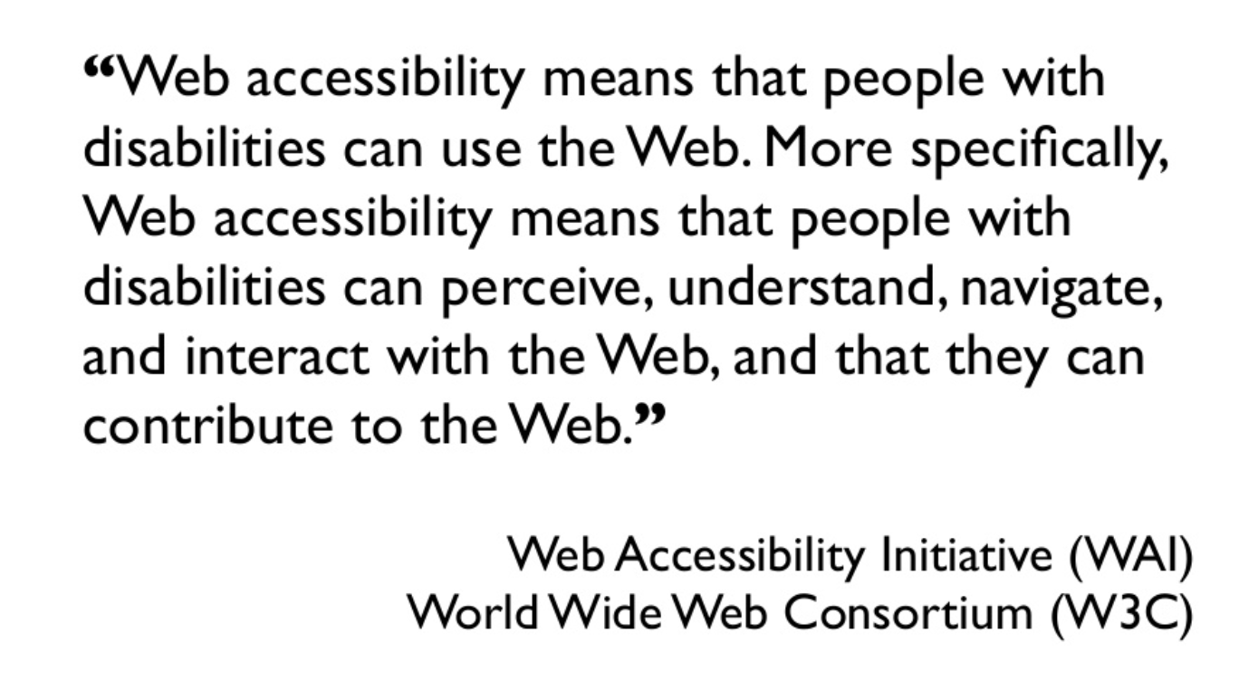
What is Accessibility?
Notes:
Web accessibility means that websites, tools, and technologies are designed and developed so that people with disabilities can use them.
More specifically, people can: perceive, understand, navigate, and interact with the Web.

Slide 3
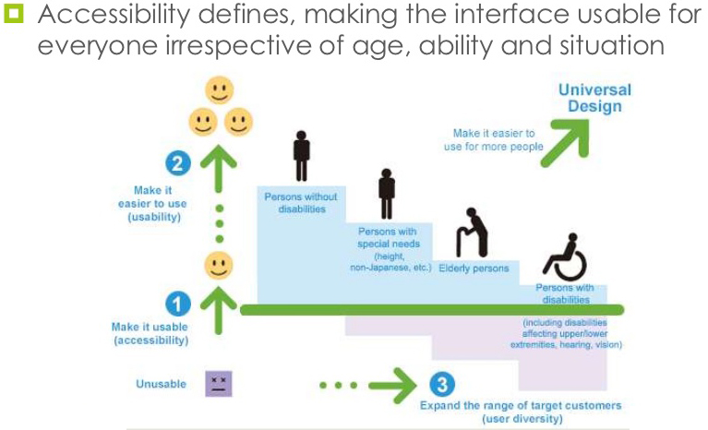
What is Accessibility?
Source: Accessibility and
User Designed LifeStyle
Notes:
Accessibility defines: making the interface usable for EVERYONE, irrespective of age, ability, and situation:
Elderly
Blind
Color Blind
Contrast and lighting
Nearsighted
Farsighted
Seizures
Migraines
Cognitive disabilities
Dyslexia
Reading difficulties
Deaf
Hard of Hearing
Mobility impaired
Autism Spectrum
Source: https://www.slideshare.net/sprayaga/accessibility-and-ucd

Slide 4
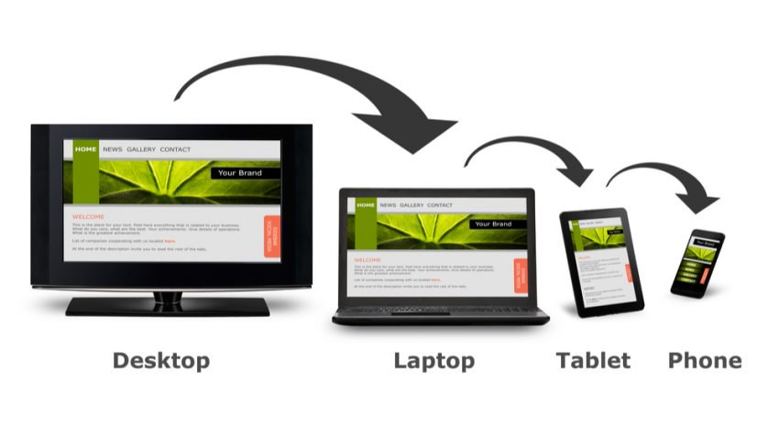
What is Responsive Design?
A web page should look good on any device!
Notes:
A web page should look good on any device!
** Source: https://www.levelaccess.com/what-does-responsive-web-design-have-to-do-with-accessibility/

Slide 5
What is Responsive Design?
“Responsive design principles, including fluid layouts, benefit users with disabilities on desktops as well as on mobile devices.”
Source: LevelAccess.com
Notes:
Responsive design takes care of a lot of problems with accessibility, because it allows the display of web content to fit to the size of the screen, and the user does not have to do anything to achieve this.
** Source: https://www.levelaccess.com/what-does-responsive-web-design-have-to-do-with-accessibility/

Slide 6
Accessibility and Responsive Design
Go Hand in Hand
“When done properly, Responsive Web Design can address many accessibility issues related to low vision and certain mobility impairments.
While responsive web design was not created specifically to address accessibility, its aim is to craft sites to provide an optimal viewing experience and easy navigation for all.
Source: InteractiveAccessibility.com
Notes:
“When done properly, Responsive Web Design can address many accessibility issues related to low vision and certain mobility impairments.
While responsive web design was not created specifically to address accessibility, its aim is to craft sites to provide an optimal viewing experience and easy navigation for all …
*** Source: http://www.interactiveaccessibility.com/blog/accessible-responsive-web-design-rwd#.W0zQO6L0kWc

Slide 7
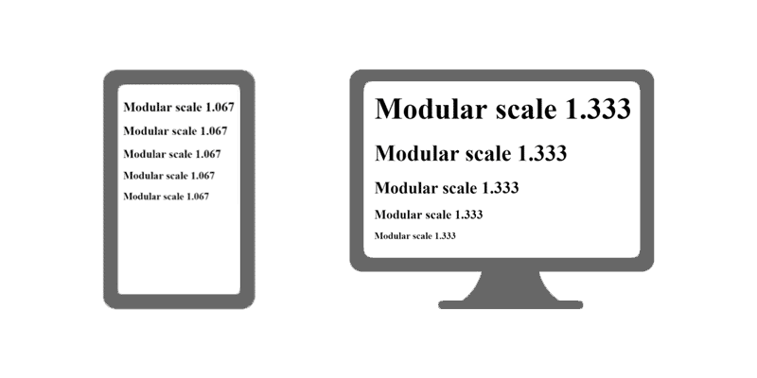
Accessibility and Responsive Design
Go Hand in Hand
Responsive sites adjust to the screen and presents in the most readable and usable way for that particular screen size and format.
Source: InteractiveAccessibility.com
Source: Smashing Magazine
Notes:
Responsive sites adjust to the screen and presents in the most readable and usable way for that particular screen size and format.
This can ensure that font size remains readable and at a high resolution for people with low vision. It also keeps interactive elements large and easier to operate for people with mobility impairments.”
Source: http://www.interactiveaccessibility.com/blog/accessible-responsive-web-design-rwd#.W0zQO6L0kWc
Image Source: https://www.smashingmagazine.com/2016/05/fluid-typography/

Slide 8
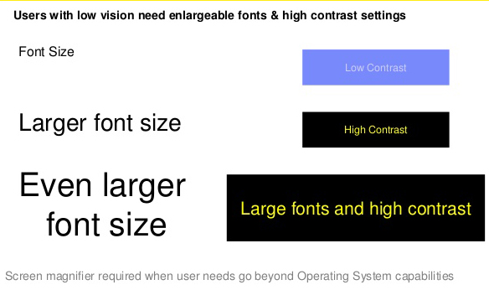
Accessibility and Responsive Design
Go Hand in Hand
Notes:
Responsive sites adjust to the screen and presents in the most readable and usable way for that particular screen size and format.
This can ensure that font size remains readable and at a high resolution for people with low vision. It also keeps interactive elements large and easier to operate for people with mobility impairments.”
*** Source: http://www.interactiveaccessibility.com/blog/accessible-responsive-web-design-rwd#.W0zQO6L0kWc
Image Source: https://www.slideshare.net/sivaprasad2020/accessibilityoverview

Slide 9

Screen Reader Demo for Digital Accessibility
Source: https://youtu.be/dEbl5jvLKGQ
Notes:
I found that it’s better to have an explanation of challenges faced by people with visual disabilities, if the explanation comes directly from someone with a visual disability. This is a Screen Reader Demo for Digital Accessibility.
https://youtu.be/dEbl5jvLKGQ
UC San Francisco

Slide 10
Screen Reader Demo for Digital Accessibility
Source: https://youtu.be/dEbl5jvLKGQ
Notes:
I found that it’s better to have an explanation of challenges faced by people with visual disabilities, if the explanation comes directly from someone with a visual disability. This is a Screen Reader Demo for Digital Accessibility.
https://youtu.be/dEbl5jvLKGQ
UC San Francisco

Slide 11
Common and Not-So Common
Accessibility Issues
Alternative descriptions of images and links
Tables
Document Type and Language
Headings and TabIndex order
Color Contrast
Notes:
There are many factors to consider for web accessibility. I am going to focus on some of the ‘biggies.’
Alternative descriptions of images and links (you may be familiar with the ALT tag)
Tables of data versus using tables to hold text content and site layout
Document Type and Language
Headings and Tabindex
Color Contrast

Slide 12
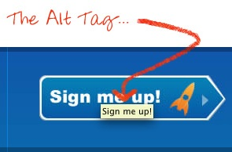
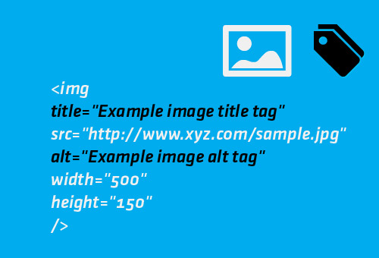
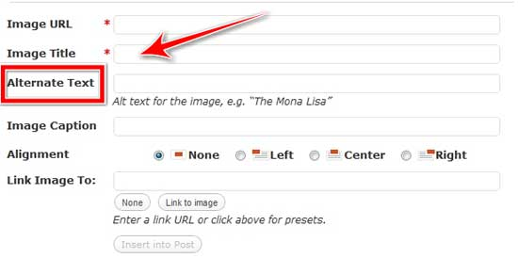
ALTernative descriptions of images and links
Notes:
“Alt” tags are necessary to describe the content of an image or a link.
Most content management systems provide the ability to add alternative text, captions, titles, and other descriptive data to an image or link placed in content.
If you work with anything like WordPress, Drupal, or LibGuides, you may see sections to add “alt” tags or alternative description.
Alt tags are one of the more well-known “THINGS THAT ARE NEEDED TO MAKE A WEBSITE ACCESSIBLE.”
You need to describe what the image is showing or referencing. Even with logos – a college logo needs an alt tag saying the name of the college, for example.

Slide 13
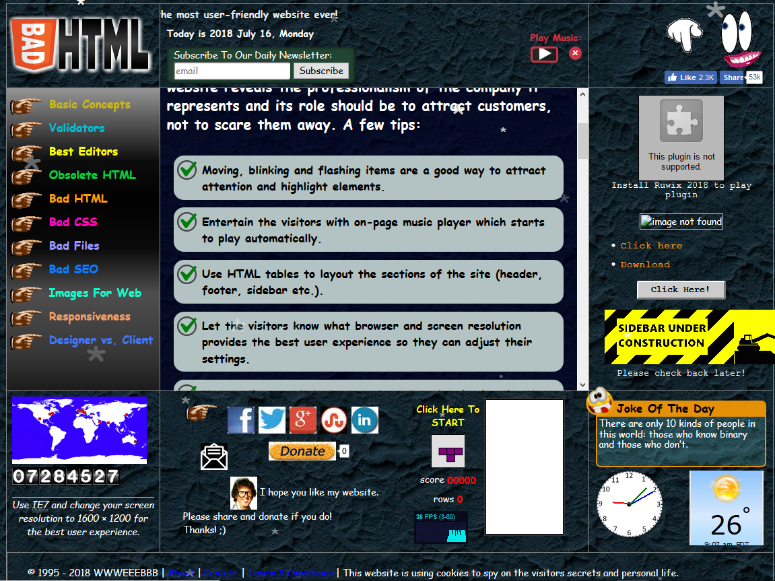
Tables: for data and coffee breaks,
NOT website layout.
https://badhtml.com/
Notes:
Tables are not for website layout. Maybe 20 years ago, but not today. BadHTML.com is a deliberately obnoxious example of – bad HTML, but it gets the point across. You have to think about how others see and use your website.
Tables are for tabular data that has clearly defined column headers, and repeated rows. Table styles and widths that are included right in the markup or code behind waste space and are read by screenreaders ,which is very confusing.
This site on this slide actually has excellent tips on responsive design, validation, and best practice. That is, if you can look at this site without getting a migraine.
https://badhtml.com/obsolete-html-code/

Slide 14
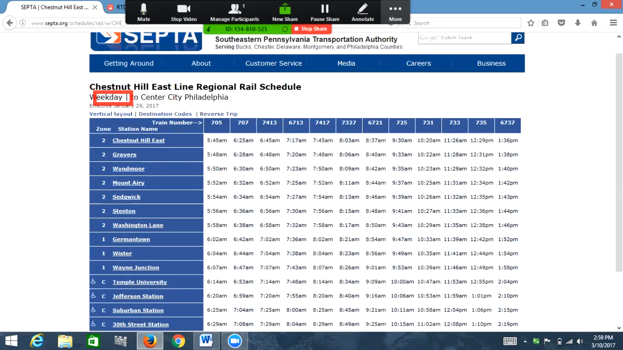
How badly coded tables sound to a Screen Reader
Source: https://www.youtube.com/watch?v=Vsj1MIg-gf8
Notes:
Badly coded tables are a nightmare for screen readers.
They are also one of the more cumbersome objects to clean up in web design and development.
This video is an example of how badly coded tables sound to a screen reader.

Slide 15
How badly coded tables sound to a Screen Reader
Source: https://www.youtube.com/watch?v=Vsj1MIg-gf8
Notes:
Badly coded tables are a nightmare for screen readers.
They are also one of the more cumbersome objects to clean up in web design and development.
This video is an example of how badly coded tables sound to a screen reader.

Slide 16
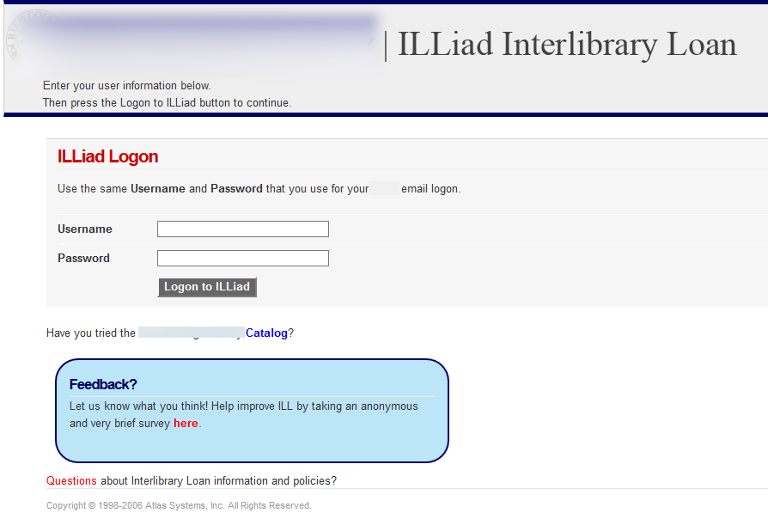
DOCTYPE and Language: ILLiAD out of the box
Notes:
Now, for something more ILLiAD related.
This is the familiar ‘Out of Box’ ILLiAD page and form layout.
I ran it through the WAVE Web Accessibility tool. I hid the name of the college to protect the ILLiAD innocent.

Slide 17
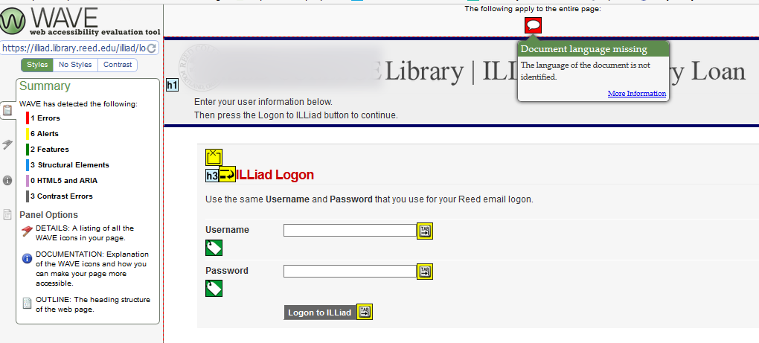
DOCTYPE and Language
This has no ”document type declaration” <html> or language declaration <en>
Notes:
The WAVE Web Accessibility tool found errors on this site immediately, including right at the beginning of the page.
Identifying the language of the page allows screen readers to read the content in the appropriate language. It also facilitates automatic translation of content.
No <!DOCTYPE> and no language declaration = Accessibility violations right off the bat.
I will discuss the WAVE accessibility tool more in this presentation and I have a link to it for your convenience. It is a fantastic web based tool for checking accessibility on any site.

Slide 18
DOCTYPE and Language
Definition and reasons for the <!DOCTYPE> declaration from W3Schools” https://www.w3schools.com/tags/tag_doctype.asp
The <!DOCTYPE> declaration must be the very first thing in your HTML document, before the <html> tag.
The <!DOCTYPE> declaration is not an HTML tag; it is an instruction to the web browser about what version of HTML the page is written in.
In HTML 4.01, the <!DOCTYPE> declaration refers to a DTD, because HTML 4.01 was based on SGML. The DTD specifies the rules for the markup language, so that the browsers render the content correctly.
HTML5 is not based on SGML, and therefore does not require a reference to a DTD.
Notes:
This is the definition and reason for the <!DOCTYPE> declaration from W3Schools” https://www.w3schools.com/tags/tag_doctype.asp
“The <!DOCTYPE> declaration must be the very first thing in your HTML document, before the <html> tag.”
This is important:
“The <!DOCTYPE> declaration is not an HTML tag; it is an instruction to the web browser about what version of HTML the page is written in.”
The rest of this may seem gibberish, but I have it here for you because it is good to know.
“In HTML 4.01, the <!DOCTYPE> declaration refers to a DTD, because HTML 4.01 was based on SGML. The DTD specifies the rules for the markup language, so that the browsers render the content correctly.
HTML5 is not based on SGML, and therefore does not require a reference to a DTD.”

Slide 19
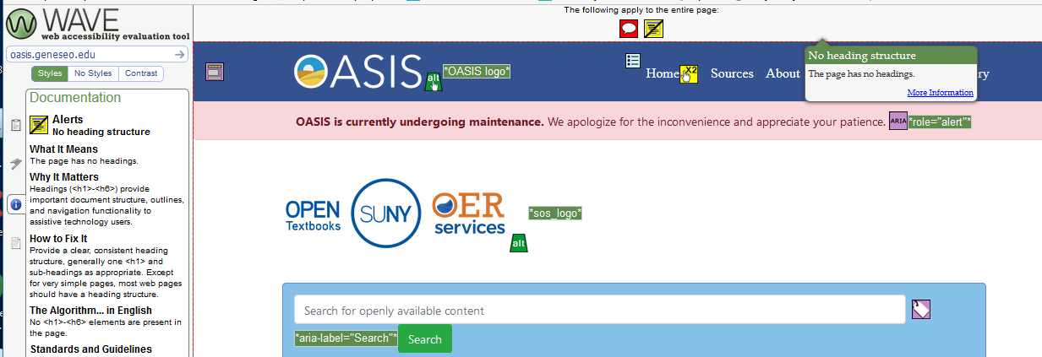
Headings: Basic HTML is still necessary
This has no ”top level heading” or page title <h1>
Notes:
This is an example of the importance of HTML headings. I ran the WAVE accessibility tool on an OER search site that is being developed in my own college. Yes, no one escapes me ☺
You would not think that search engines need headings or tags like regular pages, but they absolutely do.
Why It Matters:
“Headings (<h1>-<h6>) provide important document structure, outlines, and navigation functionality to assistive technology users.”
Structure is similar to a book or scholarly paper: Title, subtitle, Chapter or Section headings, subheadings, et cetera”

Slide 20
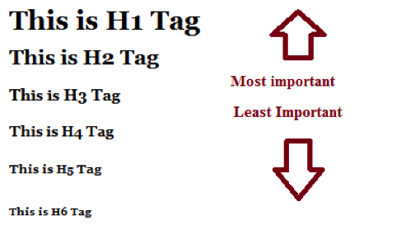
Headings: Why They Matter
“Headings (<h1> - <h6>) provide important document structure, outlines, and navigation functionality to assistive technology users.”
Notes:
Why It Matters:
“Headings (<h1>-<h6>) provide important document structure, outlines, and navigation functionality to assistive technology users.”
Structure is similar to a book or scholarly paper: Title, subtitle, Chapter or Section headings, subheadings, et cetera”

Slide 21
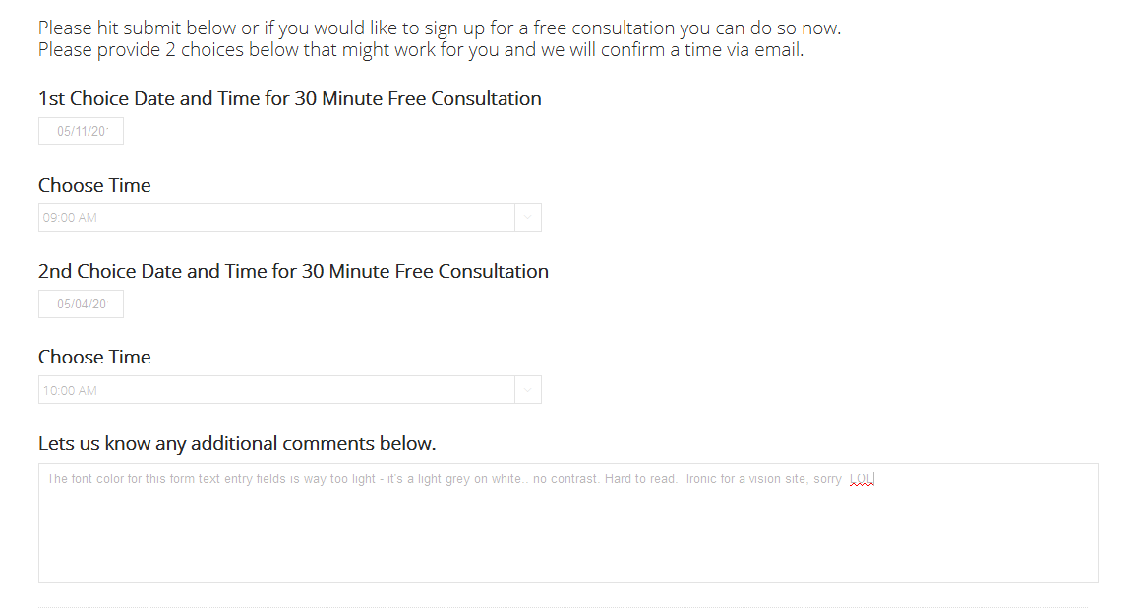
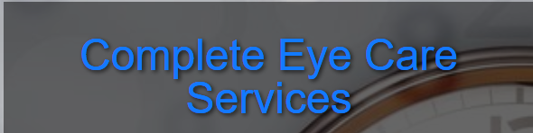
Contrast: Often ignored, extremely important
Notes:
Contrast between text and background color is not always thought of as important, but it must be.
The elderly, middle-aged, colorblind, farsighted, or people with eyestrain from sitting in front of a screen all day – If they struggle to see the content on your site, they will leave the site.
This example shows a form with contrast problems. This was from a website for improving vision, ironically.
The color of the text in the form fields was so light, I could not see what I was typing. I had to zoom in and turn up the contrast on my monitor.
The graphic banner on the form also was hard to read due to contrast issues. It also had no alt tags to explain what it was.
I did not need to run this through the Accessibility checker ☺ As a snarky courtesy, I messaged the eye center and let them know they had contrast problems on their form.

Slide 22
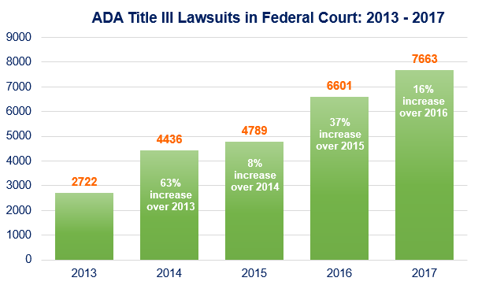
Consequences of Inaccessible Websites:
YOU COULD BE SUED
Source: ADA Title III Lawsuits…
Notes:
Accessibility violations equal massive lawsuits.
Unfortunately, people and institutions don’t always see the importance of something until they see how it hits their bank account.
This chart shows the steady increase in web accessibility violations from 2013 to 2017.
Source: http://dentalada.com/ada-title-iii-lawsuits-increase-by-14-percent-in-2017-due-largely-to-website-access-lawsuits-physical-accessibility-legislative-reform-efforts-continue/

Slide 23
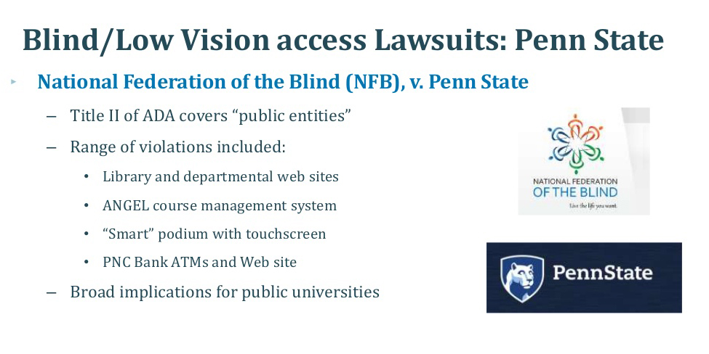
Academic Institutions, Online Library Services, Courses, Request Forms – Must be Accessible
Source: https://www.slideshare.net/3Play/the-impact-of-recent-lawsuits-on-video-accessibility-requirements
Notes:
One example: Penn State was sued for Accessibility violations, which covered everything from Library and Department websites, to LMS, to online databases and request forms.
In addition to paying fines that were in the double digit millions, Penn State went through an entire accessibility audit with a deadline. They had to revamp EVERYTHING they had online.
Penn State learned and they turned.
Penn State now has one of the best Accessibility Guide websites around. https://accessibility.psu.edu/ I have the link to this guide at the end of my presentation.
Source: https://www.slideshare.net/3Play/the-impact-of-recent-lawsuits-on-video-accessibility-requirements
I can provide sites that list academic institutions affected by Disability Lawsuits., or you can search online. I guarantee you will find long lists popping up immediately.

Slide 24
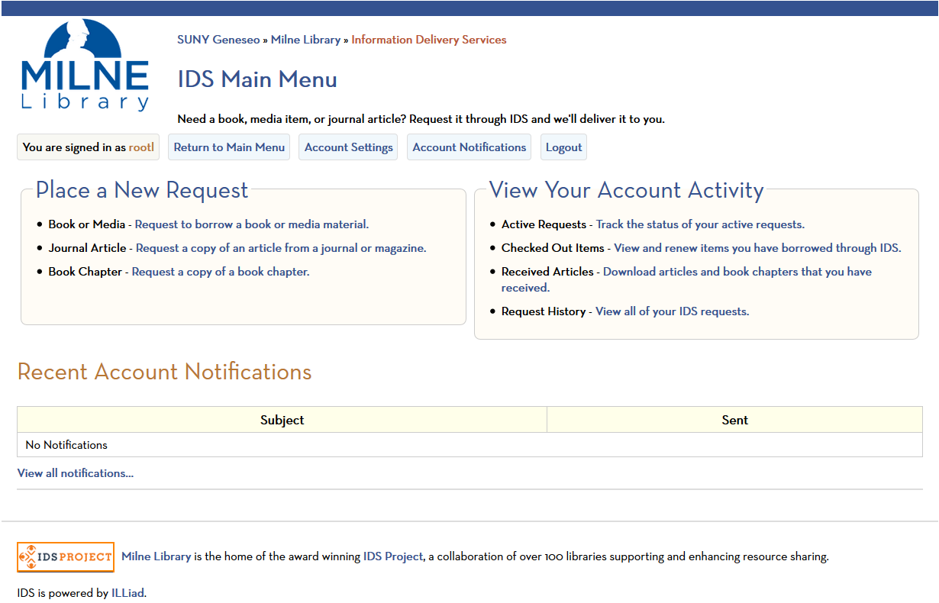
The Milne IDS/ILLiAD Redesign
Notes:
Now, for what I did to make our ILLiAD installation become responsive and accessible.
This is our redesign of IDS and ILLiAD pages. It is still a work in progress, but it passes accessibility checks, and is a lot easier for people to use.
I hope the things I learned during this process can help you with this platform, and others that you use.

Slide 25
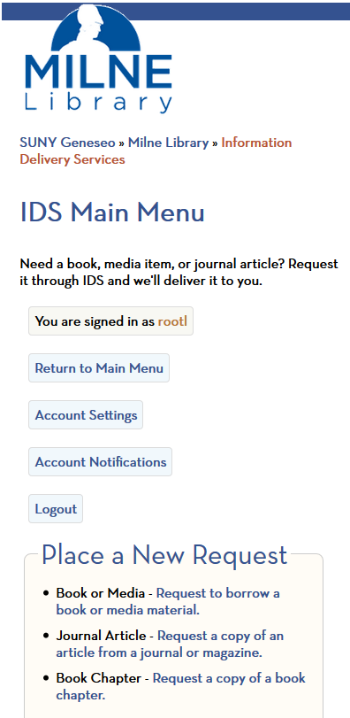
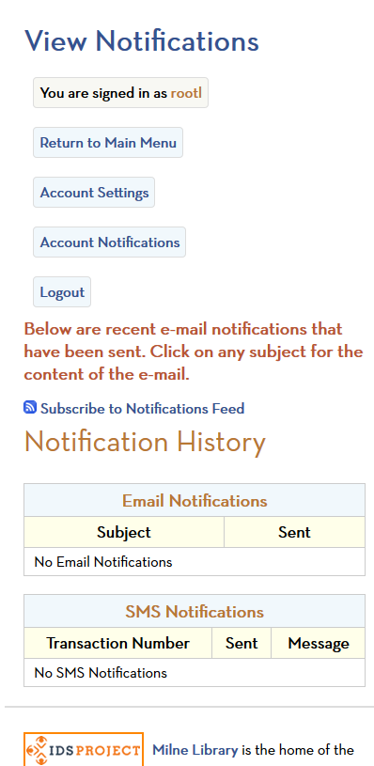
The Milne IDS/ILLiAD Redesign
Notes:
This is how IDS and ILLiAD pages display in portrait or mobile view.
The redesign took a lot of work and testing, but in the long run, it pays off. The site is much easier to maintain and add or edit features.

Slide 26
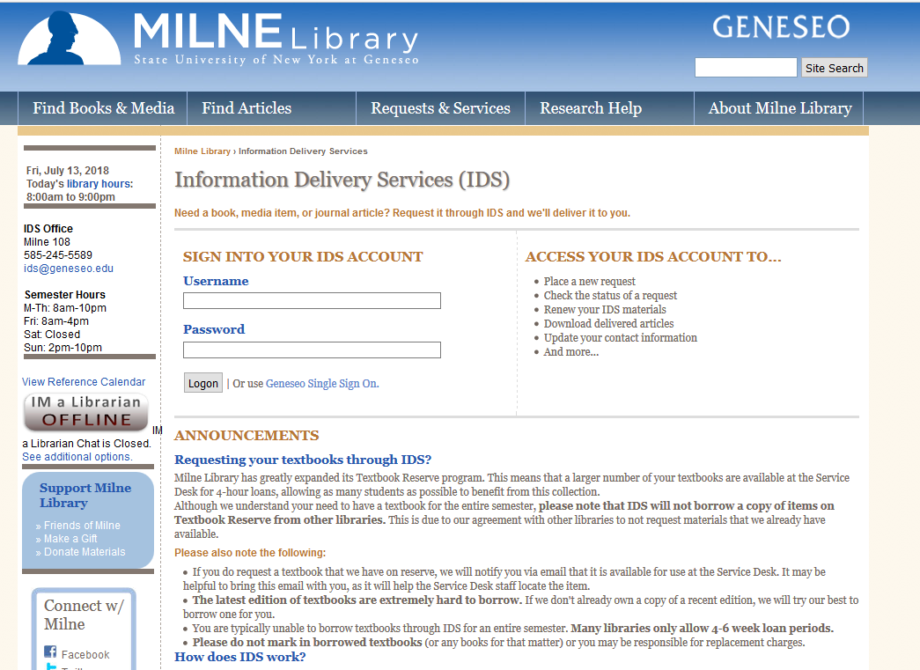
Why
Source: The Wayback Machine https://archive.org/
Notes:
Here is what prompted me to redesign IDS/ILLiAD from scratch:
This image is what our IDS pages looked like circa 2014. Image courtesy The Wayback Machine https://archive.org/ Nothing is ever gone from the internet, including awkward web design and development.
Our Library used to be required to mimic the Geneseo Drupal website as much as possible with all our 3rd party applications.
It was getting to be impossible.
The Geneseo website itself was not responsive at the time, and depended on a ton of different scripts and stylesheets.
Our ILLiAD site would often go down when the college changed styles or scripts, and it affected ILLiAD layout and functionality.
Students, faculty, and staff were affected by downtime. You can imagine the tech support tickets and widespread library panic every time the site crashed.

Slide 27
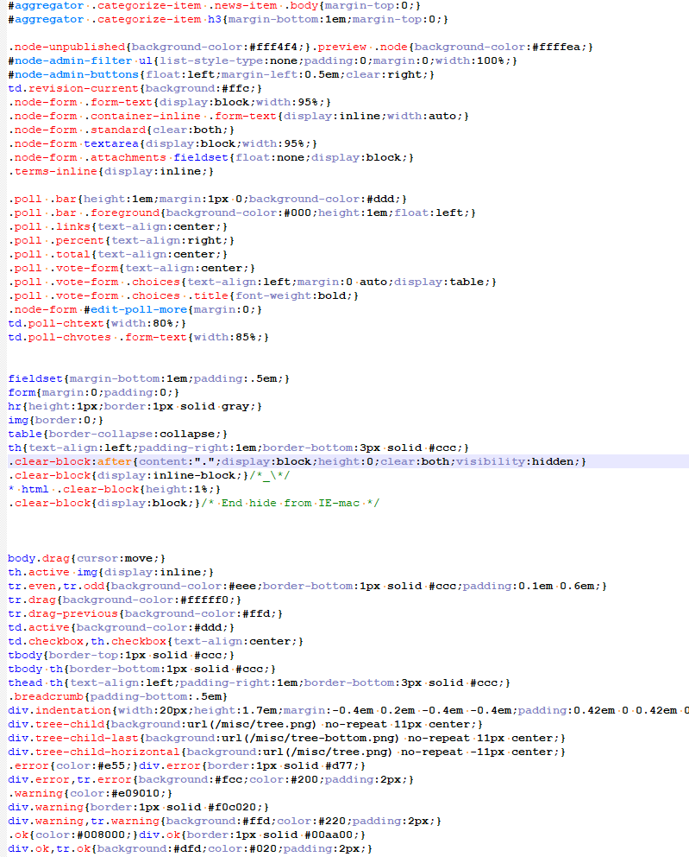
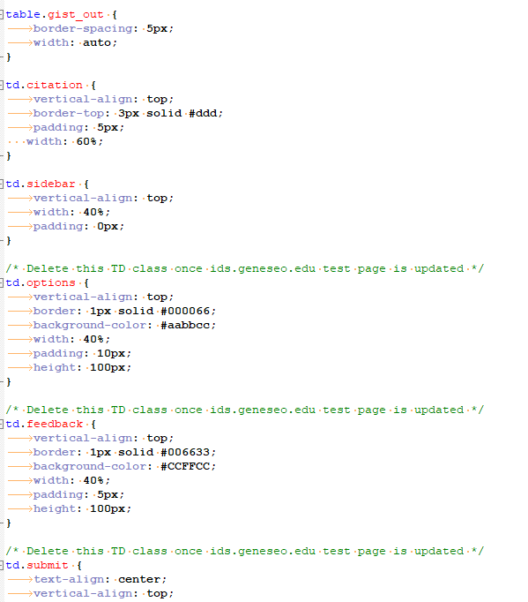
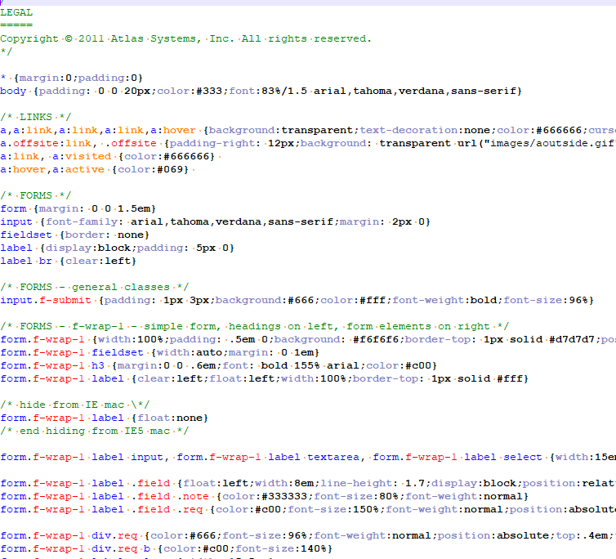

Why?
Notes:
This is just *some* of what we dealt with, from the back end point of view.
We had redundant styles, deprecated styles, styles overriding each other.
We had calls to outdated versions of javascripts, or scripts that were not being used.
Stylesheets were located on differrent servers. I could go on.
If you’re familiar with Rick and Morty, I felt like I was in a multiverse of code.

Slide 28
Strip, slash, consolidate, rebuild
Replaced dozens of <h4> and <h3> tags with <h2>
Ensured the IDS/ILLiAD site had <h1> titles
Added <alt> and <title> tags for our logos and links
Stripped out tabindexes from form fields that were not in order
Stripped out deprecated span, bold, and italic tags
Stripped out fixed (pixel) widths from tables, table cells, divs, and inputs
Rebuilt forms using fieldsets, legends, labels
Created “one stylesheet to rule them all”
Put frequently used code sections (such as menus) into include files
Notes:
This is what I did.
Replaced dozens of <h4> and <h3> tags with <h2>
Ensured the IDS/ILLiAD site had <h1> titles
Added <alt> and <title> tags for our logos and links
Stripped out tabindexes from form fields that were not in order
Stripped out deprecated span, bold, and italic tags
Stripped out fixed (pixel) widths from tables, table cells, divs, and form fields
Rebuilt forms using fieldsets, legends, labels
Created “one stylesheet to rule them all” (IDS pages, ILLiAD Lending pages, GIST pages, other modules)
Put frequently used code sections (such as menus) into include files
These tasks look daunting, but they can be done without too much stress and ibuprofen (lol), if you have some text editing tools, which I will discuss.

Slide 29
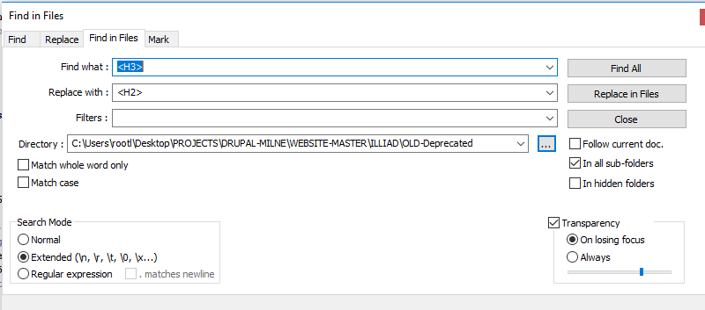
Find/Replace is Your Friend
Notes:
Code or text editors are a must. I will list recommended free and easy to use tools later in this presentation.
With dozens of files, it is much faster to batch find and replace code –as long as :
You know exactly what you are replacing.
You have AT LEAST one backup of all your files
You are working on a Test or Dev version of your ILLiAD setup

Slide 30
.INC files are your friends
Notes:
Much of what was tedious was repetitive code. Several chunks of code are repeated throughout the ILLiAD files and modules.
Particularly, Menus, main menus, login status, notifications.

Slide 31
.INC files are your friends
include_menu_you_are_logged_in_as
include_menu
include_notifications
Notes:
I made include files of these chunks of code, and put a call to the include files wherever they needed to appear.
This way, you only need to edit the include files one time.
This is far more efficient and cuts down on code errors.
This is not directly related to accessibility but it makes for easier styling, layout, and tracking of pages.

Slide 32
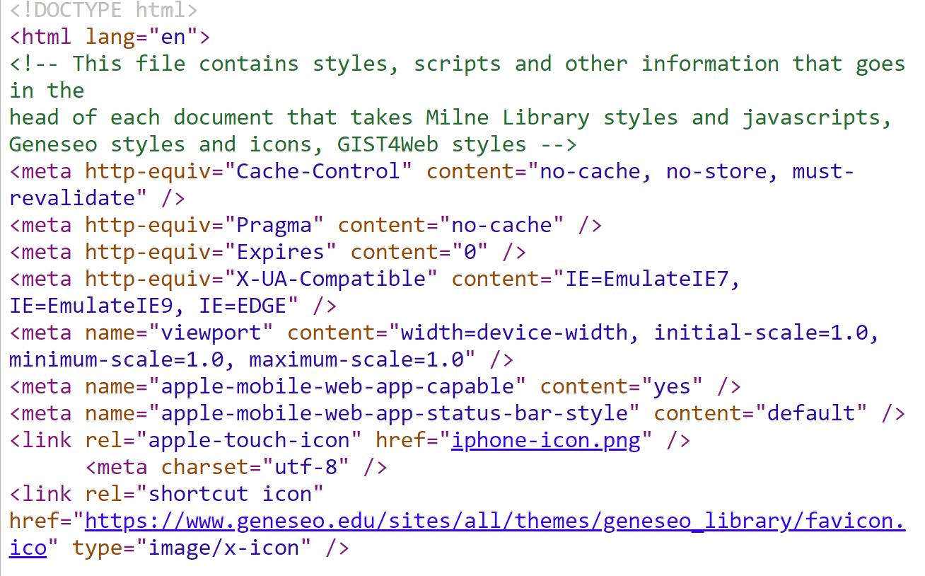
DocType for Accessible/Responsive
ILLiAD
Declare the DOCTYPE and the LANGUAGE in the header file
Notes:
‘While I was in there’ making the site responsive, I was looking into making it as accessible as possible.
Right in the beginning of the ILLiAD header code, I needed to properly declare that the site was HTML, and the language was in English.

Slide 33
Headings for Accessible/Responsive ILLiAD
<H1> Heading - Page Title - ONE on a Page </H1>
  <H2> Sub Heading - Topic Title - Section Title </H2>
    <H3> Sub Sub Heading - Sub Section - Sub Topic </H3>
Notes:
I mentioned before that I standardized heading tags on ILLiAD pages.
You really only need 3 levels of headings for ILLiAD..and most web sites or applications.
The <h1> is for titles of pages, similar to the title of a slide.
<h2> is for sub headings or sub titles.
<h3> is for dividing your topic headings further still.

Slide 34
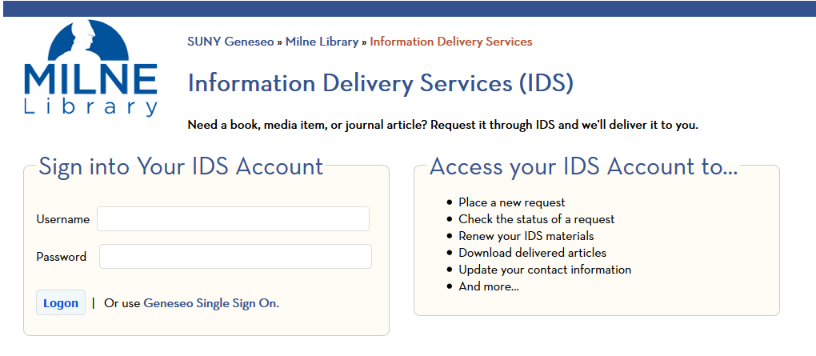
Div & Form ‘basic’ markup for Accessible/Responsive
ILLiAD
Notes:
This is our IDS/ILLiAD login page, with forms and layout designed for responsiveness and accessibility. And as we know, ILLiAD has a lot of forms.
The next slide ‘diagrams’ the structure of each area that has a title with a background and border enclosing a form or text.

Slide 35
Div & Form ‘basic’ markup for Accessible/Responsive
ILLiAD
    <div>
      <form action=“whateverILLIADneedstodo.dll">
      <fieldset id =“yourFieldSetName”>
        <legend> Form Section/Fieldset Title </legend>
        <div class=“field_name”><label for=“firstname">First Name</label>
        <input type=“text" name=“firstname" id=“firstname" value=“firstname"></div>
        <input type="submit" value="Submit">
      </fieldset>
      </form>
    </div>
Notes:
This is the ‘meat and potatoes’ of basic markup changes to make ILLiAD forms accessible and responsive.
The div is an invisible flexible container that holds the form or section of text .
The div can be ‘floated’ to the left or right, and can be controlled by the percentage of the screen it takes up.
The fieldset is the grouping of form objects into a section – commonly it has a border and a different background color to differentiate it from the rest of the site.
The legend is the title of the fieldset. Label is pretty much what it says – the label of the form field.

Slide 36
What the markup does
<H1>
<legend>
<label>
<fieldset>
<fieldset>
<div>
<div>
Notes:
This roughly translates how the markup on this page would show in a browser. Yes, there are ALT tags for our library logo ☺

Slide 37
Basic rules for Accessible/Responsive
ILLiAD
No fixed with or pixel widths in tables or divs
Fieldsets instead of tables for item groups in forms
Tables for tabular data ONLY, not for website layout
Font size in em or percentage
Alt tags for images and links
TABINDEXES must be in ORDER, or DO NOT USE THEM AT ALL
Notes:
Here as a summary, are some basic rules for accessibility and responsive design for IDS and ILLiAD pages.
These rules are also applicable for all web design and CMS content creation.
No fixed with or pixel widths in tables or divs
Fieldsets instead of tables for item groups in forms
Tables for tabular data ONLY, not for website layout
Font size in em or percentage
Alt tags for images and links
TABINDEXES must be in ORDER, or DO NOT USE THEM AT ALL!

Slide 38
Basic rules for Accessible/Responsive
ILLiAD
Title tags for images,links, form inputs (text fields, buttons, dropdown selectors, radio buttons, checkboxes)
Label tags for any form field descriptions you WANT to be visible on the website
Aria-label for images, links, form inputs (text fields, buttons, dropdown selectors, radio buttons, checkboxes) – these are picked up by screen readers, but not visible on the website
Notes:
More rules for accessibility and responsive design.
Title tags for images,links, form inputs (text fields, buttons, dropdown selectors, radio buttons, checkboxes)
Label tags for any form field descriptions you WANT to be visible on the website
Aria-label for images, links, form inputs (text fields, buttons, dropdown selectors, radio buttons, checkboxes) – these are picked up by screen readers, but not visible on the website

Slide 39
Accessible/Responsive ILLiAD:
ARIA-Labels
ARIA-label an attribute designed to help assistive technology (e.g. screen readers) attach a label to an otherwise anonymous HTML element.
<button aria-label="Close" onclick="myDialog.close()">X</button>`
Most people would be able to infer visually that this button will close the dialog. A blind person using assistive technology might just hear "X" read aloud, which doesn't mean much without the visual clues. aria-label explicitly tells them what the button will do.
https://stackoverflow.com/questions/22039910/what-is-aria-label-and-how-should-i-use-it
Notes:
I did not delve into ARIA-labels too much.
There are numerous resources and tutorials available regarding ARIA labels.
At the moment, I am just using labels and titles in our ILLiAD site, but I am going back to add ARIA labels to buttons, form fields, and anything that requires an action. Aria is an important part of accessibility, so I know there still is work to be done.
ARIA-label an attribute designed to help assistive technology (e.g. screen readers) attach a label to an otherwise anonymous HTML element.
So there's the <label> element:
<label for="fmUserName">Your name</label> <input id="fmUserName"> The <label> explicitly tells the user to type their name into the input box where id="fmUserName".
aria-label does much the same thing, but it's for those cases where it isn't practical or desirable to have a label on screen. Take the MDN example:
<button aria-label="Close" onclick="myDialog.close()">X</button>` Most people would be able to infer visually that this button will close the dialog. A blind person using assistive technology might just hear "X" read aloud, which doesn't mean much without the visual clues. aria-label explicitly tells them what the button will do.
https://stackoverflow.com/questions/22039910/what-is-aria-label-and-how-should-i-use-it

Slide 40
Recommended Text Editors/IDE tools
Sublime
Visual Studio
Visual Studio Code
TextWrangler
Brackets
UltraEdit
Notepad ++
Coda
CoffeeCup
Atom
Emacs
Vim
TopStyle CSS Editor
Notes:
This is a list of commonly used code and text editors. Many are open source or low-cost. Some are not so much.
Basically, use any editor you are comfortable with that can handle file comparison, smart code and tag completion, find/replace, recursion, regular expression, and other handy tasks. It will make your code editing and accessibility compliance life A LOT easier.
Sublime
Visual Studio
Visual Studio Code
TextWrangler
Brackets
UltraEdit
Notepad ++
Coda
CoffeeCup
Atom
Emacs
Vim
TopStyle CSS Editor

Slide 41
Recommended Accessibility Tools
https://wave.webaim.org/
WAVE Web Accessibility Evaluation Tool
http://accessible-colors.com/ Color and Font checker
https://websemantics.uk/tools/convert-pixel-point-em-rem-percent/ Font Size Conversion and Comparison Tools
http://pxtoem.com/Brackets
More Font Size Conversion and Comparison Tools
Notes:
Here are recommended tools and tutorials for accessibility . The WAVE Web Accessibility Evaluation Tool is vital . You can run it for any page on a site. The tool will let you know about errors with contrast, missing tags, missing headers, missing descriptions.

Slide 42
Recommended Accessibility Tools
https://www.nomensa.com/blog/2017/how-structure-headings-web-accessibility
How to Structure Headings for Web Accessibility
https://www.w3schools.com/html/html5_migration.asp
Convert “Ancient” HTML to HTML5
https://codepen.io/matchboxhero/post/aria-cheatsheet
ARIA Role Cheatsheet
https://stackoverflow.com/questions/22039910/what-is-aria-label-and-how-should-i-use-it
What is the ARIA label and how should I use it
Notes:
Here are recommended tools and tutorials for accessibility .

Slide 43
Recommended Accessibility Tools
https://accessibility.psu.edu/
Penn State Accessibility Guide
https://www.w3.org/WAI/tutorials/forms/
Accessible Forms
https://webaim.org/techniques/tables/
Accessible Tables
http://www.howtocreate.co.uk/accessibletable.html
Accessible Tables
Notes:
Here are recommended tools and tutorials for accessibility .

Slide 44
Access for All:
Responsive and Accessible IDS and ILLiAD Web pages
Leah M. Root
Milne Library, SUNY Geneseo
rootl@geneseo.edu
Twitter: @rootleah
Github: @rootl

