Slide 1
Aftermath of a flood: a review of ILL data
Mila C. Su
SUNY Plattsburgh
IDS Project conference 2018

Slide 2
From The American Library Association
Disaster Preparedness and Recovery
Disasters strike every area of the country, and they do not spare libraries. Planning for disaster any type or size of a disaster helps mitigate damage of your collections. The information presented here is meant as a general guide to planning, recovery, and seeking federal funding to aid in disaster response and recovery. The steps outlined here are based on current Federal policies, some of which are under review.
Planning and Prevention Resources
Collection Valuation and Insurance
Recovery and Response
http://www.ala.org/advocacy/govinfo/disasterpreparedness

Slide 3
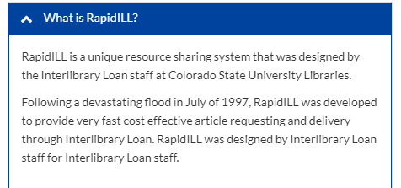
RAPID

Slide 4
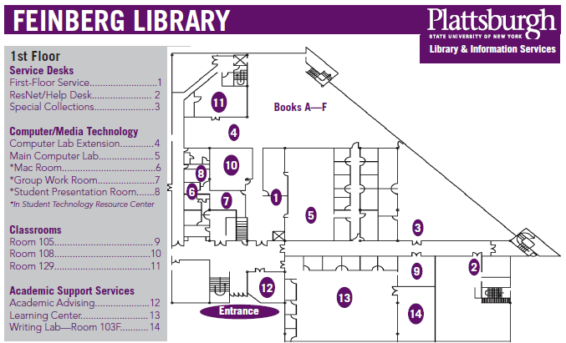
MAP of Feinberg 2010

Slide 5
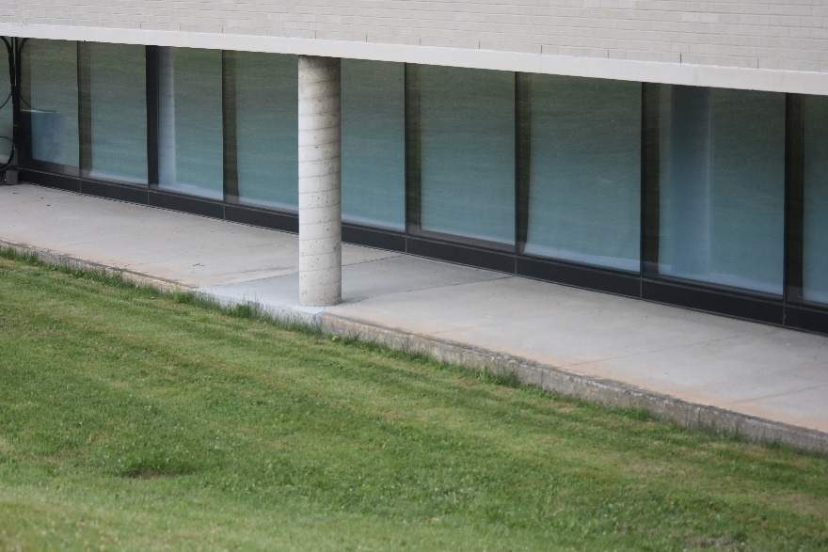
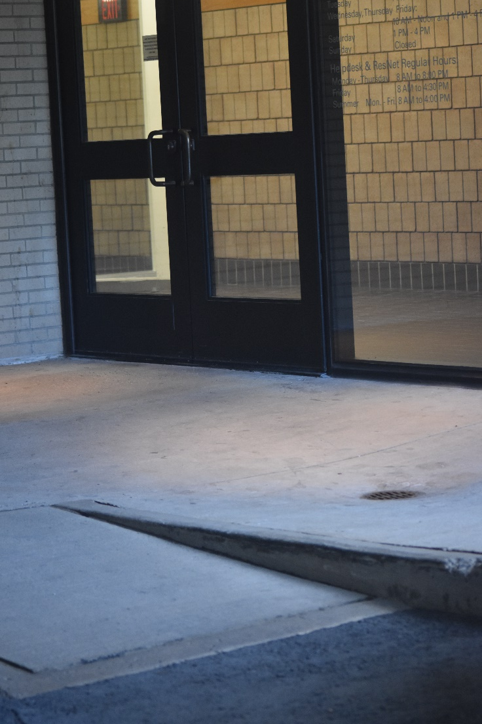
Photos

Slide 6
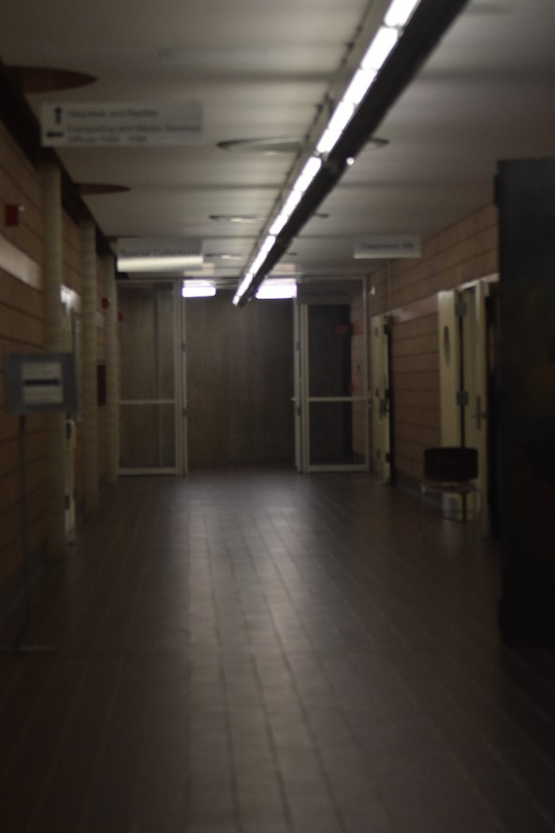
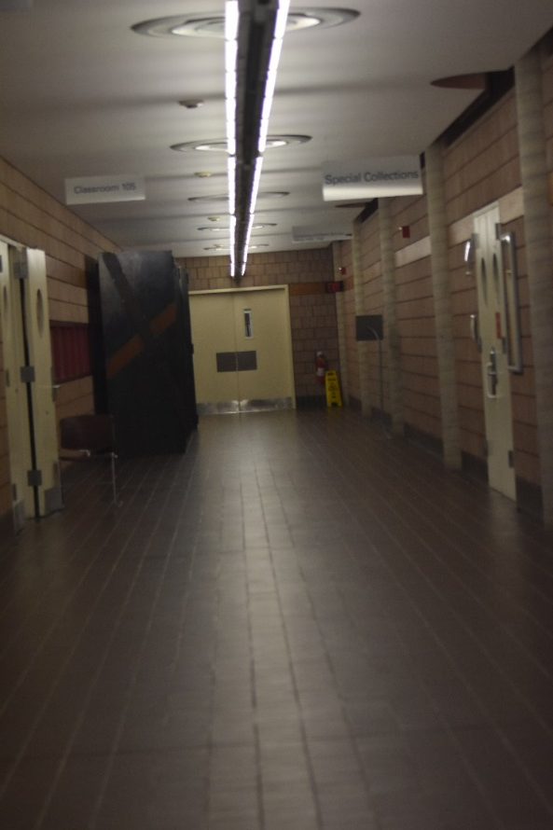
Photos

Slide 7
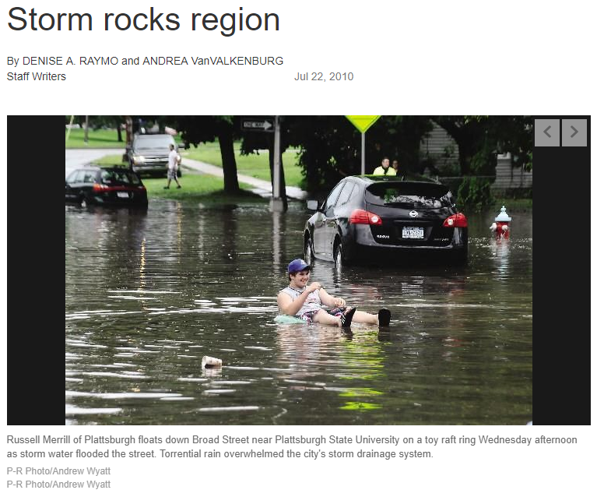

Slide 8
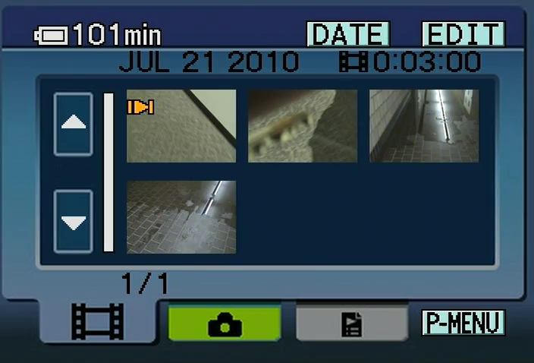
After the Flood 2010

Slide 9
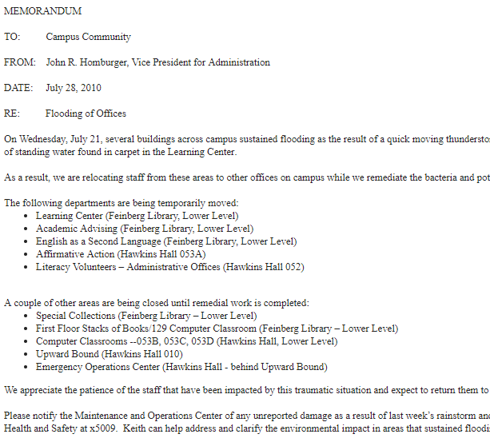
Campus Communication: critical for all

Slide 10
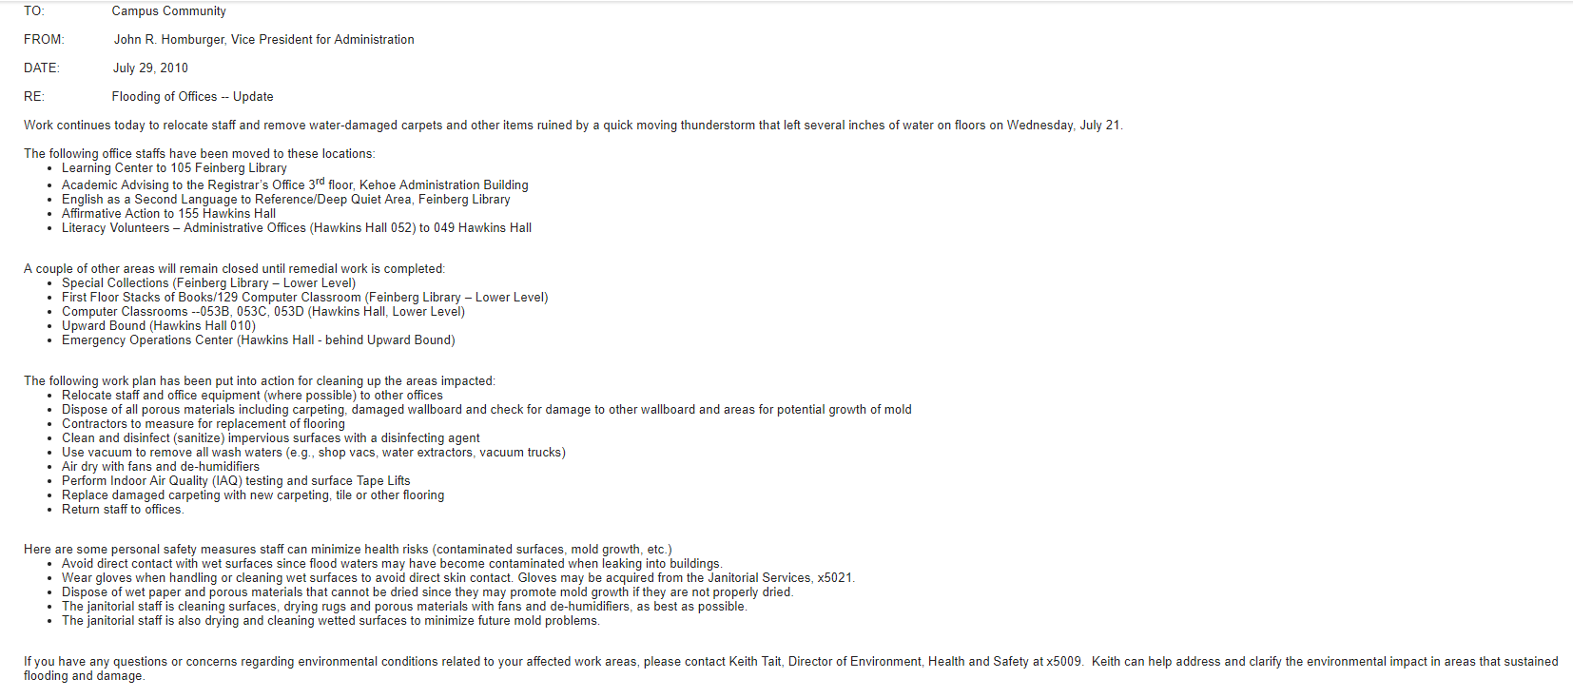
Follow up

Slide 11
Major concerns to address
Identify company to remove and method to store the collection a-f
Remediation of the first floor space
Strategies to address the access to the collection
Communication with library’s community
Then new development: timing of facility planning.

Slide 12
Role of the consortium
Catalog/holdings
ILL/IDS/WorldCat
  OCLC policy directory

Slide 13
Library Communication
Faculty Colleagues:
Due to the recent flood in Feinberg Library, we are moving with all haste to protect our collection, disinfect contaminated areas, and restore the environment. This project will entail moving the entire first-level collection (books A-F) out of the building before the fall semester begins; at this point, these local materials will not be accessible.
Therefore, if you require any books in the A-F collection for your classes or research, please request them now. Feinberg staff will pull the books for you before the collection is moved out.
To make your book-retrieval requests, contact our second-floor Service Desk (tel. 564-5182) or Mila Su (tel. 564-5307) as soon as possible; this will help us to ensure that your materials are ready when you need them.
Although local materials moved to storage will be unavailable, you will still be able to request them by using Feinberg's efficient Interlibrary Loan service.
We appreciate your understanding as we cope with this emergency. Should you have any questions, please call Mila Su or Angela King (564-5188) for assistance.
.
--Feinberg Library

Slide 14
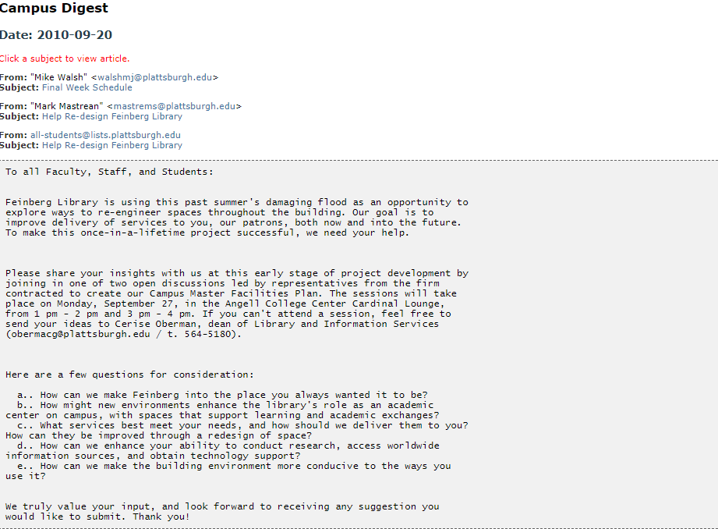

Slide 15
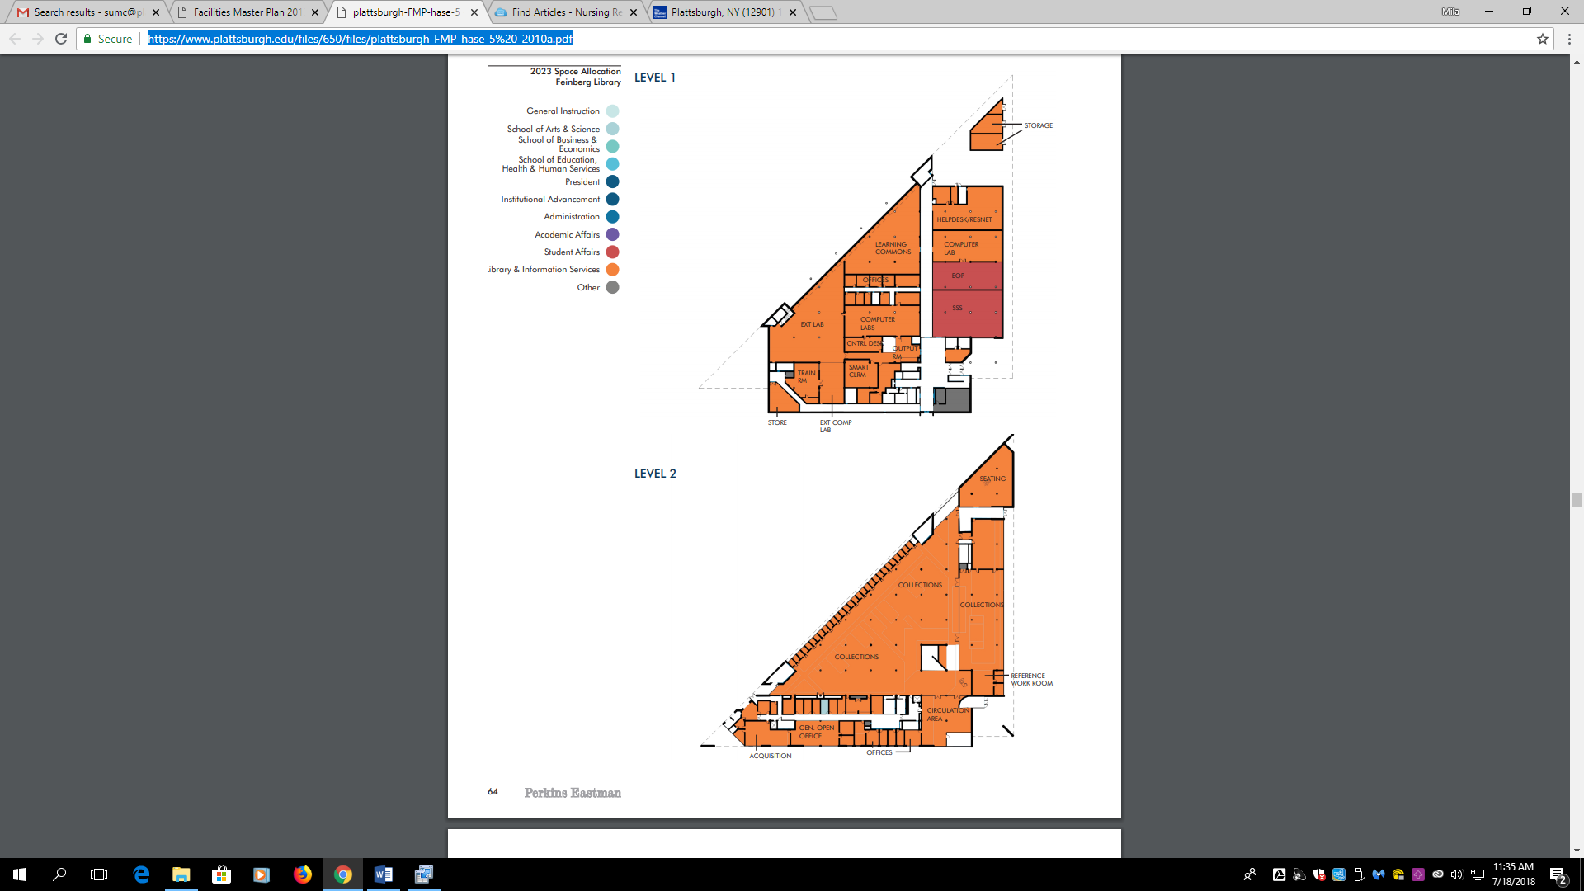
Draft Design from Facilities Planning

Slide 16
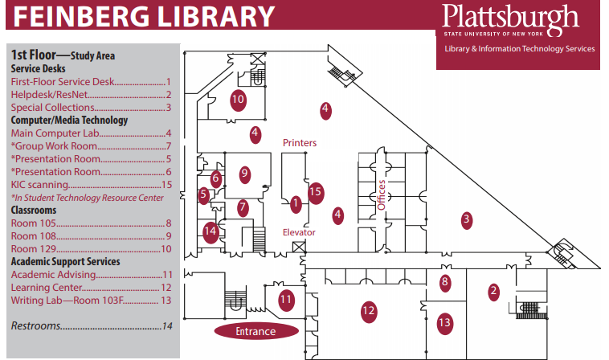
Map of Feinberg 2011

Slide 17
Borrowing overview
8/31/10-8/31/11

Slide 18
ILL Data: Borrowing
Borrowing Requested finished
Year | Loans | increase
2009 | 4226
2010 | 5472 | 29.484
2011 | 6606 | 20.72
2012 | 6988 | 5.782
2013 | 5415 | -22.495

Slide 19
ILL Data: borrowing by department
Department | 2010 | 2011 | 2012 | 2013
Loan Requests Received
Africana Studies | 84 | 55 | 102 | 53
Counseling Psychological Services | 31 | 63 | 47
Counselor Education | 228 | 60 | 111 | 116
History | 986 | 954 | 1041 | 564
Latin American Studies | 2 | 0 | 3 | 0
Philosophy | 53 | 47 | 56 | 52
Psychology | 99 | 119 | 265 | 145

Slide 20
Purchase on Demand (POD)
Reason For Cancellation: library is purchasing | Number Cancelled | % of Total Requests
2010 | 12 | 6.45%
2011 | 79 | 44.63%
2012 | 101 | 52.33%
2013 | 105 | 63.64%

Slide 21
Lending Fill Rate
Year | Loans requested total | Loans filled | % difference
2009 | 3771 | 3596 | -4
2010 | 4536 | 3651 | -19
2011 | 4790 | 3570 | -25
2012 | 4360 | 3400 | -22
2013 | 4172 | 3619 | -13

Slide 22
Lending Cancellations (Unfilled)
Reason For Cancellation 2009 | Number Cancelled | Percentage of Total Requests
At bindery | 75 | 4.28%
Exceeds copy limits | 66 | 3.76%
Not as cited | 53 | 3.02%
Reason For Cancellation 2010 | Number Cancelled | Percentage of Total Requests
Exceeds copy limits | 488 | 4.59%
Other | 404 | 3.80%
Checked-Out | 394 | 3.70%
Not on shelf | 381 | 3.58%
Non-circulating | 327 | 3.07%
Reason For Cancellation 2011 | Number Cancelled | Percentage of Total Requests
Lack volume/issue | 881 | 9.35%
Not on shelf | 654 | 6.94%
Checked-Out | 588 | 6.24%
Reason For Cancellation 2012 | Number Cancelled | Percentage of Total Requests
Lack volume/issue | 883 | 10.74%
Checked-Out | 679 | 8.26%
Other | 439 | 5.34%

Slide 23
Conclusion:
Broad
Take a look at your disaster plan, is it practical/realistic?
  Do you have communication strategies outline for internal and external constituents? Keep in mind social media, cellphone, and other communication avenues might not be available if there is no power; have alternatives in mind.
What Automation/web strategies might be adopted?
Look for opportunities amidst the chaos.
Inter-Library Loan
Do not underestimate the role of ILL
What modifications can you make via your ILS/ILL resources to help inform the ILL community?
Consider other indirect and direct impacts related to your collections and ILL.
Tweak your ILL reports to collect relevant data for before/ after data.

