Slide 1
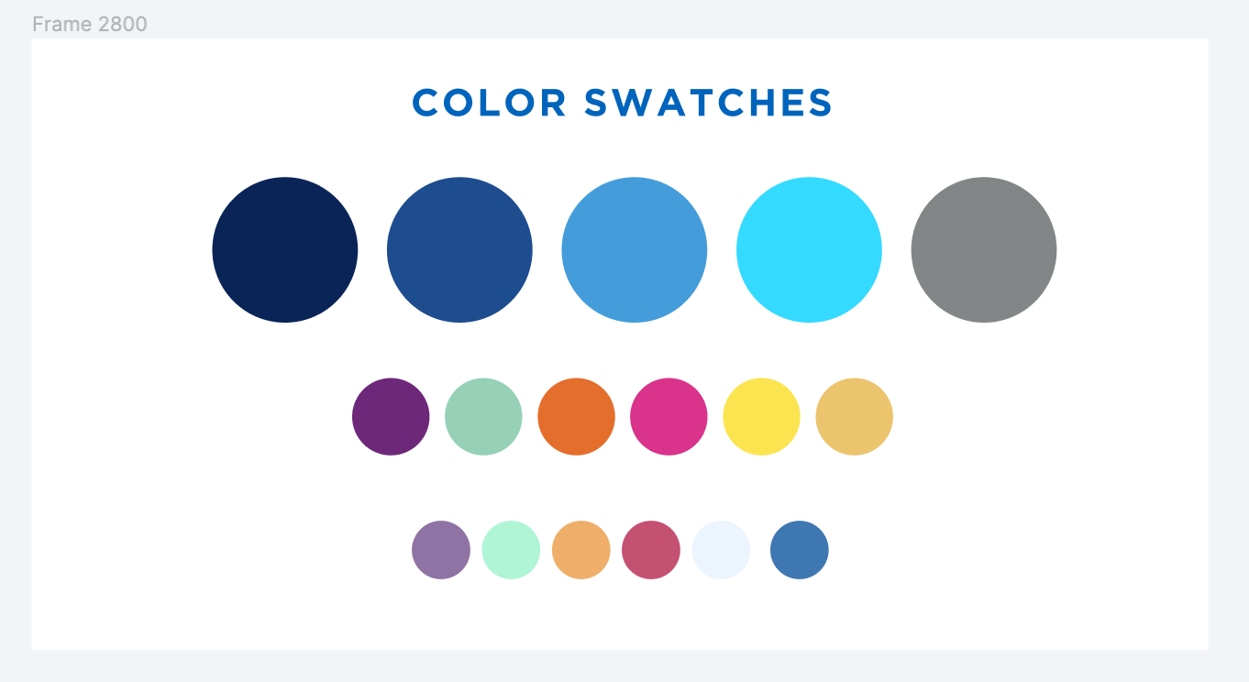
Alma Resource Sharing in the SUNY System
July 27, 2023

Slide 2
Agenda
Alma Resource Sharing Implementation
How Things Have Gone So Far
Expanding Our Alma Resource Sharing Network
ISO Borrowing with St. John Fisher University
Future Goals for Alma Resource Sharing

Slide 3
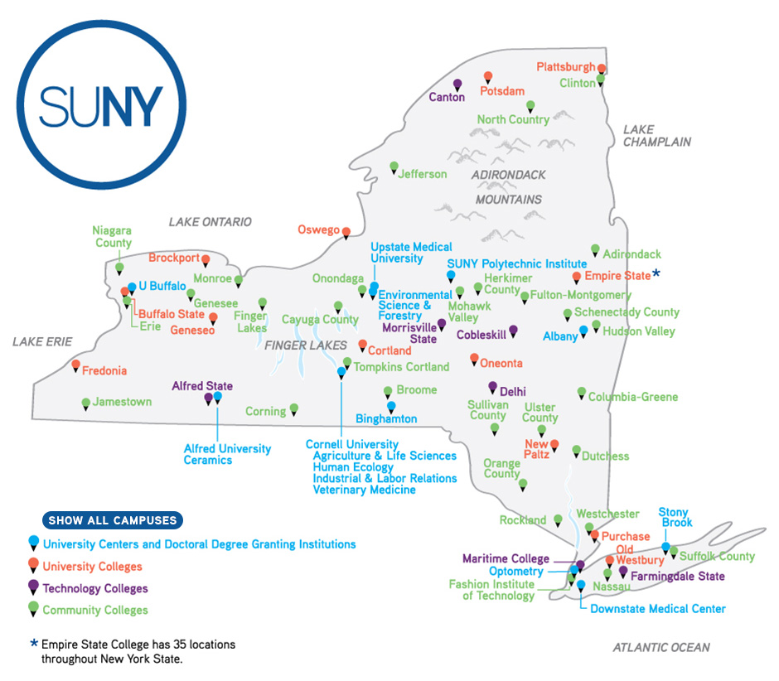
SUNY Resource Sharing Overview
60 campuses located throughout New York state
Mix of university centers, comprehensive colleges, technical colleges, and community colleges
SUNY has traditionally used ILLiad & OCLC for physical and digital resource sharing
Most of SUNY also belonged to IDS Project
Campuses accustomed to high level of automation and fast turnaround times

Slide 4
Alma Resource Sharing Implementation
All 60 SUNY campuses implemented Alma and Primo VE in summer 2019
Alma physical resource sharing implemented for all campuses at go-live
Alma digital resource sharing implemented for campuses looking to move away from ILLiad in spring 2020

Slide 5
Alma Resource Sharing Implementation
Having a shared catalog with resource sharing capabilities has long been a SUNY goal
Attempted to do this with Aleph, but that didn’t work out
Need cost effective alternatives to OCLC based resource sharing
Many campuses do not process enough requests to justify ILLiad subscription
Others locked into very bad pricing for WorldShare ILL

Slide 6
How have things gone so far?
Able to implement Alma resource sharing at no additional cost to SUNY
Using standard peer-to-peer functionality, not Rapido
Alma now SUNY’s primary platform for physical resource sharing
75% of all physical resource sharing within SUNY now happens in Alma
Alma resource sharing is significantly faster than ILLiad
Alma turnaround time: 6.3 days*
ILLiad turnaround time: 9.9 days*
* Fall 2022 data from University at Buffalo for requests filled by ELD libraries

Slide 7
How have things gone so far?
Alma’s automated locate process has made physical resource sharing more efficient
Alma performs an automated availability and requestability lookup of entire SUNY system when a new request is submitted
Only libraries that can actually fill a request are added to the request’s rota
Request automatically sent to first library in rota
Request automatically attached to record of requested item when it is received by lender
Lenders receive relatively few requests they cannot fill, so lending fill rates are much higher
Increased efficiency has resulted in significantly turnaround times

Slide 8
How have things gone so far?
Having a shared system has allowed SUNY to provide more consistent loan periods to users by implementing a shared loan period for all resource sharing loans
16 weeks
3 renewals for faculty and graduate students
Shorter 30 day loan period with one renewal for “protected collections” (new/rare books, media, etc.)
Borrowing libraries can shorten loan periods if they wish
Shared system has also allowed us to better coordinate how requests are distributed throughout SUNY
Particularly helpful with managing all of the recent changes to ELD

Slide 9
How have things gone so far?
Alma digital resource sharing is a viable option for low volume libraries
Monthly fill rate 80-90%
Alma turnaround time: 0.9 days*
ILLiad turnaround time: 1.2 days**
15 SUNY campuses (mostly community colleges) have dropped ILLiad since adopting Alma digital resource sharing
Most export unfilled requests to WorldShare ILL
One did also cancel WorldShare ILL
* Fall 2022 data for all SUNY
** Fall 2022 data from University at Buffalo

Slide 10
How have things gone so far?
Limited copyright compliance functionality means ILLiad is still a better digital resource sharing option for higher volume campuses
Alma can now check requests for CONTU rule of 5 compliance, but all it can do if a request exceeds the rule of 5 is not send it to potential lending libraries automatically
No integration with Copyright Clearance Center or Reprints Desk
Majority of SUNY still using ILLiad for article borrowing

Slide 11
How have things gone so far?
Alma’s automated locate process does not handle patron-provided metadata very well
SUNY has suppressed Alma’s blank resource sharing request form
All requests generated from discovery search results
Alma’s workflows are straightforward and highly automated but not very customizable or flexible
Manual request processing workflows largely non-existent
Very unforgiving of user error

Slide 12
How have things gone so far?
Fill rate within SUNY for physical requests has been lower than expected
Initial monthly fill rates were 55-60%
Had to rely heavily on ILLiad integration
Unfilled Alma borrowing requests automatically exported to ILLiad for fulfillment
Integration is very helpful but still somewhat clunky for staff and confusing for users
Concerns about long term stability of Alma/ILLiad integration
Better for both users and staff to fill as many requests in Alma as possible

Slide 13
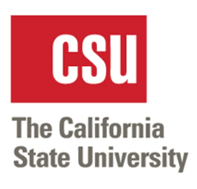
Expanding Alma RS Beyond SUNY
Trying to increase fill rate by expanding Alma resource sharing to include non-SUNY libraries
Have added 25 new libraries to our Alma resource sharing network to date
Monthly physical fill rates have improved to 65-70%
Turnaround times for out of state Alma libraries similar to turnaround times of in-state ILLiad libraries

Slide 14
Current Non-SUNY Alma RS Partners
Ithaca College
Nazareth College
Canisius College
US Military Academy at West Point
Brandeis University
Central Connecticut State University
Eastern Connecticut State University
Three Rivers Community College
Naugatuck Community College
Susquehanna University
Gettysburg College
American University
George Washington University
Marymount University
Regent University
East Tennessee State University
University of Central Florida
Florida Gulf Coast University
Hamline University
Sacramento State University
Humboldt State University
Cal State Chico
Cal State Northridge
Cal State Fullerton
Southern Oregon University

Slide 15
Potential Non-SUNY Alma RS Partners
Russell Sage College
Connect NY
Adelphi University
Marist College
Siena College
Vassar College
Connecticut State Colleges and Universities
Norwalk Community College
Tunxis Community College
Northwestern CT Community College

Slide 16
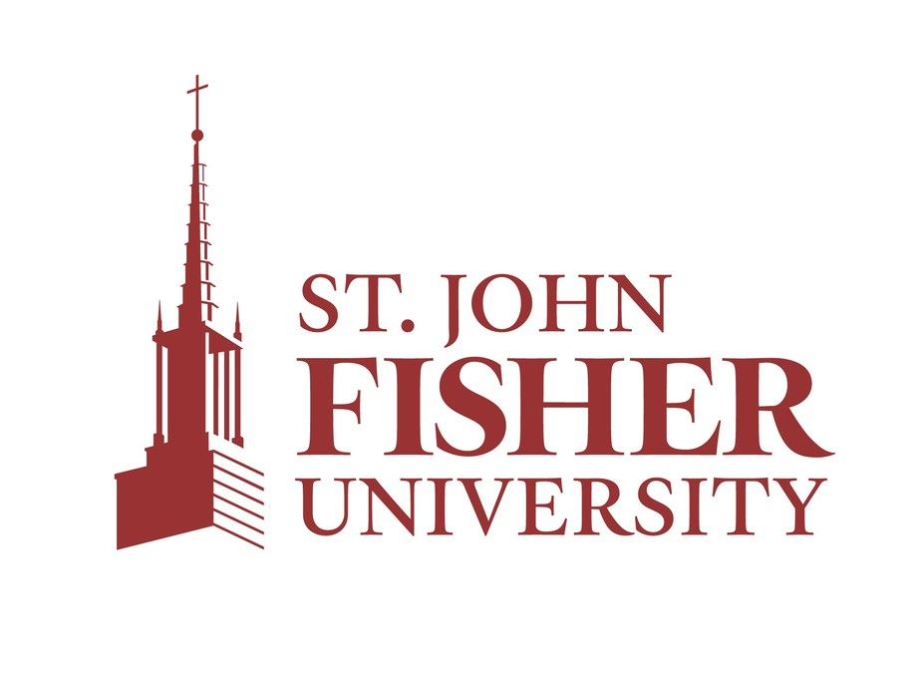
ISO Lending with St. John Fisher
SUNY implementing Alma RS resulted in significant lending volume decrease at St. John Fisher
Implemented ISO lending with St. John Fisher last summer
Requests sent from Alma directly to St. John Fisher’s ILLiad, bypassing WorldShare ILL
Requests behave (almost) like normal requests in both systems
Conditional and General Message functions don’t work
ISO lending must be configured on ILLiad library’s ILLiad server, and ISO address records must be added to lender address table

Slide 17
ISO Lending with St. John Fisher
St. John Fisher currently lending to 9 SUNY campuses via ISO
Turnaround times have been the same as regular Alma resource sharing
Lending fill rates for St. John Fisher have been very high
Workflow for sending requests from ILLiad to Alma via ISO is very clunky, so St. John Fisher is still sending requests to SUNY via ILLiad

Slide 18
Future Goals for Alma Resource Sharing
Keep expanding our Alma resource sharing network to include more Alma libraries both in New York and throughout the U.S.
Expand ISO lending partnerships
Take advantage of efforts to improve system interoperability between resource sharing platforms
Project Reshare, EBSCO’s DCB, etc.
Reduce resource sharing system costs by giving SUNY campuses a viable alternative to ILLiad & WorldShare ILL

