Slide 1
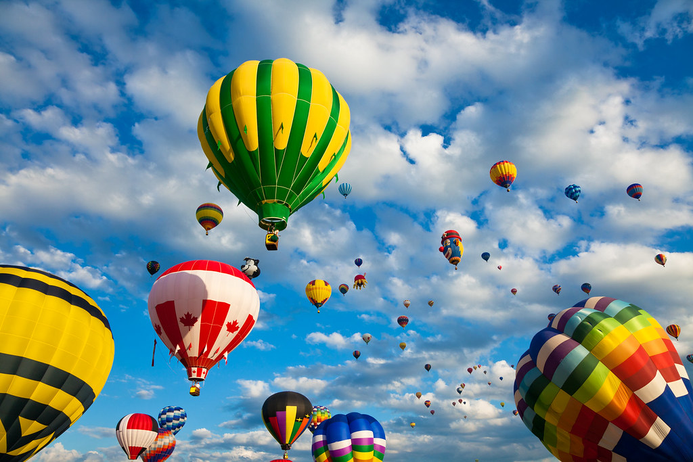
Creatively Influencing our Collective Future through Use of a Scenario to Help with a Facilitated Discussion
Lars Leon
University of Kansas Libraries
July 28, 2023
IDS Project Conference 2023
"Vibrant Hot Air Balloons" by Bold Frontiers is licensed under CC BY 2.0.

Slide 2
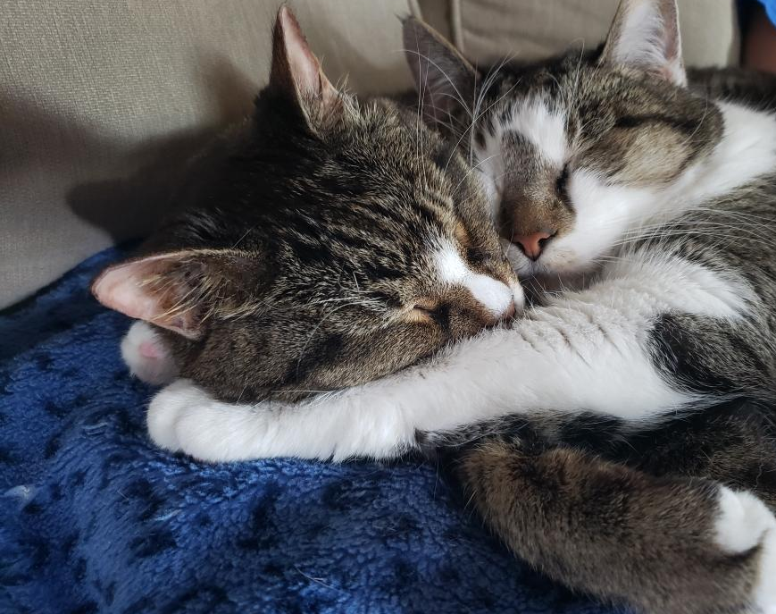
Purpose
Give you some ideas and areas you might be interested in exploring yourself.
Consider actions you can do as an individual and as a group to see success in four years.
Our boys (Lars)

Slide 3
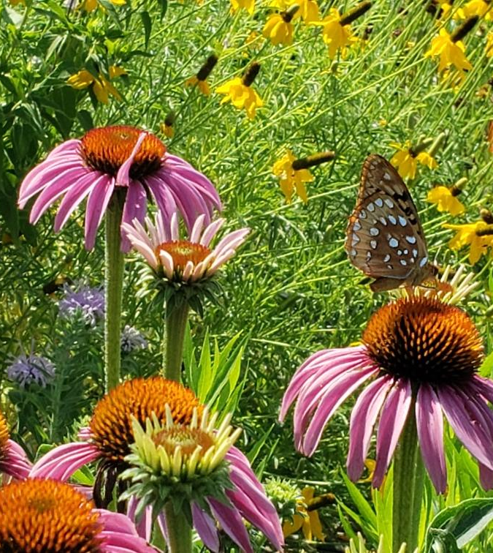
Today
1. Scenario 4 years down the road – “within resource sharing” and some areas that might impact it
2. Reflection and discussion time –
2 questions
Use 2-2-4 Facilitation technique
https://tinyurl.com/IDSConfScenario
Kansas wildflowers (Lars)

Slide 4
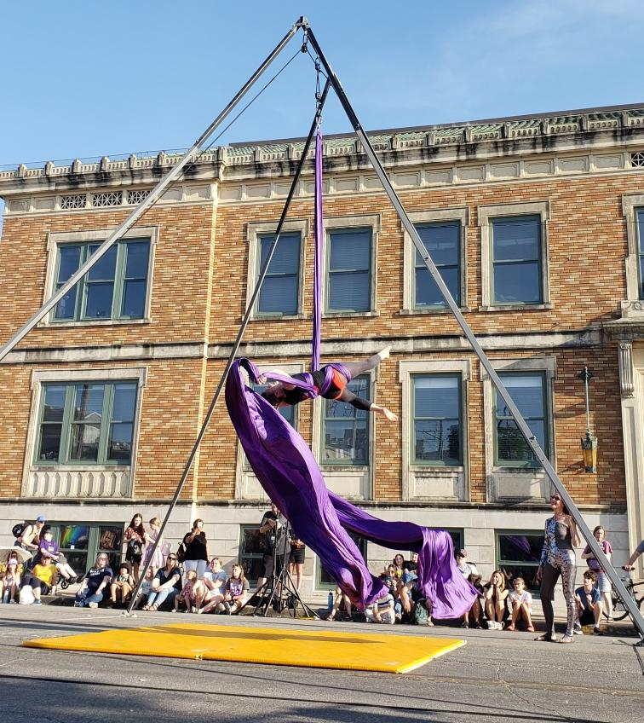
2-2-4
What benefits and challenges do you see? (Okay to add something new or disagree)
What can you do to have the future you’d like in four years? What can a group do?
Buskerfest ~ Lawrence, KS~ Memorial Day weekends (Lars)

Slide 5
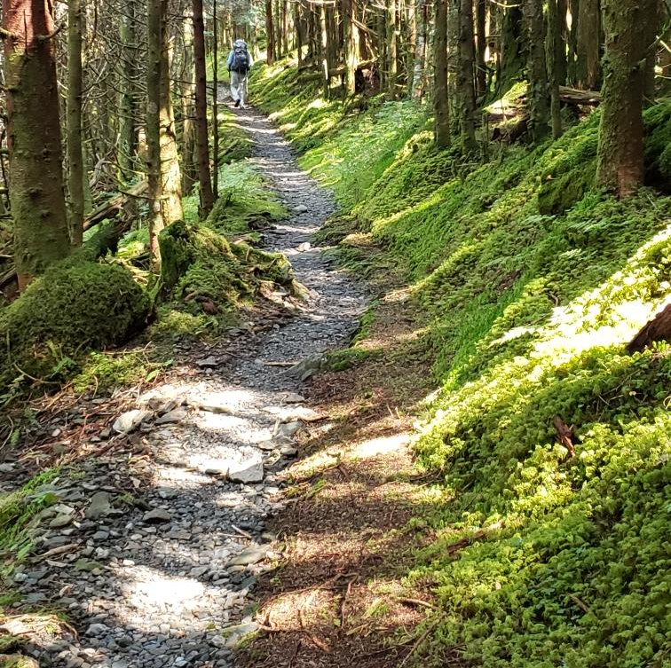
Thank you:
Co-Researcher Carol Kochan, Head, Coll. Mgmt & Resource Sharing, Utah State University
Greater Western Library Alliance (testing out some of the scenario and discussion technique)
Other speakers at IDS Conference
All of you
On the AT in the Smokeys (Lars)

Slide 6
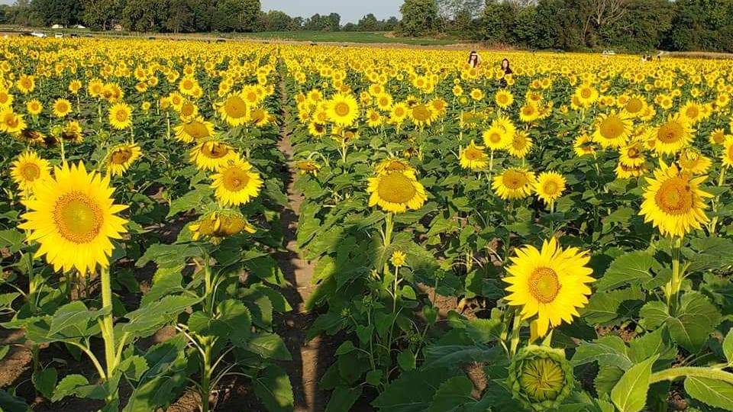
Scenario
Environment – Our Patrons & Universities, Publics
Discoverability & Mechanics of Sharing
Some Other Points
https://tinyurl.com/IDSConfScenario
Grinter Sunflower Farms, Kansas (Lars)

Slide 7
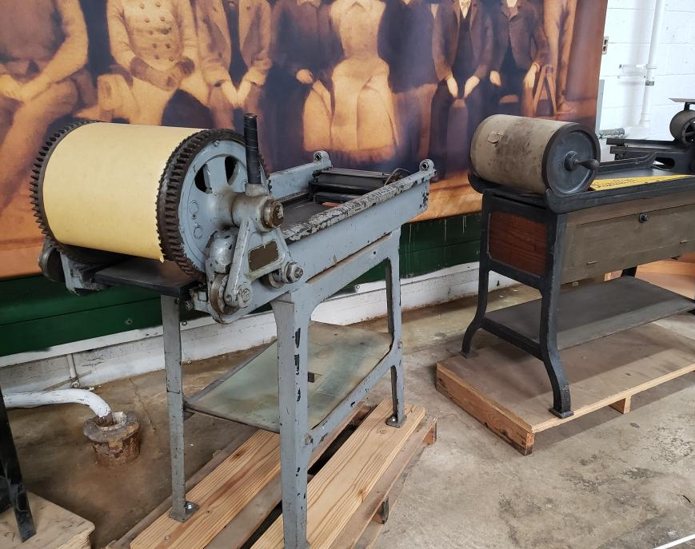
2-2-4
1. What benefits and challenges do you see?
https://tinyurl.com/IDSConfScenario
Hamilton Wood Type Museum & Printing Museum, Two Rivers, WI (Lars)

Slide 8
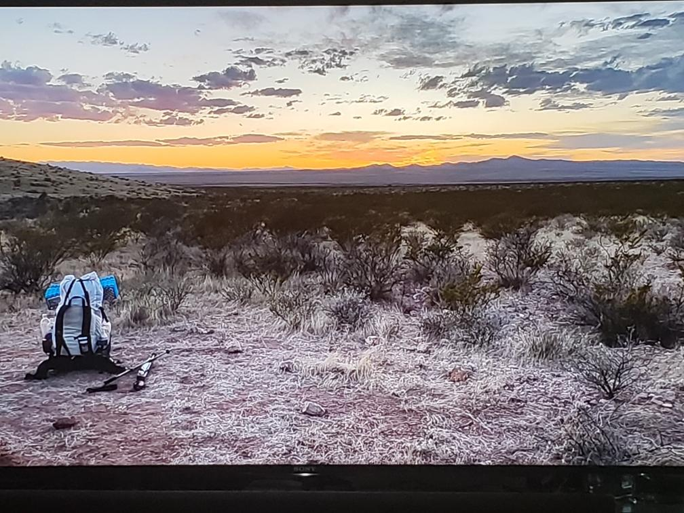
2-2-4
2. What can you do to have the future you’d like in four years?
What can a group do?
https://tinyurl.com/IDSConfScenario
Craig M. Spielberg CDT ‘23 (YouTube)

Slide 9
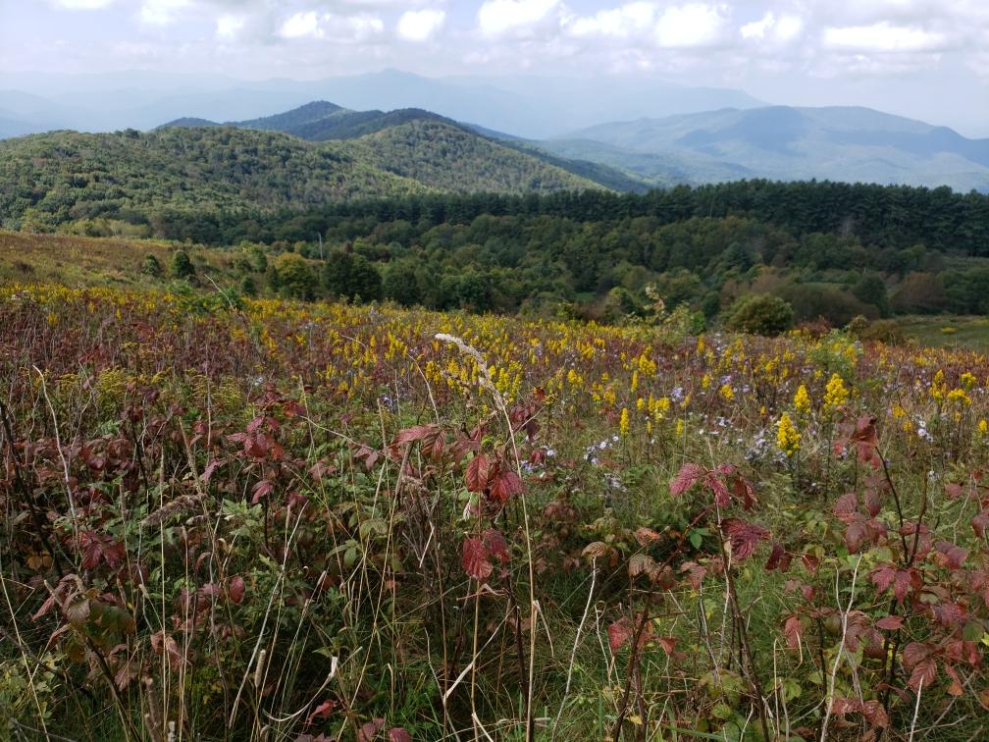
https://tinyurl.com/IDSConfScenario
Max Patch on AT (Lars)

