Slide 1
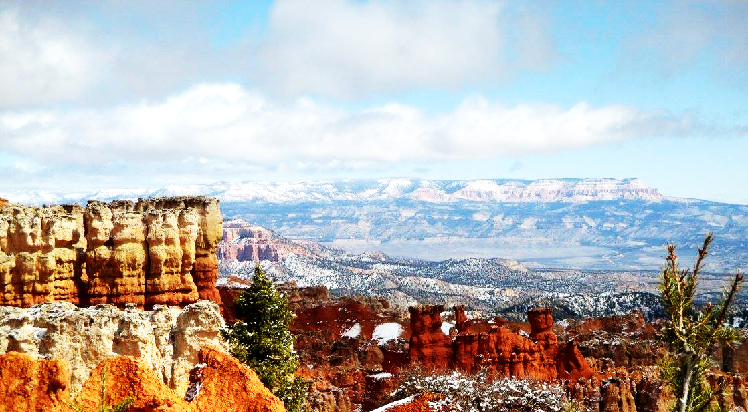
Digging Deep:
Getting better results with advanced assessment tools in ILLiad
Sarah Shank, Jay Kibby and J. Silvia Cho

Slide 2
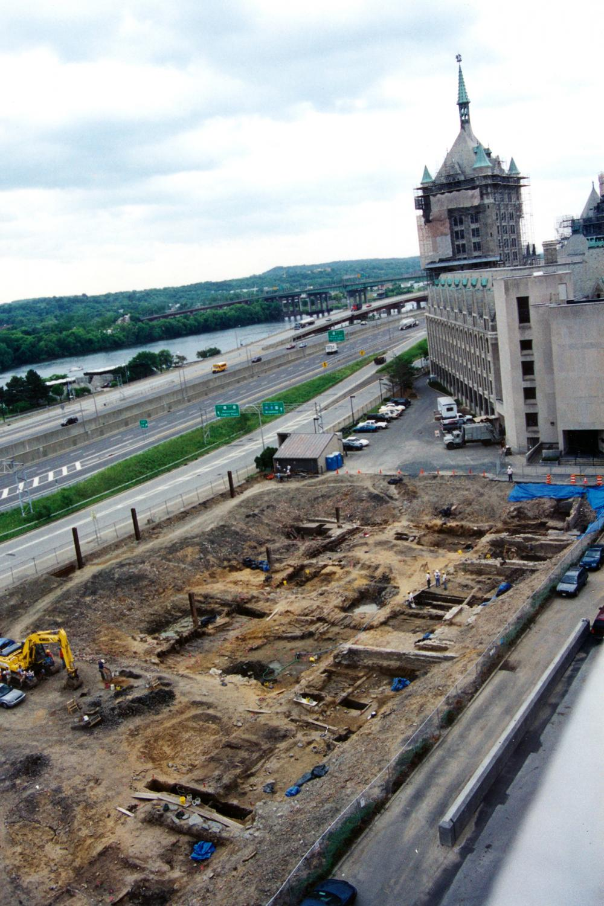
Excavation Plan
Custom searching vs. OCLC Stats/Web Reports
Basic Search, Request Search, and Custom Search
Finding and creating searches
Building searches:
Tables and fields
Boolean operators
Best practices, tips and tricks
Some of our favorite searches - and what are your favorites?
Source: New York State Museum
Notes:
One concern I have is the balance between not repeating ourselves but also leaving enough time in a rather short session for group discussion. We’re right before lunch on the last day, so if people are digging it (har har!) the discussion may just continue on its own to take the full hour - I’ve been in sessions in the past for which this was the case.
Uses for Custom Search as opposed to OCLC Stats/Web Reports (can probably take from last presentation)
How to find and create searches (can probably take some from last presentation, at least the screenshots)
Custom vs. basic search
Relationships between tables and fields
The History table could be particularly interesting/useful/unintuitive
How to use facets (between, is greater than, equals, contains, etc.) to build efficient searches
Side note: this is similar to searching for journals and articles in most systems
Best practices - saved searches, etc
Tips and Tricks - column chooser, exporting to Excel, how to find the field you need, etc
Example - Entering journal online availability in call number field
Informs other library functions such as collection development/discovery
Examples of favorite searches - and what are your favorites?
Uses for Custom Search as opposed to OCLC Stats/Web Reports (can probably take from last presentation)
How to find and create searches (can probably take some from last presentation, at least the screenshots)
Custom vs. basic search
Relationships between tables and fields
The History table could be particularly interesting/useful/unintuitive
How to use facets (between, is greater than, equals, contains, etc.) to build efficient searches
Side note: this is similar to searching for journals and articles in most systems
Best practices - saved searches, etc
Tips and Tricks - column chooser, exporting to Excel, how to find the field you need, etc
Example - Entering journal online availability in call number field
Informs other library functions such as collection development/discovery
Examples of favorite searches - and what are your favorites?

Slide 3
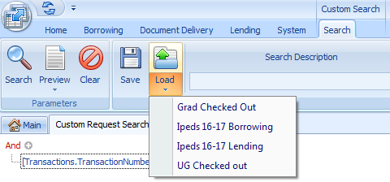
Why Not Just Use Canned Reports?
In comparison with OCLC statistics or Web Reports, searching tools in ILLiad allow:
Better manipulation of seal facets of multiple tables
More detailed results
Able to search for exact information needed
Save searches to import later
Notes:
Tried moving this from slide 7, because it could make more sense...but please feel free to put back!
I think this makes sense here--we can introduce all the different types of searches and then we can we can say why you would choose custom search (on this slide).

Slide 4
Basic Search vs. Request Search vs. Custom Search
Basic Search: Search for specific requests, users, & library addresses
Notes:
ALL vs (for example) TN/ILL
Basic Search vs. Request Search vs. Custom Request Search
Both other types of searches can be expanded in Custom Search

Slide 5
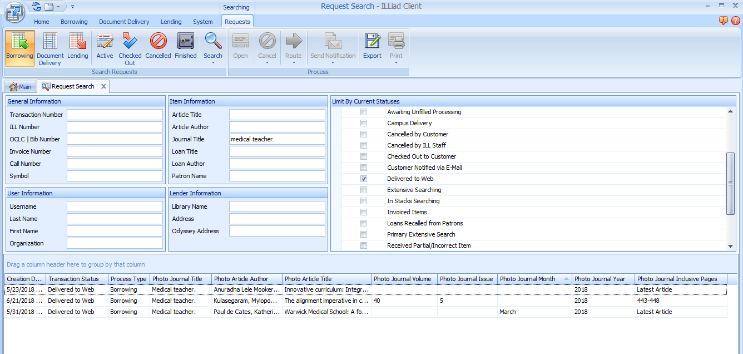
Basic Search vs. Request Search vs. Custom Search
Request Search: Search for requests within specific processes & queues
Notes:
ALL vs (for example) TN/ILL
Basic Search vs. Request Search vs. Custom Request Search
Both other types of searches can be expanded in Custom Search

Slide 6
Basic Search vs. Request Search vs. Custom Search
Custom Search: Excavation tool that digs deeper than basic and request searches
Their Digger
Our Digger
Notes:
ALL vs (for example) TN/ILL
Basic Search vs. Request Search vs. Custom Request Search
Both other types of searches can be expanded in Custom Search
**Moved the Save searches screenshot to “next” slide for “Why Custom Search”

Slide 7
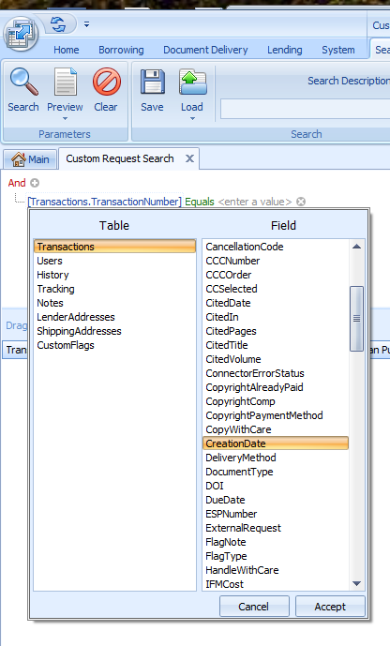
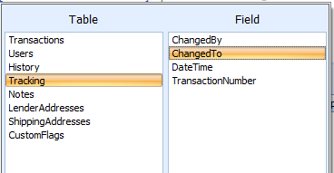
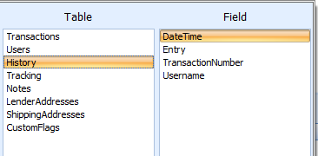
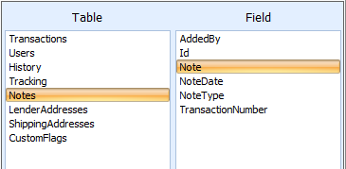
Building Custom Searches: Tables and Fields
Notes:
Full list: https://prometheus.atlas-sys.com/display/illiad/ILLiad+Database+Tables
Tables:
The History table could be interesting/useful/unintuitive
Searching for: Connection Manager Error: Update Error (narrow by date, transactions appear multiple times)
Notes table example: Delivered By & Renewals
Searches can be constructed with fields from a single table, or from different tables
Commonly used fields
Frequently confused fields:
Dates - creation, transaction, etc.
OCLC number
Blocks = cleared

Slide 8
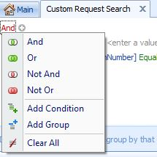
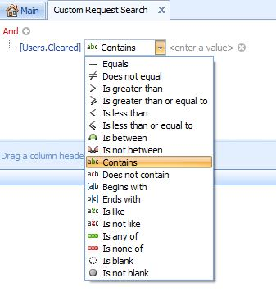
Building Custom Searches: Boolean operators
Notes:
Commonly used facets for different fields
Not all facets will be in each type of field
Date = Between (is greater than? Greater than or equal to?)
Process type = Contains, Is equal to
Blocks = Begins with : B
And/Or/Not and/Not or
Grouping

Slide 9
Example: Many ways to get there
User > Cleared:
Yes
B (blocked)
BO (blocked overdue)
DIS (disavowed)
Find all users who have a block on their account, regardless of the kind of block.
Notes:
Silvia: I inserted slides 15-17, which hadn’t been a plan, just because it occurred to me that simulating building a search live could be interesting...but maybe we don’t have time, and/or maybe this example is too easy! Please leave me your thoughts…
Ask: Is there any other search that would accomplish it? (Cleared Does not equal yes, OR equal disavowed)
Highlight: Trial and error

Slide 10
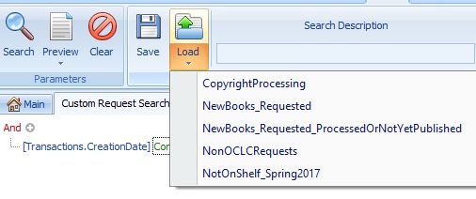
Best Practices, Tips and Tricks
Save and Reuse Searches
Notes:
Saves time and ensures consistency

Slide 11
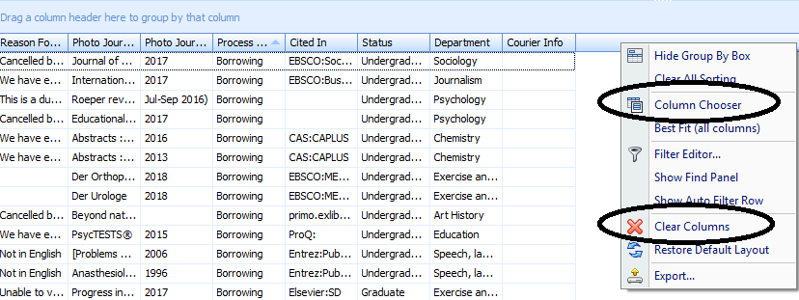
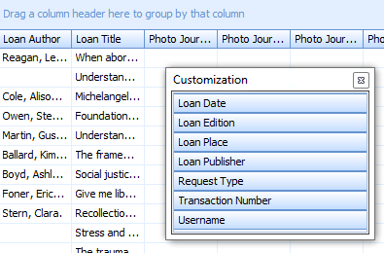
Customizing Results: Column Chooser
Right Click on the Columns to bring up the menu
Choose “Column Chooser” to add in or remove a couple of columns
Choose “Clear Columns” to send all the columns to the column chooser
Drag and drop between the column chooser and the column display.
Notes:
Saves time and ensures consistency

Slide 12
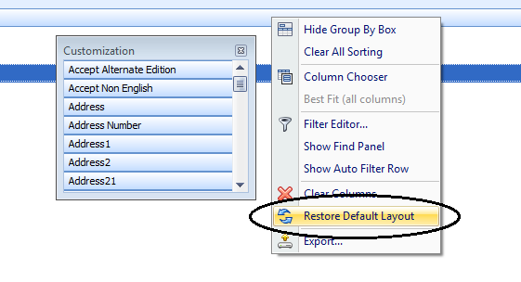
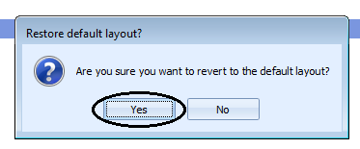
Customizing Results: Column Chooser
Protip! To make things less terrifying, add all columns back by restoring to default settings:

Slide 13
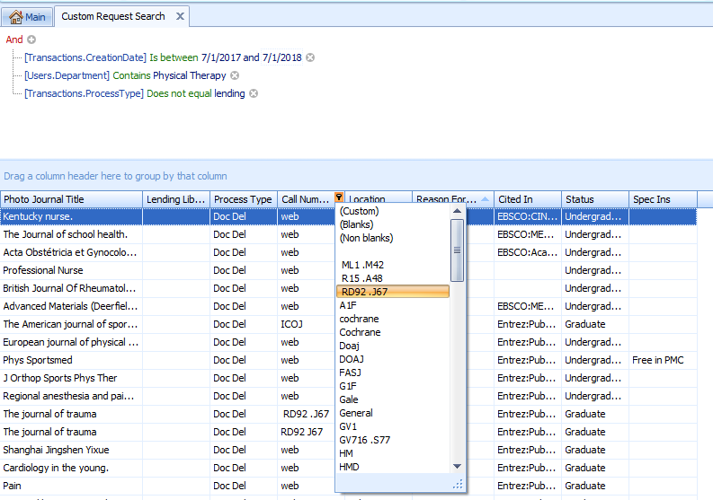
Filtering/Manipulating Results in Illiad
Click and drag columns to organize data
Click on column header to organize alphanumerically
Click on filter icon to choose specific
Export only what you need to Excel
Save your preferences for future searches

Slide 14
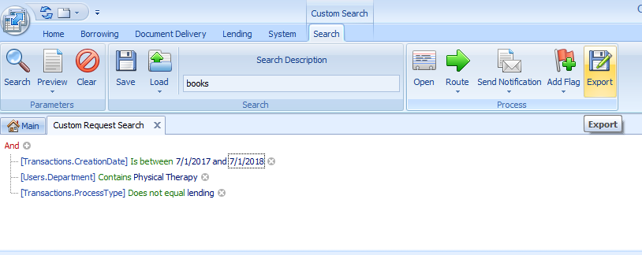
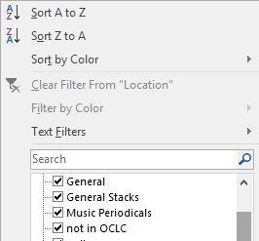
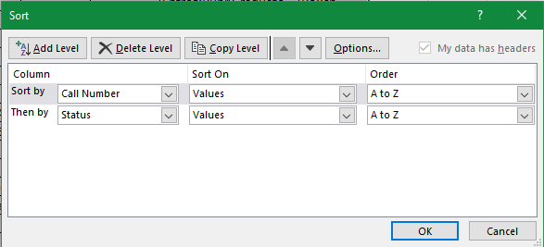
Exporting to Excel
Any changes (filtering, column reorganization, ordering) are maintained when exported to Excel
Save your file when prompted
More flexible filtering in Excel
Organize data by multiple columns
Notes:
More flexible filtering: meaning you can choose multipe things to see at the same time e.g. Per vs. Periodicals vs. Periodicals Available.
For me, it’s much easier to massage data using Excel. BTW..> This is a jumble. :/

Slide 15
Examples: Adding info to request to query later
Example 1: Database info in call number field
Use this with “cited in” data to see where there may be connection issues
Helps inform possible information literacy needs
Discover which databases tend to be missed (e.g. Ebsco with ALMA switch)

Slide 16
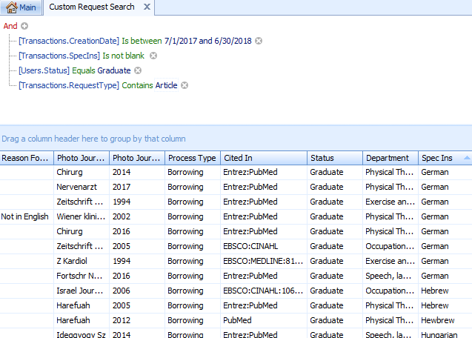
Examples: Adding info to request to query later
Example 2: Adding information to spec ins field or Item info, etc.
Notes:
Not sure this is the best example--I use this field for a bunch of different things--for example, when I cancel something that’s in a different language I put the language there and then have the e-mail template I use pull that field in so I don’t have to type it/remember it. I also sometimes use this field to note particular websites when I find something on the web.

Slide 17
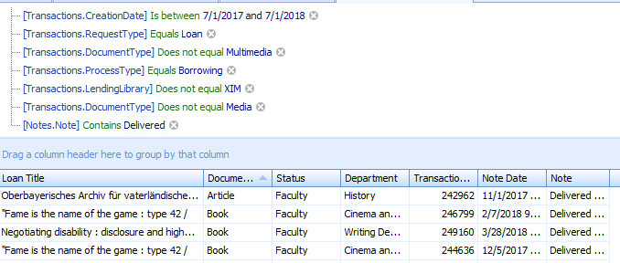
Examples: Adding info to request to query later
Example 3: Adding information to the note field
Note: “MPRALMA” (Renewal requested via ALMA)
Tracking: “Renewed by Customer...”
Note: “Delivered by”--Shows how many campus deliveries were done

Slide 18
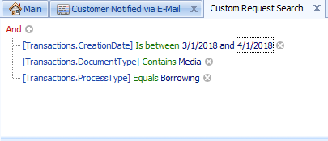
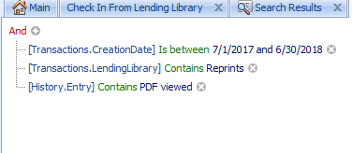
Some of Our Favorite Searches
Notes:
Do you a good search that uses any of the other tables that we haven’t discussed in depth (Lender Addresses, Shipping Addresses, or custom flags)

Slide 19
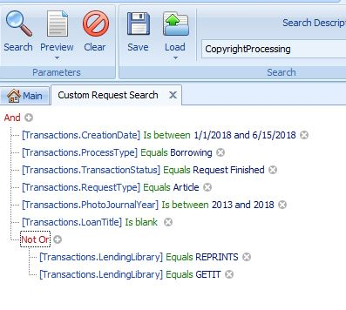
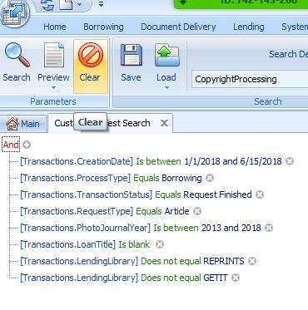
Some of Our Favorite Searches
Notes:
Part of copyright processing, in addition to the Web Report. Group: to show...same whether group or not.
Why do I use “Loan Title”: Isblank?

Slide 20
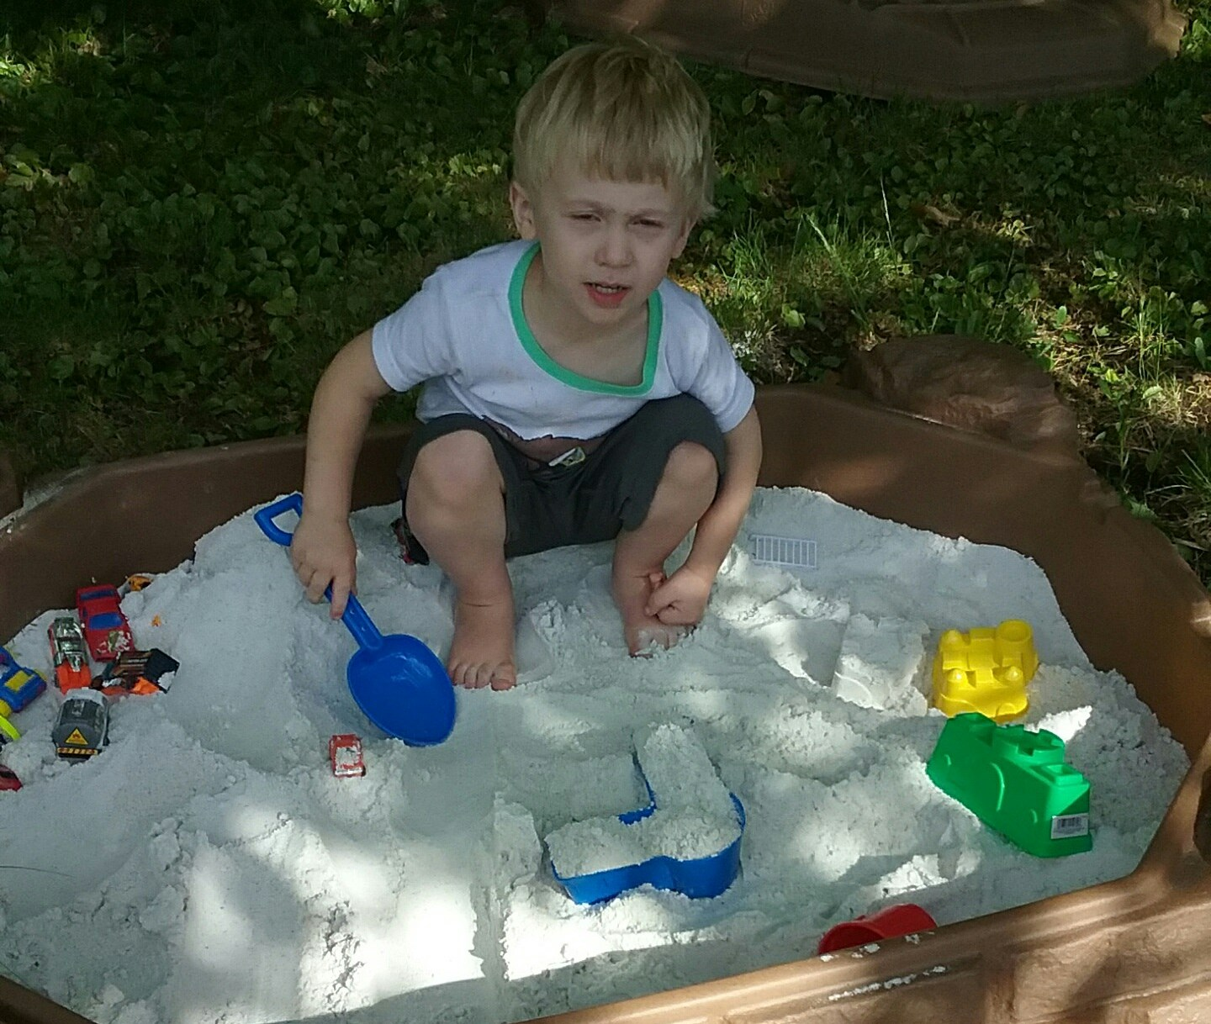
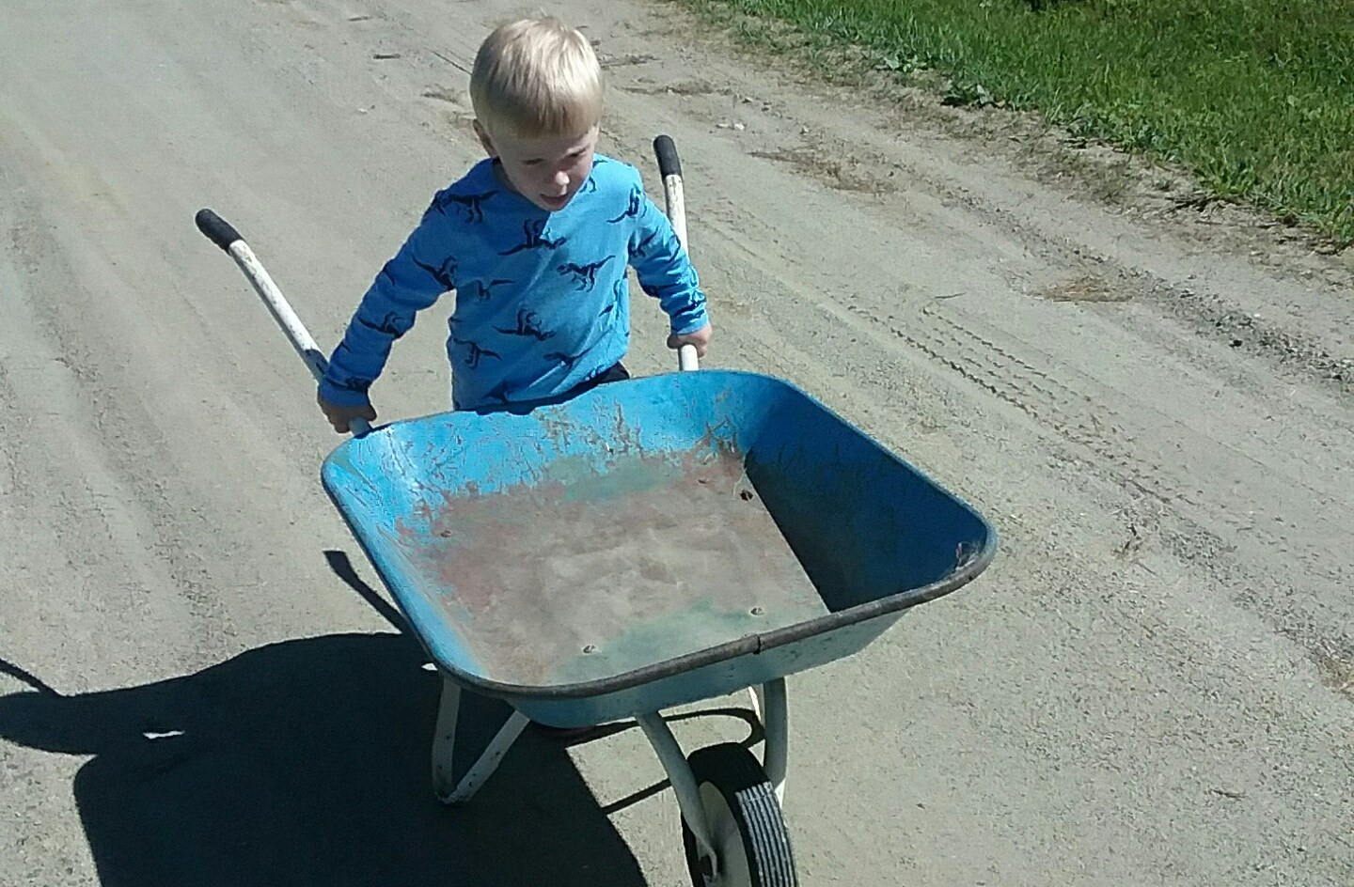
Some of Our Favorite Searches
What are some of your favorite searches?
Do you have any unresolved, nagging search needs?
Notes:
Do you a good search that uses any of the other tables that we haven’t discussed in depth (Lender Addresses, Shipping Addresses, or custom flags)
There was that email in the IDS listserv about finding how many times a request went to unfilled--think it would be helpful to address that (and maybe Logan’s Pivot tables) in this presentation?

Slide 21
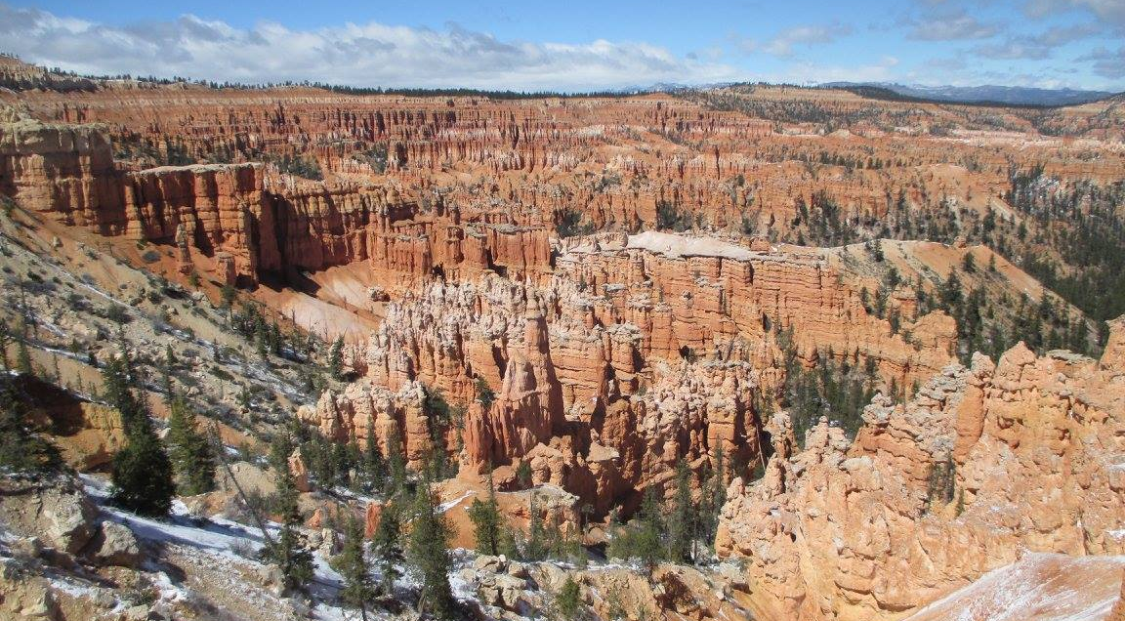
Thank you!
Sarah Shank sshank@ithaca.edu
Jay Kibby kibbyj@mail.strose.edu
Silvia Cho jcho@gc.cuny.edu

