Slide 1
Due Tomorrow: Integrating Textbook Access with Resource Sharing
Ben Hogben - Ithaca College Library
IDS Conference – Lightning Talk

Slide 2
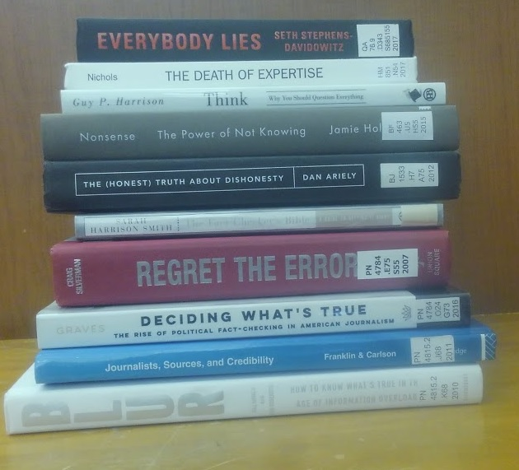
A Student Needs a Textbook
Campus textbook store
Used
Interlibrary loan
Borrow from the library
Borrow from a friend
Fake it
Rental - Chegg
Turn student challenges into opportunities for the library

Slide 3
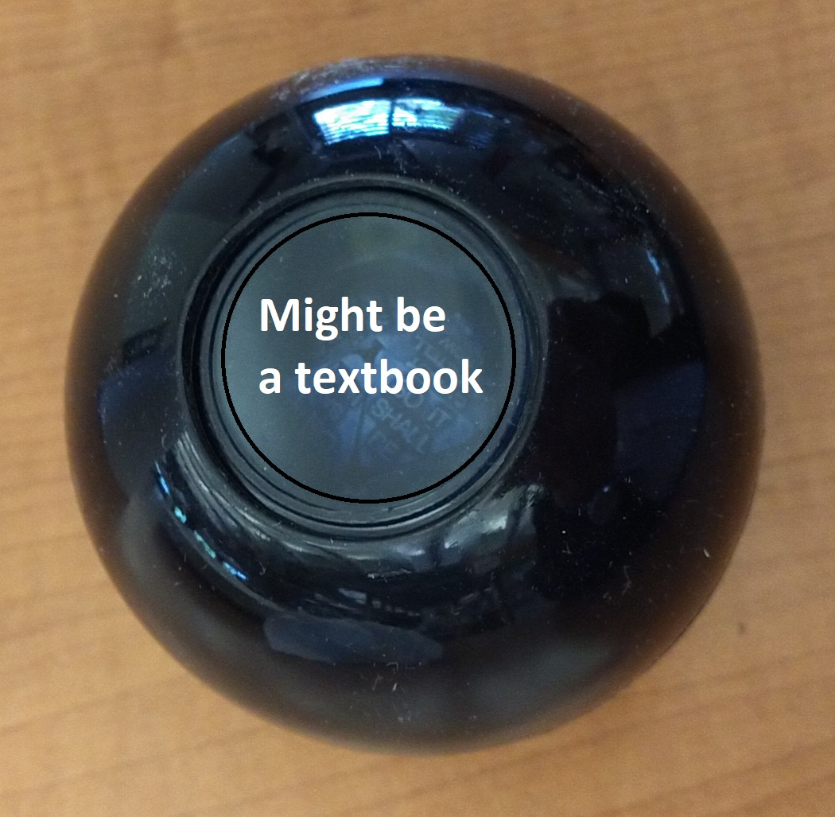
Textbook Intuition- Before Alma Integration
Multiple students requesting the same book, around the same time period, through ILL
“Introduction to…..”
“Principles of…”
“Essentials of…”
“Research methods of….”

Slide 4
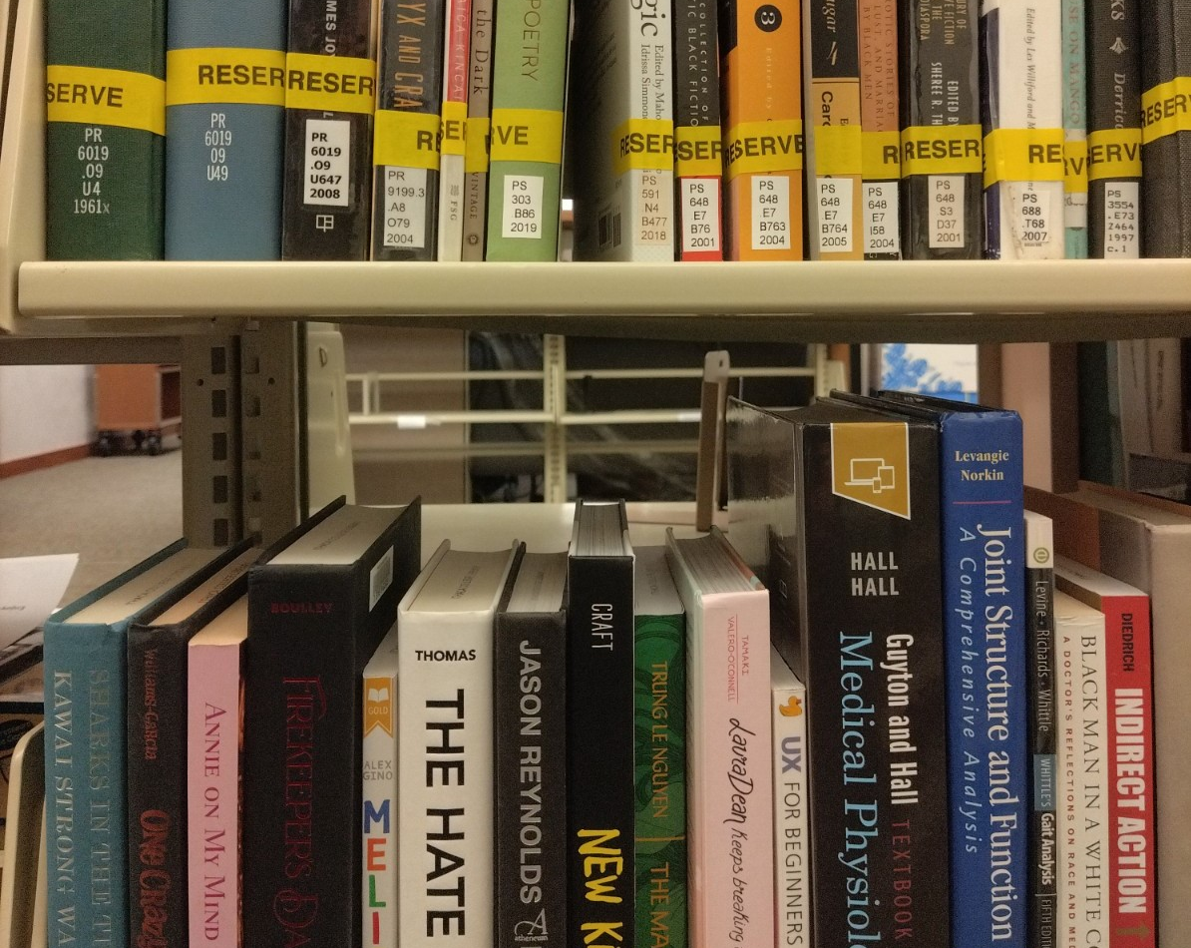
Students Helping Students
Textbook donation program launched in 2022 by a student
27 books added to the IC collection
35 books donated to Better World Books (titles already owned)

Slide 5
Proactive Reserves
Download the textbook list from the vendor
Check the titles against library holdings
Pull items, place on reserve and add to the course reading list in the CMS, then, notify the instructor
Place MUPO ebooks in the CMS when possible
Purchase multiple SUPO ebooks if the budget allows, if not, a print copy

Slide 6
Purchase On Demand Through Interlibrary Loan
The interlibrary loan borrowing coordinator has a budget to purchase items used in courses
Rapido now searches the ISBN of the textbook list to see if it matches that of the borrowing request. If so, it places a “label” on the request and the request then becomes mediated.
The Borrowing Coordinator can also search a textbook Excel file.
This is coordinated with the instructor, so they know we are purchasing an item for their course and placing it on 2-hour reserve – ebooks are preferred over print books
Ebooks are typically activated within 24 hours
Print books are processed within one week

Slide 7
Textbook Mediation
Upload a spreadsheet to Alma that contains a list of ISBNs/ISSNs of textbook titles to mediate.
If there is a match, then……

Slide 8
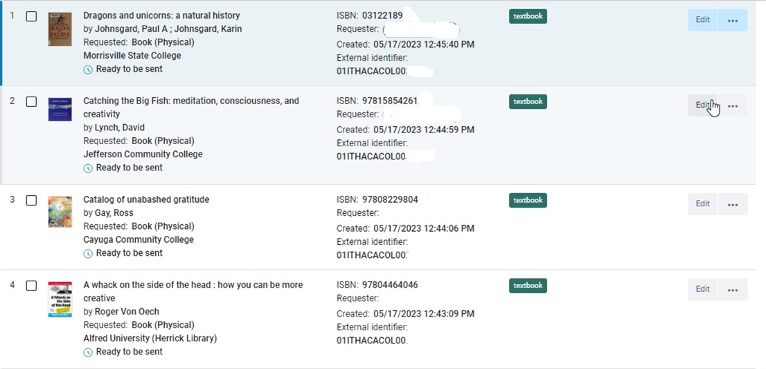
Wait, there’s a label for that!
Label = Mediation

Slide 9
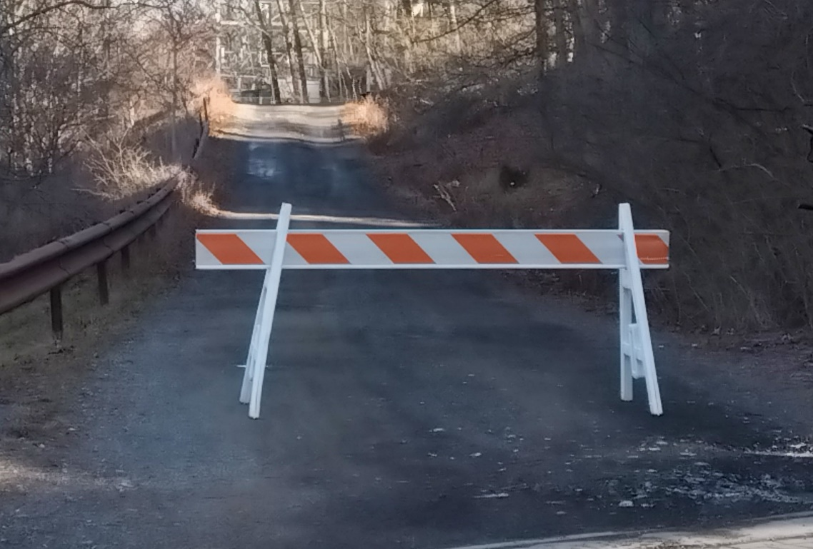
It Depends…
ISBN must match
Does not do a title search
Patron might choose an ebook record without realizing it

Slide 10
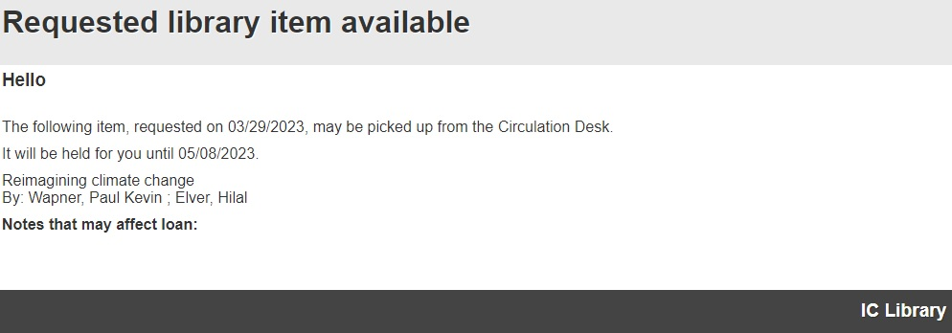
The ILL Borrowing Coordinator is notified that the item has arrived. It then gets placed on two-hour reserve by Reserve staff and the requesting student is notified.

Slide 11
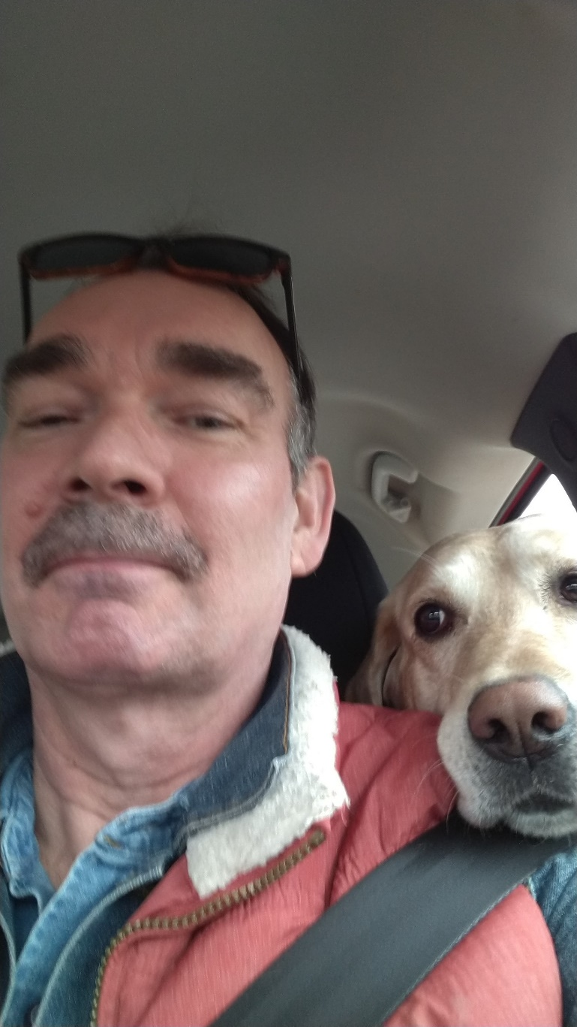
Are There Any Questions? Are There Any Answers?
Thank you for attending my lightning talk!
Ben Hogben (and Sophie) bhogben@ithaca.edu

