Slide 1
IDS Logic: Article Gateway
SHANNON PRITTING, SUNY LIBRARY CONSORTIUM
MICHAEL C. MULLIGAN, SUNY UPSTATE MEDICAL UNIVERSITY

Slide 2

Shannon Pritting
SLC Library Services Platform Project Director
SUNY Library Consortium

Slide 3

Michael C. Mulligan
Software Architect, IDS Project
Senior Epic Caché DBA, Upstate Medical University

Slide 4
Epic Cache Database Administrator?
Epic Systems Corporation, is a privately held healthcare software company, owned by Judith Faulkner.
According to the company, hospitals that use its software hold medical records of 54% of patients in the United States and 2.5% of patients worldwide.
9,000+ employees (2015) / $2.5 billion (2016)
Judy is #3 on the Forbes list of America’s Self-Made Women

Slide 5
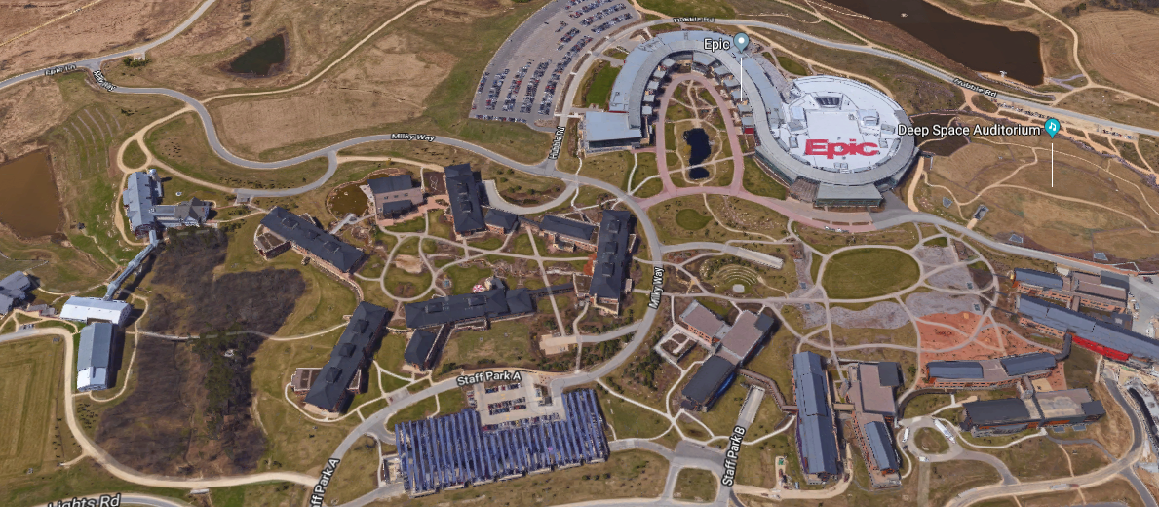
Epic’s Campus

Slide 6
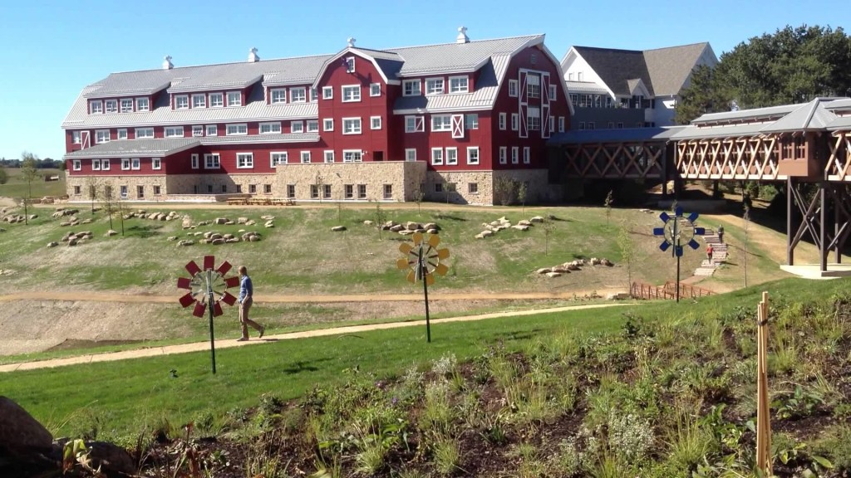
Epic’s Campus

Slide 7
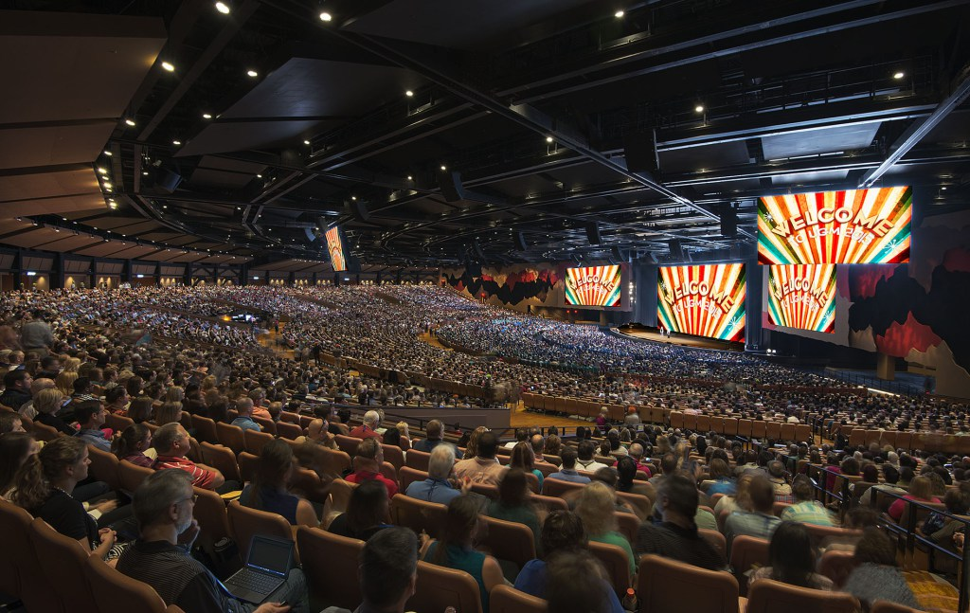
Epic’s Campus

Slide 8
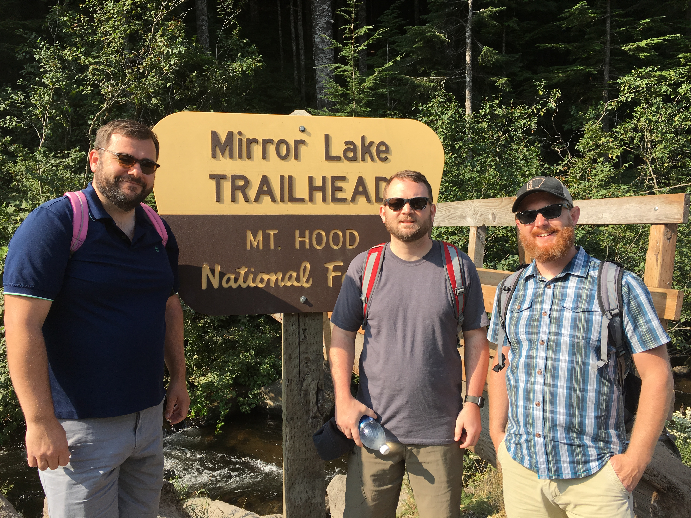

Slide 9
Let’s get started.

Slide 10
Articles vs. Journals
Collection development is shifting to article access vs. journal access.
ILL can be a key tool in providing access lost when subscriptions cancelled.
Strategy should be to reallocate some of the funds from subscriptions to enhancing ILL.
ILL can coexist with fully unmediated article purchasing.

Slide 11
Changes needed for ILL to be viable subscription alternative.
Article workflow needs to require far less mediation.
Applications needed to clean up bad input from systems and users to allow for automation.
Purchasing of articles in high value or needed situations needs to be integrated into workflow.

Slide 12

Case of SUNY Poly
Large cuts of high use journals.
Repurposed 15% of total journal costs to:
  Increasing ILL workflow and increase purchasing and automatic purchasing.
  Provided designated faculty with accounts for article purchasing outside of ILL using Article Galaxy.

Slide 13
Communication and Change Strategy
Journal cancellations announced with ILL identified as option.
Identified key faculty and deans to drive conversation on ILL as an alternative.
For those who couldn’t conceptualize ILL as an option, they received article purchase accounts after training session that focused on OA content and ILL.

Slide 14
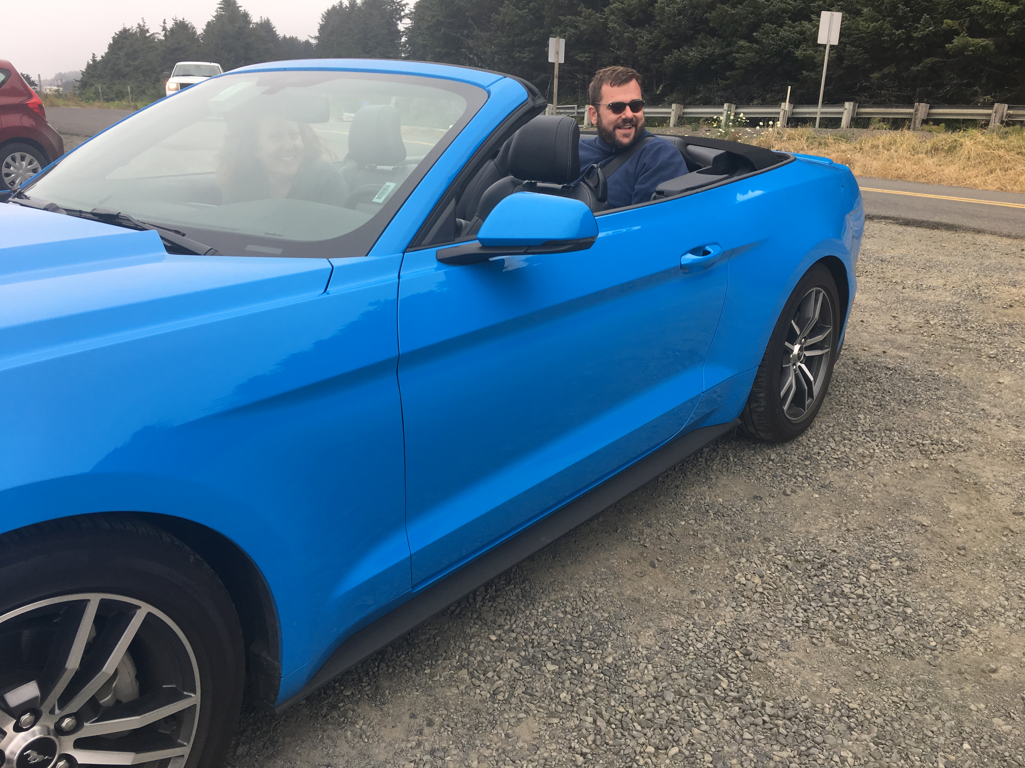

Slide 15
A little about our technology

Slide 16
IDS Logic: our workflow engine
An integration platform that brokers information between different systems
Enables rapid development and delivery of custom services
Customizable applications run to enhance staff and user experience
Middleware will become more important as systems become more complex and more open

Slide 17


Slide 18
Our initial concept for borrowing articles

Slide 19
What’s difficult to automate?
Borrowing articles are one of the toughest types of requests to automate as there are many different obstacles:
Copyright compliance
Erroneous or incomplete user created citations
Erroneous OpenURL mapping

Slide 20
How does copyright affect workflow?
From 1/2016 through 10/2016
  Average time a TN sat in Awaiting Copyright Clearance was 8 hours
  1,824,000 hours were lost to Copyright in IDS Project
  That’s 76,000 days across 100 IDS Project libraries.

Slide 21


Slide 22
Article Gateway

Slide 23
The start of Article Gateway
We systematically developed configurable modules to automate workflow and chip away at work that is methodically performed by staff.
The general concept has always been cleaned citations all with standard ISSNs.
Goal was 85% of borrowing articles completely unmediated.

Slide 24


Slide 25
The Article Gateway workflow

Slide 26
Filtering and fixing years
Find all TNs in copyright without a valid year
  Move them to a holding queue
  Programmatically try to fix the year based on the citation
    If fixed, put the TN back into Copyright
    If not fixed, route to a queue for staff to monitor
  Clean years enable automation of copyright compliance

Slide 27
Filtering and fixing ISSNs
Find all TNs in copyright without a valid ISSN
  Move them to a holding queue
  Programmatically try to fix the ISSN based on the citation
    If fixed, put the TN back into copyright
    If not fixed, route to a queue for staff to monitor
  Clean ISSNs enable automation of copyright compliance
  How do we fix the ISSN?
    External APIs such as Crossref and OCLC
    IDS Curated list of known titles with issues

Slide 28
Fixing even more ISSNs
Community Curated List
Our reliance on external indexes to complete and fix citations was working well, and we were hitting our 85% mark for most libraries.
But, developed a community curated list of ISSN to title matches.
Has led to increase in 10% automation at some libraries.
In 6 months the CCL has completed/fixed 6,700 transactions.
  Some campuses have had an additional 1,000 fixed.
  List is now at 3,000 title to ISSN matches.
Leverages expertise of staff to give the best ISSN.

Slide 29
We also have some batch fixers
We have a batch fixer for year and ISSN
  This helps with installing Article Gateway mid-year
  Most of our workflow assumes all years/ISSNs have been fixed

Slide 30
Checking for locally owned items
Find all TNs in copyright that are locally owned
  If owned, move them to a queue for staff to monitor
How do we determine ownership?
  For the IDS Project
    ALIAS - Article License Information Availability Service
  For Rapid
    The Rapid article availability API service

Slide 31
Automate the (first) rule of five
Find all TNs for articles that are older than 5 years
  If older than 5 years, move them to borrowing
This can be configured for local interpretation

Slide 32
Automate the (second) rule of five
Find TNs where copyright hasn’t been reached
  If copyright not reached, move them onto borrowing
This can be configured for local interpretation
Because we are cleaning ISSNs
  We can automate the copyright reached query based on ISSN
  Contrast this with manual processing based on title(s)

Slide 33
Automatically determine OA
Check various external sources for OA
  Pubmed, Unpaywall, OA Button, etc.
    Crossref and DOI are extremely important for OA
If article is available via OA, we have some options
  Route to a queue for staff to monitor
  Send an email to the customer and finish transaction
  configure level of OA automation based on variety of criteria such as user status.

Slide 34


Slide 35
Is there anything left in Copyright?

Slide 36
What’s left in copyright?
Everything that’s left in Copyright Clearance
  Has a valid year
  Has a valid ISSN
  Is not locally owned
  Is published within 5 years
  Copyright has already been reached
  Is not available via Open Access

Slide 37
CCC versus POD
Is purchase on demand cheaper than copyright?
  Compare copyright to prices from Reprints Desk and Get It Now
  If POD is cheaper, send to a processing queue
    Awaiting RPD Processing / Awaiting GIN Processing
  If copyright is cheaper than POD
    Store the copyright details in the TN and move it on to borrowing

Slide 38
CCC versus POD – Purchase profiles
We use purchase profiles to determine if POD is “cheaper”
  Profiles consist of a max cost and a “premium” for POD
    The premium is a way to rank the importance of POD higher
  Default purchase profile as a catch-all for all patrons
    Ex: max cost of $20 and $5 premium
      “We are willing to pay $20 for POD, up to $5 over copyright”
  Many custom purchase profiles based on “patron type”
    Ex: max cost of $1,000 and $50 premium for the president
      “We are willing to pay $1,000 for POD, up to $50 over copyright, for the president of the university”

Slide 39
Purchase Profile Configuration
Configuration options
  Year delta for publication date
  ISSN lists or single issns
  day of week and time of day
  User Info fields
  Department
  User Statuses
  Max Costs

Slide 40
POD automation
If Reprints Desk was the cheapest option
  We move the TN to “Awaiting RPD Processing”
  We automatically purchase from RPD
If Get It Now
  We move the TN to “Awaiting GIN Processing”

Slide 41
Borrowing automation
For IDS Project members
  We automatically create lending string and send out via OCLC. If CC payment is needed, insert data into TN for copyright gateway processing later.
For Rapid members
  We route to a queue for the Rapid Manager to process the TN

Slide 42


Slide 43
How does Article Gateway impact ILL?

Slide 44
Who is using Article Gateway?
47 Libraries using Article Gateway
19 Libraries using only fixers and filters
27 Libraries using full suite
Maybe even more?

Slide 45
How many TNs has AG processed?
TN price checks
  8/2016-7/2016 = 5,642
  8/2017-7/2017 = 11,258
TNs copyright not reached
  8/2016-7/2017 = 32,789
  8/2017-7/2018 = 74,297
TN ISSN Fixes
  8/2016-7/2017 = 110,893
  8/2017-7/2018 = 174,381
TN Year Fixes
  8/2016-7/2017 = 35,530
  8/2017-7/2018 = 82,023
TNs worked on by AG
  8/2016-7/2017 = 181,777
  8/2017-7/2018 = 364,717

Slide 46


Slide 47
How does Article Gateway benefit staff?

Slide 48
Benefits for staff
Reduction in amount of manual processing
University at Albany before Article Gateway
  43% ISSN look ups
  48% Manual CC Processing
University at Albany after Article Gateway
  10% ISSN look ups
  6% Manual CC Processing

Slide 49
What % of Requests are Fixed and Automated?
Libraries typically only need to review ~ 11% of all requests. The rest are fixed and automatically processed.
Using ILL librarians and staff to crowdsource “known source and citation” list that will further decrease % of requests needing processing. This has already led to 2-3% reduction, with improvements continuing.
Notes:
UBuffalo’s numbers for 2017: 48764 total requests, only 5966 needed staff review.

Slide 50
So, what’s left?
Mostly, the hard requests:
  Mostly conference proceedings
  Obscure journals
  Citations that have highly problematic information
Ultimate goal is to get % requiring processing to 2-3%, and we’re only a few percent away.

Slide 51
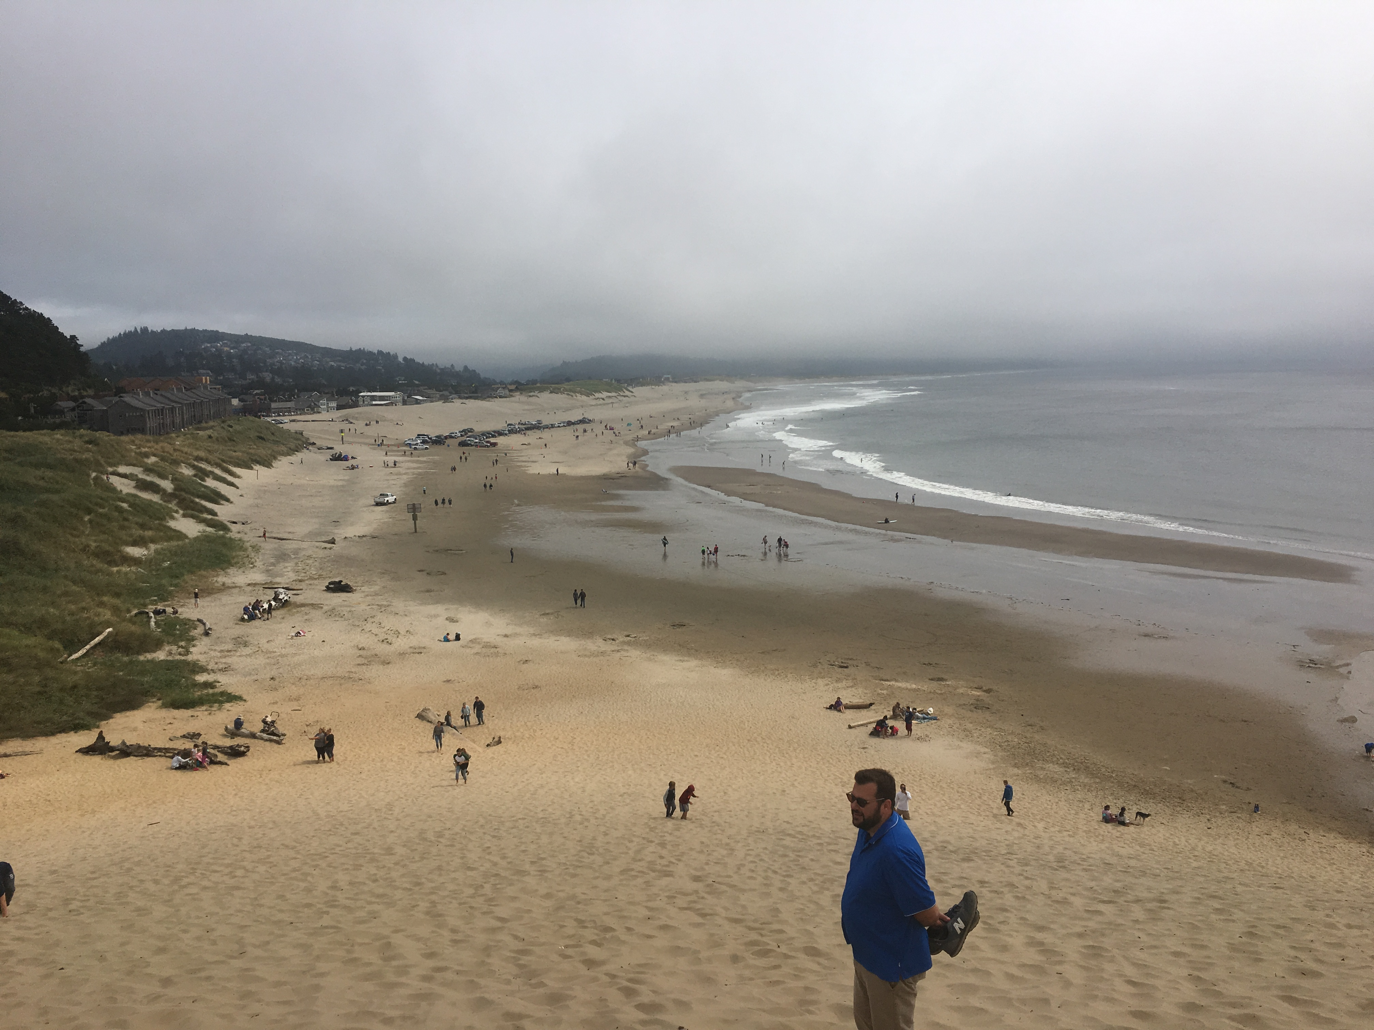

Slide 52
How does Article Gateway benefit patrons?

Slide 53
Benefits for patrons
10% increase in requests delivered within 4 hours or less at AG institutions.
Significant reductions in overall turnaround time. Typically reduces turnaround time by 25-30% in libraries.
As more auto purchasing is enabled and purchase profiles developed, % of requests delivered within a few hours will continue to increase, with a decrease in requests that exceed average turnaround time.

Slide 54
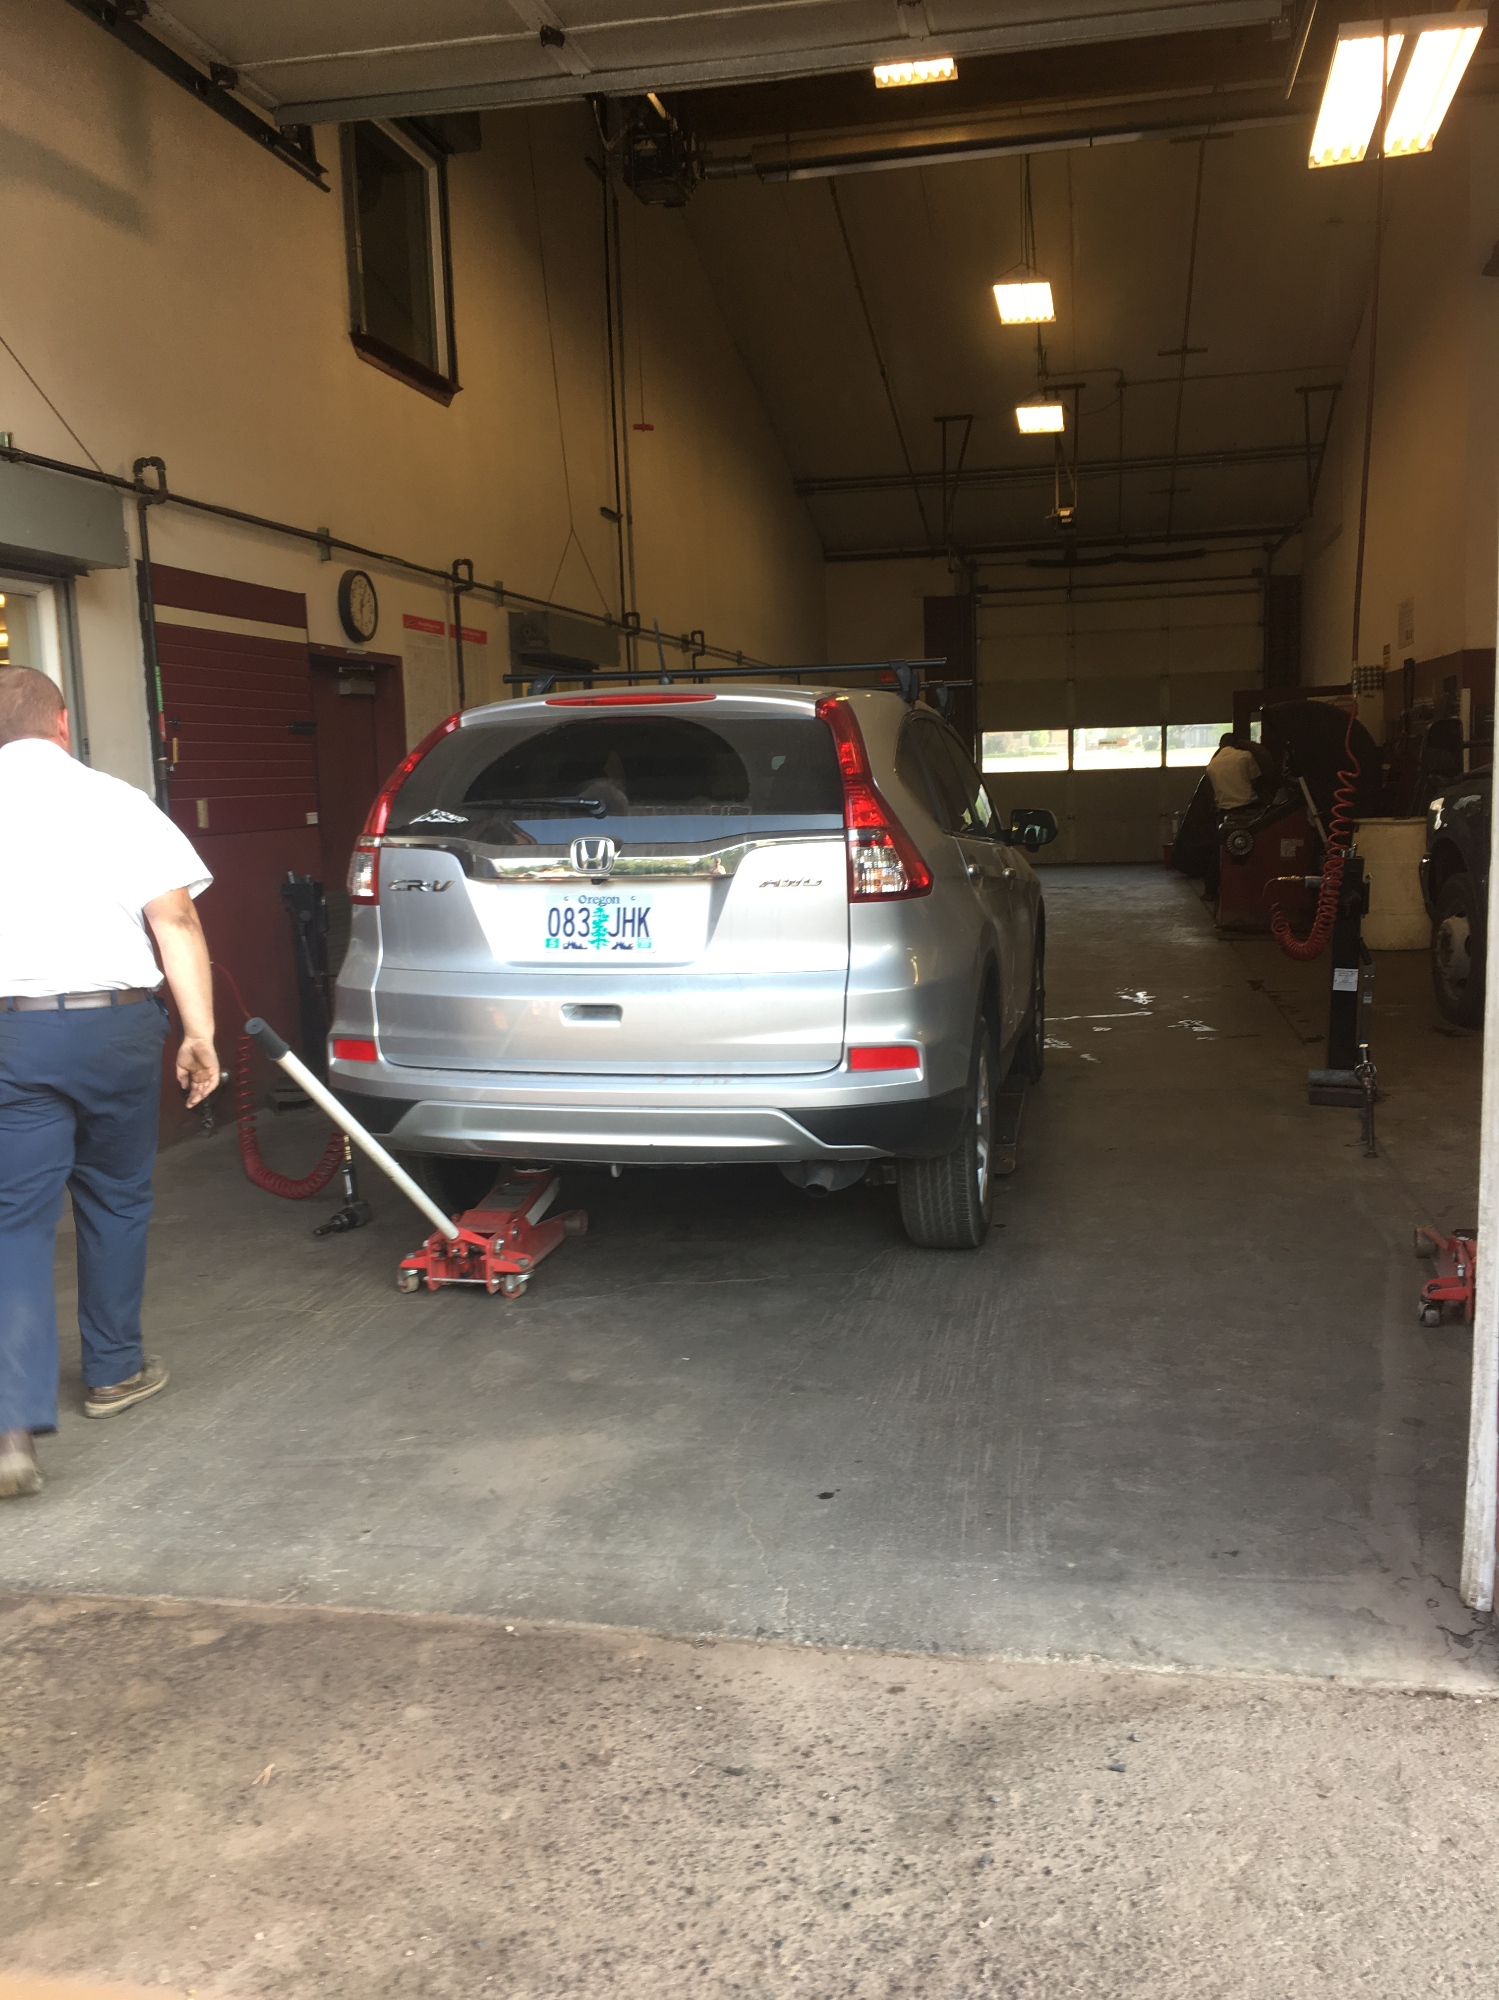

Slide 55
Do you want to know more?

Slide 56
Our article
Enhancing Resource Sharing Access Through System Integration
Shannon Pritting, William Jones III, Timothy Jackson & Michael Mulligan
Journal of Interlibrary Loan, Document Delivery & Electronic Reserve
http://www.tandfonline.com/doi/full/10.1080/1072303X.2017.1305034

Slide 57
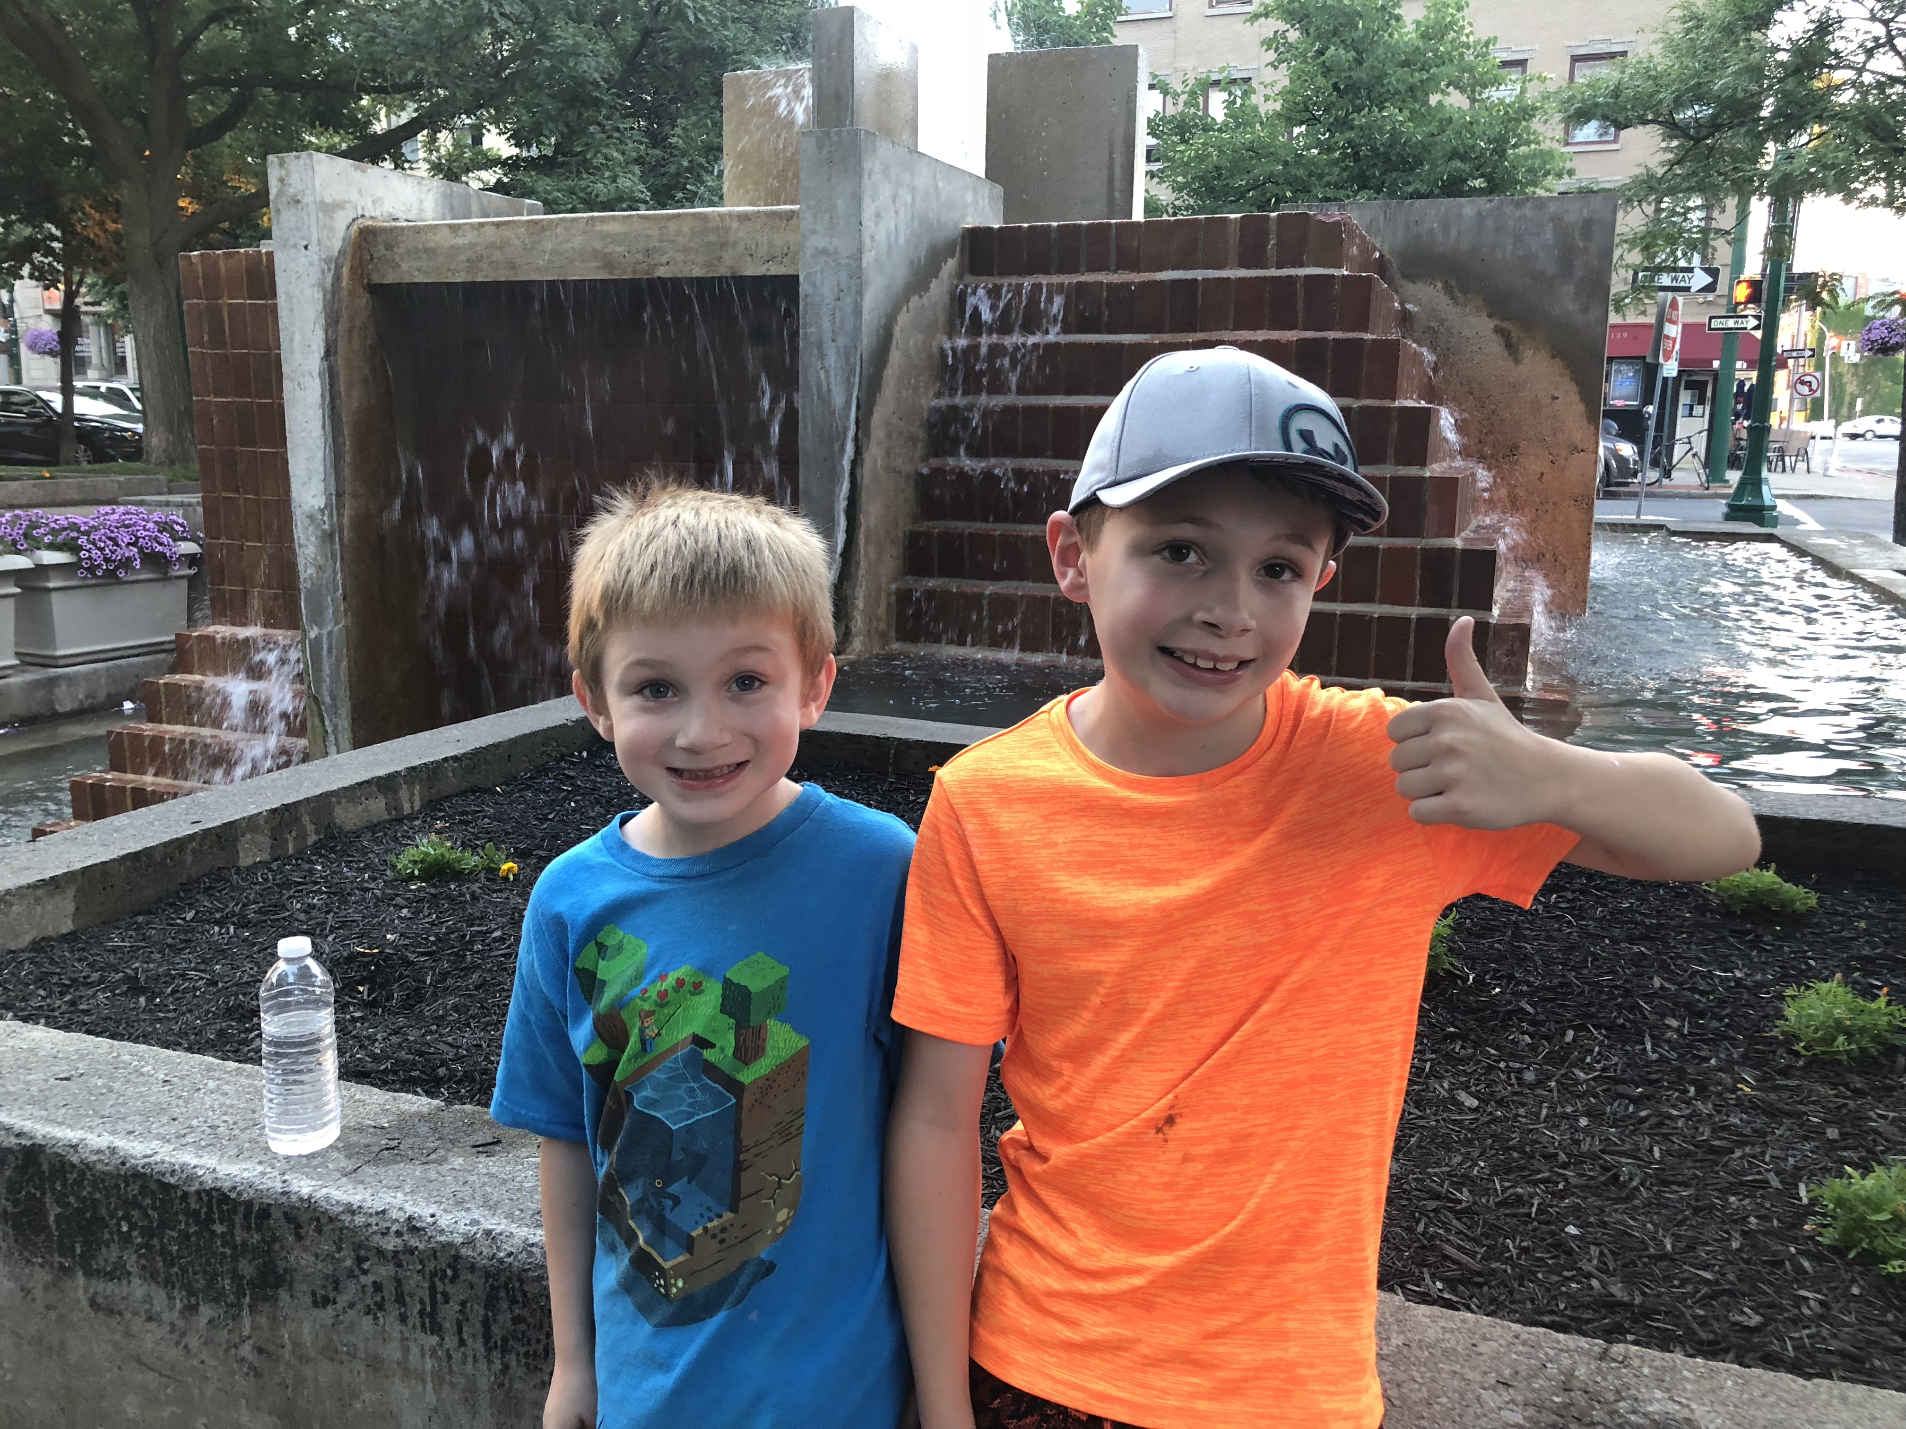

Slide 58


