Slide 1
ILL Purchase on Demand: A Decade in the Making
Elise F. Thornley
Barbara Blake
Notes:
https://docs.google.com/document/d/1X4Eujdyzrq8_jMadyJfU6gxA8y1KFRJUHG2qf4CiqGc/edit
E&B

Slide 2
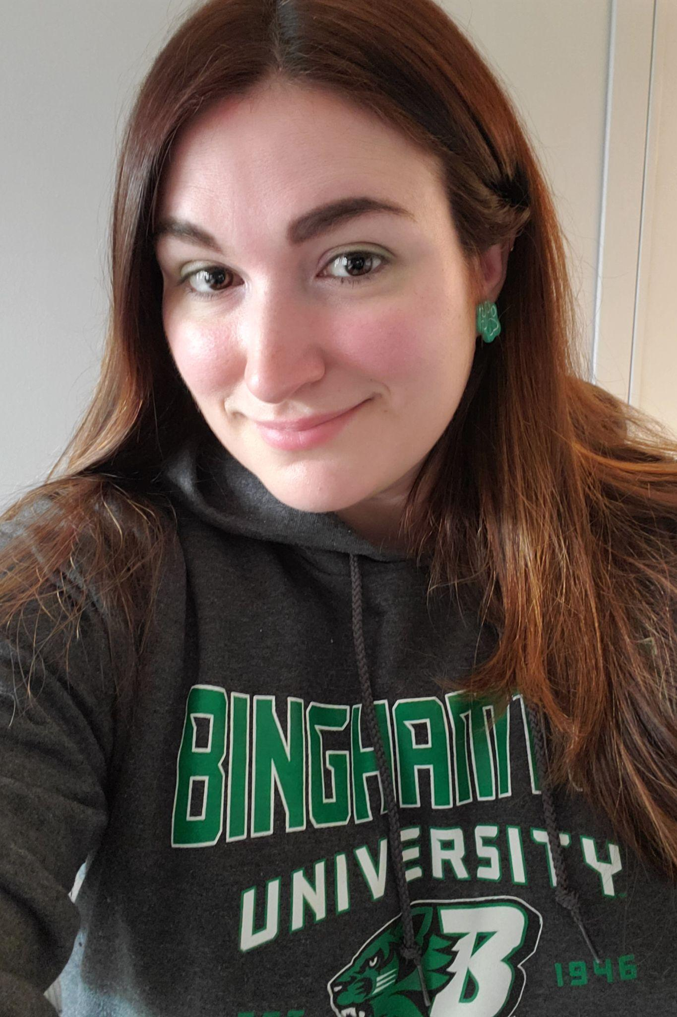
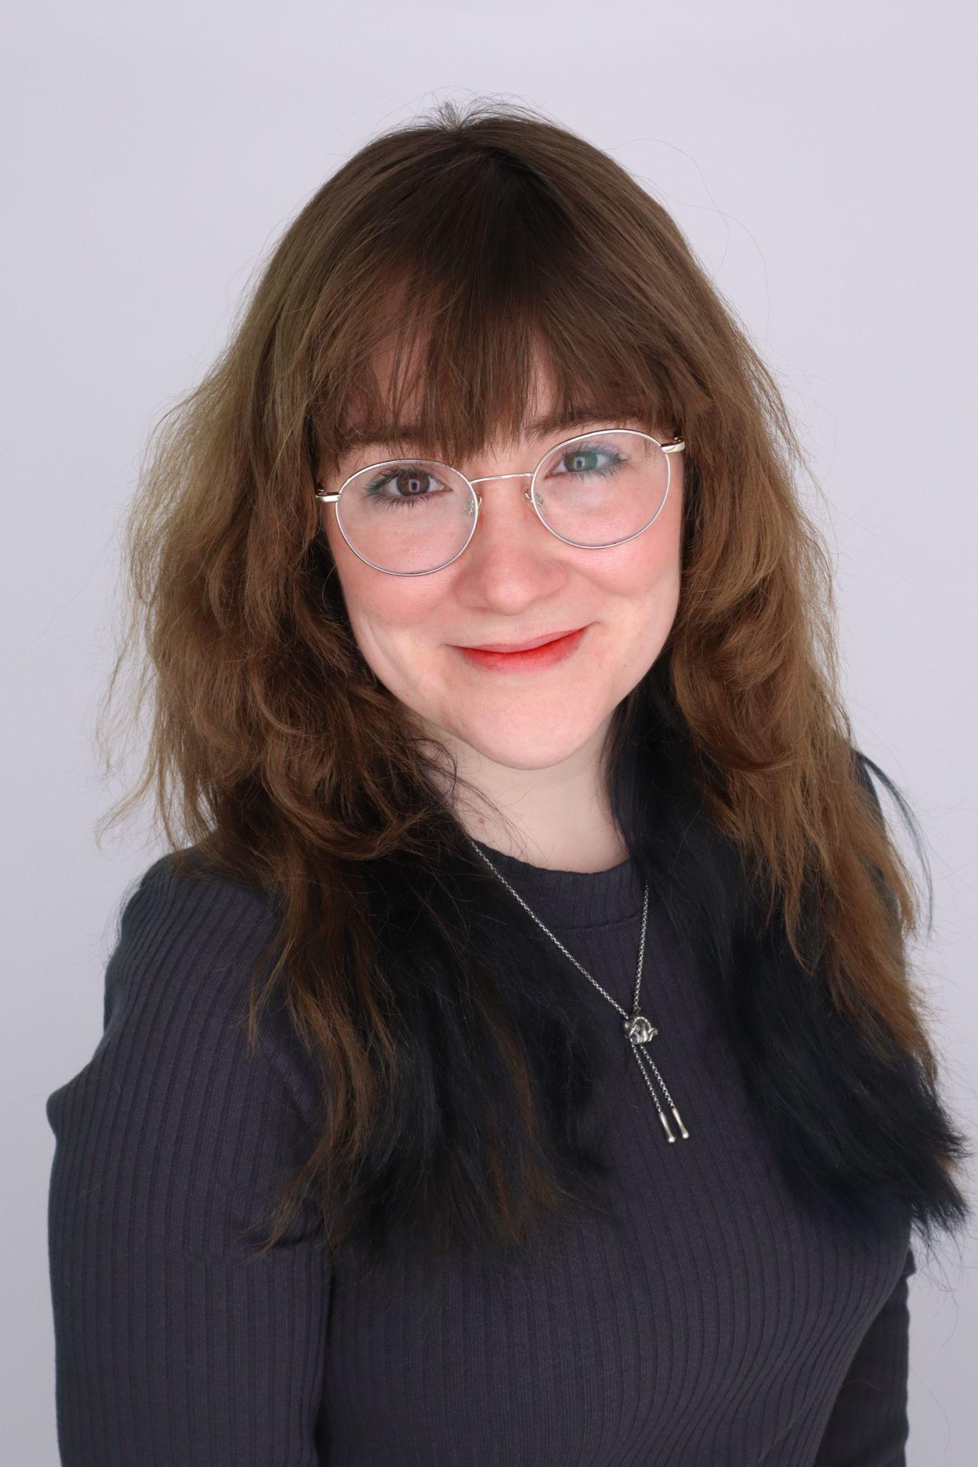
Introductions
Elise Thornley is the Senior Associate Head of Resource Sharing at Binghamton University, and oversees all Resource Sharing/ILL workflows. She directly supervises 5 employees in the department.
Elise started working at Binghamton as a student employee in Resource Sharing in 2008. Shortly after graduating in 2012 with a BA in Japanese, she was hired at Binghamton in the Resource Sharing/ILL department, where she has been since!
Elise completed her LIS at Syracuse University in 2017. Her professional interests include leadership development
Barbara Blake is the Resource Sharing Assistant at Binghamton University Libraries, overseeing management of Borrowing and Document Delivery processes. She is a Binghamton University alumnus, holding a BA in English Literature & General Rhetoric.
Barbara began working in academic libraries in 2017 as a student assistant in Course Reserves at the Binghamton University Libraries while finishing her bachelor’s degree. Upon graduation in 2018, she returned to the Libraries as a full time staff member to oversee the Course Reserves department. She moved into her current position in 2020.
Barbara’s professional interests include increasing accessibility within access services, and advocating for students from non-traditional backgrounds.
Notes:
E&B

Slide 3
Agenda
Program origins, 2009-2016
History, scope of program
Pros vs. cons
POD Pilot Round 2, 2021-2022
Changes to program
Workflow
First year of POD program, 2022-2023
Workflow
Results
Second round success; what changed?
Looking at the future; expanding from here
Q&A

Slide 4
Today’s takeaways…
A demand-driven acquisitions program is only as successful as the support behind it
Too many restrictions on a program can harm its success
Don’t be afraid to go all in!
Embrace changes and modifications; trial and error is key to success!
Food for thought as we work through today’s presentation:
Notes:
Link for image: https://giphy.com/stickers/phonecase-sonix-shopsonix-M8tjZeslKBiZYCMoID

Slide 5
Early POD Pilot
The original pilot began around 2009
Borrowing department moved to Technical Services from 2010-2013
Borrowing moved back to Reader Services at the end of 2013
Total of 159 books were purchased between 2009-2016
Pilot ended in 2016
Timeline: 2009-2016
Notes:
E
The impact wasn't substantial in my recollection. Tina was kind of the connector between ILL and acquisitions/cataloging
Borrowing moving back also coincided with Jesslynn (my boss) leaving the University for another job

Slide 6
Early POD Pilot
Criteria:
Faculty (non-librarian)
Physical books only
Published in the 2 calendar years
University Press only
$75 or less
No 3rd party vendors
Workflow
Staff email Head of Acquisitions & cc Borrowing staff
In ILLiad, staff add POD in Lender String & Lender field, change System ID to OTH, and route to Request Sent queue
Head of Acquisitions determines if material can be purchased
If there’s no response from Acquisitions in 1 business day, obtain via ILL
Criteria & Workflow
Notes:
E
Foreign University Press publications will be purchased AND requested via ILL, in the interest of timely service
Bibliographer is notified if price exceeds $75 and asked if book should be purchased. If there is no response within 24 hours, the book will be requested via ILL.
If item is out of print it will revert to an ILL request

Slide 7
Early POD Pilot: Pros vs. Cons
Pros
Patron-driven acquisitions were new for the Binghamton Libraries; helped change thinking surrounding acquisitions
Acquired numerous physical items for the collection
Allowed faculty to easily submit requests for approval
Cons
Very restrictive! A limited number of requests fulfilled all purchasing criteria
Only faculty requests - no graduate or undergraduate requests
Faculty could fulfill purchase requests through other means, such as communicating with subject librarians
Ebook purchasing limited at the time; too high of costs for very limited user access
In past five years, seen significant increases in ebook accessibility
Notes:
E

Slide 8
POD Pilot Round 2
Conversations in Collections meetings created an opportunity for a second pilot. A working group with representation from Acquisitions, Collections and Resource Sharing met to discuss the pilot.
Stats from the original pilot were shared, and the group determined that the criteria was too restrictive. Additional stats from ILLiad were shared to help set parameters for the new pilot.
From these collaborative efforts, a new POD pilot & workflow were developed. It featured less restrictions and a formal budget.
Second Time’s the Charm!
Pilot November 2021-2022
Notes:
E
Talk about the importance of stats
Tools used in ILLiad & Alma

Slide 9
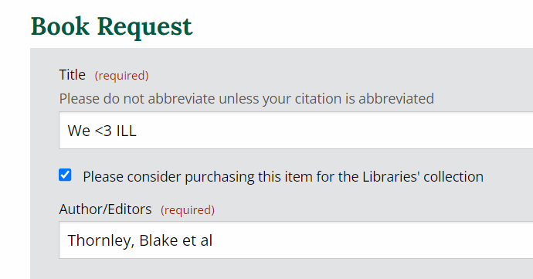
POD Pilot Round 2: Criteria for Requests
Patron status is Faculty, PhD or Graduate
Patron indicated that material should be purchased*
Book requests only
English language publications
For PhD/Grads, University Press only
Published in the past 5 calendar years
Cannot be awaiting publication
Not owned by Binghamton
If owned but lost or missing, continue POD process
Under $300
Available in Gobi (Electronic, Physical) or Amazon (Physical)
ebook preferred, physical book if ebook exceeds $300
For ebooks, multi-user format preferred, single-user format acceptable

Slide 10
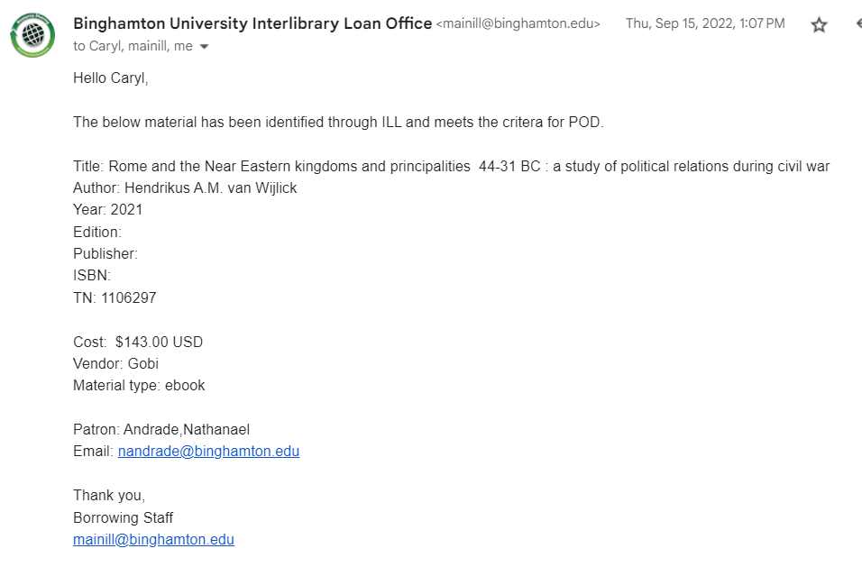
POD Pilot Round 2: Workflow
Patron submits request to ILLiad, or request is imported from Alma to ILLiad.
Routing rules vet requests published within past 5 years if submitted by faculty or grad students.
Requests go to the appropriate custom queues for Resource Sharing staff review.
Staff open the request in ILLiad and review the criteria. If request meets the criteria, staff will notify Acquisitions using built-in ILLiad template.
If it does not meet the criteria, the request is processed normally though ILL
Staff review catalog/patron account periodically to see when the purchase arrived/has been activated. Once it is available, staff update the ILLiad record.
Patron automatically notified by Acquisitions/Alma features when material is available
Notes:
B

Slide 11
POD Pilot Round 2: ILLiad Routing Rules
In ILLiad, we set up custom routing rules. Requests published within the last 5 years submitted by faculty or graduate students will be directed to custom ILLiad queues for manual staff review.

Slide 12
POD Pilot Round 2: Results + Improvements
Pilot and Results
Total Budget: $40,000
Budget spent: $18,600
Pilot timeline: November 2021- 2022
141 requests fulfilled; 130 eBooks, 11 print
125 requests for faculty
17% of ILLiad Loan requests were POD
49 rejected requests; 46 filled through ILL
16 requests for grad students
1% of ILLiad Loan requests were POD
63 rejected requests; 53 filled through ILL
Turnaround time
Average of 3-4 days for eBooks, 27 days for print
Improvements
Expand Grad student restrictions
University Press limitation proved far too restrictive; most requests from grad students were for non-University Press materials
Physical books vs. ebooks
Some patrons do not want ebooks; purchases for ebook formats may “go to waste”
Requests from one individual patron dominating POD queues
Communicate outside of system; transparency is key!
Notes:
Top requesting areas: History 28, English 12, Comp Lit: 12, Anthro 9, Romance Language 8
12

Slide 13
Second round success; what changed?
Greater departmental and administrative support behind the program
Less restrictions around parameters
Acquisition mindset more open to patron-driven collections
DDA programs new/developing in 2009-2016
Developments in acquisitions programs (Rialto) allows for easier, more streamlined purchasing
COVID-19 and impacts on collection development, especially eBooks
eBook acquisitions favored post-pandemic. Collection development programs are also mindful of accessibility
Notes:
Both the department and administration wanted to re-explore DDA programming in 2021; after reviewing statistics from 2009-2016 pilot, elected to lighten POD guidelines

Slide 14
POD Program
A permanent program was developed after the success of pilot, round 2!
Additional changes to support the program were made based on the pilot data.
Timeline: November 2022-present

Slide 15
From Pilot to Program: POD at BNG 2022-2023
Updates to program from pilot:
Expand publisher restrictions for graduate student POD requests
With use of Rialto, POD purchasing was moved under the purview of the Senior Associate Head of Resource Sharing (Elise)
Instead of looking up items on Gobi/Amazon, Borrowing staff now notify Elise if a request meets criteria
Easier, streamlined workflow for RS and Acquisitions!
Program results November 2022-June 2023:
105 requests fulfilled through POD!
64 faculty
41 graduate student
Over 150% increase in fulfillment!
Budget spent: $13,776
$20,321 including the pilot from July - November 2022 (full Fiscal Year)

Slide 16
Looking to the future: Improving POD at Binghamton
Using Resource Sharing to assist Leisure Reading collection development
Undergraduate statistics might be most useful! Huge uptick in Resource Sharing being used for leisure reading.
Do not underestimate the power of BookTok!
Over the next year, look at Course Reserves data to see there are additional ways to streamline patron acquisitions for Public Services
How can we expand our program to benefit more patrons?

Slide 17
In conclusion…
A POD program is as successful as the support behind it, so get your team on board!
Collect & share statistics to support a potential pilot or program.
Collaboration is key! The POD program at Binghamton was successful due to the collaborative work of multiple departments.
Make sure workflows are sustainable for all.
Build a program that’s adaptable!
Notes:
A POD program cannot be too restrictive, or it could become obsolete.
Needs to be to patron demand and the organization’s capabilities.

Slide 18
Questions..?

Slide 19
Some reading!
Kat Hart, Chris Palazzolo & Sofia Slutskaya (2022) Cross-departmental collaboration for successful DDA and EBA management , Journal of Electronic Resources Librarianship, 34:4, 336-341, DOI: 10.1080/1941126X.2022.2133924
Patron-Driven Acquisitions : History and Best Practices, edited by David A. Swords, Walter de Gruyter GmbH, 2011. ProQuest Ebook Central, https://ebookcentral.proquest.com/lib/binghamton/detail.action?docID=799409.
Rebecca Walton, Jacob Mauldwin & Jenica Bunderson (2022) Patron Drivers, Patron Impacts: Investigating Potential Patron Impacts of Moving to a Patron Driven Acquisition Model for Print Books, Collection Management, 47:4, 272-285, DOI: 10.1080/01462679.2022.2030841
Through POD, we also discovered our top-requested materials of the 2022-2023 academic year:
Atomic Habits by James Clear
The Seven Husbands of Evelyn Hugo by Taylor Jenkins Reid
Want to learn a little more about DDA programs? Check these out.

Slide 20
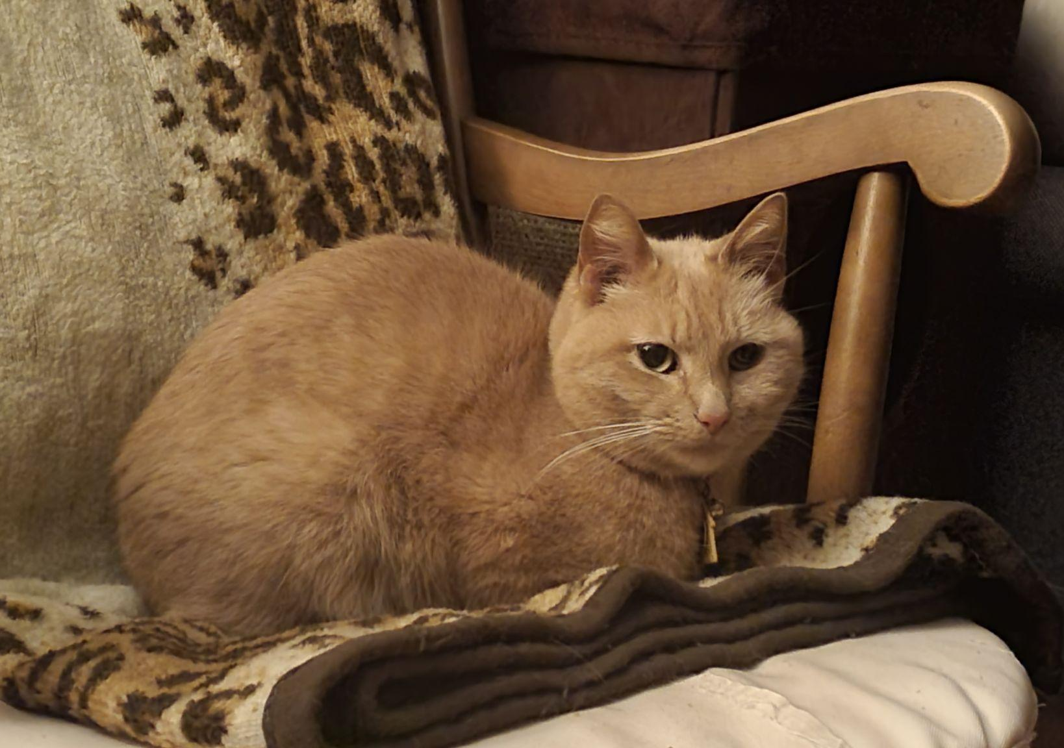
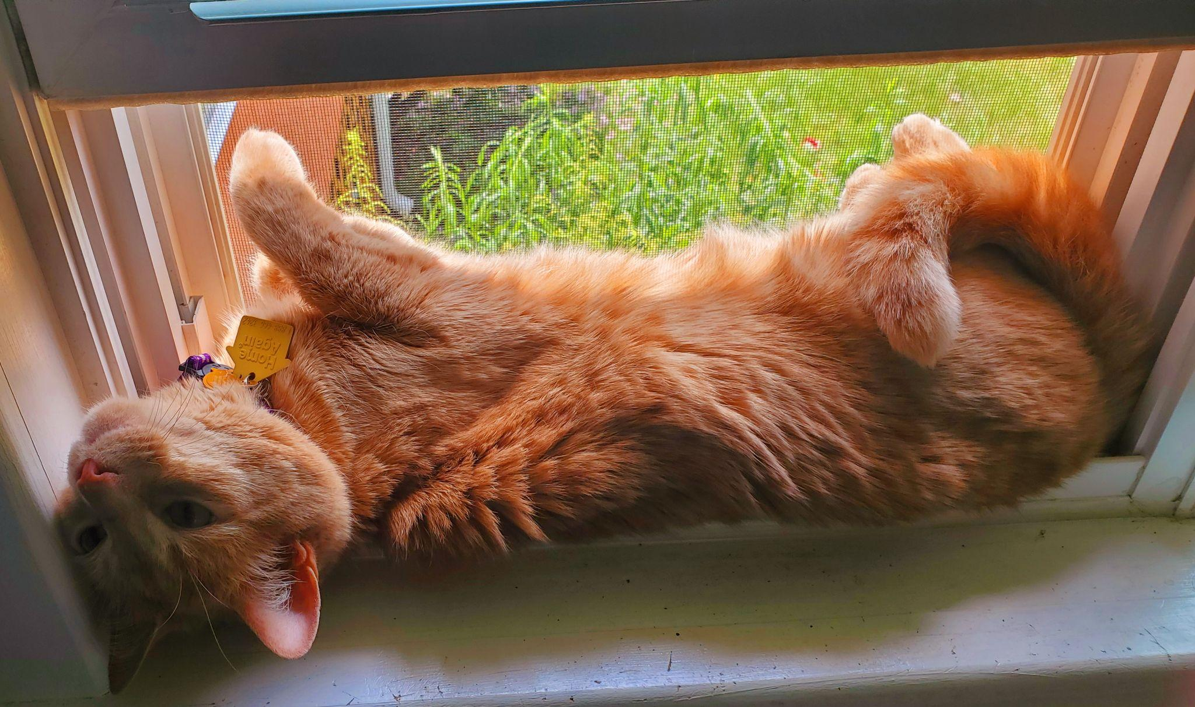
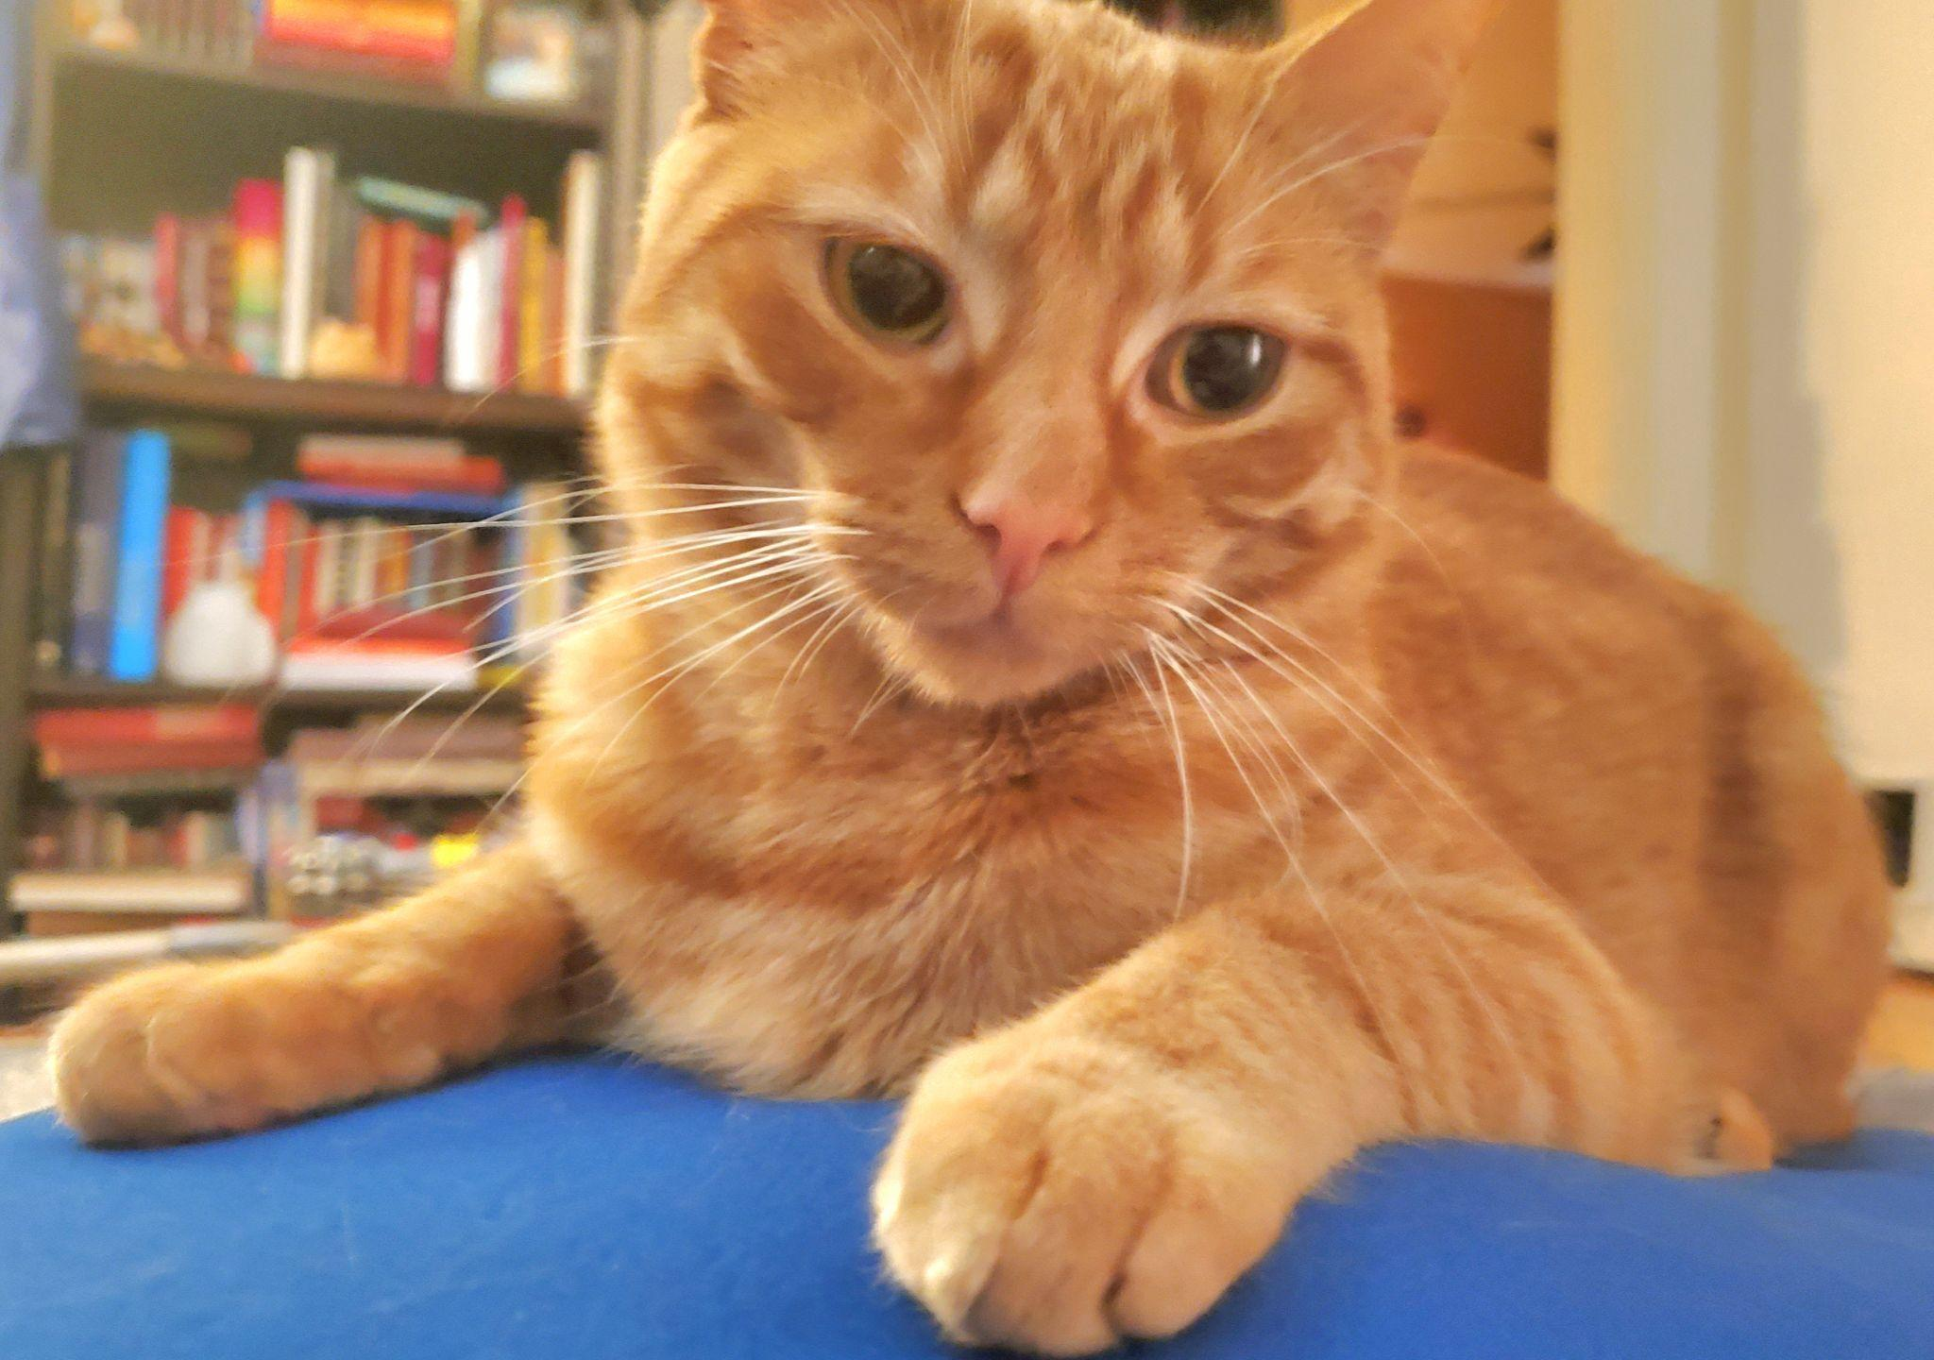
Thank you!
Enjoy our kitties as a token of our appreciation.
(Yeah, they’re all orange).

