Slide 1
ILLiad Update & Highlights
IDS Project 2023 Annual Summer Conference

Slide 2
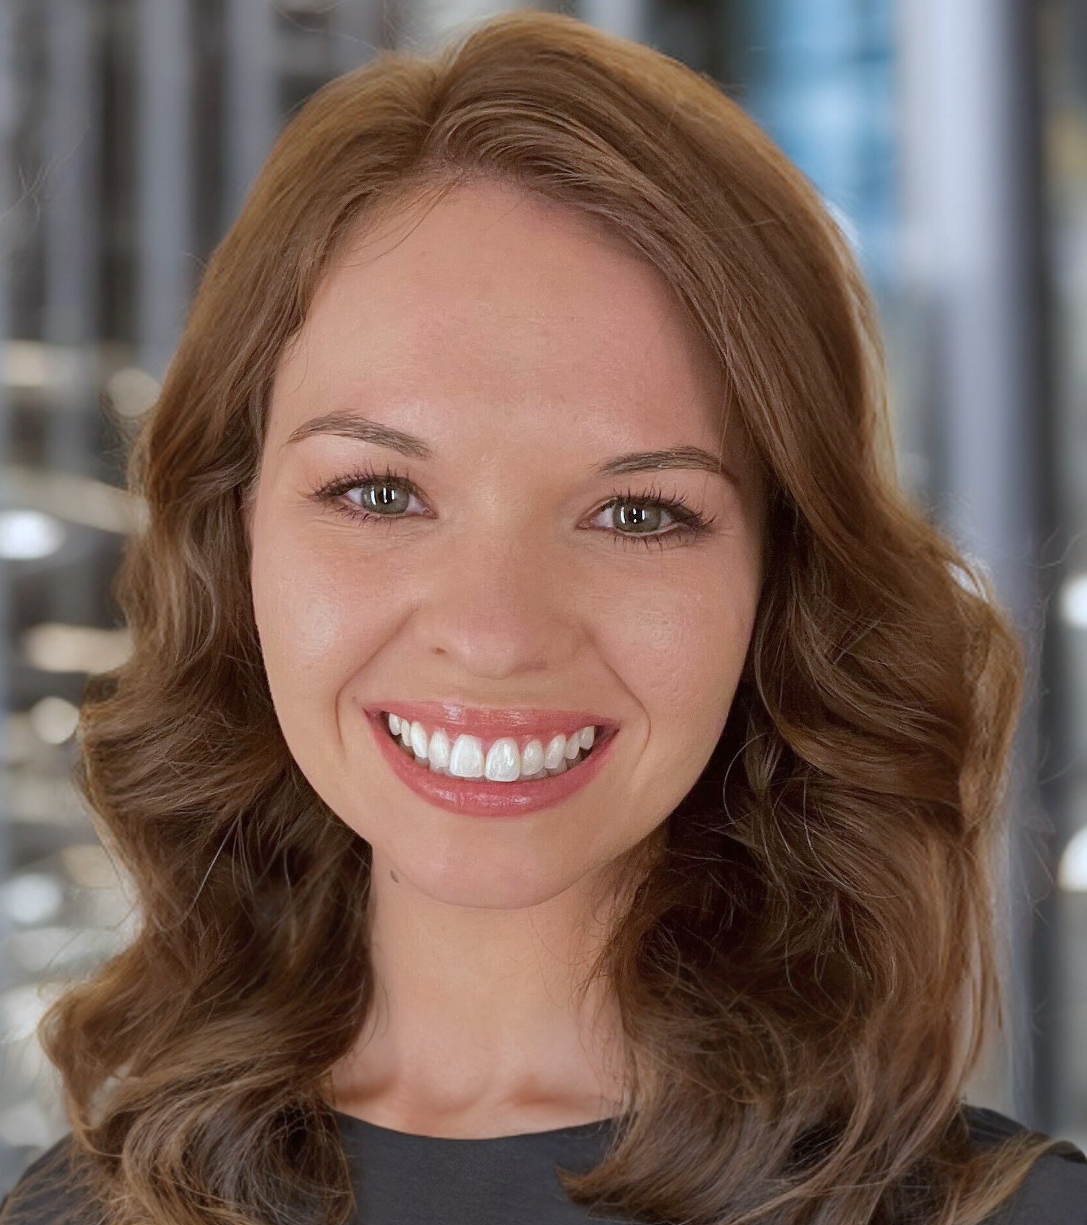
Welcome!
Sara Juel
Access Services Program Manager
Contact me at support@atlas-sys.com for questions about the following:
ILLiad Roadmap
New Integrations/Enhancement Ideas
Custom Work
Etc.

Slide 3
Recent Updates

Slide 4
Recent Minor Releases
(9.2.1) Database, (9.2.3) Web DLL, (9.2.3) Lending Web DLL, and (9.2.2) Connection Manager Release
Includes captcha challenge
Increased length of ZServerConfig Username and Password fields to support WSILL with Z39.50
(9.1.5) Database, (9.1.7) Web DLL, (9.1.7) Lending Web DLL, and (9.1.1) Connection Manager Release
Includes captcha challenge
Increased length of ZServerConfig fields
(9.2.4) ILLiad Client Release
Includes WebView2 browser update
Recently updated addons
WorldCat Local Search Client Addon (v.1.5.1)
Google Search Client Addon (v.2.2.1)
CCC GetItNow Client Addon (v2.5.3)
Reprints Desk DSP Addon (v1.0.3)
CaiaSoft Server Addon (v1.0.5)
...and several 3rd party addon updates
Notes:
Increased width of ZServerConfig Username and Password fields from 50 to 100 in both ILLiad and Ares. The captcha challenge will provide extra security against bot-driven account creation by requiring new users to solve the challenge in order to submit the form and create their accounts. The following captcha providers and plans are supported by ILLiad (note that a separate account must be created with your chosen captcha provider to implement

Slide 5
Captcha
ILLiad can now integrate with one of three supported third-party captcha providers to add a captcha challenge requirement to the New User Registration forms (NewUserRegistration.html and LendingNewUserRegistration.html):
Google reCAPTCHA: reCAPTCHA v2 (both the "invisible" and "checkbox" variants) and reCAPTCHA v3
Note that reCAPTCHA Enterprise is not supported by ILLiad
hCaptcha: Free "Publisher" plan
MTCaptcha: Free plan
Notes:
Not needed for shib & remoteauth

Slide 6
WebView2
Updated the underlying browser components to utilize Microsoft Edge’s WebView, a Chromium-based browser.
Auto-update functionality via Windows updates
ILLIad will support addons with the Chromium, Webview2, or IE browsers (Note: some IE features may not work due to the depreciation of IE)
Details can be found here: https://bit.ly/3DSOdxQ
Notes:
WorldCat Local Search Client Addon (v.1.5.1)
Google Search Client Addon (v.2.2.1)

Slide 7
What’s Next?

Slide 8
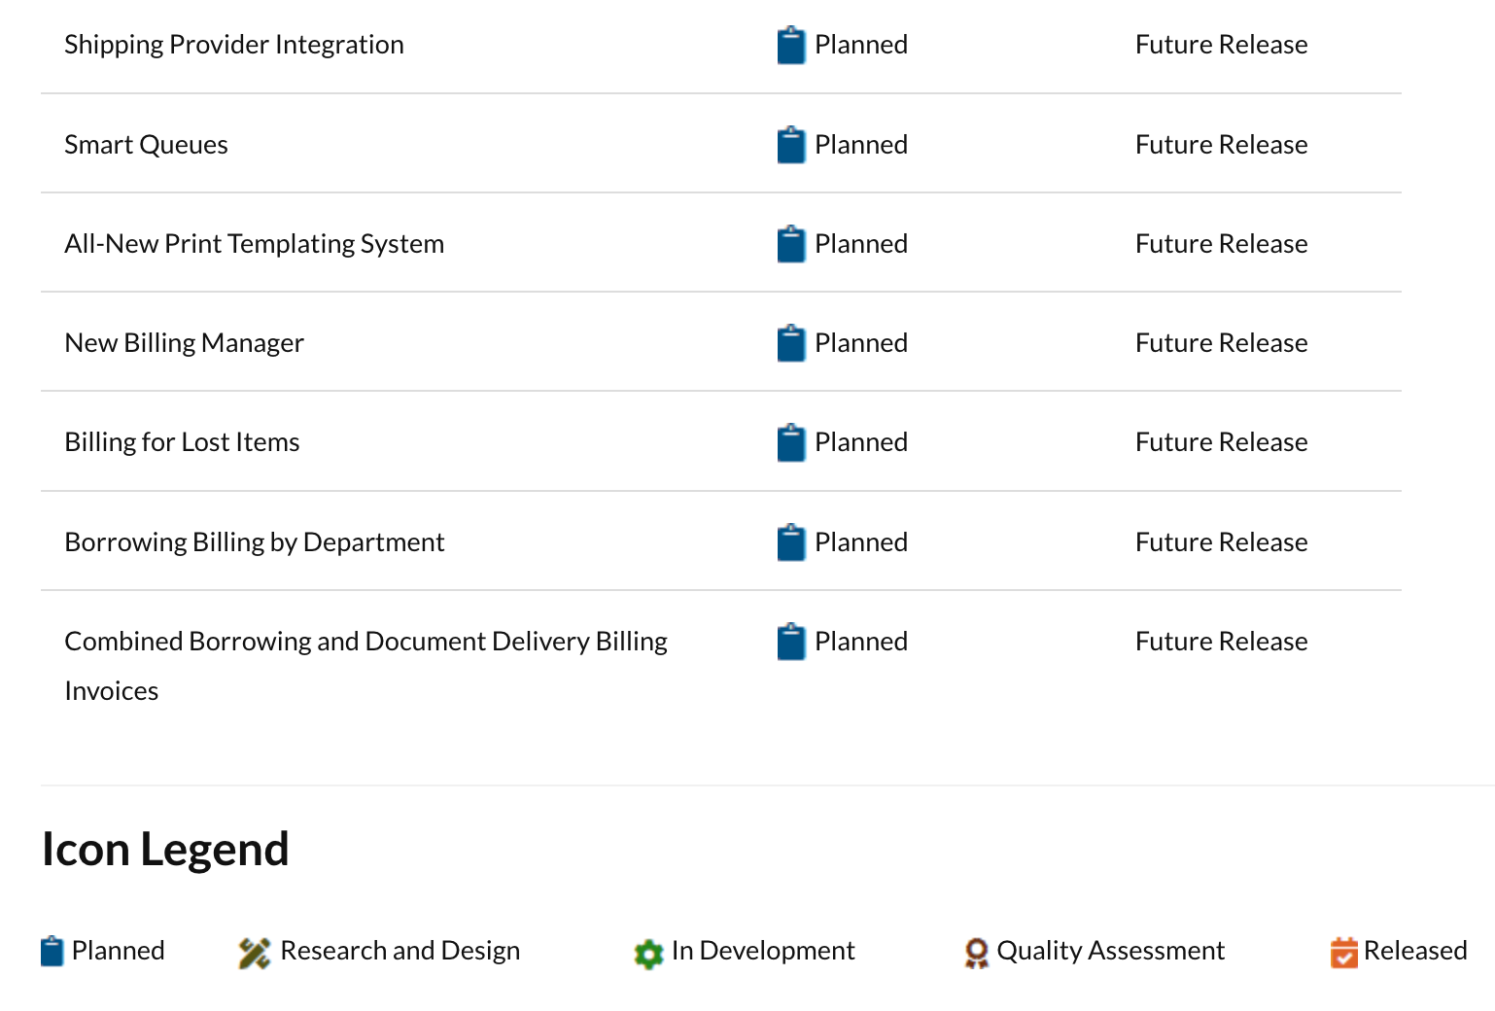
ILLiad Roadmap

Slide 9
ILLiad Update
Upcoming Work/Projects
ReShare Client Addon
LibKey DSP Addon Integration
Connection Manager update for Direct Request / Automated Request Manager (ARM)

Slide 10
ReShare Client Addon

Slide 11
Integration with LibKey
Currently working on a DSP addon to integrate with LibKey: https://libkey.io/
Libkey checks the Open Access database as well as subscriptions your institution owns

Slide 12
OCLC Resource Sharing for Groups
Working with OCLC to implement Resource Sharing for Groups
Details on the product can be found here: https://www.oclc.org/en/resource-sharing-for-groups.html
Releasing a connection manager update to improve direct request / ARM workflows
Notes:
Optimizes smart fulfillment, searches worldcat through a collective group view, provides consortia analytics

Slide 13
Example 1

Slide 14
Example 2

Slide 15
Training & Webinars

Slide 16
See EventBrite for upcoming classes: https://www.eventbrite.com/o/atlas-systems-29295592643

Slide 17
New User Group the First Tuesday of Each Month!
Notes:
ILLiad’s greatest feature has always been its community of users who show their support through collaboration and innovation. We welcome you to come and meet your fellow ILLiad practitioners and learn more about how to get the most from your powerful resource sharing management system. Each meeting’s focus will be selected from a participant-generated list and will include a discussion that features shared experiences and helpful tips from Atlas Systems staff and experienced ILLiad mentors.

