Slide 1
Metadata Matters: The Commoditization of Metadata and Possible Futures for Resource Management and Resource Sharing

Slide 2
For Today’s Discussion
Libraries depend upon ready access to accurate, robust, and flexible metadata.
Libraries and library professionals create metadata which may then be shared with other libraries, most often with other organizations and systems serving as intermediaries to facilitate this work.
However, organizations working in the library ecosystem have commoditized metadata, limiting the ability of libraries to access, share, adapt, and re-use metadata in fulfillment of their work.
The future of libraries is intertwined with the future of metadata.
This session will present an overview of the current state of metadata as a commodity, along with a discussion of possible future pathways for the work of libraries in resource management and resource sharing.

Slide 3
Introduction: Florida Virtual Campus (FLVC) Library Services
The Florida Virtual Campus (FLVC) is a statewide provider of innovative educational support services for all public postsecondary institutions within the Florida College System (FCS) and the State University System (SUS), and for the larger K-20 education community.
FLVC is defined in F.S. 1006.73 to provide resources and services in Library Services, Distance Learning, and Student Services.
FLVC serves ~1.3 million students, faculty, and staff at 40 institutions.

Slide 4
FLVC Library Services
Integrated Library System (ILS) for all 40 FCS and SUS Institutions
Single, Shared Catalog
Uborrow consortia borrowing and courier service
Electronic Resources
Statewide Collection, Centrally Funded
Group Licensing Opt-Ins, Locally Funded
Authentication Platform
Digital Services
Digital Asset Management Platform
Journal Publishing Platform

Slide 5
FLVC Library Services
Textbook Affordability and Open Education Resources
Research and Support – Florida Textbook Affordability Survey
OpenFL Community of Practice
Annual OER Summit
Professional Development and Training
Help Desk Support for All FLVC Resources and Services

Slide 6
I’m giving a talk about Metadata???
Things They Didn’t Tell You in Library School

Slide 7
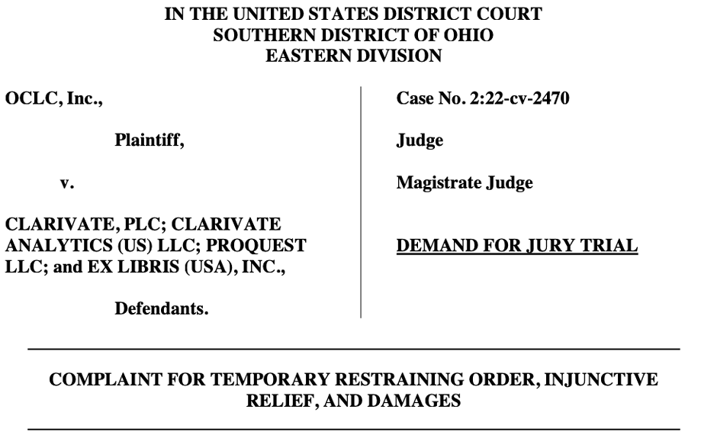
What Prompted This Conversation
https://www.infodocket.com/wp-content/uploads/2022/06/Microsoft-Word-1093931750_1.docx-gov.uscourts.ohsd_.269526.1.0-1.pdf

Slide 8
OCLC v Clarivate – June 13, 2022
Full Coverage from InfoDocket: https://www.infodocket.com/2022/06/15/oclc-files-lawsuit-against-clarivate-analytics-worldcat-metadoor-metadata/ by Gary Price
Case Centers on Clarivate’s Development of MetaDoor:
“Defendants have been contacting OCLC customers and encouraging them to contribute the bibliographic records from WorldCat®, and provide access to those records from the MetaDoor platform, all of which is in direct breach of those customers’ contractual obligations to OCLC.”
Four Counts:
Tortious interference with contractual relationships
Conspiracy to tortiously interfere with contractual relationship
Tortious interference with prospective business relationships
Conspiracy to tortiously interfere with prospective business relationships

Slide 9
OCLC and Clarivate
OCLC
FY ‘22 Revenue $219.5 million
1,229 Employees
Clarivate
FY ‘22 Revenue $2.659 billion
11,000 Employees
Ex Libris
FY ‘22 Revenue $108.2 million
950 Employees
Two large companies pursuing expensive legal action about control of library metadata.
Data is indeed the currency of the 21st century.

Slide 10
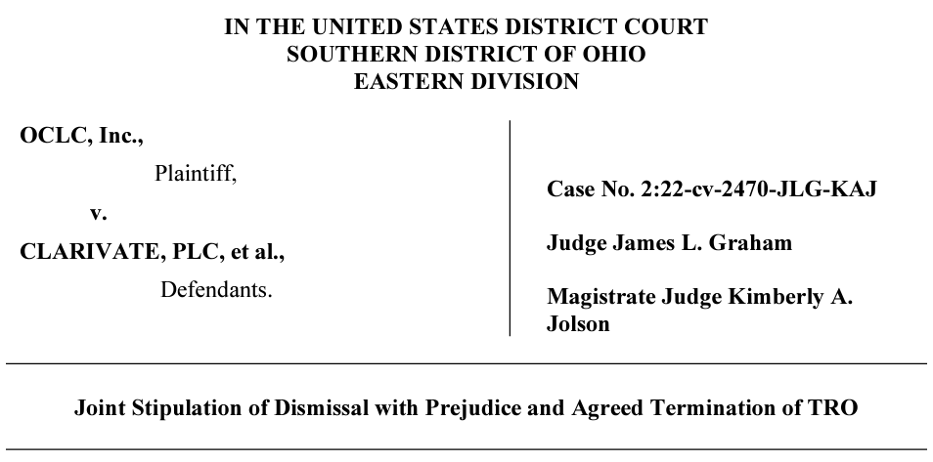
“Resolution”
https://storage.courtlistener.com/recap/gov.uscourts.ohsd.269526/gov.uscourts.ohsd.269526.52.0.pdf

Slide 11
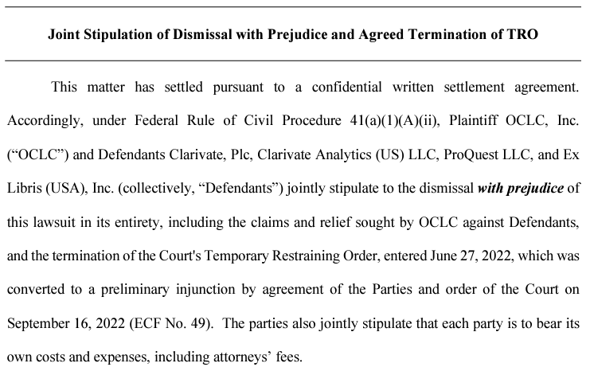
“Resolution”
https://storage.courtlistener.com/recap/gov.uscourts.ohsd.269526/gov.uscourts.ohsd.269526.52.0.pdf

Slide 12
OCLC v. Clarivate – Questions Raised
Who owns the metadata?
In part, or in whole?
How can the metadata be used, shared, reused?
First, some context . . .

Slide 13
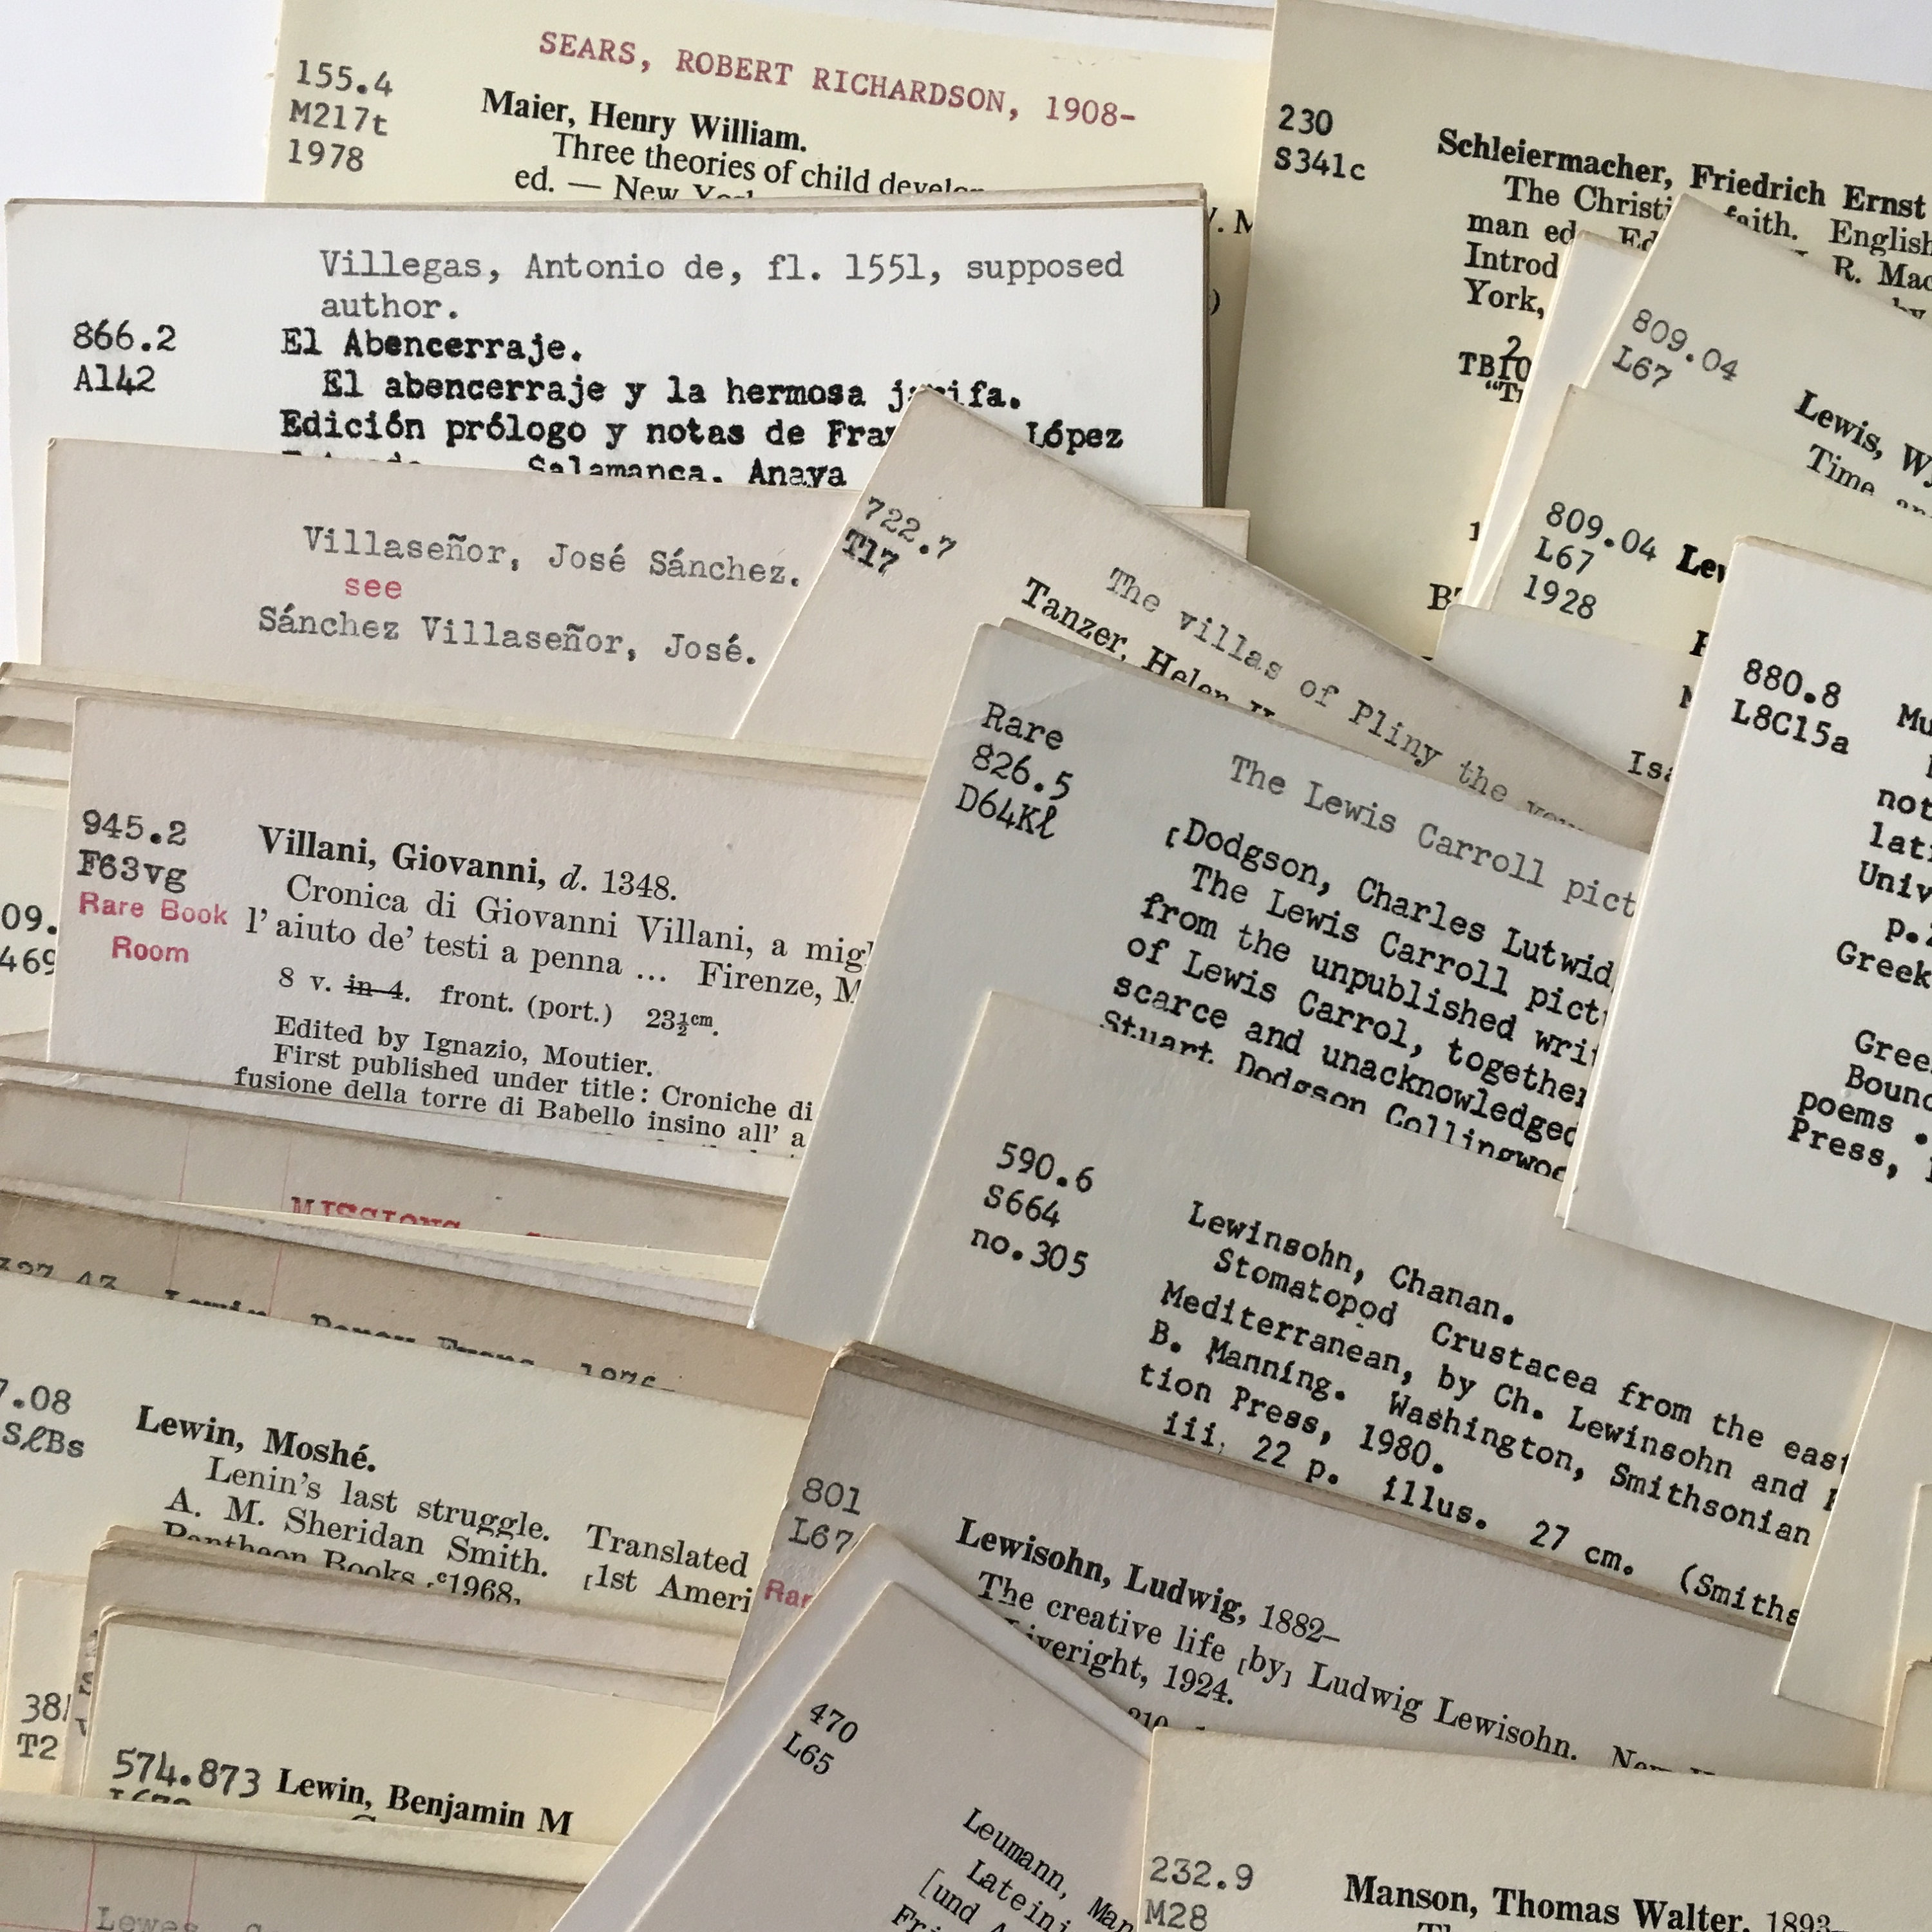
It all began with the 3” x 5” index card…

Slide 14
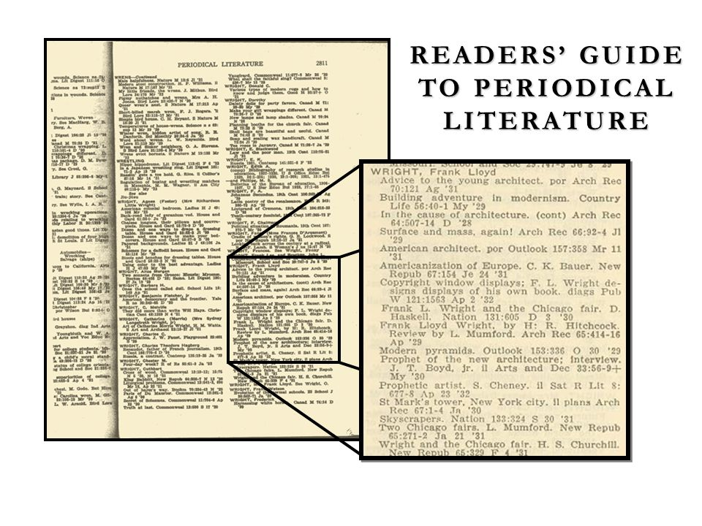
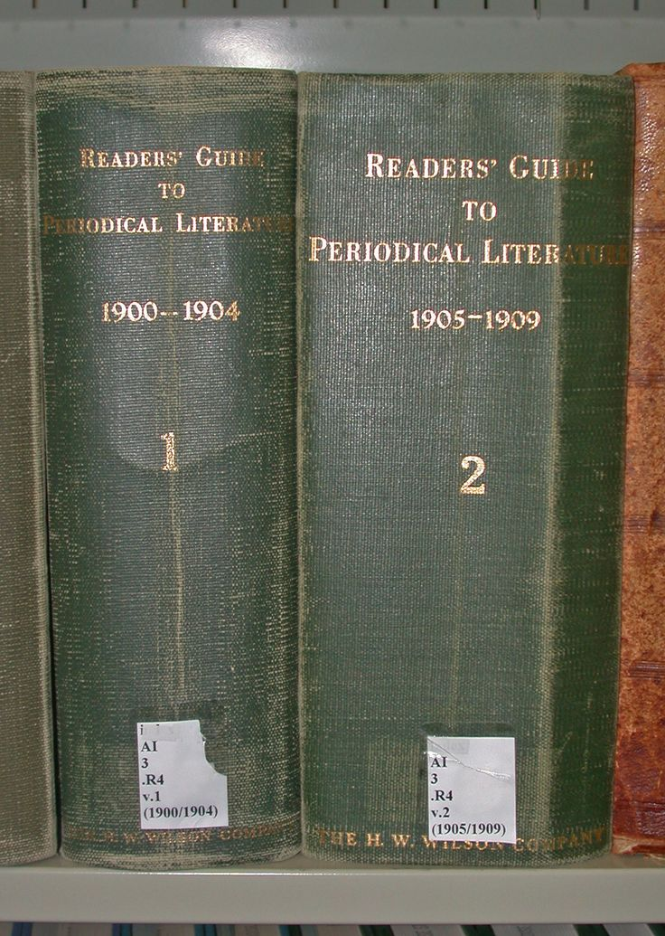
And the print index.

Slide 15
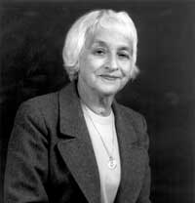
And Then the Computer, with Libraries at the Forefront of the Digital Age
Henriette Avram (1919-2006)
Computer Programmer at National Security Agency (NSA), 1952
Private sector work with software companies in 1960s
Datatrol Corporation, led project to design a computer science library
1965 – Library of Congress, Systems Analyst, Office of the Information Systems Specialist
Directed LOC MARC Pilot Project to create MARC format
Consulted with Fred Kilgour on creation of OCLC

Slide 16
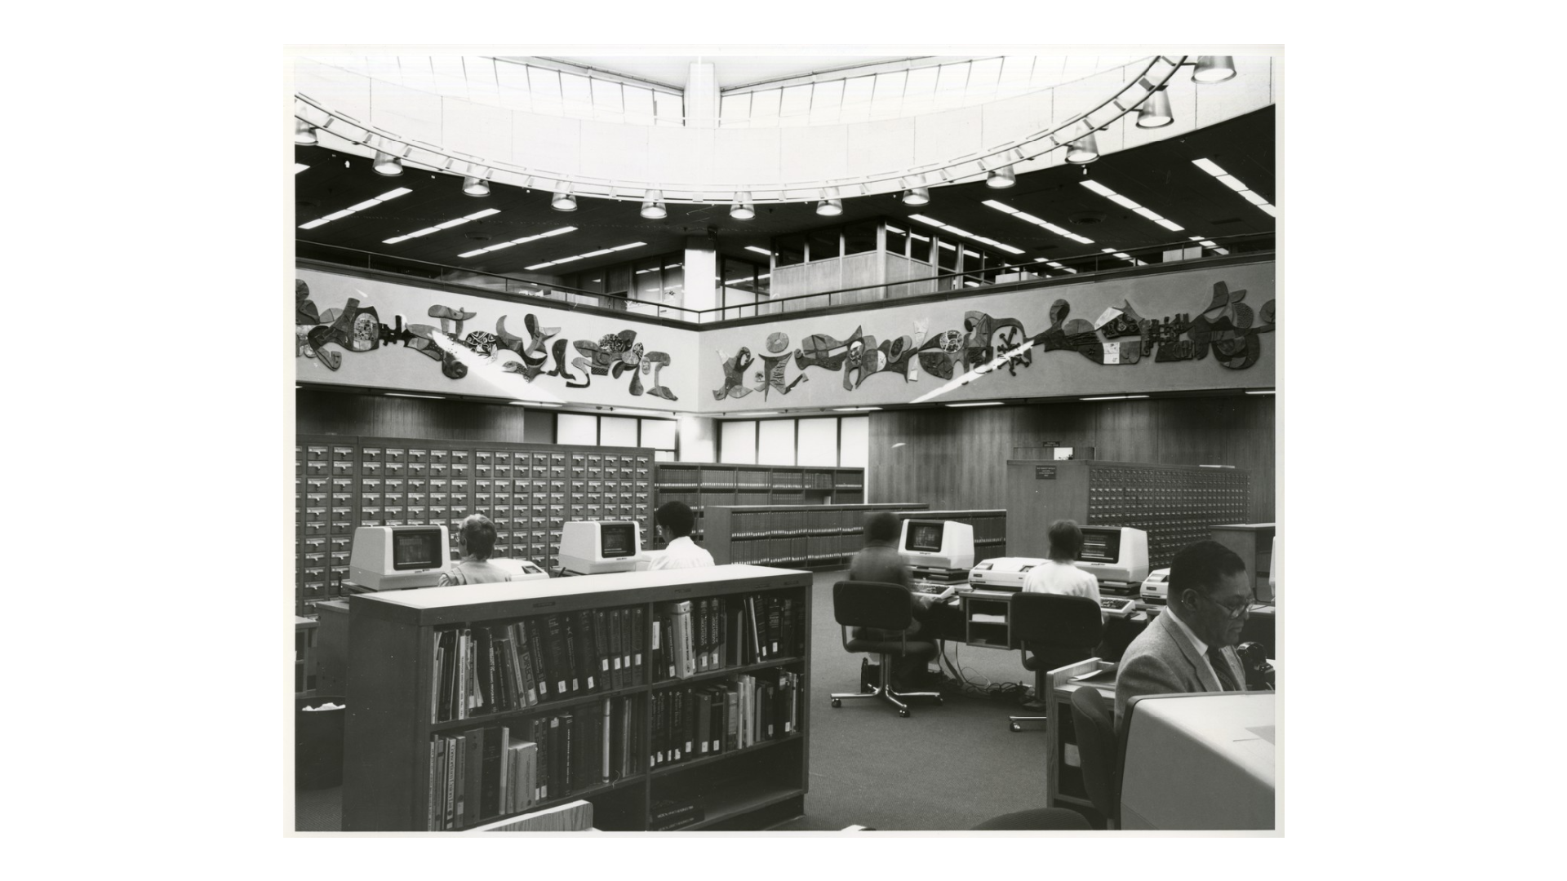
Decades-long transition to electronic metadata systems MARC Conceptually Built Around the 3” x 5” Index Card
National Library of Medicine: [Library rotunda with online catalog terminals next to the library's card catalog] http://resource.nlm.nih.gov/101445872

Slide 17
OCLC Over Time
Ohio College Library Center, incorporated as nonprofit July 5, 1967
1967 – 1977, membership limited to institutions in Ohio
1978, membership opened to institutions in other states
2002, membership opened to institutions outside the United States
2023
30,000+ members in over 100 countries
40+ million search requests processed daily
547,409,991 bibliographic records in WorldCat, as of April 2023
https://www.oclc.org/en/worldcat/inside-worldcat.html

Slide 18
Metadata as a Commodity

Slide 19
547,409,991
Where does all that metadata come from anyway?
From all of us!
Librarians at Libraries Create Metadata, Presumably for Sharing and Reuse by Other Librarians at Other Libraries
Everything We Do with Library Collections Depends on (Accurate, Robust, Accessible, Shareable, Reusable, Affordable, Sustainable) Metadata

Slide 20
547,409,991
WorldCat is, arguably, the single largest source for library metadata
Libraries depend on access to metadata to function
How much does a bib record cost?
Libraries pay librarians to create bibliographic metadata
Libraries pay for access to WorldCat as a platform to create and store bibliographic metadata
Libraries pay OCLC to enhance bibliographic records
Libraries pay to retrieve bibliographic metadata from WorldCat
Libraries pay for their holdings, attached to bibliographic metadata, to display in WorldCat
How much does a bib record cost?
I don’t know
FLVC FY ‘23-’24 ~$880K for Cataloging/Metadata across all 40 member institutions

Slide 21
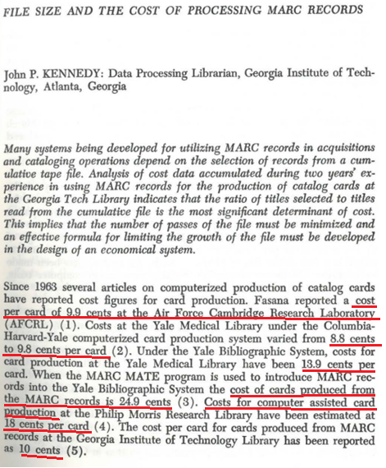
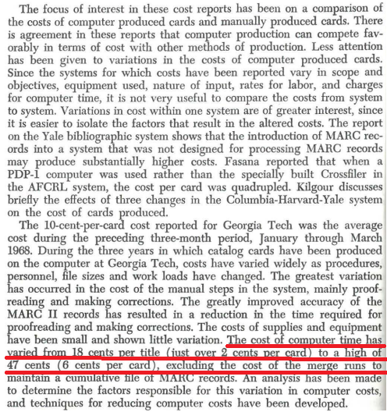
Cost of Metadata . . . A While Back
https://ejournals.bc.edu/index.php/ital/article/download/5581/4938

Slide 22
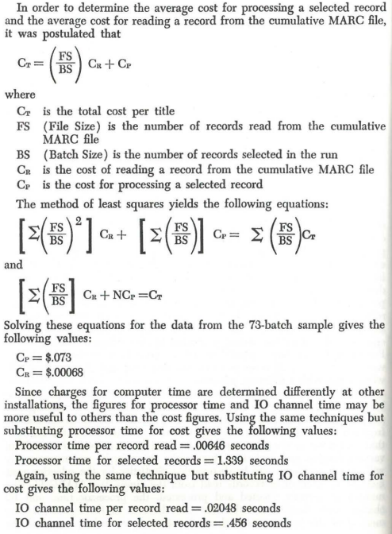
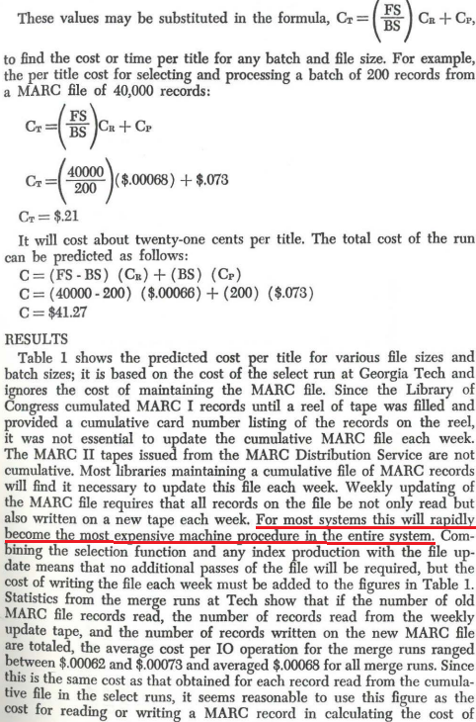

Slide 23
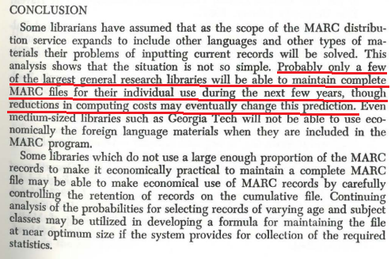

Slide 24
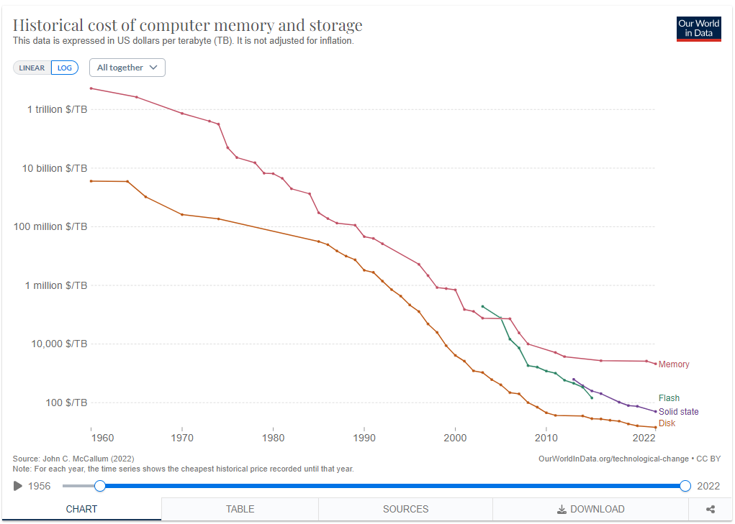
Cost of Data Storage from https://ourworldindata.org/grapher/historical-cost-of-computer-memory-and-storage?time=1960..latest

Slide 25
547,409,991 Redux
WorldCat is, arguably, the single largest source for library metadata
Libraries depend on access to metadata to function
How much does a bib record cost?
Libraries pay librarians to create bibliographic metadata
Libraries pay for access to WorldCat as a platform to create and store bibliographic metadata
Libraries pay OCLC to enhance bibliographic records
Libraries pay to retrieve bibliographic metadata from WorldCat
Libraries pay for their holdings, attached to bibliographic metadata, to display in WorldCat
How much does a bib record cost?
I don’t know
FLVC FY ‘23-’24 ~$880K for Cataloging/Metadata across all 40 member institutions
Cost is for access to metadata collection, not actual usage
Cost increases by X% annually, based on opaque metrics (i.e. library usage in 2005)
Library budgets typically are flat or declining (a problem compounded by inflation = decreased buying power)
X% annual increase, decoupled from any meaningful metrics, is unsustainable

Slide 26
Why is Metadata an [Expensive] Commodity?
And Also Many Other Library Systems?
Library-Specific Formats and Systems and Limited Options
50 Years of Building Electronic Systems around MARC Format
Systems are Unique to Libraries
ILS/LSP, Link Resolvers, Cataloging Utilities, Bibliographic Management, Search/Discovery Tools, Resource Sharing Platforms, etc.
Trend Over Time: Few, and Increasingly Fewer Vendors
Lack of Choice
If you only have one vendor for a product, it isn’t really a choice

Slide 27
Some Examples of Ever-Decreasing Options
From Library Technology Guides, by Marshall Breeding
Mergers and Acquisitions
https://librarytechnology.org/mergers/

Slide 29
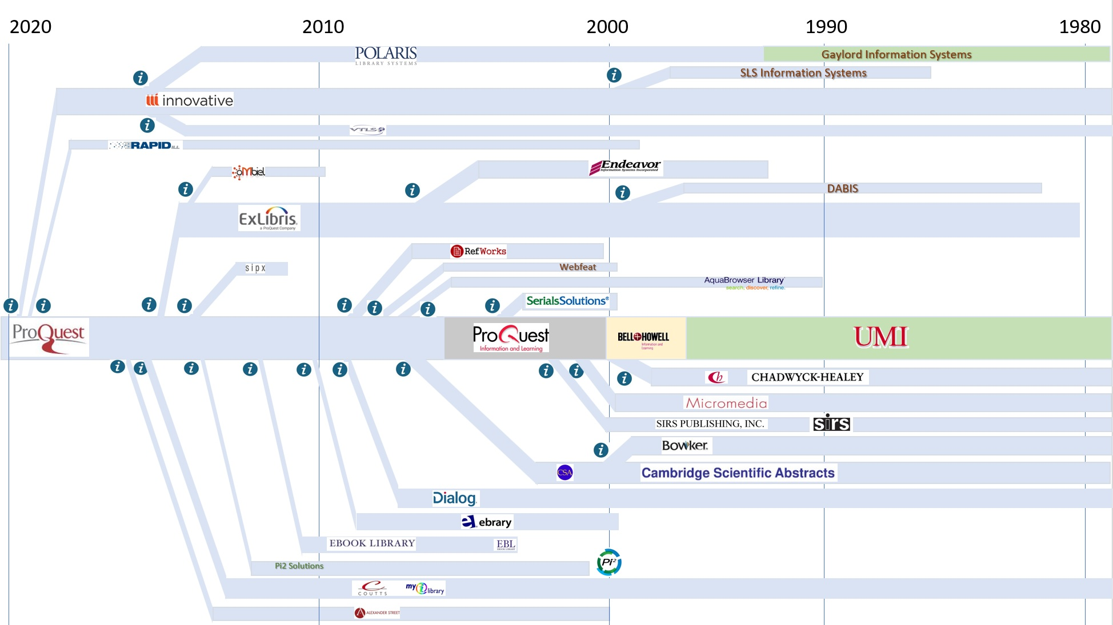

Slide 30
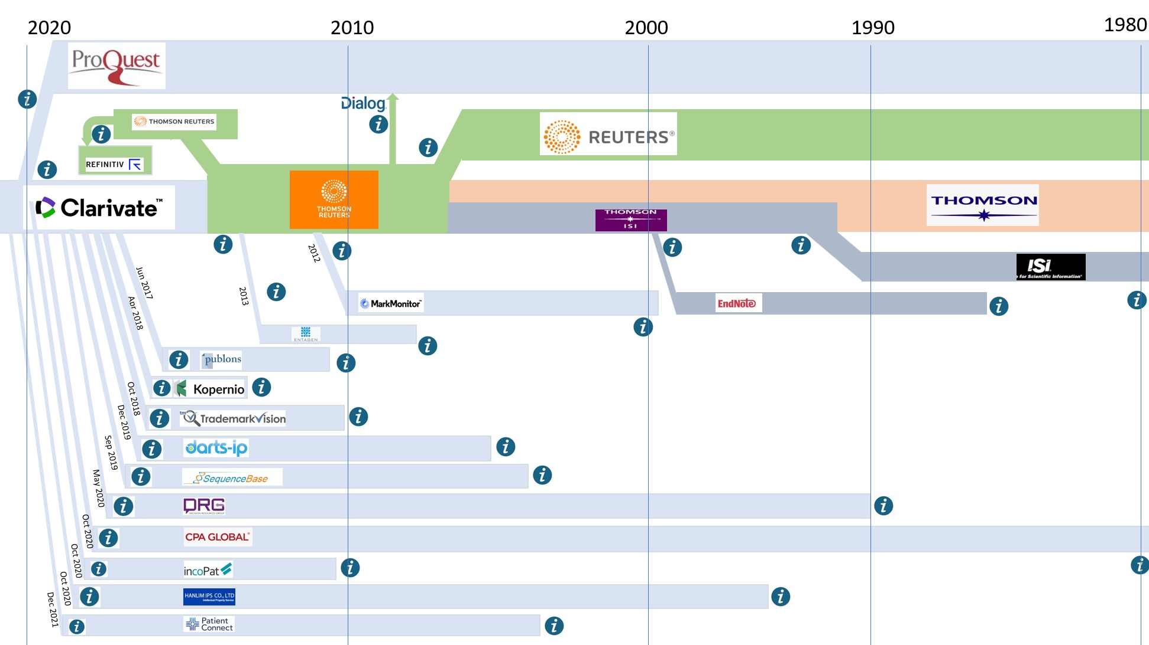

Slide 31
Impact of Consolidation on Libraries
Few, and Increasingly Fewer Vendors
Lack of Choice
If you only have one vendor for a product, it isn’t really a choice
Hinders Innovation and Growth for Libraries
Increased cost for metadata, systems, technology, draws resources away from funding for collections
Example: 4.25% annual cost increase for metadata
Library budgets flat or declining
Sustainability is an issue for collections, services, systems
For comparison . . . OCLC Cataloging/Metadata and the Scholarly Research Cycle . . .

Slide 32
https://creativecommons.org/about/program-areas/open-access/

Slide 33
Scholarly Research Cycle and Funding Model
The existing system for producing and distributing publicly funded research articles is expensive and doesn’t take advantage of the possibilities of innovations like open licensing.
Without a free-flowing system, access to the results of scientific research is limited to institutions that are able to commit to hefty journal subscriptions — paid for year after year — which don’t allow for broad redistribution, or repurposing for activities such as text and data mining without additional permissions from the rightsholder.
This closed system limits the impact on the scientific and scholarly community and progress is slowed significantly.
https://creativecommons.org/about/program-areas/open-access/

Slide 34
547,409,991 Redux Redux
Where does all that metadata come from anyway?
From all of us!
How is it funded?
Librarians at Libraries Create Metadata, Presumably for Sharing and Reuse by Other Librarians at Other Libraries
Libraries pay librarians to create bibliographic metadata
Libraries pay for access to WorldCat as a platform to create and store bibliographic metadata
Libraries pay OCLC to enhance bibliographic records
Libraries pay to retrieve bibliographic metadata from WorldCat
Libraries pay for their holdings, attached to bibliographic metadata, to display in WorldCat

Slide 35
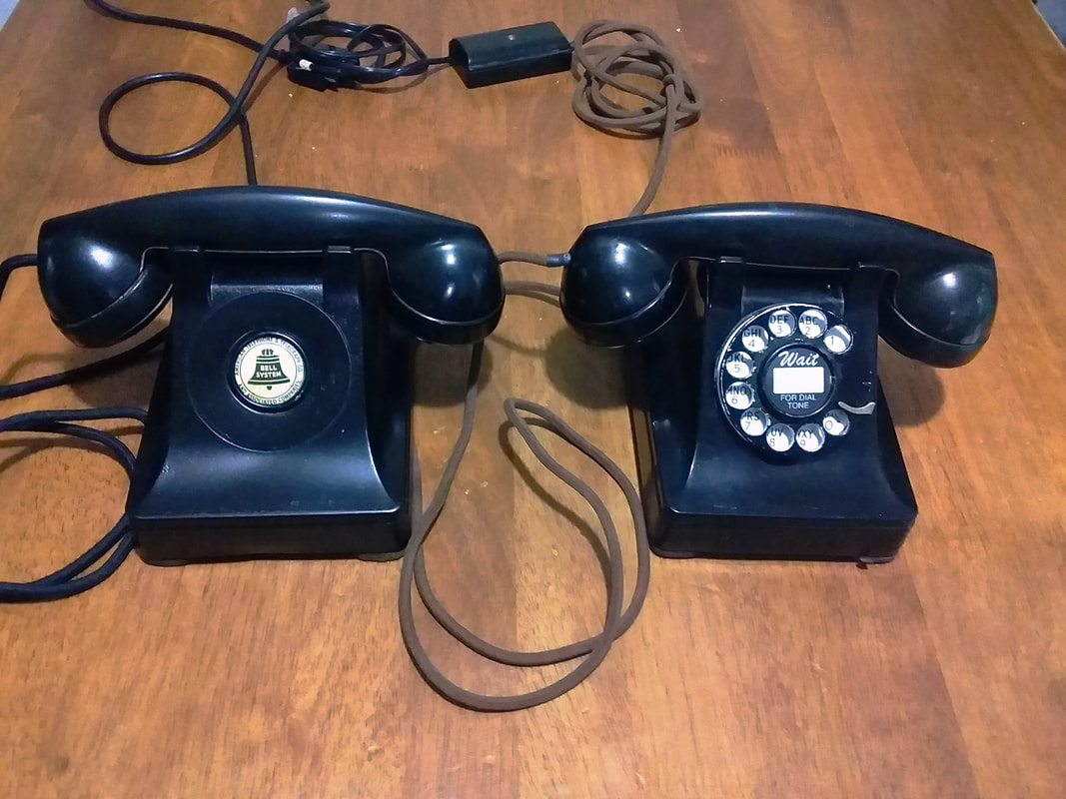
So, who owns the metadata and how can we use it?
Individual metadata records are not copyrightable
Facts are not copyrightable.
Metadata records are collections of facts about things.
Large collections of metadata, taken as a whole, MAY be copyrightable, but only under certain circumstances
Feist Publications, Inc. v. Rural Telephone Service Co., 499 U. S. 340 (1991)

Slide 36
Feist Publications, Inc. v. Rural Telephone Service Co., 499 U. S. 340 (1991)
“(a) Article I, § 8, cl. 8, of the Constitution mandates originality as a prerequisite for copyright protection. The constitutional requirement necessitates independent creation plus a modicum of creativity. Since facts do not owe their origin to an act of authorship, they are not original and, thus, are not copyrightable. Although a compilation of facts may possess the requisite originality because the author typically chooses which facts to include, in what order to place them, and how to arrange the data so that readers may use them effectively, copyright protection extends only to those components of the work that are original to the author, not to the facts themselves. This fact/expression dichotomy severely limits the scope of protection in fact-based works.”
O'CONNOR J., delivered the opinion of the Court, in which REHNQUIST, C.J., and WHITE, MARSHALL, STEVENS, SCALIA, KENNEDY, and SOUTER, JJ., joined. BLACKMUN, J., concurred in the judgment.

Slide 37
OK, so, who owns the metadata and how can we use it???
WorldCat Rights and Responsibilities for the OCLC Cooperative
https://www.oclc.org/en/worldcat/cooperative-quality/policy.html
2. C. WorldCat, a Shared Resource
The WorldCat database is more than a collection of OCLC member-contributed records. Its value is in the cooperation and outcomes it supports, not in the ownership of the records themselves. While, on behalf of its members, OCLC claims copyright rights in WorldCat as a compilation, it does not claim copyright ownership of individual records. With millions of bibliographic descriptions and more than a billion holdings from OCLC members around the world, the WorldCat database is a central point of concentration for the largest library network in the world. WorldCat gives libraries a Web-scale presence. The more libraries participate, the better and more useful WorldCat becomes to libraries, their end users, and other organizations that want to interact with libraries on the Web.

Slide 38
OK, so, who owns the metadata and how can we use it???
WorldCat Rights and Responsibilities for the OCLC Cooperative
https://www.oclc.org/en/worldcat/cooperative-quality/policy.html
3. A. OCLC Member Rights: OCLC members who have extracted WorldCat data representing, or enriching the records for, their own holdings from the WorldCat database have the right to:
Transfer or make available such data to individual scholars for their personal academic or scientific research or study, to library consortia or public agencies working on behalf of libraries, or to other libraries and educational, cultural or scholarly institutions (e.g., museums, archives, historical societies, research institutes), whether these institutions are members or non-members of OCLC, for these organizations' institutional or collaborative re-use.

Slide 39
OK, so, who owns the metadata and how can we use it???
WorldCat Rights and Responsibilities for the OCLC Cooperative
https://www.oclc.org/en/worldcat/cooperative-quality/policy.html
3. A. OCLC Member Rights: OCLC members who have extracted WorldCat data representing, or enriching the records for, their own holdings from the WorldCat database have the right to:
In these cases, the transfer or making available of WorldCat data and its subsequent uses (including copying, displaying, publishing, modifying, reformatting, and/or creating works or services from) should be carried out in keeping with OCLC member community norms, OCLC's public purpose, and this policy's intent.
Transfer or make available WorldCat data representing their own holdings to agents they retain to perform services on their behalf that directly benefit the OCLC member (e.g., peer or consortial resource sharing, automated authority control, increased visibility of collections).

Slide 40
OK, so, who owns the metadata and how can we use it???
WorldCat Rights and Responsibilities for the OCLC Cooperative
https://www.oclc.org/en/worldcat/cooperative-quality/policy.html
3. B. Responsibilities:
Abide by this policy, and ensure awareness of it both within their institutions and on the part of their agents, their cooperatives, and other organizations to which they make their data available.
Contribute and maintain bibliographic and holdings data consistent with the standards and guidelines adopted by the OCLC cooperative.
Make reasonable efforts to ensure that their contributions to WorldCat do not violate the rights of any third party.
Make reasonable efforts to attribute the OCLC cooperative as a contributor in works or services based substantially on WorldCat data.
Make reasonable efforts to ensure that the subsequent re-use and transfer of their WorldCat data by non-members is consistent with this policy and OCLC's public purposes and supports the long-term viability and utility of WorldCat.
Encourage and practice responsible use of OCLC systems and services, including:
not permitting unauthorized use of their OCLC logons or passwords;
not engaging in mass downloading from WorldCat without OCLC's prior written consent;
not engaging in mass distribution of data directly from WorldCat to non-members without OCLC's prior consent;
not engaging in other activities that diminish the value of WorldCat to the OCLC cooperative

Slide 41
OK, so, who owns the metadata and how can we use it???
WorldCat Rights and Responsibilities for the OCLC Cooperative
https://www.oclc.org/en/worldcat/cooperative-quality/policy.html
5. Addressing Disputed Use of WorldCat Data by Members
OCLC member use of data extracted from the WorldCat database is carried out in a diverse and rapidly-changing environment. It is, therefore, impossible to anticipate all of the conceivable uses to which members might want or need to put WorldCat data. OCLC members are encouraged to discuss with OCLC any uses that do not appear to be covered by this policy. If a particular use is determined to not be covered, OCLC and the member will seek a mutually agreeable resolution of the matter. If either party believes that timely resolution cannot be reached, then the matter will follow resolution and/or arbitration procedures to be determined by the Global Council and the Board of Trustees.

Slide 42
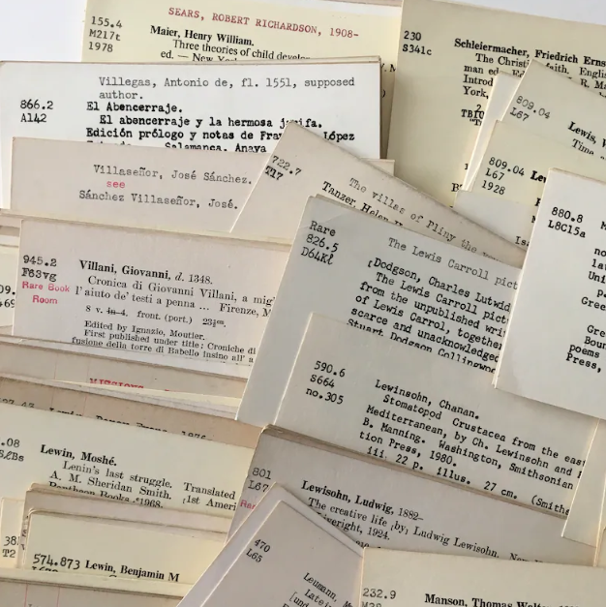
Metadata as a Commodity
A Response

Slide 43
ICOLC Statement on the Metadata Rights of Libraries
https://icolc.net/statements/icolc-statement-metadata-rights-libraries

Slide 44
About ICOLC
The International Coalition of Library Consortia (ICOLC) is an informal, self-organized group currently comprising approximately 200 library consortia in North and South America, Europe, Australia, Asia, and Africa.
ICOLC member consortia serve all types and sizes of libraries.
ICOLC supports participating consortia by facilitating discussion on issues of common interest.
Twice per year, ICOLC conducts meetings to inform consortia about new electronic information resources, pricing practices of electronic information providers and vendors, and other issues.
ICOLC also issues statements regarding topics that affect libraries and library consortia.
ICOLC has been in existence since 1996.

Slide 45
ICOLC Statement in Response to OCLC v. Clarivate
ICOLC Statement created to express the positions of libraries as creators and users of metadata:
“Any corporate interest that asserts a right to limit or determine how libraries may use, re-use, or share the records that they have created does so in direct contradiction to libraries’ articulated needs and against the public interest.”

Slide 46
ICOLC Statement on the Metadata Rights of Libraries
Metadata and the metadata services that describe library collections are critical in supporting content discovery, knowledge creation, and libraries’ public missions. Metadata describing library collections is not typically copyrightable, and should be considered freely shareable and reusable under most circumstances. However, some industry players restrict libraries’ rights to use such metadata through contractual terms and market influence. Such restrictive activity is out of alignment with libraries’ needs and public, not-for-profit/educational missions.

Slide 47
Background
"Metadata" is a term without a static definition in law, but it is generally accepted that "metadata" is factual data about data.
Library bibliographic metadata typically provides a factual description of the content and collections that libraries make available to their users.
Libraries create metadata about their collections with the explicit intent that it be shared, re-used, and modified openly in an unrestricted manner to promote access to information.
Metadata that describes library collections is core to libraries’ non-profit, educational missions in how they function, both day-to-day and strategically. It enables users to discover and access library materials, supports collaboration among libraries, aids in stewardship of informed library purchasing decisions

Slide 48
Areas of Concern
Given how important it is for libraries to use, re-use, and share such metadata freely, current industry trends are troubling.
Limited choice in affordable metadata service options, along with restrictions imposed on metadata use, re-use, and sharing across collaborations, platforms, system types, and providers, are impeding libraries’ rights and ability to innovate and collaborate to serve their users effectively.
Market-limiting pressure that allows for and enforces any monopolistic practices, whether through commercial contracts or policy, is antithetical to libraries’ purpose and marginalizes underfunded libraries.

Slide 49
Support for ICOLC Statement
“ICOLC member consortia and other entities, organizations or individuals endorsing this statement wish to signal their opposition to any ventures that aim to impose limits on libraries’ ability to effectively use, re-use, adapt, aggregate, and share the bibliographic metadata they create or enhance.”
ICOLC welcomes libraries and other organizations who wish to signal their support of this statement
https://icolc.net/statements/icolc-statement-metadata-rights-libraries

Slide 50
What Can Libraries Do NOW?
Negotiate COLLECTIVELY and aggressively; be willing to walk away
Actively work to regain control of our own collective destiny
Where possible and practical, support open source library software and systems
Consider “The 2.5% Commitment” (David Lewis, 2017, in response to Elsevier’s acquisition of bepress)
https://digitalcommons.unl.edu/cgi/viewcontent.cgi?article=1084&context=scholcom
“Every academic library should commit to contribute 2.5% of its total budget to support the common infrastructure needed to create the open scholarly commons.”
Apply the concept (if not the percentage) to library software and systems acquisitions, whenever possible or practical

Slide 51
An External Consultant Suggests . . .

Slide 52
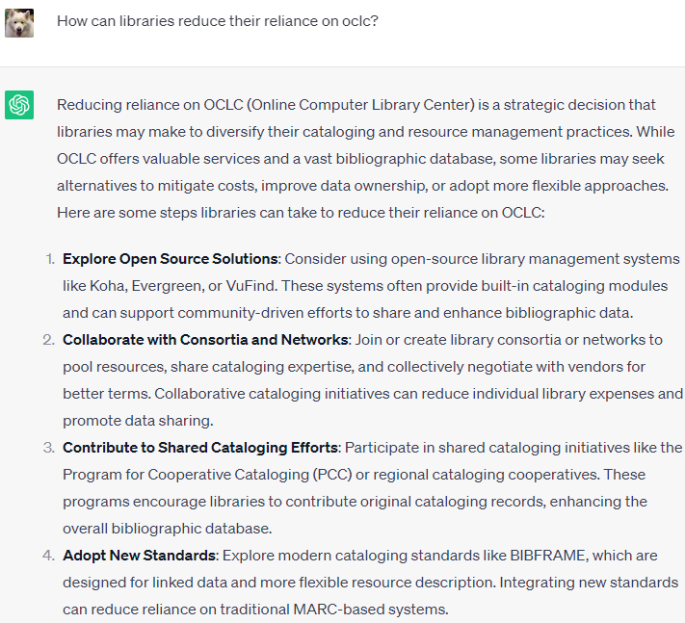
24 July 2023

Slide 53
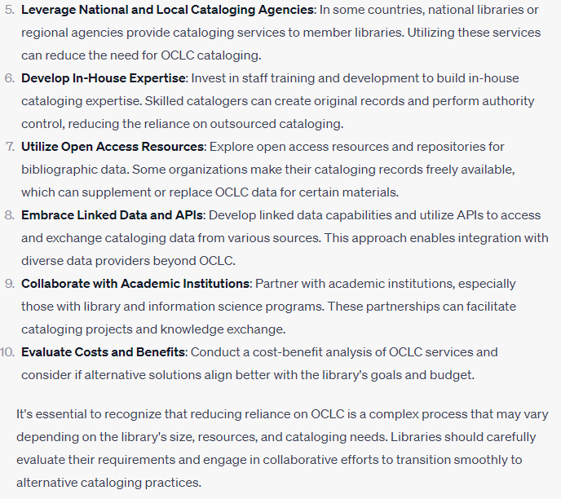
24 July 2023

Slide 54
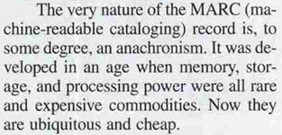
What Else Can Libraries Do?

Slide 55
Possible Futures – Change Isn’t Easy!
50 Years of MARC . . . 547,409,991 records
Incredibly Complex Systems Built on MARC and Intertwined Across Tens of Thousands of Libraries
Only a fraction of information searches are initiated in a library catalog
So, we have to start somewhere . . .
“MARC is unquestionably an artifact of an earlier era. However, in replacing it, libraries must understand that it isn’t just the complexity of an old format which must be replaced but rather the reliance on a single data format for everything. We must accept that potential users of the library can easily get their needs met elsewhere and instead of fighting to get a library-specific standard supported by the Googles of the world, we should focus on making it so easy that they don’t have to.”
Moss, Paul. “Replacing MARC: Where to Start.” Information Standards Quarterly 25.4 (2013): 14-16.

Slide 56
More From An External Consultant . . .

Slide 57
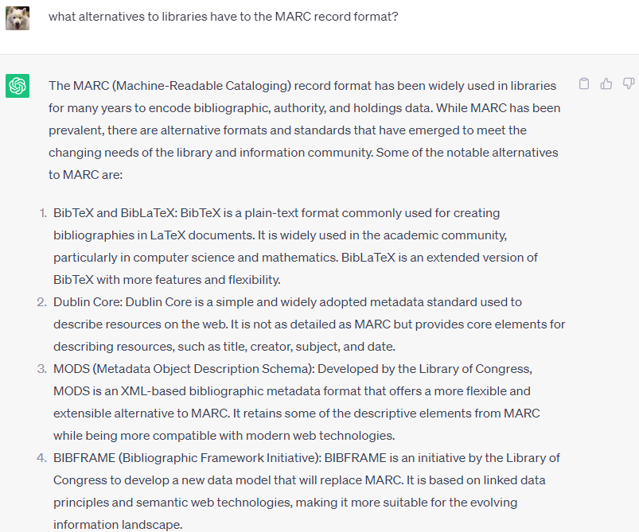
24 July 2023

Slide 58
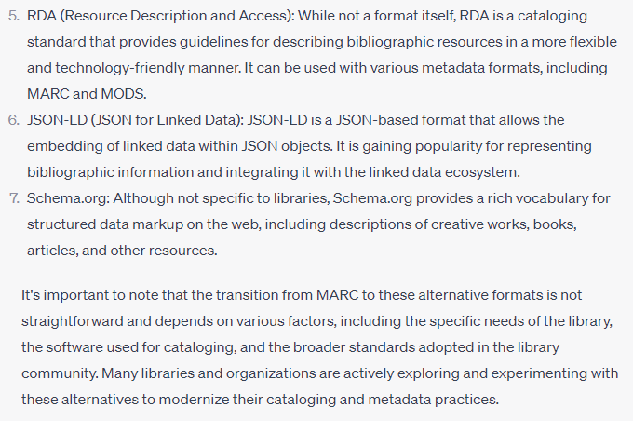
24 July 2023

Slide 59
A Viable Possibility?
BibFrame: “Initiated by the Library of Congress, BIBFRAME provides a foundation for the future of bibliographic description, both on the web, and in the broader networked world that is grounded in Linked Data techniques. A major focus of the initiative is to determine a transition path for the MARC 21 formats while preserving a robust data exchange that has supported resource sharing and cataloging cost savings in recent decades.”
https://www.loc.gov/bibframe/

Slide 60
Until Then . . .
ICOLC Statement on the Metadata Rights of Libraries
“Any corporate interest that asserts a right to limit or determine how libraries may use, re-use, or share the records that they have created does so in direct contradiction to libraries’ articulated needs and against the public interest.”
Voice Your Support at https://icolc.net/statements/icolc-statement-metadata-rights-libraries

Slide 61
Metadata Matters: The Commoditization of Metadata and Possible Futures for Resource Management and Resource Sharing
Thoughts?
Comments?
Solutions?
Questions?

