Slide 2
August 2, 2019
OCLC Update
Cathy King
Executive Director, Delivery Services

Slide 4
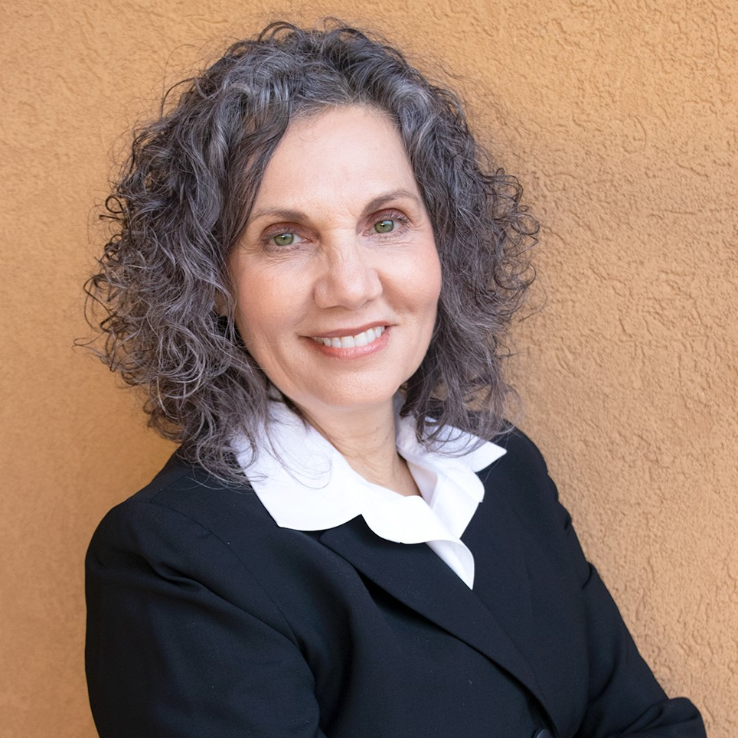
OCLC Research
Community
User Trends
+
+
Lynn Silipigni Connaway,
PhD
Director, Library Trends
and User Research
Discovery-to-Delivery
BTAA Reports

Slide 5


















Slide 6

Seamless User Experience
Flexibility & Customization
Automation
Integration & Standards
Transparency & Collaboration

Slide 7

Jill
Student
English Literature & Marketing
Looking for Of Mice and Men

Slide 8




Waited until the last minute… Again.
One click, and it’s on her Kindle.
Plan ahead: Sees another book in print. Her preference.
Needs coffee. And food. Now.

Slide 9
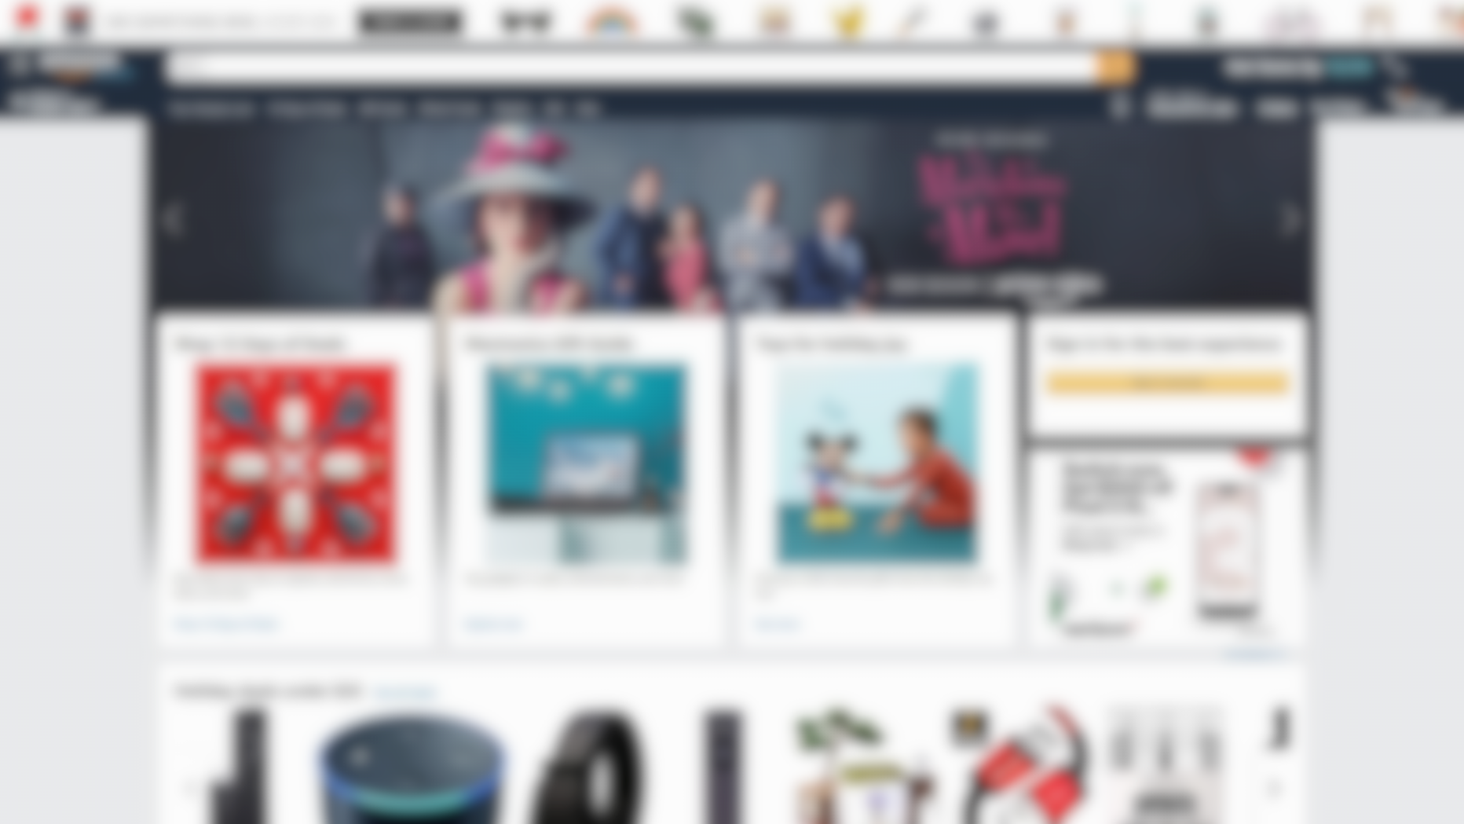



Anything you want on demand

Slide 10
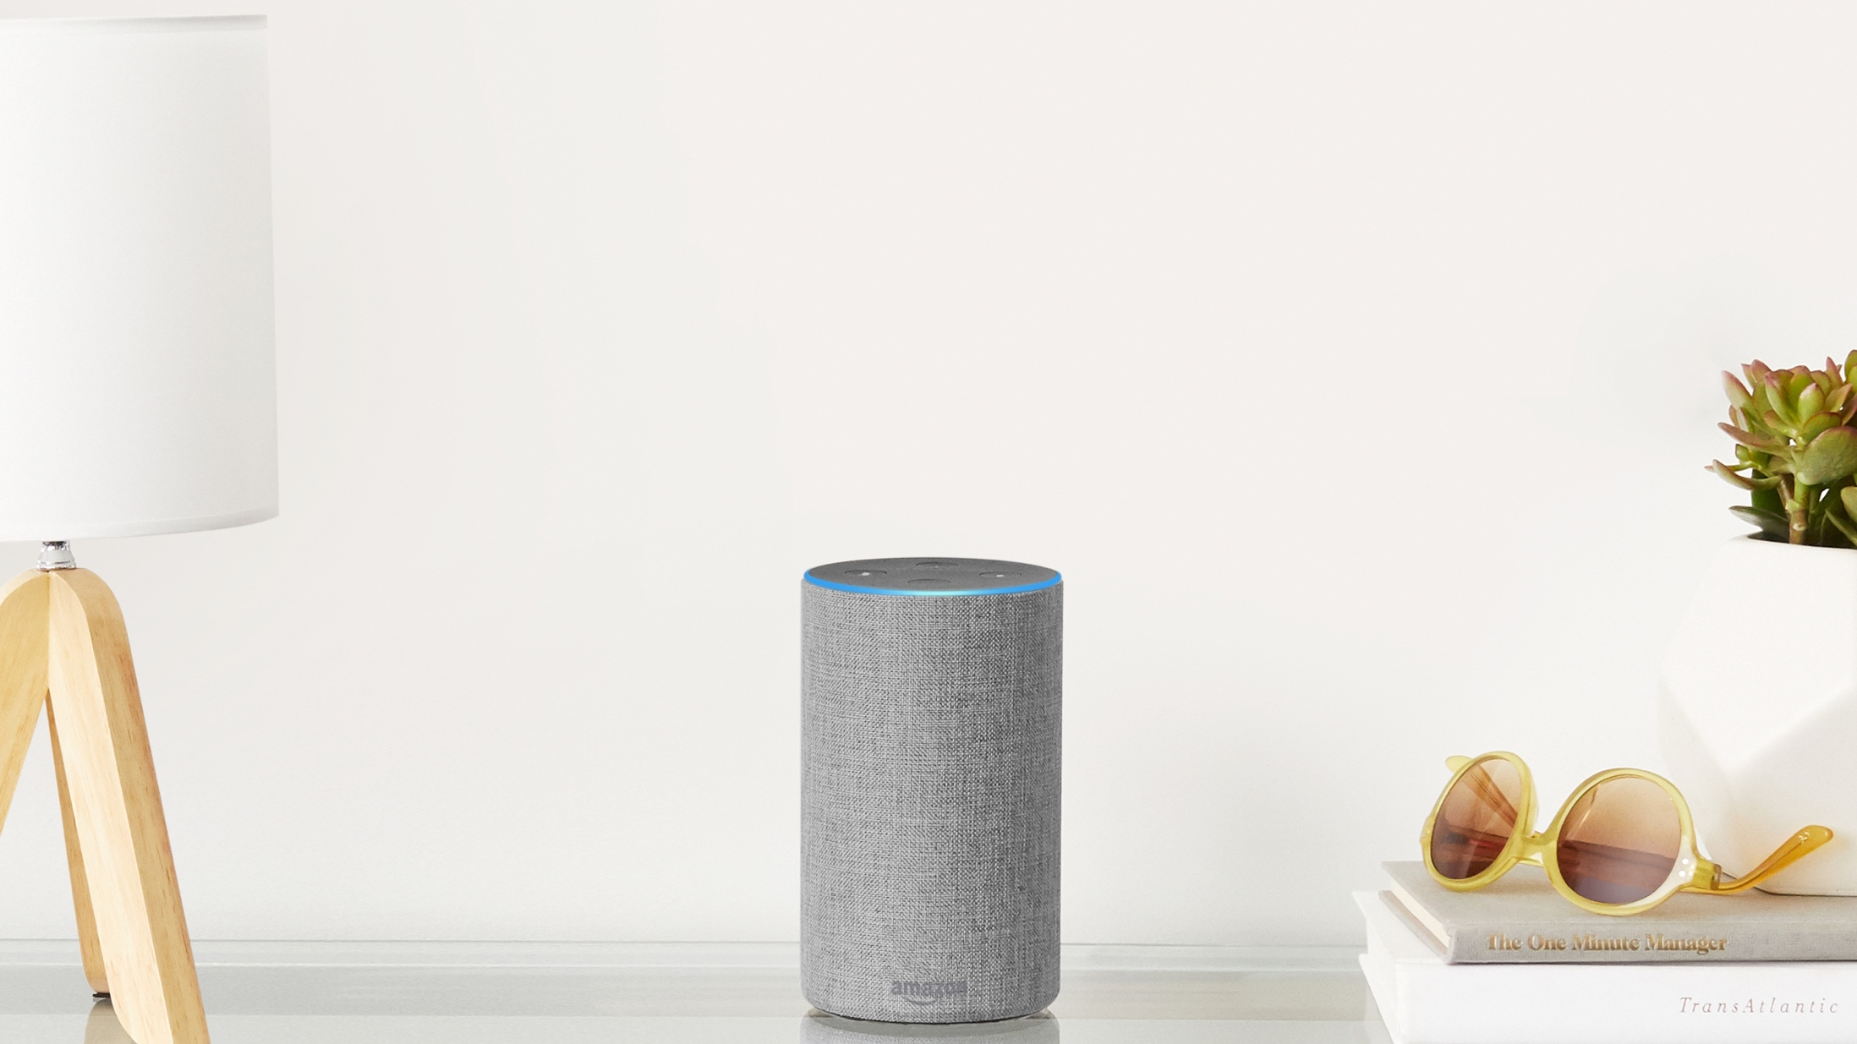

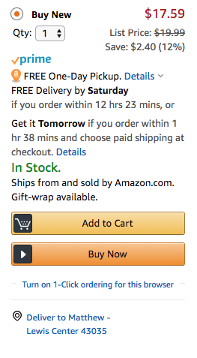
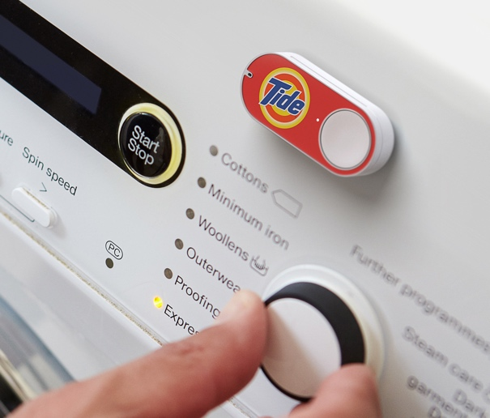
Intuitive Discovery
Through any channel.

Slide 11
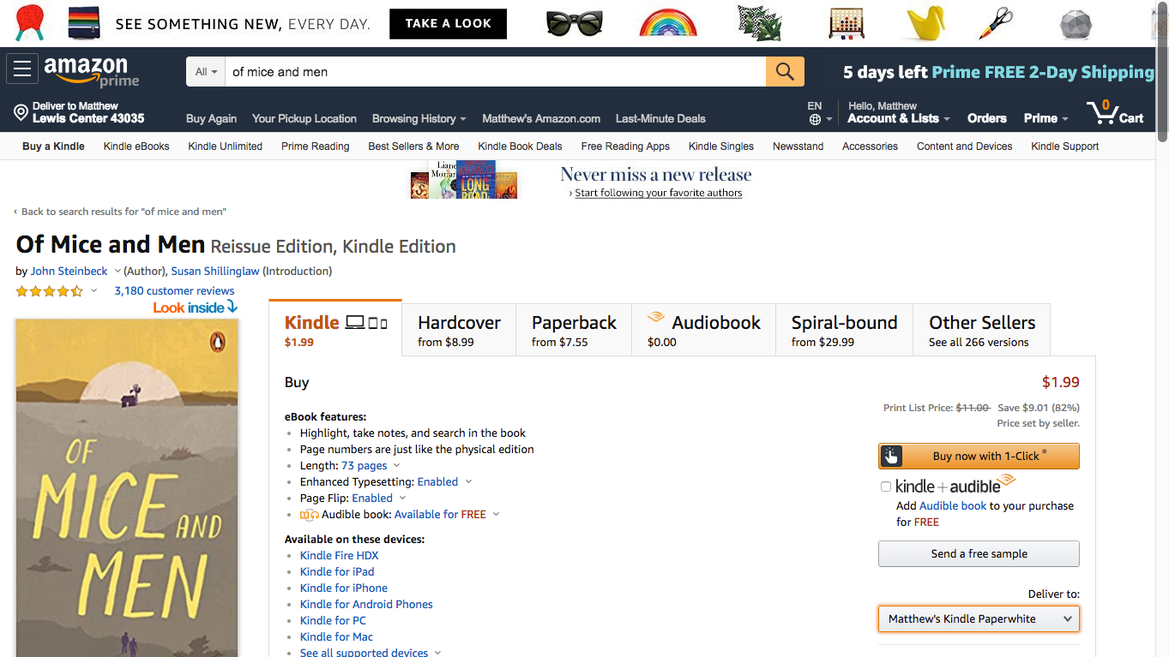
Smart fulfillment
According to my preference. Predictable.

Slide 12

Single account
One-stop shop to track, inventory, recommend and return.

Slide 13



Intuitive discovery
Through any channel.
Smart fulfillment
According to my preference.
Predictable.
Anything you want
on demand
Single account
One-stop shop to track, inventory, recommend and return.

Slide 14
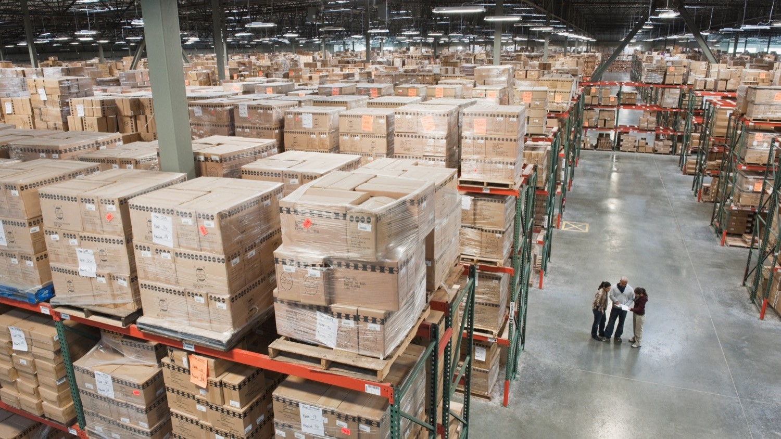

Universal access
to a massive inventory
Anything you want
on demand

Slide 15


Library on-demand

Slide 16



Intuitive discovery
Through any channel.
Smart fulfillment
According to my preference.
Predictable.
Library
on-demand
Single account
One-stop shop to track, inventory, recommend and return.

Slide 17
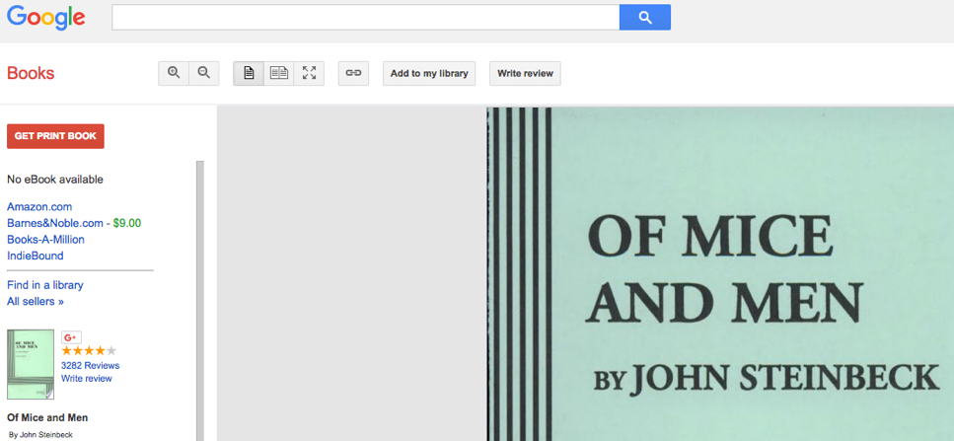
Intuitive Discovery
Through any channel.
Strong partnership network
WorldCat.org
Notes:
Leverage the scale of OCLC to meet the users where they are

Slide 18
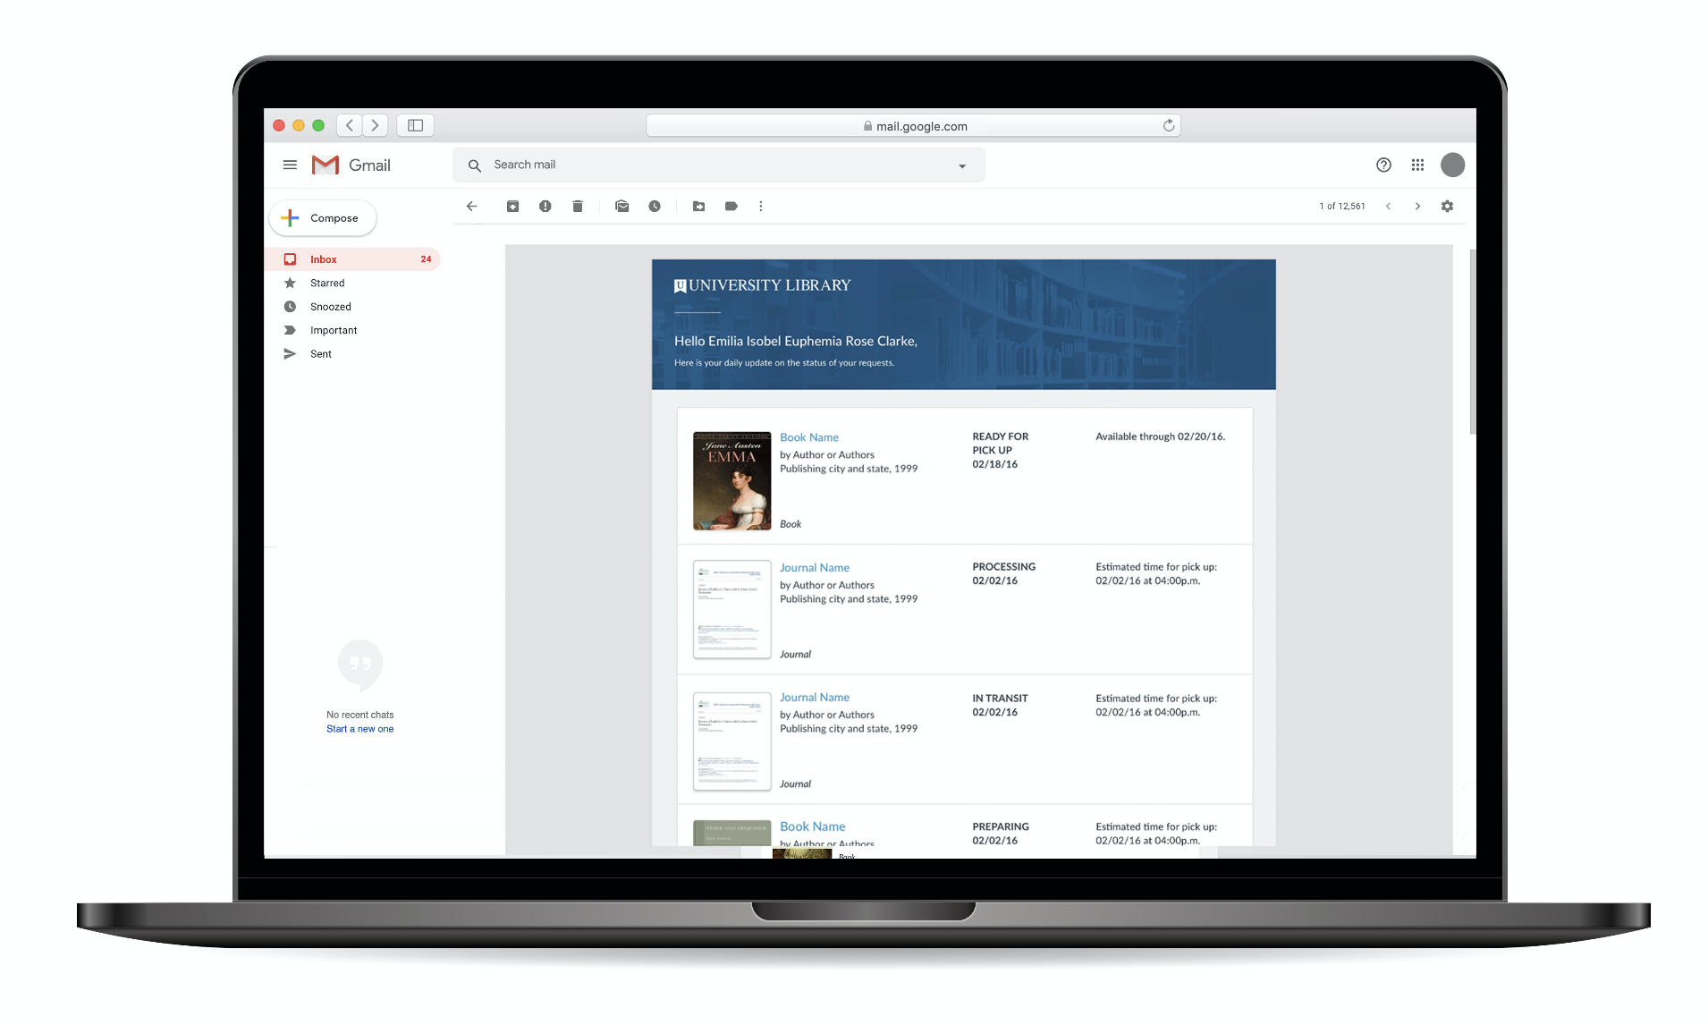
Intuitive Discovery
Through any channel.

Slide 19
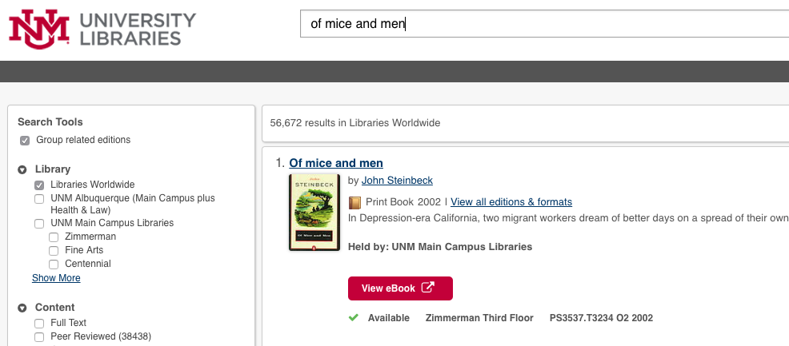


Smart fulfillment
According to my preference. Predictable.
eBook 2002

Slide 20
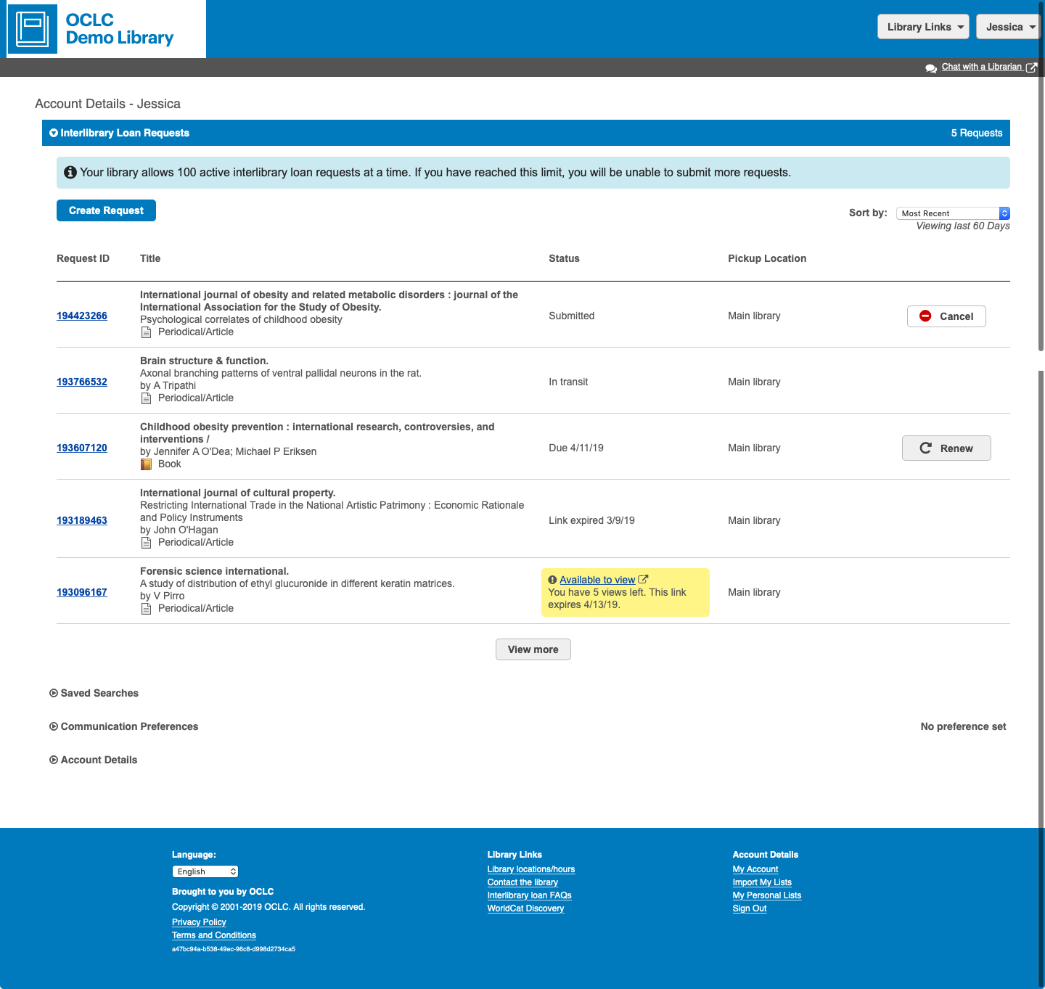
Single account
One-stop shop to track, inventory, and return.

Slide 21
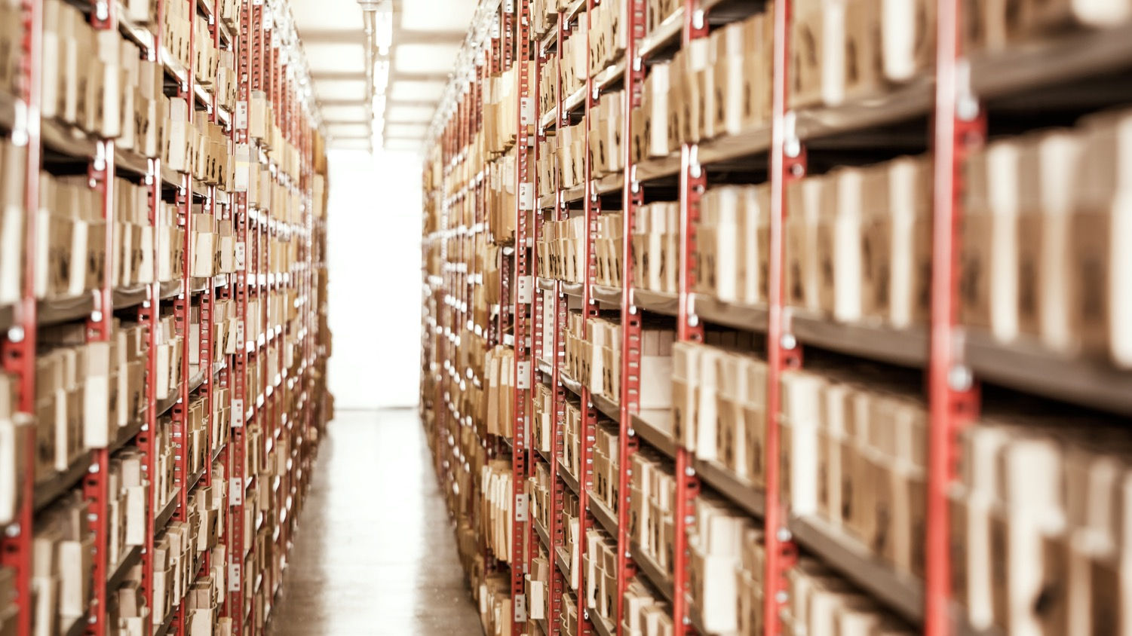
Universal access
to a massive inventory
Library
on-demand

Slide 22

Universal access
to a massive inventory
What’s next?
Library
on-demand
Notes:
With all of those pieces – what’s coming up next? Lots to talk about, but going to share just a few things.

Slide 23
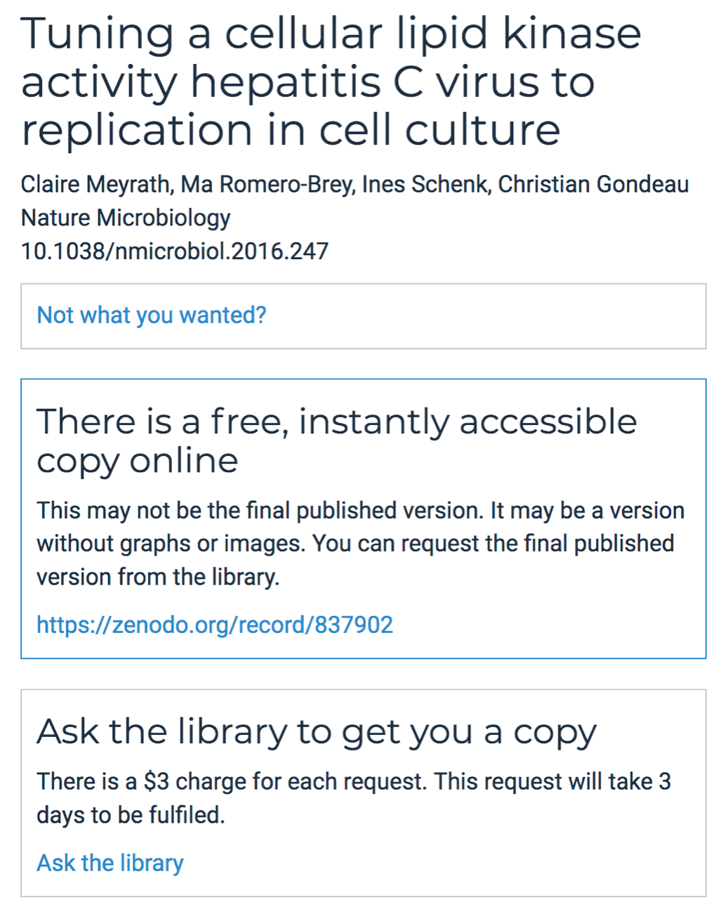
Intuitive Discovery
Through any channel.
Inspired by community-driven solutions
Bring OA to users On Demand
Top community request
Inspired by OA Button’s InstantILL prototype (pictured)
Licensed and open links
Preview of OA Button’s InstantILL

Slide 24
Smart fulfillment
According to my preference. Predictable.
Transparency for the user:
Probability to fill + Prediction
Enabled by:
Greater automation for staff

Slide 25
Smart fulfillment
According to my preference. Predictable.
Probability that your ILL request ends in fulfillment.
Are you sure that you’d like to request an item that
has a 50% probability of being filled?
If yes, great! If not, let’s see what options we can find for you.
Notes:
Are you sure that you’d like to request an item that has a 50% probability of being filled? If yes, great! If not, let’s see what options we can find for you.

Slide 26
Smart fulfillment
According to my preference. Predictable.
Predict Time to Fill Algorithm:
library configured processing time
+ predicted lender processing time
+ predicted shipping time
= Predicted Time to Fill

Slide 27
Smart fulfillment
According to my preference. Predictable.
Direct Request: Automated Workflows
Today
Tomorrow
Auto send requests to preferred lenders
Identify acquisitions requests
Leverage your holdings for doc del
Auto tagging requests (e.g. ‘rush’)
Notifications
Auto send to Reprints Desk or Get it Now

Slide 28
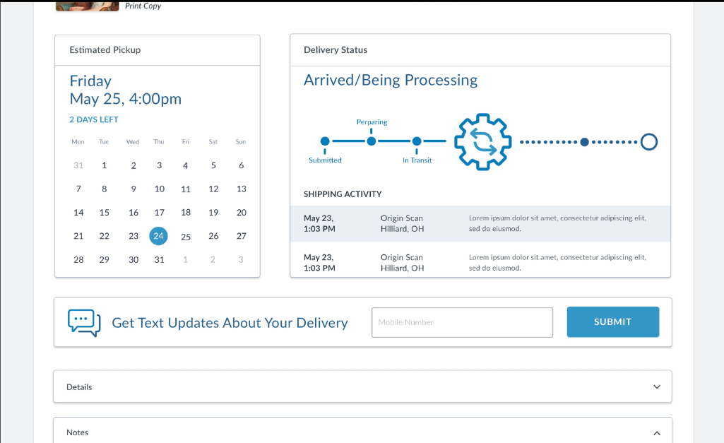
Single account
One-stop shop to track, inventory, recommend and return.

Slide 29
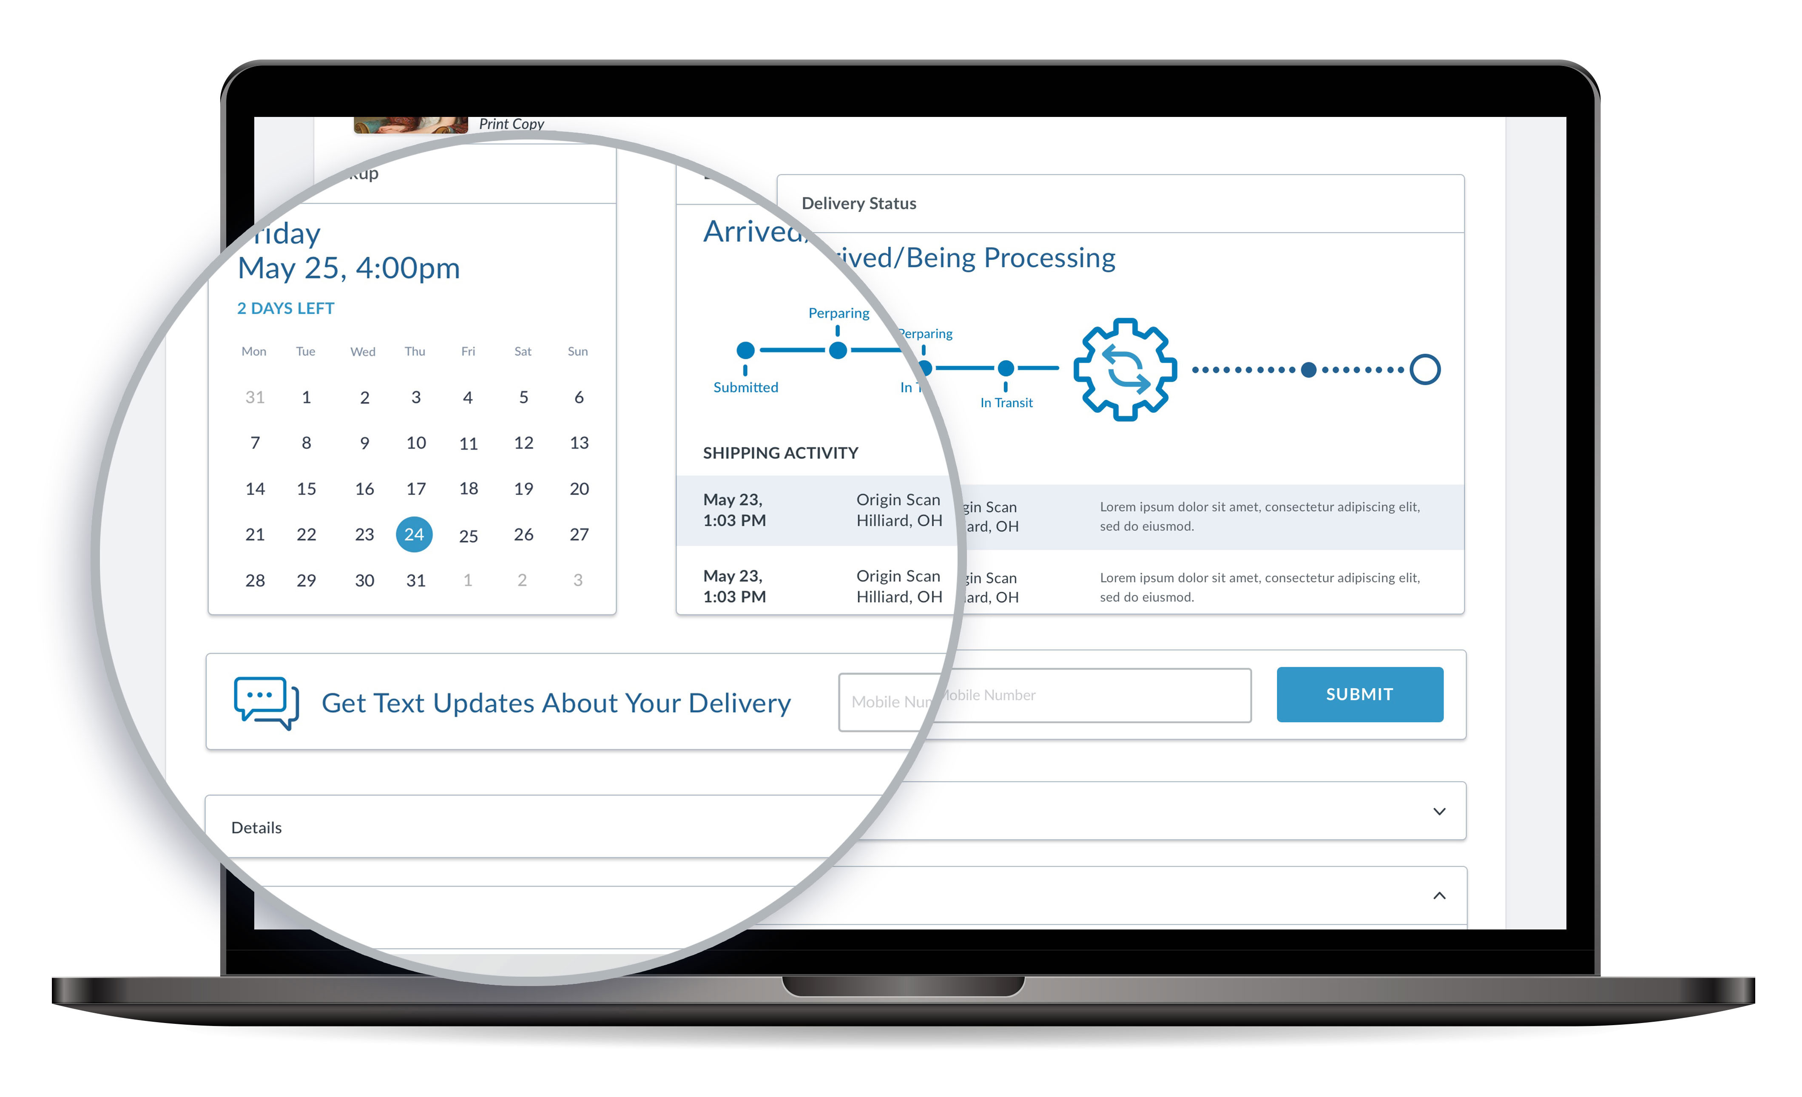
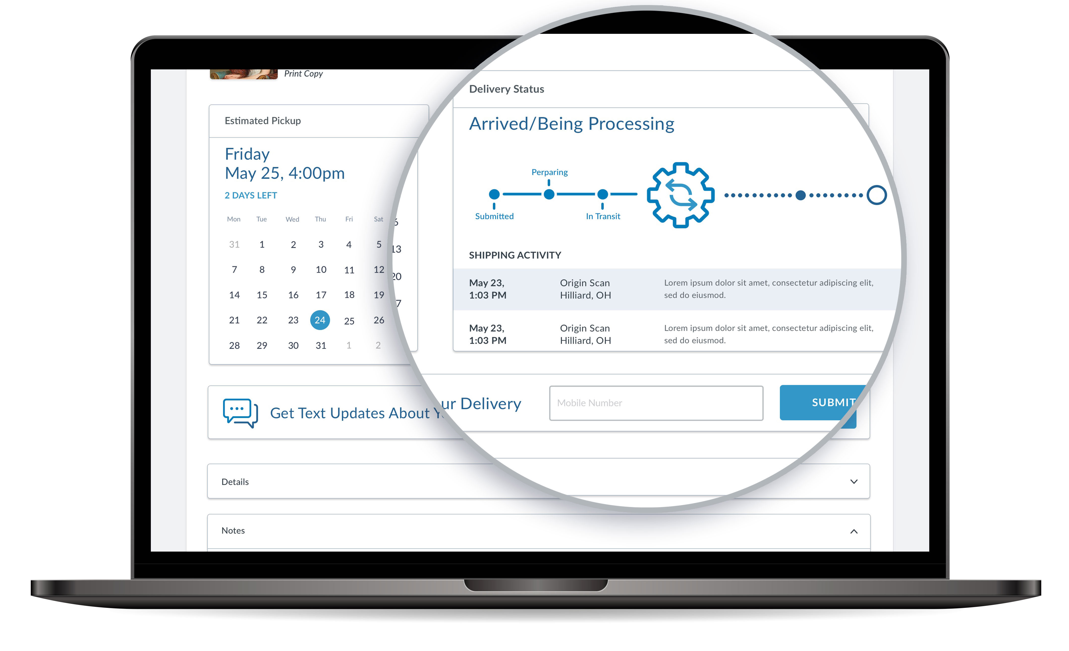
Single account
One-stop shop to track, inventory, recommend and return.

Slide 30
Single account
One-stop shop to track, inventory, recommend and return.

Slide 31

Single account
One-stop shop to track, inventory, recommend and return.
Tipasa APIs

Slide 32
OCLC as your partner going forward
Research
10,000 libraries connected
Analytics
API-First, Standards
Content neutral position

