Slide 1
One Doc to Rule Them all:
Creating and Maintaining ILL Documentation from Scratch
How we developed a sustainable living documentation practice for ILL: Borrowing at SUNY Binghamton
Presented by Resource Sharing Assistant, Barbara Blake

Slide 2
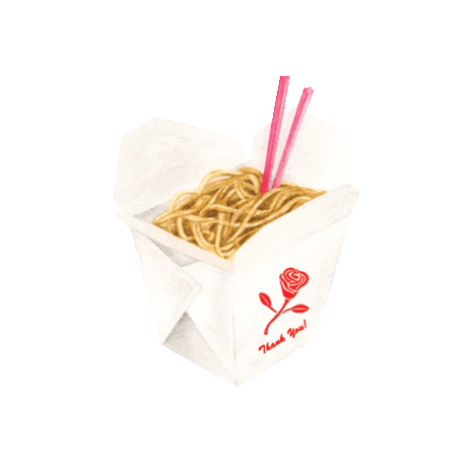
Today’s takeaways…
Setting up a sustainable documentation process is not easy, but worth it
Allows for easier training/succession planning
Can keep track of consistent troubleshooting errors
Teach the workflows, don’t just record steps!
Documentation is a highly collaborative process!
Different staff roles = different perspectives
Too much is better than too little
Sometimes over explaining is a good thing
You can always cut things out
Reinventing the wheel for your organizational needs
Don’t always rely on documentation provided by services
Think: how does my team perceive this info?
Colloquialisms/getting on the same page

Slide 3
Barbara Blake is the Resource Sharing Assistant at Binghamton University Libraries, overseeing management of Borrowing and Document Delivery processes. She is a Binghamton University alumnus, holding a BA in English Literature & General Rhetoric.
Barbara began working in academic libraries in 2017 as a student assistant in Course Reserves at the Binghamton University Libraries while finishing her bachelor’s degree. Upon graduation in 2018, she returned to the Libraries as a full time staff member to oversee the Course Reserves department. She moved into her current position in 2020.
Barbara’s professional interests include increasing accessibility within access services, and advocating for students from non-traditional backgrounds.
Meet Barb Blake and her cat, Frank

Slide 4
Getting started
Choosing a program to write in
Easy collaborative features
Google Docs or Word
We’re partial to Docs!
Consider security concerns
Word is more secure than Docs; consider password sharing
Setting up a format
See how your program utilizes chapter
Setting up a basic format from the beginning makes it easier to navigate
Google Docs and Chapter Layout
Utilizes Headings and Normal text formats; auto-populates a Table of Contents

Slide 5
Where to begin? Setting the foundation…
Always ask:
WHY is this important?
Look at documentation provided by companies/services already, such as Atlas or Exlibris
Service provider documentation often clinical/very straight forward, might not take the time to explain why things work in favor of simply providing steps
Think: how would you describe ILL to someone with no experience?
What is ILL? What can it do? What can’t it do?
Connect to concepts beyond ILL
What systems does ILL use at your facility? Why? What terminology is used in these systems?
Take the time to explain the systems and how they work
Give a tour of the systems.
Explain terminology and give clear definitions
Misunderstanding key terminology can lead to problems down the line!
A lesson from BU: ILLiad Pull Slips, Alma Pick From Shelf

Slide 6
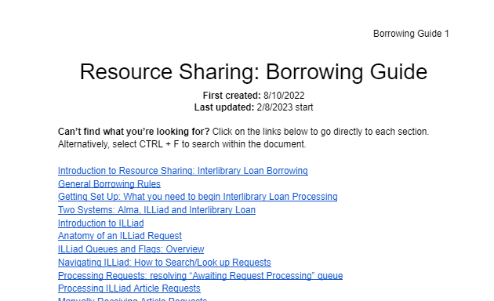
Walk through examples; process requests from start to finish
Walk through a basic request, introducing the process from start to finish
Establish the rules first, then identify the exceptions
With Google Docs/Word, you can embed links to directly take the viewer to a specific section. For example, to show staff how to process damaged materials, you can link the text to jump to the necessary section.
Do not be afraid of repetition with hyperlinks.
Screenshots are key!
Don’t forget visual learners; take frequent screenshots and connect them to the text, using terminology like (Figure 1) to match images to the appropriate directions.
Write down everything.
When you are working in a program day-to-day, you might consider some information to be too simple/basic to record. What might be basic to you might be new information to someone else.

Slide 7
Falling into place…
Once you establish your basic workflow, the rest of the document begins to fall into place
Focus on setting up everyday, basic workflows first; then move onto the exceptions
Sometimes, an exception might be a workflow you’ll describe later down the line
Link, link, link! Use bookmarks, link to pages/sections, etc.
Again; do not be afraid of repetition with hyperlinks!
Linking to information directly is easier for the viewer; imagine someone using this to walk themselves through a workflow
Don’t just write down what the processes are; explain why they work the way they do
You don’t know what information might sound “redundant” or “unnecessary” to a new hire with no experience
Notes:
For 2,A, go to Receiving Damaged Materials in the borrowing doc

Slide 8
Keeping track of the weird stuff: miscellaneous/appendix section
Odd, one-off issues that happen from time-to-time? Document, document, document!
Keep track of odd issues in a troubleshooting section; worry less about names/categorizing, more about referencing/describing the issue in the moment
Once troubleshooting is documented, it can be later moved to a different section of the document if needed

Slide 9
Share it with your team
Think of the different perspectives held by your team; no two people are alike. Consider:
Someone with no/little experience; what do they think? Can someone with no experience learn the work using this document?
Someone with daily experience; what do they think? Are any workflows missing? Is something written confusingly/too technical?
Higher admin; is the document all inclusive?
Writing the first draft is only half of the process; sharing it with all members of your ILL team is imperative to ensure the document is:
Clear/concise
Accurately describing workflows
Is understood by all team members and different types of learners
Can be followed easily
Is not missing any steps

Slide 10
Q: I made my first draft– now what?
A: Keep writing.

Slide 11
Living documentation: a continual process
Once you have started your documentation process and completed your initial draft(s), now the key is sustaining the practice.
Continue open dialog with your team; ask what can be improved
When new updates are decided upon, work on incorporating them into your document as soon as possible, especially if there are significant changes to a workflow
Do not just rely on auto-updates. If your team is working on a complete update of your document, note it clearly to avoid confusion
We keep track of when we are in the process of updating our documentation in full so viewers using the document can easily tell which section(s) are under construction
If using figures to help describe workflows, make sure they are consistent with how your ILL programs currently look

Slide 12
Good documentation practices take time to build.

Slide 13
In sum, to create good documentation…
Teach the workflows, don’t tell them
Include images/screenshots for visual learners
Developing good documentation is a highly collaborative process
Make sure all perspectives are seen!
It’s better to have too much information than too little!
What is redundant to you might not be to someone else!
Too wordy? You can always delete!
Repetition isn’t a bad thing with a technical document
This is technical writing used to understand a process, not prose! Overuse your hyperlinks!

Slide 14
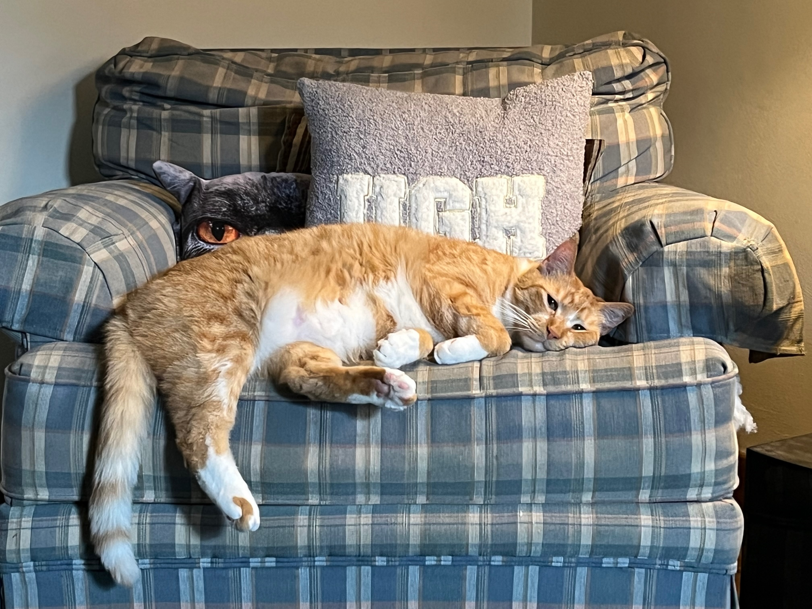
Thank you!
If you would like a copy of our Borrowing Documentation template, please email bblake@binghamton.edu
Now I rest like Frank after giving two presentations.

