Slide 1
IDS CONFERENCE 2023
Timothy Kohn

Slide 2
Optimizing OCLC Custom Holdings at Stony Brook University
IDS CONFERENCE 2023
Timothy Kohn

Slide 3
Stony Brook University Resource Sharing
>25,000 students
Three full-time staff in ILL
2 OCLC Symbols:
YSM and VZB
ILLiad, Alma, Microsoft Office 365, Google Workspace
21,800+ requests in 22-23
OCLC, Alma, and Docline

Slide 4
Why Change?
COVID Lockdowns +
Staff turnover +
Different systems =
New Perspective

Slide 5
The Situation
Outdated information
Loose ends
Where could we improve without rocking the boat?

Slide 6
How Did We Optimize Our Custom Holdings?
Master Sheet for all symbols
Divided into Loans and Articles
Broken down by billing group
IDS, Reciprocal, SHARES, Regular, International
For duplicates, keep in the priority group for efficient sorting
For loans, also sort by geographical location
Create custom holdings groups for each tier

Slide 11
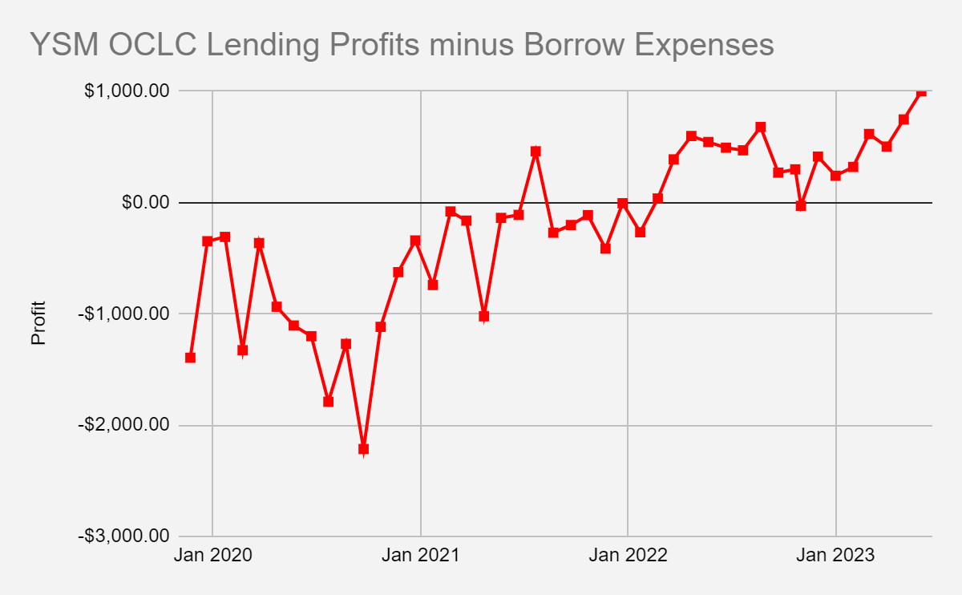
Results
The Good
Finances
More items borrowed free
Turnaround time

Slide 12
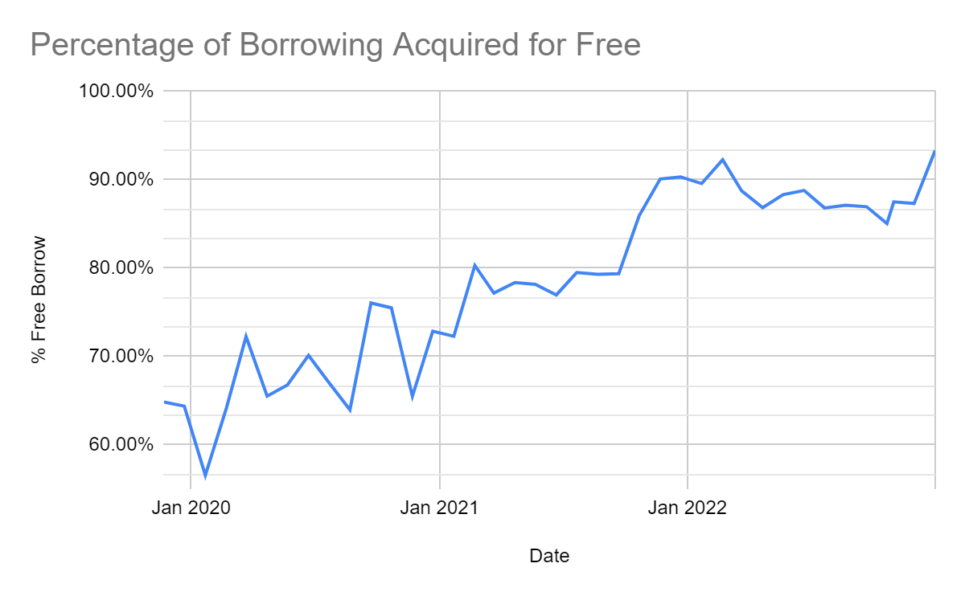
Results
The Good
Finances
More items borrowed free
Turnaround time

Slide 13
Results
The Not-As-Good
Data reflects former practices, not current
Are some schools misrepresented by too much or too little data?
Could be better organized

Slide 14
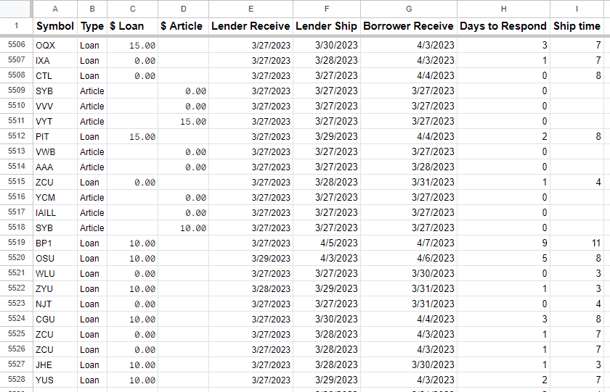
Improving on the New Custom Holdings
Now that things are organized, who performed the best?
Analyze recent data since first change
Practical data calculations to generate another list
New tier implemented, BOOST

Slide 16
Results II
Unexpected new potential relationships
Rowan University gets us books in 2 days for free without any affiliation!
University of New Mexico consistently provides articles very quickly
Further improving turnaround times
Helps us communicate evidence-based predictions and expectations to patrons

Slide 17
Future Directions
Easy data analysis = More data analysis
Meaningful data for reporting
Quick response to change
Potential to inform new relationships
Easier navigation for new borrowing employees / assistants
Continued improvement over time

Slide 18
Questions?

Slide 19
Thank you
IDS CONFERENCE 2023
Timothy Kohn

