Slide 1
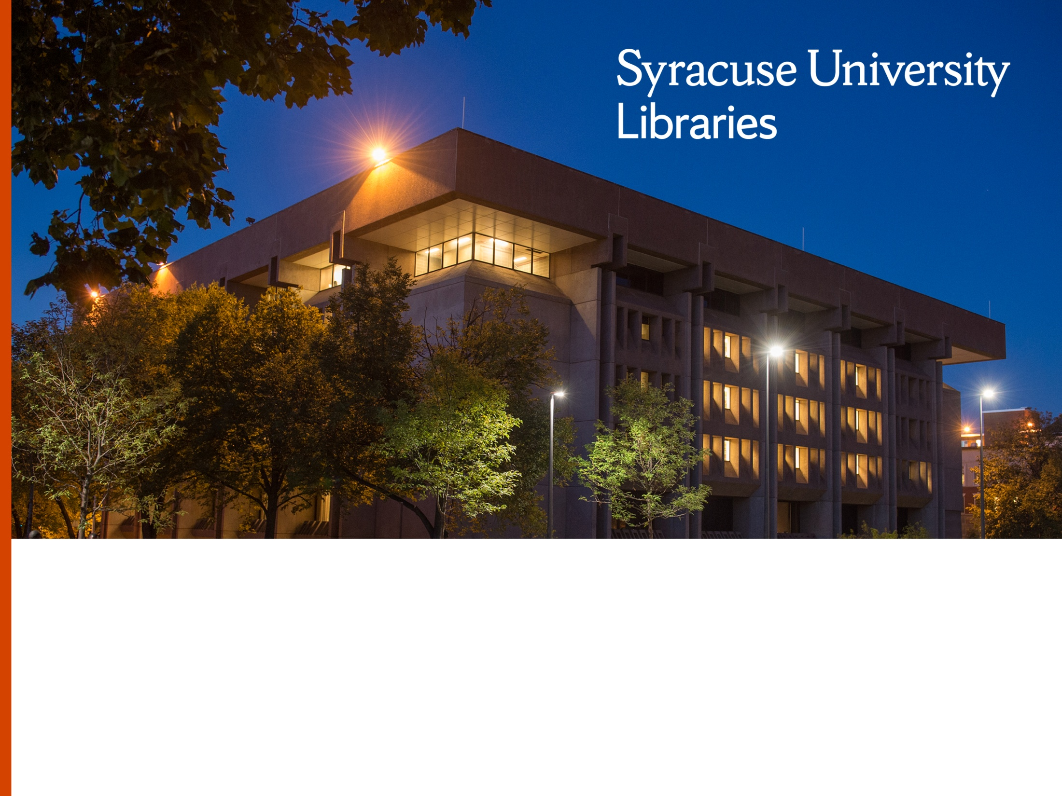

Reformatting Library Services
Providing services for patrons with disabilities
Ronald Figueroa, Resource Sharing Manager
Stephanie Helsher, Interlibrary Loan Supervisor

Slide 2
Syracuse University
1800 Faculty
200 Majors
Founded in 1870
15,000 Undergrads
5,500 Graduate
Private Research University

Slide 3
What’s Driving this Change?

Slide 4
What’s driving the Change?
The library is part of a larger campus effort to get Syracuse University beyond compliance.
Chancellor, Provost and University have new commitment to ADA issues, laws and obligations, and inclusion.
Well-known Disability Studies Program and Burton Blatt Institute.
Beginnings of some financial commitment to staffing, including within IT and the Library.
More self-advocacy from those with disabilities.
Larger national disability rights movements.

Slide 5
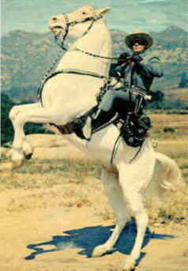

What is a cowboy without a horse?
What is a student without access to information?
What is a pirate without a ship?

Slide 6
Why Alternate Format Services?
Diverse population of over 25,000 students, faculty and staff.
Many different incarnations of print disabilities.
Students: Office of Disability Services (ODS).
Faculty & Staff: Campus ADA/503/504 Coordinator.

Slide 7
Why the Library?
ODS’s alternate format services:
  Students only.
  Personal copies + proof of purchase required only.
So… What about?
  Faculty
  Library books
  Course Reserve
  ILL

Slide 8
What about copyright?

Slide 9
We can…
  ACCESSIBLIITY, THE CHAFEE AMENDMENT, AND FAIR USE
  The Fifth Principle in the Code of Best Practices in Fair Use for Academic and Research libraries is entitled Reproducing material for use by disabled students, faculty, staff, and other appropriate users. It describes in some detail the circumstances in which making and providing copies of collection materials in formats that are accessible to persons with disabilities constitutes fair use, as well as certain limitations to which that general principle is subject.
  http://www.arl.org/focus-areas/copyright-ip/fair-use/code-of-best-practices/2445-briefing-accessibility-the-chafee-amendment-and-fair-use#.Wgz_xUqnG00

Slide 10
We can…
17 U.S. Code § 121 - Limitations on exclusive rights: Reproduction for blind or other people with disabilities
(a) Notwithstanding the provisions of section 106, it is not an infringement of copyright for an authorized entity to reproduce or to distribute copies or phonorecords of a previously published, nondramatic literary work if such copies or phonorecords are reproduced or distributed in specialized formats exclusively for use by blind or other persons with disabilities.
(b)
  (1) Copies or phonorecords to which this section applies shall—
    (A) not be reproduced or distributed in a format other than a specialized format exclusively for use by blind or other persons with disabilities;
    (B) bear a notice that any further reproduction or distribution in a format other than a specialized format is an infringement; and
    (C) include a copyright notice identifying the copyright owner and the date of the original publication.
    https://www.law.cornell.edu/uscode/text/17/121

Slide 11
Web Page

Slide 12
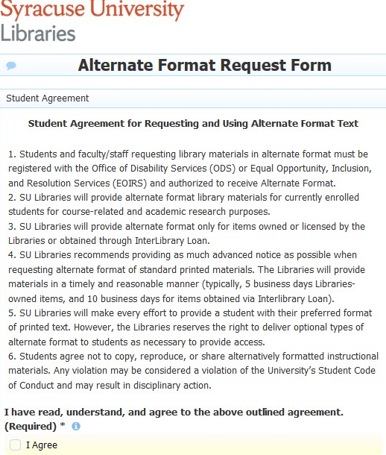
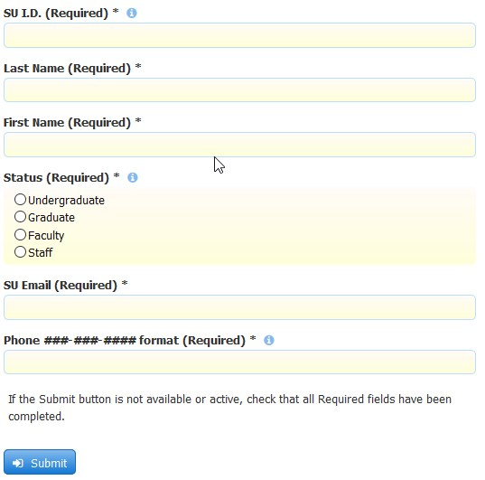
Webpages

Slide 13
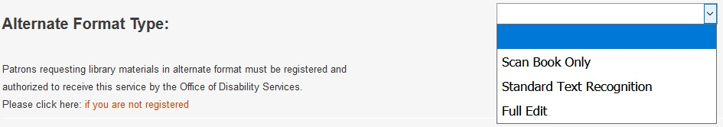
Webpages
ILLiad:
  New section added to all “New Request” pages in ILLiad.

Slide 14
The Request Process

Slide 15
Request Process
Need is determined by:
  Students: Office of Disability Services (ODS).
  Faculty & Staff: Campus ADA/503/504 Coordinator.
Requests submitted through ILLiad.
Books, articles and book chapters.

Slide 16
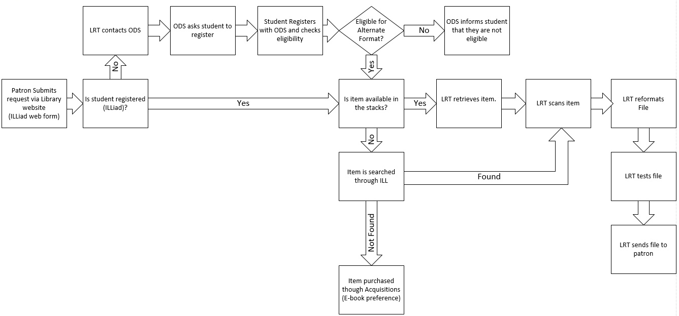
Request Flowchart

Slide 17


Can you please make this accessible?

Slide 18

Patron view
The patron may or may not be a seasoned self-advocate
Can’t expect the patron to be an expert, or know the realm of possibilities beyond what they are used to

Slide 19
Different facets to consider
File Format
Screen Readers
In house processes
Operating System
Vendor outsourcing
Notes:
The different heads of this hydra that need to align for this service are

Slide 20
Operating Systems
Establishing the general environment
  Apple
  Windows
  Android or Linux?
Any additional information is helpful
  Desktop, laptop, tablet or phone
Notes:
Gathering information about the hardware and software that your patron is using is paramount. While system and file formats seem to be increasingly heading towards interfunctionality there are some roadbloacks. Being able to test functionality, in the environment that the patron is using, before delivering the product is our service goal, but there are so many possibilities that it makes this goal difficult. Gathering this information is important to build your own knowledge base of what works

Slide 21
Screen Readers/Text to Speech
Most patrons with print disabilities are accessing the text with text-to-speech functions (there are exceptions)
There are many different products with evolving capabilities
  Native Read Out Loud function within Adobe
  Read & Write Gold
  JAWS
  NVDA (free!)
  iOS’s Voice Over
  Android’s TalkBack

Slide 22
Acquiring the Material for Remediation

Slide 23
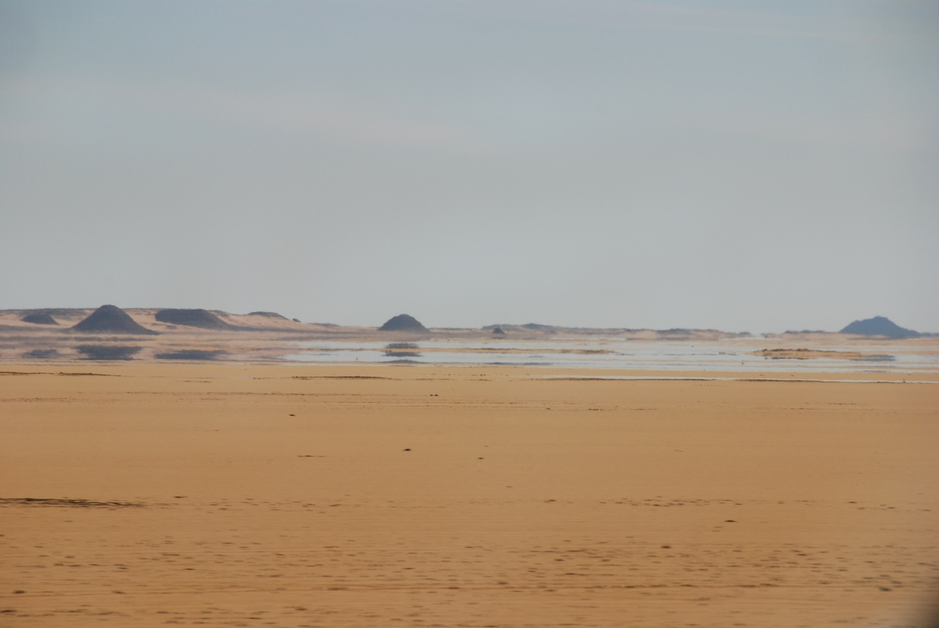
Acquiring the book: eBooks
Deceptively appears to be the fastest, easiest option

Slide 24
Acquiring the book: eBooks
Many titles prior to 2006 are images, not capture-able text
DRM: Adobe Digital Editions
  Read & Write Gold cannot access text in ADE
  IF DRM is present, we only have the file formats presented by the publisher– we cannot convert
  DRM free EPUB cannot be satisfactorily converted to a PDF

Slide 25
Acquiring the book: purchase or ILL
A rush ILL can be faster (yay!) than a purchase, but the condition of an ILL is unknown until it arrives
ILL isn’t necessarily the cheaper option as rush shipping charges can be up to $100
Items with large bindings (over 1.5cm) may need to have their bindings destroyed
If the item is not on our collection, we prefer to purchase; if it is in our collection, but not convertible, we prefer to ILL

Slide 26
Remediation

Slide 27
File format: PDF
In-house processing experiments
  Very little education about remediating scanned documents (compared to born digital) because it is difficult to do well; the technology we currently have access to (Adobe DC Pro) is not up to par with the need
  A good tutorial from SU Libraries here: https://www.youtube.com/watch?v=G2a1g9bNrhk&feature=youtu.be
  Free Webinar series on PDF accessibility from Level Access: https://www.levelaccess.com/resources/pdf-accessibility-basics-webinar-series/

Slide 28
File format: PDF
Scanning issues
Levack, B et al. 2004. The West: Encounters and Transformations. New York, NY: Pearson.
Notes:
Levack, B et al. 2004. The West: Encounters and Transformations. New York, NY: Pearson.

Slide 29
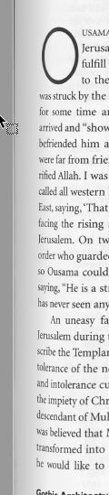
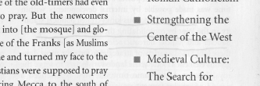
File format: PDF
Underlining, notes, and markings
Curves on books with tight binding
Levack, B et al. 2004. The West: Encounters and Transformations. New York, NY: Pearson.
Notes:
Levack, B et al. 2004. The West: Encounters and Transformations. New York, NY: Pearson.

Slide 30
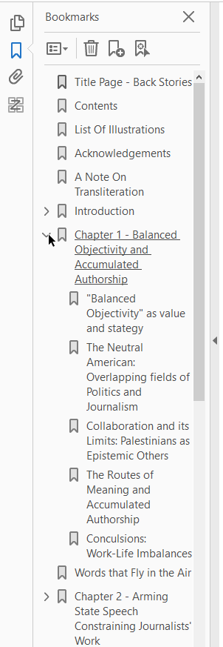
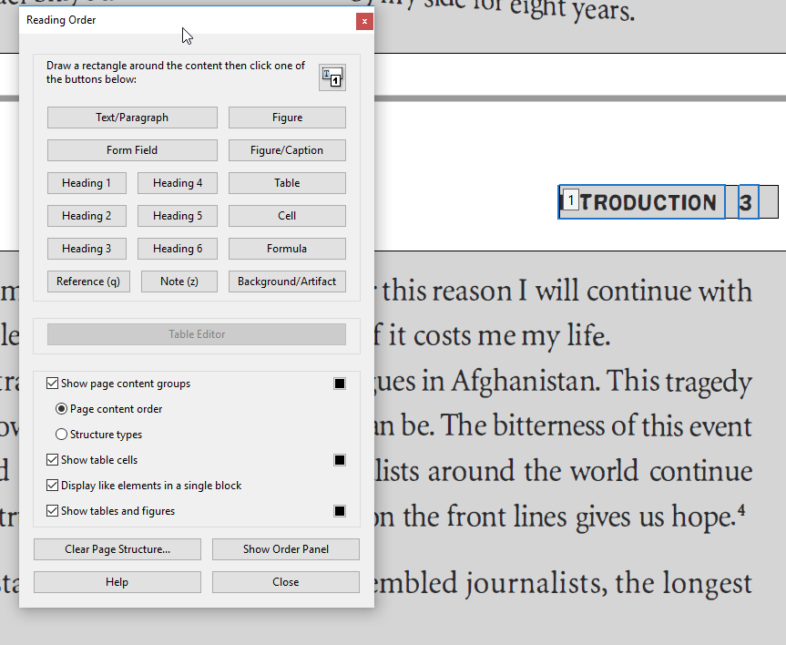
File format: PDF
Bookmarks & tagging
Bishara, A. 2013. Back Stories: U.S. new production and Palestinian politics. Stanford, CA: Stanford University Press.
Notes:
Bishara, A. 2013. Back Stories: U.S. new production and Palestinian politics. Stanford, CA: Stanford University Press.

Slide 31
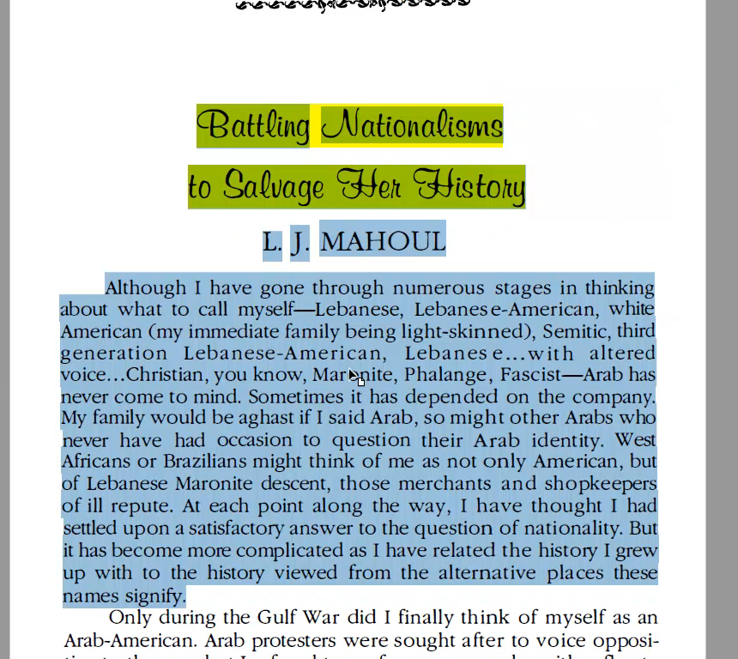
File format: PDF
Optical Character Recognition (OCR) Issues
Kadi, J. 1994. Food for Our Grandmothers: Writings by Arab-American and Arab-Canadian feminists. Boston, MA: South End Press.
Notes:
Kadi, J. 1994. Food for Our Grandmothers: Writings by Arab-American and Arab-Canadian feminists. Boston, MA: South End Press.

Slide 32
File format: PDF
Optical Character Recognition (OCR) Issues
Kadi, J. 1994. Food for Our Grandmothers: Writings by Arab-American and Arab-Canadian feminists. Boston, MA: South End Press.
Notes:
Kadi, J. 1994. Food for Our Grandmothers: Writings by Arab-American and Arab-Canadian feminists. Boston, MA: South End Press.

Slide 33
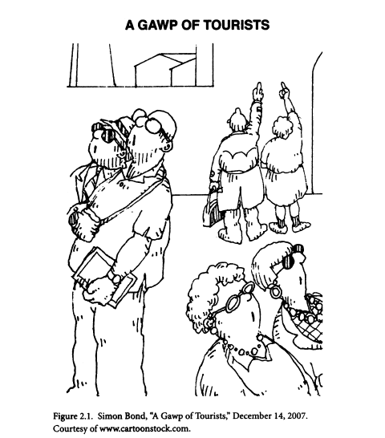
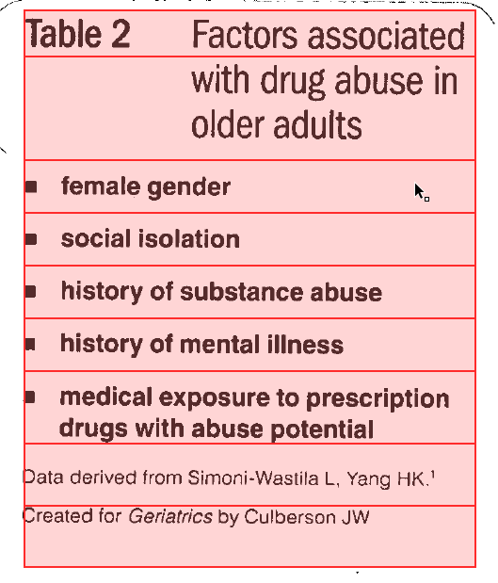
File format: PDF
Alt Text and Tables
Garland-Thomson, R. 2009. Staring: How we look. New York, NY: Oxford University Press.
Culberson, J.W. et al. 2008. Prescription drug misuse/abuse in the elderly. Geriatrics, 63(9), 22-31.
Notes:
Garland-Thomson, R. 2009. Staring: How we look. New York, NY: Oxford University Press.
Culberson, J.W. et al. 2008. Prescription drug misuse/abuse in the elderly. Geriatrics, 63(9), 22-31.

Slide 34
File format: PDF
Difficulty with files sizes, and different languages
With enough time, staff, expertise, attention to detail, and investment in new software/hardware, these elements can be mitigated….but we went another route with vendors

Slide 35


Vendors
Blue Leaf
  http://www.blueleaf-book-scanning.com/
  Will scan items without destroying the item (with exceptions)
  Adobe with not natively read their OCR because they use proprietary OCR software
AMAC Accessibility
  http://www.amacusg.org/
  Must scan items in-house
  PDFs are readable within Adobe

Slide 36
PDF
1. Download from Repositories
2. Purchase eBook if compatible with user's access technology
5. ILL book for scanning & reformatting
4.1 If a screen reader is being used, send the book to Blue Leaf
4.2 If the book is being read via Adobe's Read-Aloud function, scan in-house and send to AMAC
5.1 Scan in house and send to Blue Leaf if the prove to be faster and the patron is using a screen reader
5.2 Scan in house and send to AMAC
3. Use owned book for scanning & reformatting (must be checked for mark-up)
3.1 If a screen reader is being used, send the book to Blue Leaf
3.2 If the book is being read via Adobe's Read-Aloud function, scan in-house and send to AMAC
4. Purchase book for scanning & reformatting

Slide 37
File format: Word
An accessible Word Document starts with a well reformatted PDF
Word Docs do not usually look exactly like the source material

Slide 38
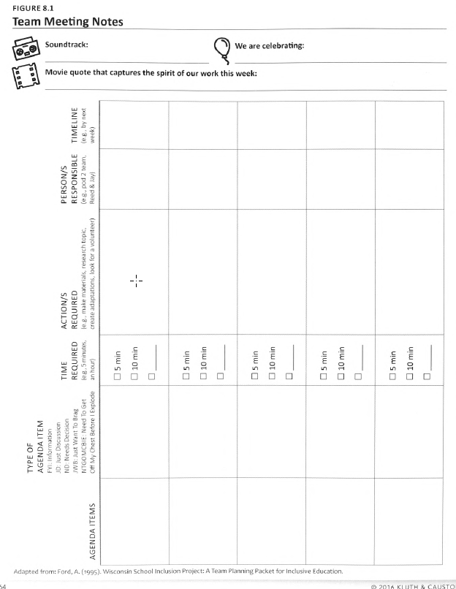
File format: Word
Table from scanned document in Adobe
Kluth, P. and Causton, J. 2016. 30 Days to the Co-Taught Classroom. Minneapolis, MN: North Loop Books
Notes:
Kluth, P. and Causton, J. 2016. 30 Days to the Co-Taught Classroom. Minneapolis, MN: North Loop Books

Slide 39
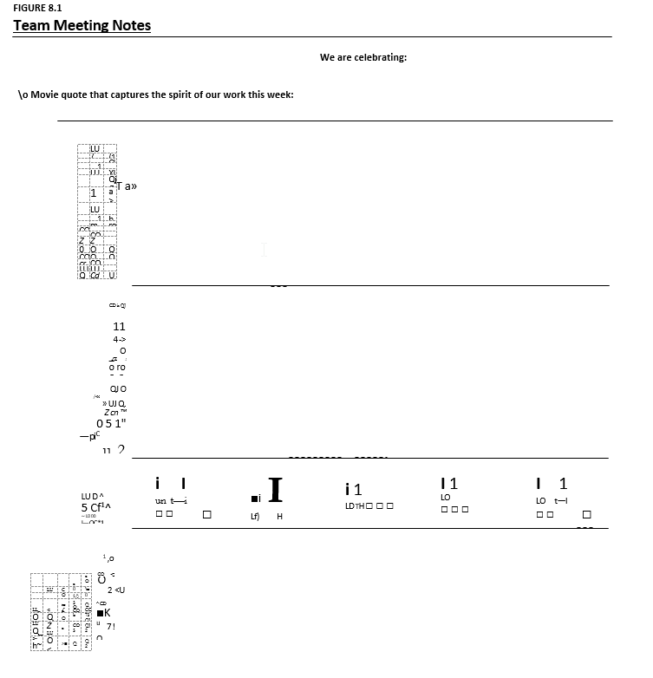
File format: Word
Table after converting from Adobe to PDF
Kluth, P. and Causton, J. 2016. 30 Days to the Co-Taught Classroom. Minneapolis, MN: North Loop Books
Notes:
Kluth, P. and Causton, J. 2016. 30 Days to the Co-Taught Classroom. Minneapolis, MN: North Loop Books

Slide 40
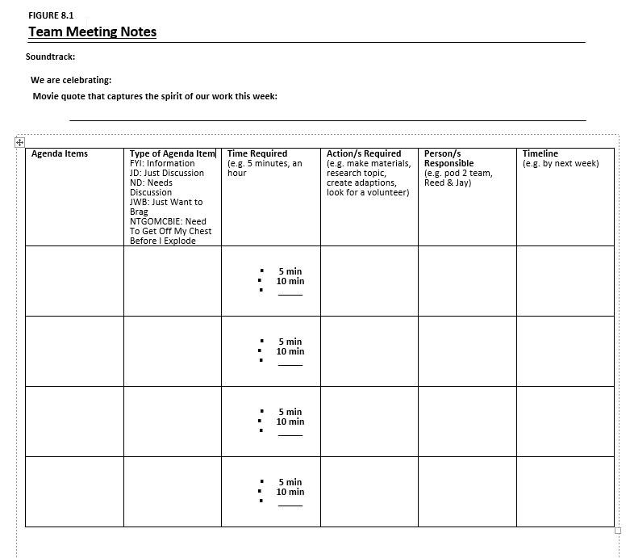
File format: Word
File constructed by staff in Word
Kluth, P. and Causton, J. 2016. 30 Days to the Co-Taught Classroom. Minneapolis, MN: North Loop Books
Notes:
Kluth, P. and Causton, J. 2016. 30 Days to the Co-Taught Classroom. Minneapolis, MN: North Loop Books

Slide 41
File format: Word
Most figures will not look like those from the PDF.
It is helpful to have a copy of the book on hand to correct these pages
Our decision tree for Word is built off of the PDF decision tree, as the PDF needs to be created before the Word Document
We remediate files we receive from vendors in house

Slide 42
File Format: EPUB
Based on HTML markup
Attempted to remediate in house using the open source software Calibre
SU’s Accessibility Analyst estimated that the remediation would take approximately 20 hours for a 150 page book
EPUB is looking like it will be the best standard for accessibility, but it’s not always a good option for researchers because it lacks page numbers

Slide 43
Requests Filled

Slide 44
Requests Received
Between April 2015 and May 2018, we’ve received 190 requests for this service
  75 request for excerpts or articles
  115 full book requests
There are 8 patrons who have made requests

Slide 47
Next Steps
Work on improving in house service for faster turn-around time
  ABBYY software
  Approaching vendors for more accessible options in eBooks
Work more closely with ODS to anticipate need
Using Atlas Concierge service to improve ILLiad webpages

Slide 48
Questions?

Slide 49
Thank you!
Ronald Figueroa
Resource Sharing Manager
rfiguero@syr.edu
Stephanie Helsher
Interlibrary Loan Supervisor
shhelshe@syr.edu

