Slide 1
Resource Sharing
IDS Conference,
July 27, 2023
Tim Auger – Product Manager, EBSCO
Notes:
Greetings, everyone. My name is Tim Auger, a Product Manager for EBSCO FOLIO and the Product Owner for the ReShare DCB project. Besides working in academic, public and special libraries over my career, I was at Innovative Interfaces for 17 years serving in three different roles with a focus on leading Innovative’s resource sharing efforts.
My presentation will focus on the following 4 areas.
introduce the concept of DCB
Talk to the benefits of our solution
Review the project timeline
Speak to the vision and future of FOLIO Resource Sharing

Slide 2
What is Open DCB?
DCB = Direct Consortial Borrower
Solution characteristics
Automated harvesting of catalogs → physical union catalog
Accurate deduplication of instances and consolidated holdings
Patron initiated requesting, RTAC and automatic item selection
Leverage APIs for integration with library service platforms
Seamless integration with FOLIO, Sierra and Polaris circulation workflows
Pickup at any participating library
Automated re-requesting (item selection process)
Reporting
Circulation exception handling and more…
Notes:
The open relates to the code: Open Source.
We are working with a coalition of large consortium who need a resource sharing system that is agnostic and based on patron initiated requesting and automated item selection from the library best able to provide it the fastest and, most importantly, is integrated into circulation workflows. We are also planning to move forward on a document delivery system. Will talk more about that later…
RTAC = real time availability checking

Slide 3
Notes:
This is our low-fidelity topographic diagram of what will be a reality by the end of 2023
This is the topology, with a dash of data flow, illustrating the systems at play within a DCB environment
Note the key on the left side of the diagram (note that there are 3 different platforms, with two flavors of FOLIO
In the center, we have the hub known as DCB. This is the place where the union catalog resides.
Radiating out from the center are arrows depicting the data flow for harvesting bibliographic or instance records from each of the ILS’ – Polaris, Sierra, FOLIO and FOLIO ECS.
If you have not heard of FOLIO ECS is simply an enhanced version of FOLIO (hence, the acronym ECS standing for Enhanced Consortium Support) that allows for a new set of capabilities available to consortium running FOLIO.
So, each library system allows the harvesting of their records, there is a deduplication process so that the same instances are distilled down to one instance where holdings from all libraries are associated with that one instance.
The union catalog has an OPAC layer atop for patron search and requesting. This is known as LOCATE.
When a patron is ready to place a request, the system will ask for their library credentials and, if the patron is eligible to request, the request is placed and the circulation lifecycle begins.
DCB then uses the open APIs from each ILS platform to communicate with the library circulation system to create transactions at the requesting and item owning library. In future iterations, we are poised to leverage industry standard APIs wherever vendor open APIs are not available.

Slide 4
Benefits
High first-to-fill rate (90 – 95%)
Fast turnaround (2 – 3 days)
Low total cost ($1 – 2 per transaction)
ILS agnostic
Directly integrates into existing ILS capabilities
Most importantly, very high levels of customer satisfaction
Notes:
Besides the product characteristics noted a couple of slides back, a well-designed DCB system will

Slide 5
Capabilities to date
Focus on foundation and Sierra interoperability
Record harvesting + match key creation
Union catalog indexing + matching instances + best record selection
Discovery scaffold – search, display, audit
Requesting, item selection, DCB circulation messaging
Place hold, checkout to borrowing library via Sierra
Notes:
Capabilities to date
Since late January, we’ve been engaged in a scrum development practice where we demo at the end of every sprint to our stakeholders. We are currently in Sprint 10 (2-week iterations) and so everything on this list has already been developed.
For a variety of reasons, we decided to break our work into 4 phases. Primarily, this allowed us to focus on a single platform (Sierra) in the first phase which would allow us to apply the learnings from one to Polaris and FOLIO. This approach also gave us the necessary time to build out the DCB foundation for the union catalog build, the matching and deduplication algorithms and requesting and the basics of circulation.
We were also in a position to build out what is called the “Discovery scaffold” a lightweight discovery application that we use in testing and demo’ing new capabilities while FOLIO’s OPAC, LOCATE, is enhanced to support the union catalog and requesting.
We’ve built out the basics of requesting, item selection and DCB circulation messaging.
And, most recently, have developed the ability to make requests and place holds in Sierra.

Slide 6
Near-term capabilities
Matching, matching, matching
Data transforms
Integration with LOCATE + pass-through searching
Patron authentication (SSO + native)
Item selection + pickup at any participating member library
Full circulation lifecycle
Lending/borrowing reports
Circulation exception reports
Notes:
Matching, matching, matching – IMHO, the single most important component of the system. Why? Because it is the start of the lifecycle. Better matching means, increase rates of findability → increase satisfaction → increased use (virtuous cycle)
This will be an ongoing pursuit for the lifetime of the project. As with most capabilities, our first target by go-live is parity with INN-Reach. For deduplication, our goal is to take a more conservative approach and give our partners the tools to adjust what are considered “candidate matches”. What comes with this will be a way to reexamine records and/or the configuration so that adjustments can be made by a central office administrator without having to recontribute the records from their source system. The underpinning of this is maintaining the full catalogs of each member system. This means less time and less effort to calibrate deduplication.
Along with these steps are data transforms. If you are not familiar with the acronym “ETL” it means “extract, transform, load” that is effectively what all physical union catalogs use to normalize and clean the incoming data from individual catalogs into the union catalog. Same for DCB. The transformations allow us to create a single data profile on the union catalog to help create consistency in search results and requesting the correct edition of, say, Ayn Rand’s Atlas Shrugged.
Also, enhancements to LOCATE as the OPAC for DCB is in progress.
Patron authentication will support SSO and native authentication (or, that is, the ILS patron database as the source of patron records). Somewhat obvious but this is the first step in placing requests.
And as we continue over the next 2-8 sprints, we will pickup the remainder of the list
Item selection + pickup anywhere
Full circulation lifecycle
Lending/borrowing reports
Circulation exception reports

Slide 7
Project Roadmap
June – initial sanity tests with Sierra sites
June – FOLIO development & integration begins
July – LOCATE development & integration begins
August – Polaris integration begins
August thru December – beta testing
January thru March – on-boarding + training
May 22 – Go Live!!!
Notes:
The project roadmap from now to go-live includes…

Slide 8
Vision
The 4 As
Anything, Anyone, Anywhere, Anytime
World-wide network
A commitment to a demonstrably better future
Future trends
Non-returnables
Linked Data
Notes:
The 4 As
What it means is Anything for Anyone, to or from Anywhere, at Anytime.
What this means is that the system is being designed to fill as much as possible within the primary network but as we move along in development, we will add capabilities to continues to search in other networks *automatically* should the primary network be unable to fill the request.
A world-wide network
Naturally, this leads to an opportunity to build regional, country-wide and world-wide distributed network.
EBSCO sees Resource Sharing as a very strategic component of our overall product portfolio. As a result, we are committed to helping fuel membership in those networks, such as MOBIUS and GALILEO, that have already embraced the vision. To forge a better future for your patrons and your library team members and your resource sharing partners, please consider our product offering when looking for a new Resource Sharing system.
Future trends
Non-returnables.
When I first joined EBSCO about 10 months ago, I asked if a business case already existed for a document delivery solution. Without getting into the details, the answer was effectively no. But, with MOBIUS already using ArticleReach (a document delivery system by Innovative) and finding great value and savings with the product, we asked them if they would be interested. The answer was a resounding “yes”. Soon thereafter, multiple inquiries and a couple of RFIs for very large-scale consortium were seeking an alternative to expensive ILL based docdel solutions.
So, while we have not yet finalized the business case to advance on building a docdel solution, I’d like to take this opportunity to say that if you are stretched thin on your ILL budget, please come and talk with me. I’d like to bolster the business case, of course, but more importantly, I would like to to gain a better understanding of your current docdel solution and what would make it better.
Linked Data
Another future trend is Linked data.
Linked data gives us a way is clearly to identify relationships between instances and has some very practical outcomes.
For example, linking all forms (i.e. instances) of a given work would allows a discovery or OPAC application to consolidate all of those forms within one search results entry. The physical resource, the PDF, the audio book, etc. would not require scanning all search result for the PDF version. Once you find the work, you would not need to look further.
Imagine what this would do for your user base – patrons would certainly find it more helpful when performing searches and would likely lead to greater satisfaction and increased requesting.

Slide 9
Document Delivery – Design philosophy
Lightweight user processing
Automation whenever and wherever possible
Born digital v. born physical? Equal access
Rights management and copyright
Clean data and GIGO mitigation
Notes:
NLA Question
Digital copies - could you please provide some more information on how digital copies of material would be offered as part of this solution.
From the patron side of the equation, in other comparable systems, the largest majority of requests stem from an OpenURL derived from local discovery resource or citation database. Ideally, the patron should also be able to access the discovery application directly to make a request as well.
Lightweight user processing
The intention with all of our resource sharing solutions is to provide a lightweight approach for the user to process requests. This means as much automation is put into place for identifying which library is best to fill a request (e.g. based on member library groups and priorities and/or other criteria).
The hierarchy for fulfillment will be to source a digital copy first (whether a link or a previously born physical that’s been digitized), then a physical copy that can be provided digitally then a physical copy (not sure if that is an option you want to provide or not).
All of this will be regulated by compliance with rights and copyright. So, we will have a Rights Management sub-system that, as part of the supplier selection algorithm, that examines holdings statements and historic supply information to determine if the resource can be supplied and by which library.
We will produce an application atop of the DCB that every member library can access to fulfill requests, cancel requests and mediate requests.
Mediation mode will allow modification of the request as a means to correcting poor citation data
There are a series of assumptions we would like to review with you at the appropriate time:
Electronic paging list in a responsive application that allows you to review all or a subset of requests in a member library queue.
Requests can be passed to other libraries (at which point, a dynamic re-examination of paging queue is examined) and then passed to another library. If no other libraries exist, options for each library to take → cancellation, pass to lender of last resort or mediation mode within the patron’s library system to search via other ILL systems.
Making sure we have clean data and mitigating GIGO is important.
We will take lessons learned from experience building other document delivery systems.
This includes the capabilities to review mediated and cancelled requests as input into understanding if there are patterns that would allow us to improve parsing algorithms and/or the data itself.
We used this at Innovative to modify transform tables and modifying the parsing algorithm
As part of our self-service philosophy, whatever tables or configuration exist will be available to the NLA central office.

Slide 10
Full lifecycle – happy path
Patron request (redirect via openlink to the union catalog)
Doc del searches for a supplier (automated)
Parse holdings
Rights management & copyright
Load balance
Page request
Supply
Born digital v. born physical
Access
URL

Slide 11
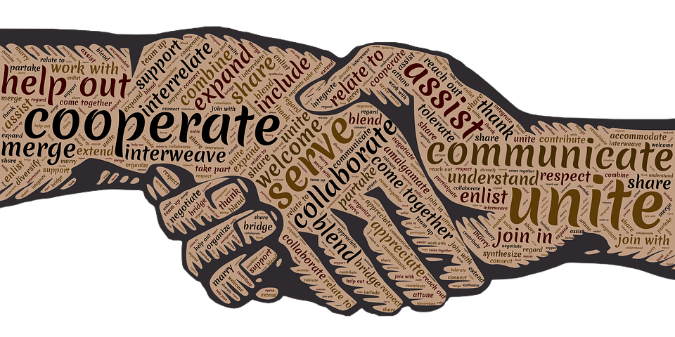
Thank you for joining us!!!

