Slide 1
The Blockbuster Model in a Netflix World
Zack Lane
Head of Delivery Services
Columbia University Libraries (ZCU)
IDS Project Conference
July 25, 2019
Delivery Services
Columbia University

Slide 2
…or, Hit Them With the Carrot
Delivery Services
Columbia University

Slide 3
…or, Stop Chasing Chickens and Let the Fences Do the Work
Delivery Services
Columbia University

Slide 4
…or, Listening to Sermons from Mystical Germans Who Preach from Ten to Four
Delivery Services
Columbia University

Slide 5
…or, Letting the Punishment Fit the Crime
Delivery Services
Columbia University

Slide 6
What is this about?
Control
Fear
Change
Data-driven decisions
Loan periods kind of
Delivery Services
Columbia University

Slide 7
Part 1 : Teaser Trailer
Context: Columbia increasingly dependent as a borrower in resource sharing
Lending: Lending data strongly suggests Columbia can be a confident & generous lender
Borrowing: Fine distribution suggests preferred terms of use and/or vagaries of human behavior
Delivery Services
Columbia University

Slide 8
More about that…
Columbia’s paradigm shift about patrolling shared resources for benefit of RTL originated with:
Zack was annoyed with invoices
Removing mis-applied fines is the worst
Lots of data
Originated as webinar to “show & tell” about how data analysis can shift thinking on library policies and actual policies
Scrutiny on legacy practice
Large-scale consortial transaction data proves there is low risk involved with sharing returnables
Large-scale Columbia fine data strongly suggests need for term-length loan period
Delivery Services
Columbia University

Slide 9
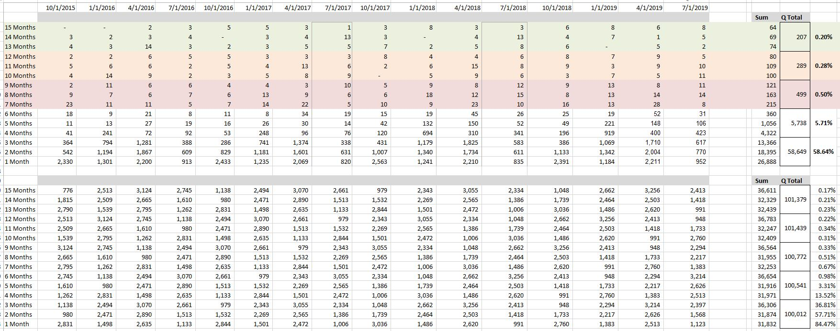
And Then There Was Data
Delivery Services
Columbia University

Slide 10
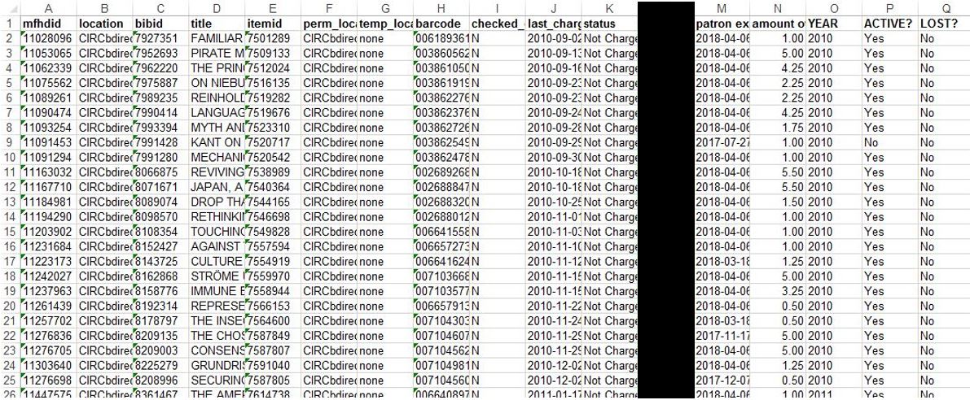
ILL QR#1 – Insight into Borrowers
Make it stop
The details are important
Delivery Services
Columbia University

Slide 11
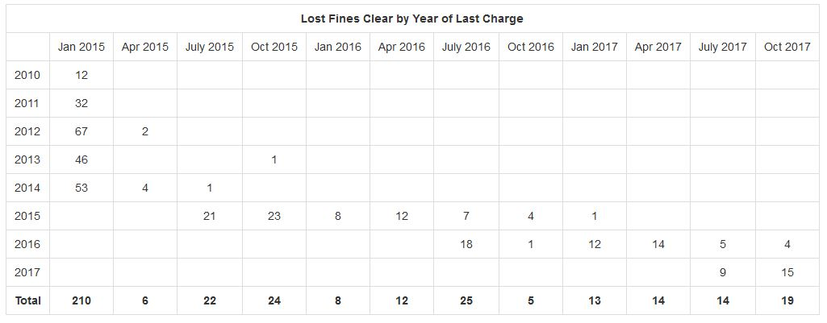
Keep the river running
Standing water breeds creatures
Delivery Services
Columbia University

Slide 12
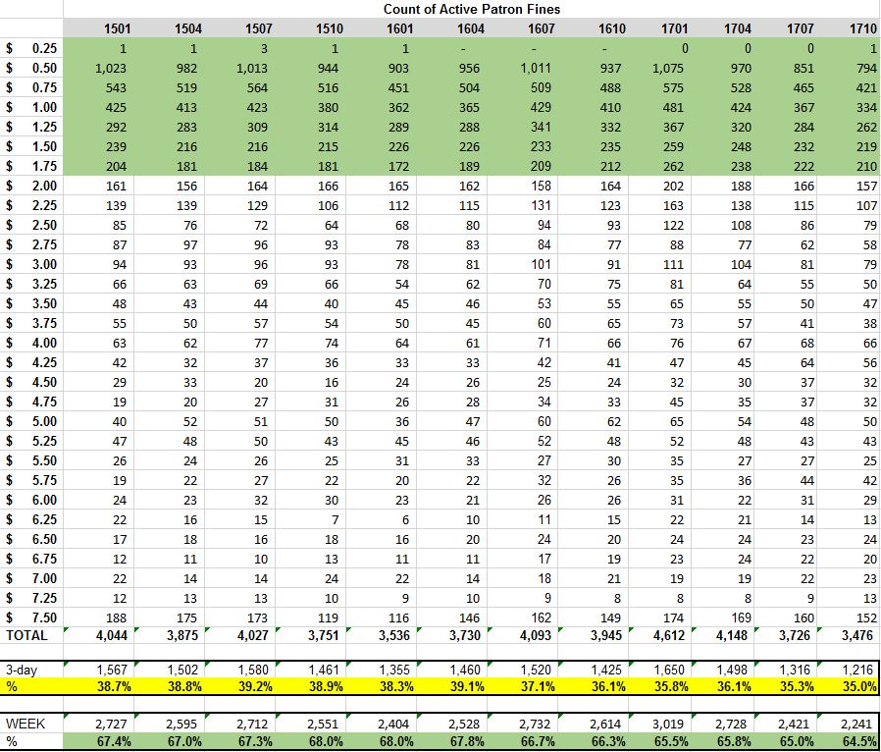
Delivery Services
Columbia University

Slide 13
What Happened Early
Consider increasing consortial loan period from 12- to 16-weeks
Eliminate ½ way renewal
Extended grace period from 1 to 3 days
Tightened time to Lost (account block) to 30 days from 45
Empower service desk staff
Extend loan periods 1-2 weeks or negotiate
Place mediated request on patron’s behalf
Routinely clear fines from Inactive accounts
Strongly consider eliminating “casual” fines entirely
“We care about the book not the money”
Think about how ILL Borrowing can mimic BD
Delivery Services
Columbia University

Slide 14
What Happened Later
Consortium-wide increase loan period from 12- to 16-weeks
Policy Group decision to seriously chill on invoicing
Rationalized local loan periods during shift to ReCAP Shared Collection (big deal, very boring)
Columbia changed ILL loan period from 6-weeks (perpetual renewals) to 16-weeks (no renewal)
Shift footing from renewal footstooling to the integrity of recall
Planned integration of acquisition routines
Rationalized notification timelines
Delivery Services
Columbia University

Slide 15
What Else We’ve Been Doing
Extended local loan periods
Term loan standard for all circulating print books
Unlimited renewals (99 will outlast most)
16-week, non-renewable loan for other formats (DVDs, CDs, etc)
Significant adoption of 16-week loan standard at network level
ILL Borrowing pushed into LMS with 16-week, non-renewable loan period
Built new recall routines
Protect integrity of borrowing recall
Reduce lending recalls
Integrated acquisition routines
Eliminated all casual fines (please don’t tell)
Delivery Services
Columbia University

Slide 16
The Carrot & The Stick
Core reflections:
What is appropriate cost of doing business?
Policy is written on whiteboard not stone
How “good” must Columbia be to be “bad”?
Delivery Services
Columbia University

Slide 17
Make News Good
8/18/2017
Hooray for Children
Hooray for Reading
Boo Budgets
Complex vs Complicated
Effecting Change in Context
Is … Can … Should
Delivery Services
Columbia University

Slide 18
Part 2 : Further Preamble
Re-writing the language of policy around change of practice
Inform and promote consistent use of “good discretion”
Focus on shared values
Delivery Services
Columbia University

Slide 19
Columbia University Libraries will no longer assign staff to send invoices for long overdue books lent via Borrow Direct as part of routine operation. Columbia staff may opt to recall long overdue books or contact partner library staff directly to facilitate return. Columbia may opt to invoice for long overdue books. Long overdue books will otherwise be reviewed and charged as Missing to put them into the replacement queue. Review of long overdue items will take place quarterly according to the procedure outlined below.
Columbia may opt to recall items from partner institutions at any time. It is our expectation that the recall request does not need explanation and will be honored.
Columbia may opt to issue invoices to Borrow Direct partner libraries if books are reported lost, damaged, etc. Pursuit of all invoices and acceptance of replacement copies are at the discretion of Head of Delivery Services.

Slide 20
Columbia University Libraries will no longer assign staff to send invoices for long overdue books lent via Borrow Direct as part of routine operation. Columbia staff may opt to recall long overdue books or contact partner library staff directly to facilitate return. Columbia may opt to invoice for long overdue books. Long overdue books will otherwise be reviewed and charged as Missing to put them into the replacement queue. Review of long overdue items will take place quarterly according to the procedure outlined below.
Columbia may opt to recall items from partner institutions at any time. It is our expectation that the recall request does not need explanation and will be honored.
Columbia may opt to issue invoices to Borrow Direct partner libraries if books are reported lost, damaged, etc. Pursuit of all invoices and acceptance of replacement copies are at the discretion of Head of Delivery Services.

Slide 21
Lost, Damaged & Long Overdue
The goal of Columbia’s invoicing policy is to balance maximizing patron return rate and minimizing staff time spent on invoicing.
The resultant philosophy focuses on being a sympathetic, trusting and well-patrolled borrower rather than a mindful, assiduous lender.
The return of the book is always preferred to invoicing.
Delivery Services
Columbia University

Slide 22
Date - Quarterly Reports
Run automatically everything 3 months
Defined, adjustable parameters
Immediately actionable by department
Goal : Reduce BS (user problems)
All publicly accessible until recently
ILL QR#1 – Borrow Direct Fine Report
ILL QR#2 – Overdue Borrow Direct Lending Report
ILL QR#3 – Overdue Borrow Direct Borrowing Report
ILL QR#4 – Morningside to HSL Report
ILL QR#5 – ILL Missing Status Patron Report
ILL QR#6 – Overdue ILL Lending Report
ILL QR#7 – Borrow Direct In Transit Report
ILL QR#8 – Temp Loc Report
Delivery Services
Columbia University

Slide 23
Part 3 : Circulation Data
Columbia circulation: Modeling use of print
There are other measures, this one is “OK”
Purpose: Put resource sharing (Borrow Direct) in context
I’m not ignoring ILLiad data but I am
It’s not there yet
Borrow Direct data set is much larger
BD is much “cleaner”
…and much easier to work with
Delivery Services
Columbia University

Slide 24
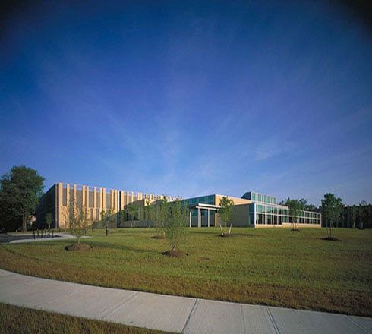
Circulation Data
Are you really going to make us look at Circ Data?
Yes
Borrow Direct activity in context of print usage
Scale is important
This will be fast, it’s ok
Delivery Services
Columbia University

Slide 25
Delivery Services
Columbia University

Slide 26
Delivery Services
Columbia University

Slide 27
Delivery Services
Columbia University

Slide 28
Delivery Services
Columbia University

Slide 29
Delivery Services
Columbia University

Slide 30
Delivery Services
Columbia University

Slide 31
Part 4 : Borrow Direct Lending
Consortial borrowing & lending activity among the Ivy Plus Libraries
Collections added in recent years:
Univ of Chicago
Duke
Johns Hopkins
Stanford
Users love Borrow Direct
Predictable & Consistent User Experience
Data shows: Users Are Good People (or People Are Not the Horrible Monsters We Fear)
Delivery Services
Columbia University

Slide 32
Delivery Services
Columbia University

Slide 33
Delivery Services
Columbia University

Slide 34
Data Table
Delivery Services
Columbia University

Slide 35
Insight into Lending
Original Destination: How to effectively invoice
Journey: Aggregate rate of use
New destination: Everybody chill out
Delivery Services
Columbia University

Slide 36
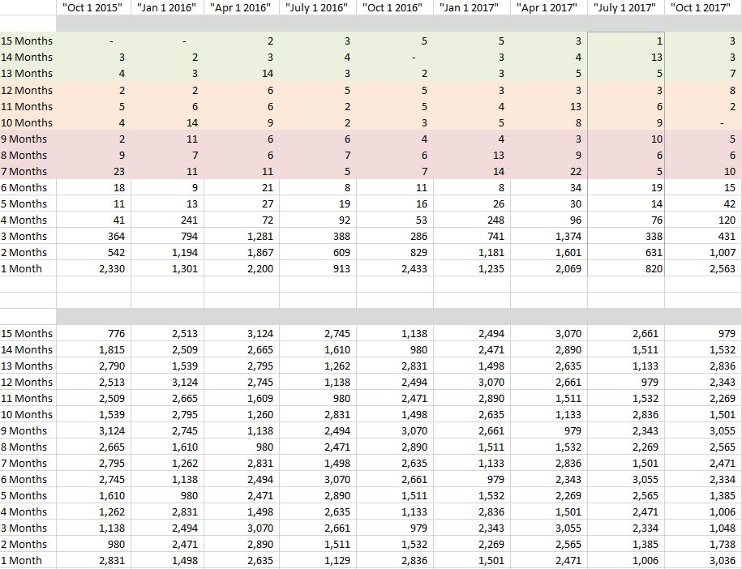
TIME
TIME
Delivery Services
Columbia University

Slide 37
Aggregate
Delivery Services
Columbia University

Slide 38
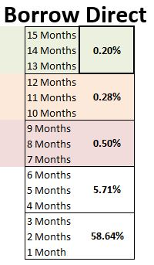
Delivery Services
Columbia University

Slide 39
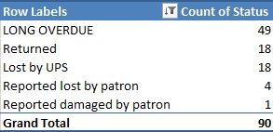
Delivery Services
Columbia University

Slide 40
Most Items are Common
Delivery Services
Columbia University

Slide 41
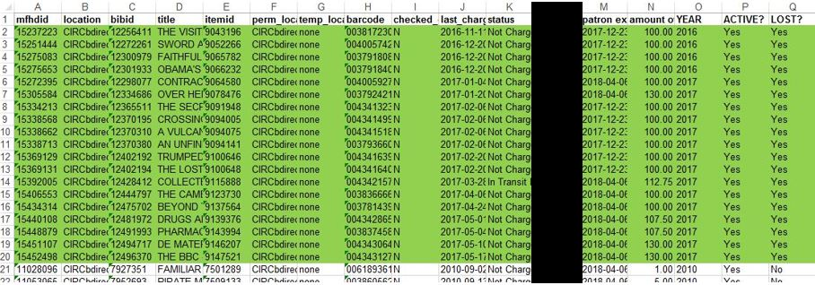
Part 5 : Borrow Direct Fines
A Borrowing Story…
Original Destination: Forgive the blameless
Journey: Behavior distribution analysis
New destination: Extend the fences
Delivery Services
Columbia University

Slide 42
Original Purpose Has Merit…
Delivery Services
Columbia University

Slide 43
TIME
Delivery Services
Columbia University

Slide 44
Delivery Services
Columbia University

Slide 45
What Happened?
Eliminate Columbia’s renewal
Extend grace period from 1 to 3 days (failed)
Tightened time to Lost & block from 45 to 30 days
Empower service desk staff
Extend loan periods 1-2 weeks or negotiate
Place mediated request on patron’s behalf
Routinely clear fines from Inactive accounts
Strongly consider eliminating “casual” fines entirely
“We care about the book not the money”
Think about how ILL Borrowing can mimic BD

Slide 46
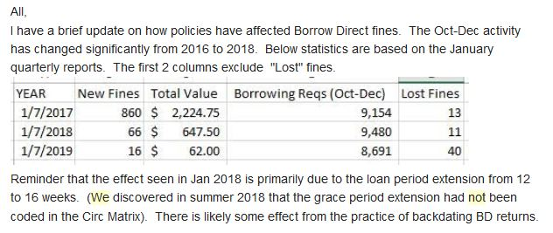
16-Week Loans = 92.3% Fewer Fines

Slide 47
What We Did
Consortium-wide comfort increasing loan period from 12- to 16-weeks
BD Policy Group decision to chill on invoicing
Rationalized local loan periods during shift to ReCAP Shared Collection (big deal)
Columbia changed ILL loan period from 6-weeks (perpetual renewals) to 16-weeks no renewal
Shift footing from renewal footstooling to the integrity of recall
Planned integration of acquisition routines
Delivery Services
Columbia University

Slide 48
Part 6 : Returns
A frank confession of bad things that happened
There was a problem with returns
There was a problem with recalls
But…
Delivery Services
Columbia University

Slide 49
Discharging Returns
Perception that heavy return load now falls in mid-late January
Voyager lists service desks as “closed” over the winter break
“Non-Due Period” = Last day of Finals to MLK Day
Pushes all Fall due dates to the day after MLK Day
Late January discharge increased ~35%
May discharge also increased by ~35%
Ouch
Delivery Services
Columbia University

Slide 50
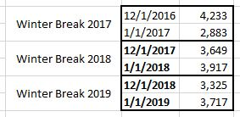
Delivery Services
Columbia University

Slide 51
Part 7 : Recall Pathways
Recall is common topic of pushback
Likelihood of recall increases with longer loan period
Likelihood of loss increases with longer loan period
Both true
But the order of magnitude is very very low
Negative impact does not outweigh the net benefit to Columbia patrons
Delivery Services
Columbia University

Slide 52
System-wide Borrowing Recalls
Recalls have been dropping at Columbia for 6 years
System-wide recall stats represent only recalls placed for Columbia-owned collections
Recognition that some user groups should be able to recall; others should not have this permission
Hypothesis: there are often “better” options than recall
Delivery Services
Columbia University

Slide 53
Delivery Services
Columbia University

Slide 54
Borrow Direct Borrowing Recalls
It looks like I made a huge mistake
I did but not what seems obvious at first look
Borrow Direct recalls have continued to drop, even with a 16-week loan period
Delivery Services
Columbia University

Slide 55
Delivery Services
Columbia University

Slide 56
Delivery Services
Columbia University

Slide 57
Before “I Told You So!”
Borrowing recalls can only be done by Columbia staff
Partner systems or staff communicate with Columbia staff
Who then act accordingly…
Back in October 2017 I alluded to how Columbia planned to be a “well-patrolled borrower rather than a mindful, assiduous lender”
Workflow was designed accordingly
I made a huge mistake
Delivery Services
Columbia University

Slide 58
Lost, Damaged & Long Overdue
The goal of Columbia’s invoicing policy is to balance maximizing patron return rate and minimizing staff time spent on invoicing.
The resultant philosophy focuses on being a sympathetic, trusting and well-patrolled borrower rather than a mindful, assiduous lender.
The return of the book is always preferred to invoicing.
Delivery Services
Columbia University

Slide 59
Lost, Damaged & Long Overdue
The goal of Columbia’s invoicing policy is to balance maximizing patron return rate and minimizing staff time spent on invoicing.
The resultant philosophy focuses on being a sympathetic, trusting and well-patrolled borrower rather than a mindful, assiduous lender.
The return of the book is always preferred to invoicing.
Delivery Services
Columbia University

Slide 60
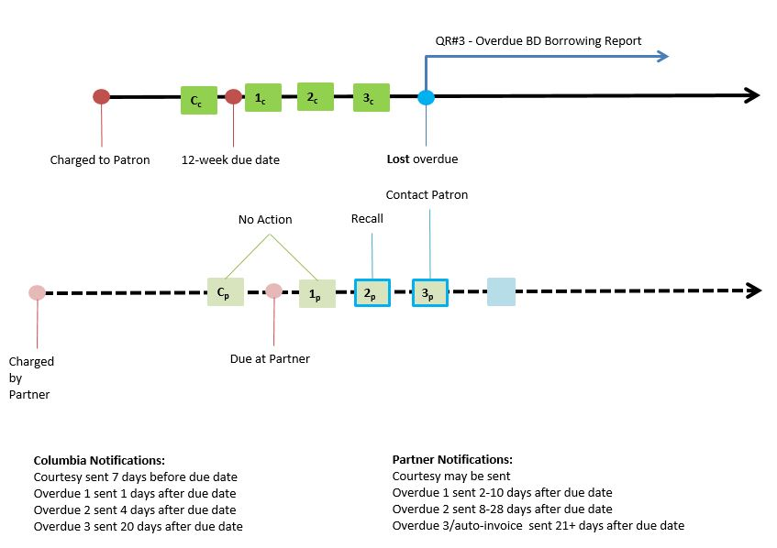
Delivery Services
Columbia University

Slide 61
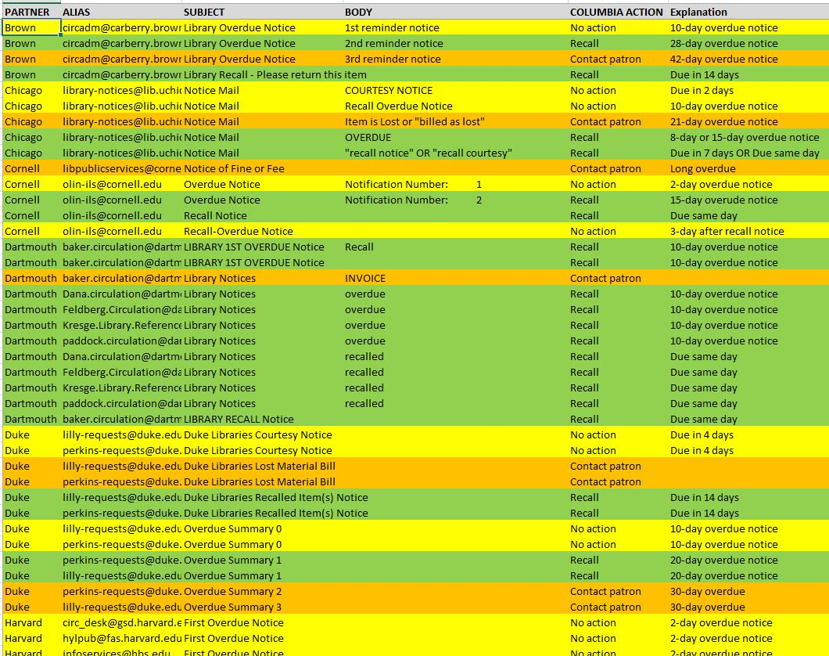
Delivery Services
Columbia University

Slide 62
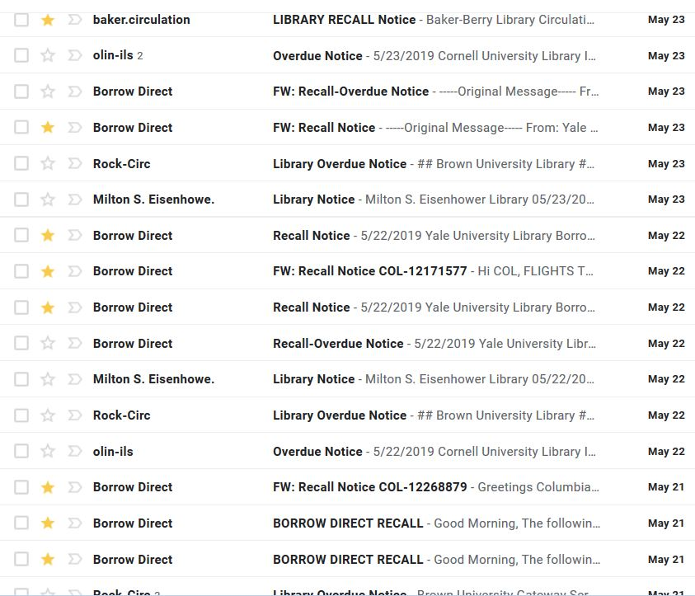
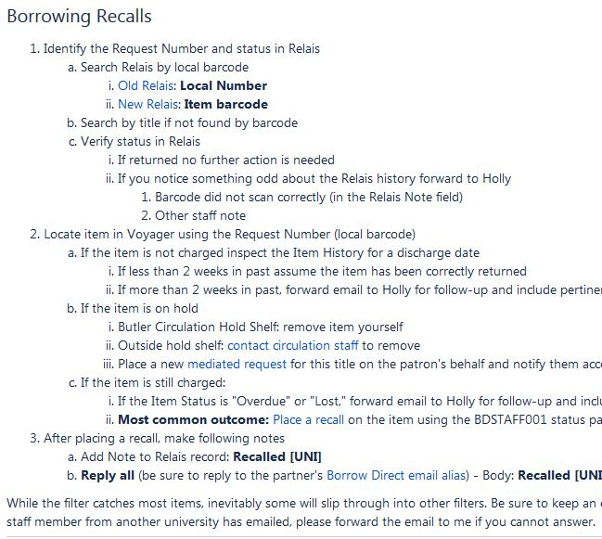
Delivery Services
Columbia University

Slide 63
Borrow Direct Lending Recalls
Columbia opted to reverse the fire hose
Staff-mediated recalls; akin to consortium’s staff-mediated invoicing
Delivery Services
Columbia University

Slide 64
Delivery Services
Columbia University

Slide 65
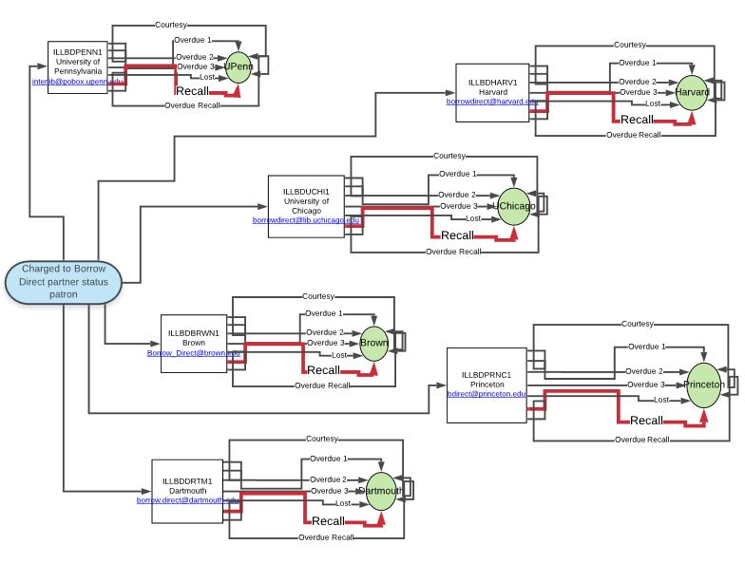
Delivery Services
Columbia University

Slide 66
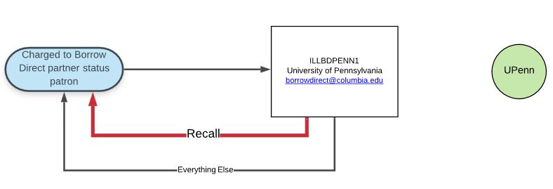
Delivery Services
Columbia University

Slide 67
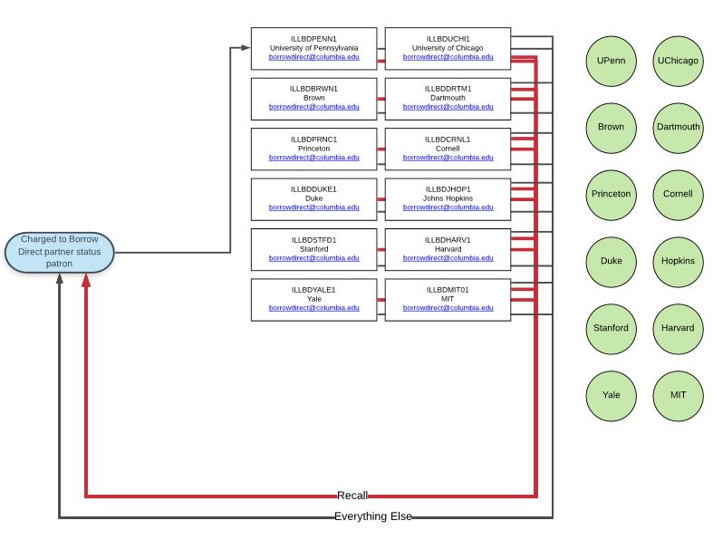
Delivery Services
Columbia University

Slide 68
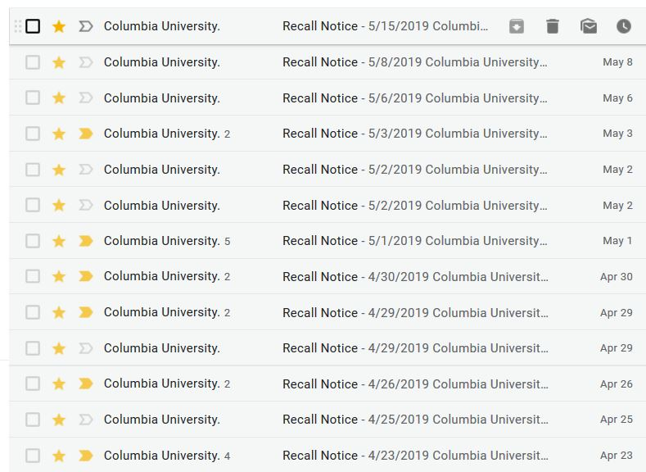
Delivery Services
Columbia University

Slide 69
Lending Recall Interference
90% of recalls can be cancelled
Opportunity to provide better user experience (for 2 patrons)
Passive collection development strategy
How many copies are too many copies?
How many copies are too few copies?
Problem: it is labor intensive
Delivery Services
Columbia University

Slide 70
Part 8 : The End
Thank you for your patience!
Is … Can … Should
Perception is subjective and subject to change
Delivery Services
Columbia University

