Slide 1
Notes:
Ice Cream Social Group Photo at 2:45
Jessica designed the shirts and tumblers
Remember to stop by the registration desk and pick up a tumbler today

Slide 2
IDS Project Sponsors

Slide 3
Conference Planning Team
Kristen Heinrich, Director of Conferences
Jennifer Acker
Jessica Alexander
Logan Rath
Lucy Yang
Joni Pulliam and Utica University Staff

Slide 4
IDS Peer Advisors
Jennifer Acker
Marta Ambroziak
Silvia Cho
John De La Fontaine
Ronald Figueroa
Heather Gad
Tara Gold
Kristen Heinrich
Stephanie Helsher
Timothy Jackson
Will Koch
Jessica McGivney
Beth Posner
Elise Thornley
Heidi Webb

Slide 5
A little history…
“Development of Interdependent Information Delivery Systems Among Participating SUNY Four-Year College Libraries : A Pilot Project”
IDS Pilot Project was started in 2003
Was developed because SUNY required a universal borrowing system
Ed Rivenburgh brought the 12 comprehensive directors together to see if the pilot would work
Mark Sullivan began work on developing the statistics package
The first conference was at SUNY IT (Now SUNY Poly)
53 attendees

Slide 6
“Development of Interdependent Information Delivery Systems Among Participating SUNY Four-Year College Libraries : A Pilot Project”
CONFERENCE ATTENDEES July 9, 2003
BROCKPORT: Frank Wojcik, Director
Bob Gilliam, ILL Librarian
Chris Brennan, Associate Director
BUFFALO: Maryruth Glogowski, Director Marjorie Lord, Head of ILL
Nancy Frasier, Reference Librarian
CORTLAND: Gail Wood, Director
Gretchen Gogam, ILL Clerk Laurie Pepper, ILL Clerk
Ellen Paterson, ILL Librarian
Marc Wildman, Collection Development Librarian
EMPIRE STATE: Suzanne Hayes, Coordinator of Info. Resources
Susan McAdam, Coordinator of Info. Resources
FREDONIA: Randy Gadikian, Director Barbara Kittle, Head of ILL Linda Auflick, ILL Clerk
Janet Ferry, ILL Clerk
Mary Grzegorzewski, ILL Clerk
GENESEO: Ed Rivenburgh, Director
Sonja Landes, Head of Access Services
Harriet Sleggs, ILL Manager
Mary McGrath, ILL Clerk
Bill Baker, ILL Clerk
Mark Sullivan, Systems Administrator
NEW PALTZ: Chui-Chun Lee, Director
Nancy Nielson, Collection Access Team Leader Corinne Nyquist, ILL Librarian
Lena Teater, ILL Clerk
ONEONTA:
Janet Potter, Associate Provost
Mary Lynn Bensen, Librarian Nancy Sacco, Library Clerk
OSWEGO: Mary Beth Bell, Director
Drew Urbanek, Head of Access Services Michelle Parry, Head of ILL
Karen Hogen, ILL Assistant
Carol Carter, ILL Assistant Cheryl Nevelizer, ILL Assistant
PLATTSBURGH: Virginia Johnson, ILL Clerk
Ravil Veli, Coordinator of Access Services Cheryl LaFountain, ILL Clerk
POTSDAM: Rebecca Thompson, Director
Kathy LaClair, ILL Supervisor
Nancy Alzo, Team Leader for Public Services
PURCHASE: Patrick Callahan, Director
Mark Smith, Head of Access Services
SUNYIT: Dan Schabert, Director
Jackie Coughlan, Head of ILL
NYLINK: Mary-Alice Lynch, Executive Director Donna Dixon, OCLC Services Librarian Jon Penn, Resource Sharing Librarian Carrie Nyc, Assistant Business Manager
OCLC: Tony Melvyn, ILLIAD Operations
OLIS: Maureen Zajkowski, SUNYConnect LMS Project Manager

Slide 7
Workflow Toolkit Binder
A complete 3-ring binder
All the changes to make in ILLiad to streamline the workflow
Updated when new ideas were found or when Atlas updated ILLiad

Slide 8
The Blessing of the Fleet
The Blessing of the Fleet is a tradition that began centuries ago in Mediterranean fishing communities
The blessing was meant to ensure a safe and bountiful season
Ed had a background in theology and a love of sailing ships so…
IDS Members became a fleet and we started handing out boats at the conference to new members

Slide 9
Ed Rivenburgh handing out boats!

Slide 10
IDS Availability Server (2006)
Worked with Serials Solutions to get e journal data imported
Built our own license database for the different publishers and providers
Used Index Data’s Zebra server for z39.50
Very manual system and needed to be automated

Slide 11
Mentor Program
Began in 2006 when IDS had grown too much for the staff at Geneseo to support on their own
Support from Deidre Dowling and Jon Penn at Nylink to get the training modules and program started
Additional support from the NY 3Rs
Documentation and later video training access was provided by Atlas Systems

Slide 12
IDS Project Mentors 2007

Slide 13
Article Licensing Information Availability Service
The Availability Server was updated in 2008
Atlas Systems created the IDS Service to pull data from ALIAS to automate Borrowing Article Requests
IDS Service would query ALIAS
Pull down the lending string for five libraries that could lend the article
Send off to OCLC through Direct Request
ALIAS now had a load balancing system in addition to the holdings and license data

Slide 14
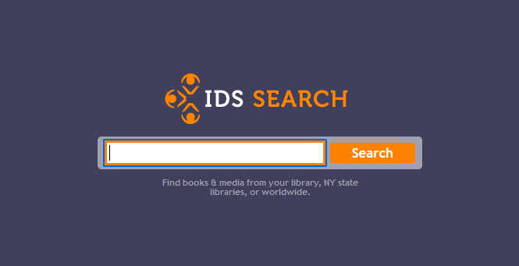
Project wide discovery system built using the OCLC WorldCat Search API in 2008/2009
Used Z39.50 connections to member catalogs to determine who had the item available
Allowed users to connect from the item in the catalog directly to the ILLiad system on their campus
Sent Lender string to ILLiad in the request

Slide 15
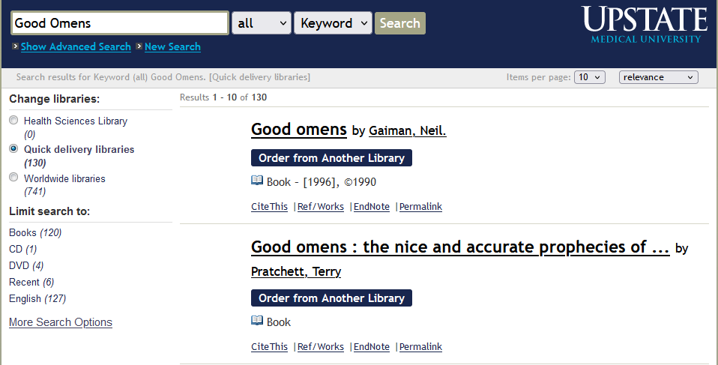

Slide 16
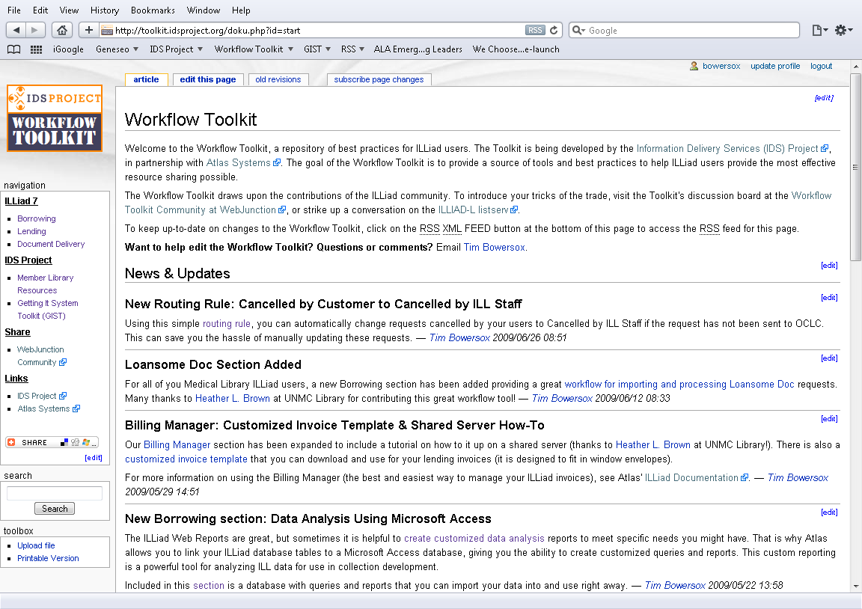
Workflow Toolkit Take 2

Slide 17
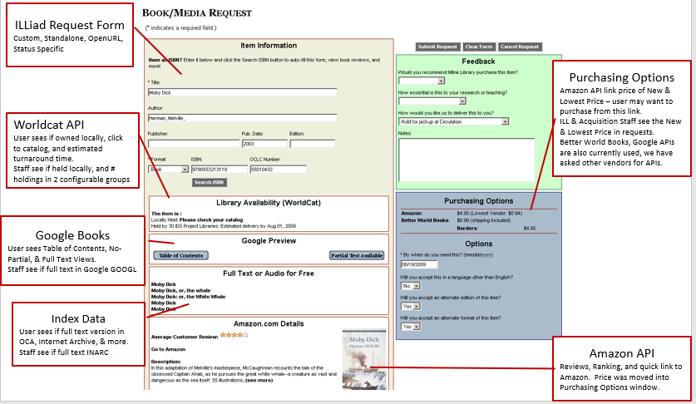
Getting It System Toolkit 2009

Slide 18
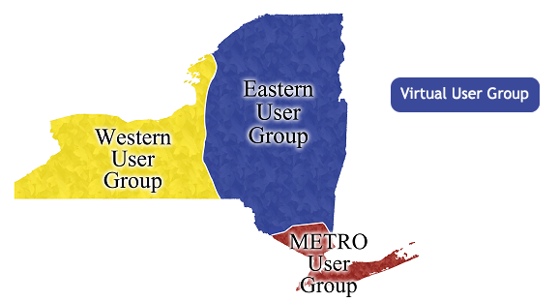
Regional User Groups 2012
Started off with Western, Eastern, and Metro
Added the Virtual Group a few years later
Focused on training for ILLiad and ILL in general
Webpage development training
Alma workshops
Winner of 2013 Rethinking Resource Sharing Innovation Award

Slide 19
IDS Project Goes National!

Slide 20
ILL 101 and 102
Assessment
Borrowing
Copyright
Lending
Supported by IDS Members and Non-Members
Winner of 2016 Rethinking Resource Sharing Innovation Award

Slide 21
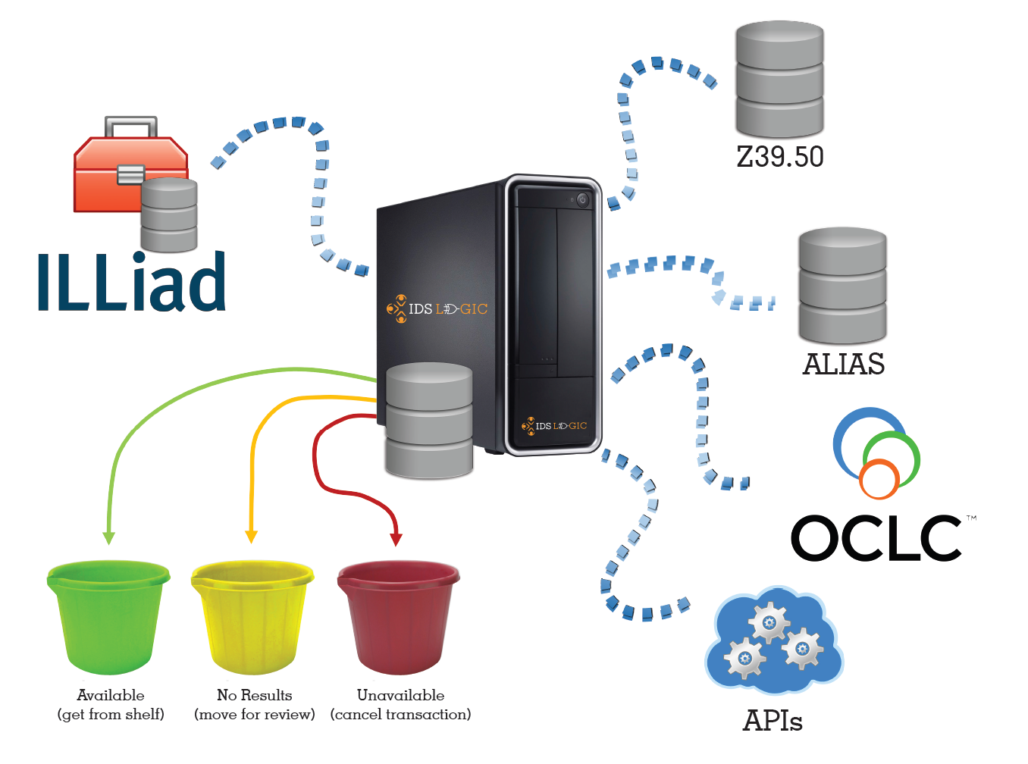
Lending Availability Service
Borrowing Availability Service
Article Gateway
Logic Rules
Winner of 2018 Rethinking Resource Sharing Innovation Award

Slide 22
Where We Are Now
Approximately 120 Members
25 States
Five time zones

Slide 23
IDS Admin Team
Jennifer Acker
Jessica Alexander
Kristen Heinrich
Rachel Manning
Logan Rath
Heidi Webb

Slide 24
The Future of IDS Project
Cross-Share
IDS Forums
IDS Orientation
Peer Advisors

Slide 25
Cross-Share 2023
Union catalog for all libraries
Allows IDS Logic level configuration for lending and borrowing
Facilitates sharing among the various systems without having to configure your own connection
Uses ISO 18626 and other APIs

Slide 26
IDS Orientation
Self-paced orientation to help new staff members acquaint themselves with everything ILL
There will be a high-level overview of the IDS Project itself as well as Borrowing, Lending, and Copyright
We'll also point out where to get help and who to contact for everything from workflow to IDS logic!
Coming Fall 2023!

Slide 27
IDS Forums Monthly online community – coming soon!
An opportunity to ask questions, brainstorm answers and share projects, challenges and solutions with each other
Get to know more IDS members
Mark Sullivan and Beth Posner and other Peer Advisors will be available to help with both technical and workflow topics
Everyone is encouraged to join as often as your schedules permit
The meetings will be at 3 so that everyone from Hawaii to New York can attend. (We'll send out a doodle poll to decide what day of the week and then we’ll start in September)

Slide 28
Creatively Influencing our Collective Future through Use of Scenario to Help with a Facilitated Discussion
Lars Leon
Friday at 12:00 in Strebel Auditorium
Key points to be made will be noting Lars’ session will be:
Scenario with individual reflection, small group, and all discussion time.
Encouraging folks to think about how other speakers ideas impact the future.
tinyurl.com/IDSConfScenario

Slide 29
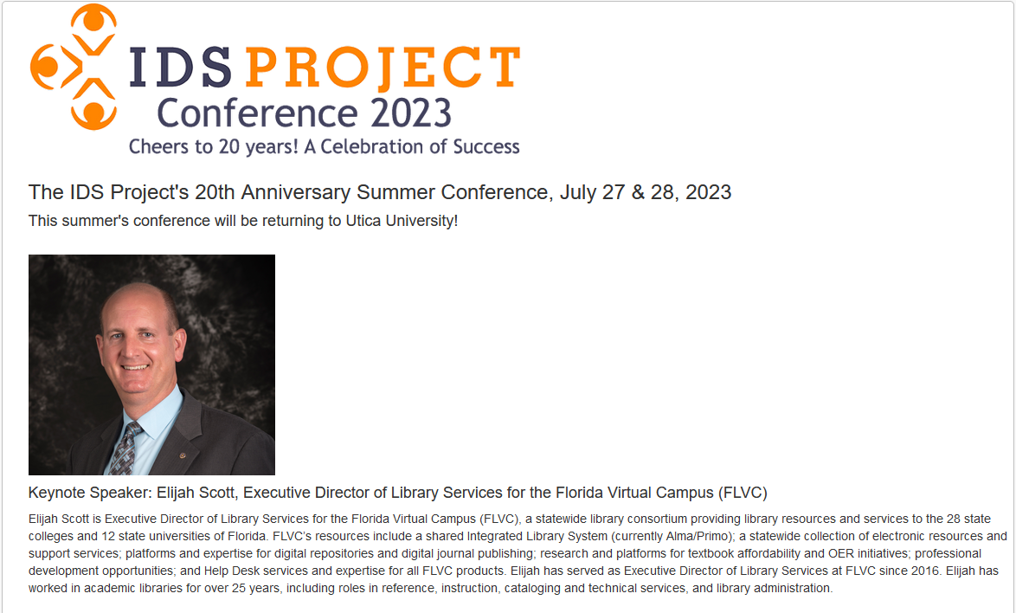
IDS Conference is July 27 & 28, 2023 at Utica University.
Pizza party on Wednesday the 26th if you come in the night before the conference.
Registration is https://www.idsproject.org/conferences.aspx

