Slide 2
Tipasa Acquisitions Integration
Crissy Ross & Erin Smith
Northern Kentucky University

Slide 3
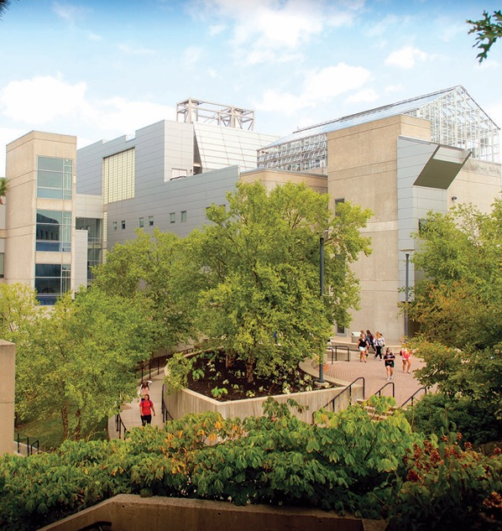
Northern Kentucky University
Metropolitan university of more than 14,000 students served by 2,000 faculty and staff
Traditional 16-week or accelerated 7-week courses, as well as 5-week format for the MBA program

Slide 4
Northern Kentucky University
Programs
70 Majors
22 Master
Law School
Regional medical school campus of University of Kentucky.
Partnership between St. Elizabeth, UK and NKU
Inaugural class, fall 2019

Slide 5
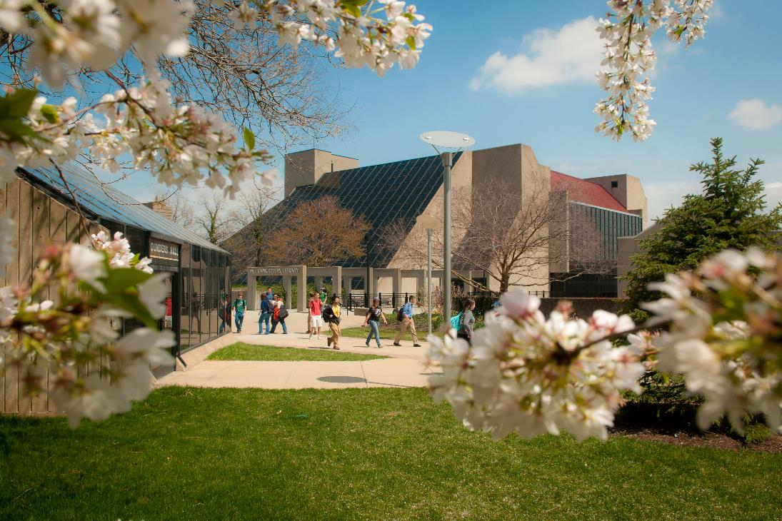
W. Frank Steely Library
Notes:
Library is 5 stories
Includes writing center, pathfinders, CITE and a café.
Library won the QEP for information literacy and how an undergraduate degree in library science

Slide 6
W. Frank Steely Library (KHN)
SourceFinder Department
SourceFinder is the brand name for a handful of Steely Library services. These services include:
Interlibrary Loan (borrowing/lending)
Information Brokerage (purchasing)
Steely Delivers (document delivery/distance learning service)
Personnel
4 Full Time Personnel
1 Lending, 1 Borrowing, 1 Acquisitions, 1 Manager
Students Assistants
Notes:
Interlibrary Loan = traditional ILL borrowing
Information brokerage = purchasing requests on demand, our patron driven acquisitions
Steely Delivers = delivering articles that we have in our collections, to our customers
Student Assistants: process all mail, search for paper requests, do our shipping, all of our scanning

Slide 7
W. Frank Steely Library (KHN)
Borrowing Request 2018/19 5,115
Lending Request 2018/19 6,801
Document Delivery Requests Filled 2018/19 803
Purchase Requests Filled 2018/19 315
Illiad Library
2004-July 2018
WorldShare Management Services (WMS)
July 2015
Cloud based
Tipasa Library
July 2018
Full Circulation and Acquisitions Integration

Slide 8
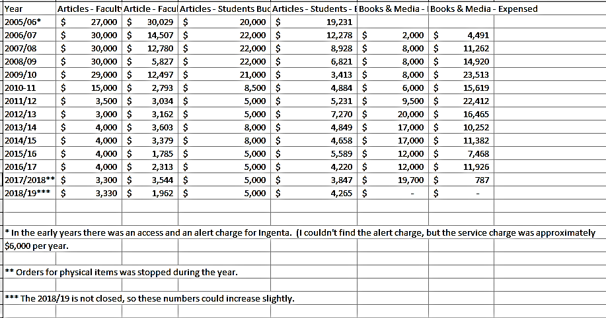
Purchasing

Slide 9
What’s important to the SourceFinder Department?
Notes:
According to our Dean ☺

Slide 10
W. Frank Steely Library (KHN)
Accuracy
Access to what our users want
Speed
Automation
Direct requests
Proven senders
Custom holdings
Turn around times
Turnaround time: @4 days (loans and copies)
Purchasing on Demand
Notes:
Accuracy– getting our patrons exactly what they need without much hassle
Speed: Delivering items as quickly as possible. Purchase on demand? Automating our processes, so requests are sent out and delivered without mediation (we can do a lot of that in Tipasa with direct requests and trusted senders). Patron enters their requests, system automatically sends requests out and lender fills. If lender is designated a “trusted sender”, then customer automatically notified of delivered request without any staff mediation. We have designated all lenders as “trusted”.
AVERAGE TURN AROUND TIME: @4 days (loans and copies) Borrowing
We have also implemented weekend hours. Erin signs in remotely over the weekend to process requests and emails, to keep our turnaround times low. She can do this all from home and the flexible schedule has been helpful to her. Lowered our turnaround times by a day. Plus, we were able to decrease our turnaround time data in OCLC, increasing our lending requests.

Slide 11
Purchase on Demand Acquisitions Model at Steely
We Purchase:
Articles
Physical Items (video, books, ect.)
Currently on hold due to budget
Faculty directed to department funds
Who is Eligible for Service
NKU faculty, staff and students
Notes:
Our budget changes from year to year and unfortunately, our POD program excluded physical items this last year, but we are hopeful this will change. We are hoping to integrate the faculty department purchasing into our Tipasa software at some point, so that users can have a one stop shopping experience. We believe we will be able to integrate our tagging mechanism for this process, so that we can keep the 2 budget lines separate from eachother
We DO purchase articles still.

Slide 12
How it works
Borrowing staff identify requests that meet purchasing requirements:
Articles
Copyright Issues
Purchase immediately
5 Lender Rejections
After five lenders say no, attempt to purchase articles
Get it Now (integrated)
Article Galaxy (integrated)
Via publisher, etc. (purchase outside of system, track in Tipasa)
Physical Items
Recent Publications (Physical Items Only)
5 Lender Rejections
Send to Acquisitions Staff
Purchase immediately (in discussion)
Direct request rule determined by patron status
Notes:
Physical items, in the past
We are interested in immediate purchase because of our intense 7 week semesters, where our patrons need their materials literally RIGHT NOW. Waiting a week is nor acceptable for their timeline. If we decide to implement Purchase Now, Tipasa allows us to designate certain requests to be directed to purchasing (staff mediation before going out to ILL), so that we can immediately purchase these requests
We used to purchase current year articles and books immediately, but budget changed that
Physically purchase outside of system, track/notify/follow/deliver request in Tipasa

Slide 13
How it works - Articles
Articles
Items located in purchase tab (Reprints Desk/Get it Now) are processed by interlibrary loan borrowing staff
Items not located in purchase tab are routed to acquisitions staff via “WMS Acquisitions” process
Notes:
We have integrated both the Copyright Clearing Center’s “Get It Now” application and the Reprint’s Desk “Article Galaxy” application into our Tipasa module.
If we were purchasing physical items, we would also be using the book applications…

Slide 14
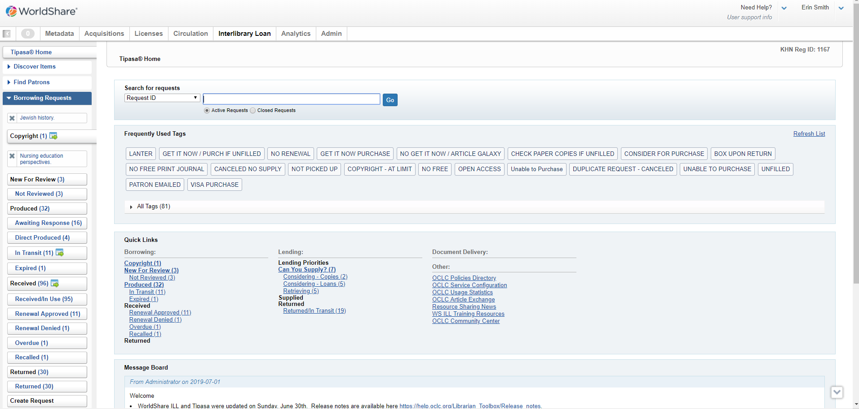
Article Galaxy–Reprints Desk
Notes:
ERIN STARTS
Article Galaxy/Reprints Desk process
Tipasa opening layout
See Borrowing Request that have copyright questions

Slide 15
Article Galaxy–Reprints Desk
Notes:
Open documents with copyright questions
Scroll down to copyright clearance – I can see that we have used this item 5 times so I need to either go to clear with fee payment required or look at check out the purchase tab

Slide 16
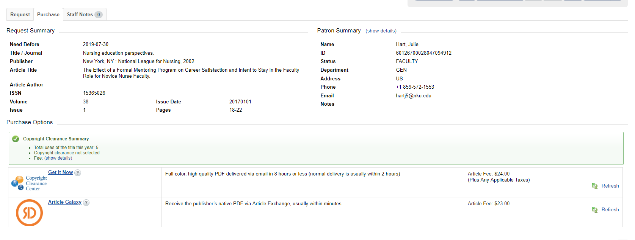
Article Galaxy-Reprints Desk
Notes:
Select Vendor

Slide 17
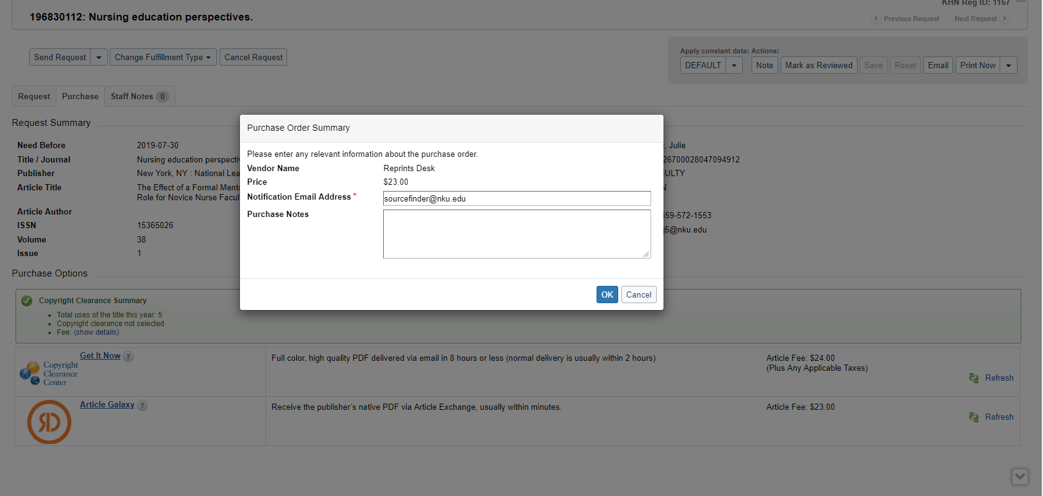
Article Galaxy–Reprints Desk
Notes:
Auto populates purchase order summary – add any add purchase notes

Slide 18
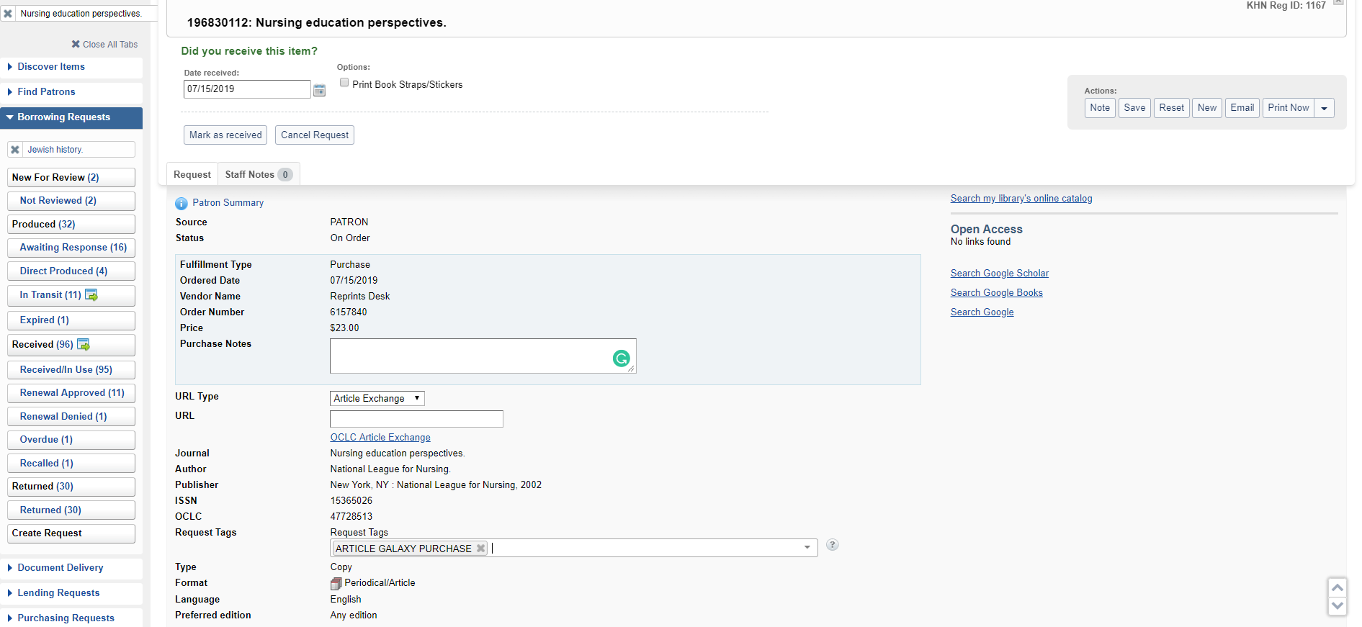
Article Galaxy–Reprints Desk
Notes:
Add a request Tag, save and exit request

Slide 19
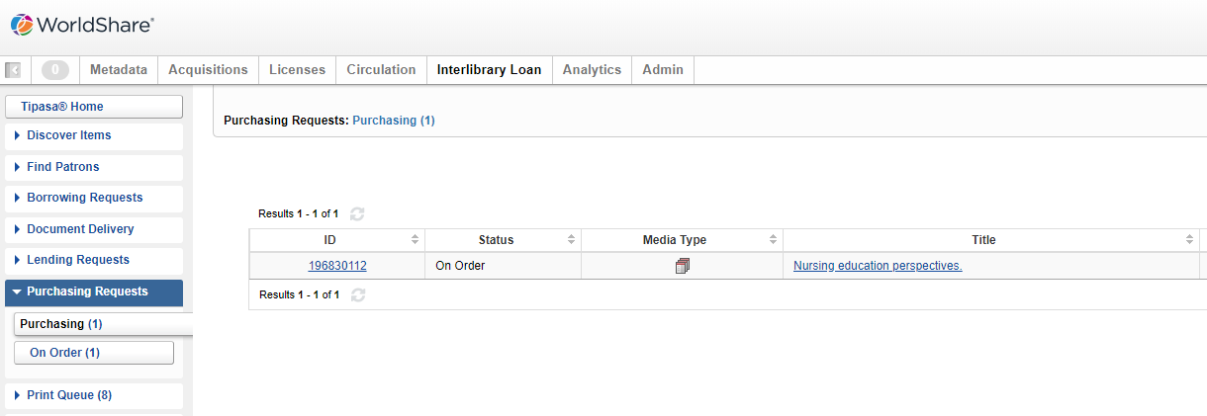
Article Galaxy–Reprints Desk
Notes:
Item is sent to Purchasing request tab until received

Slide 20
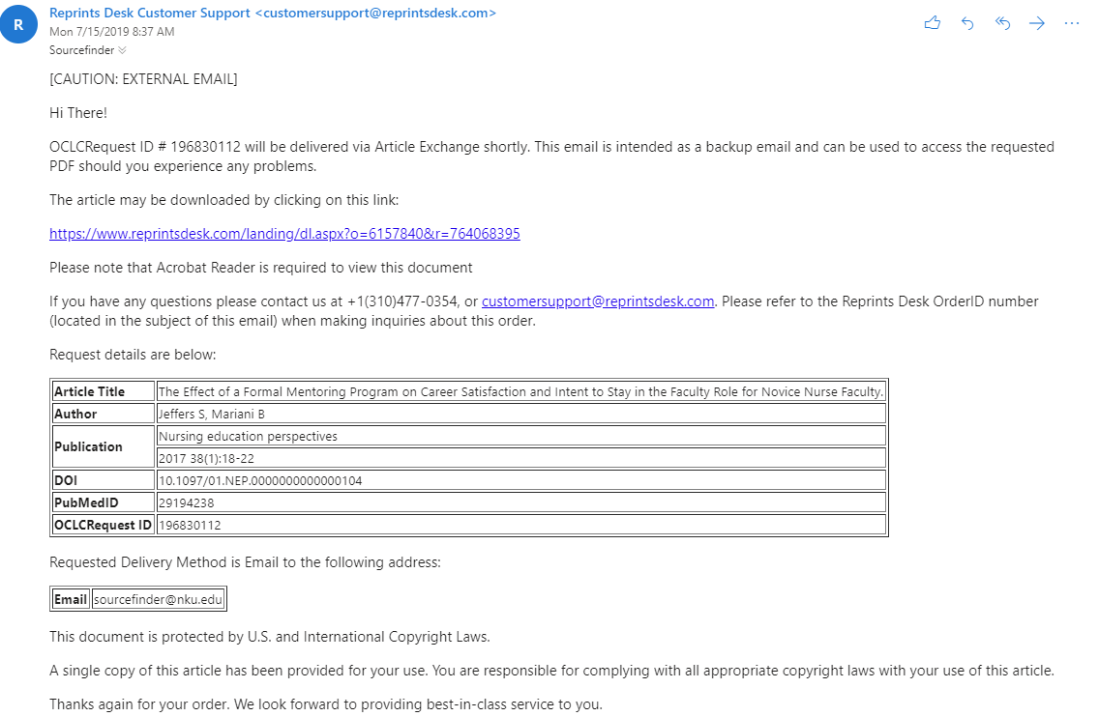
Article Galaxy–Reprints Desk
Notes:
You will receive an email that verifies your order
Email will contain link in case for some reason the item is not automatically delivered

Slide 21
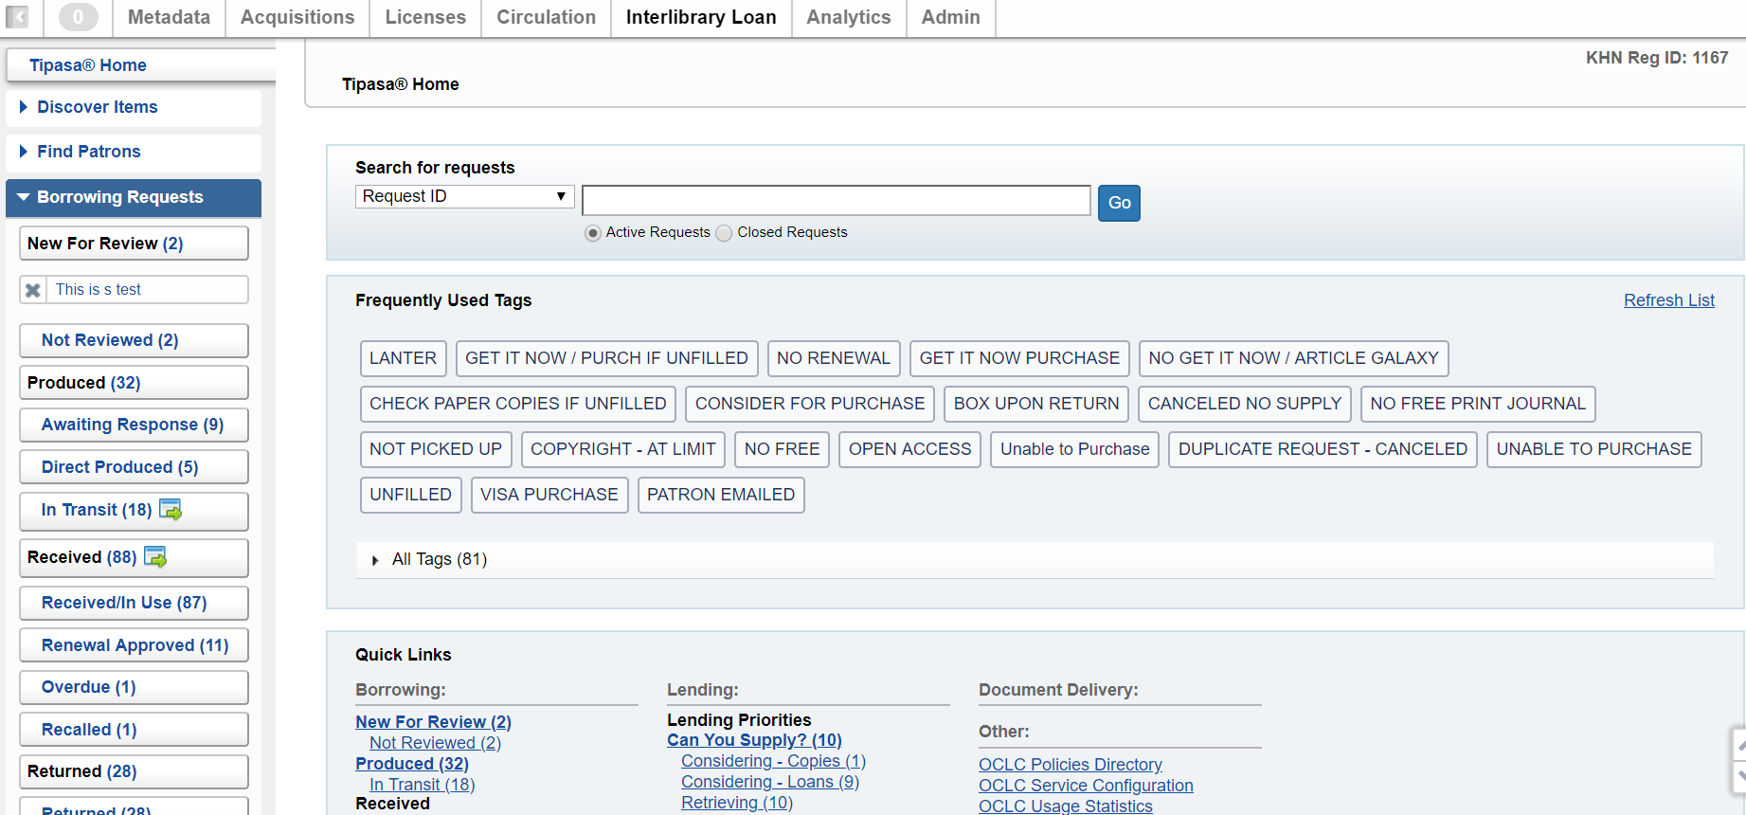
CCC-Get it Now

Slide 22
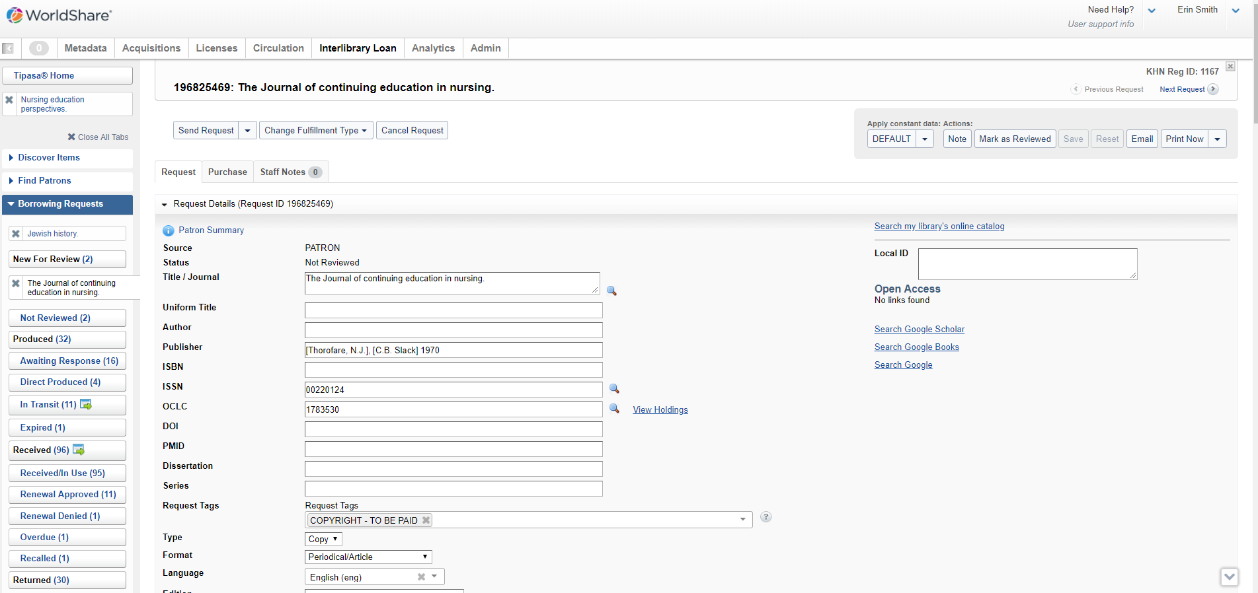
CCC-Get it Now

Slide 23
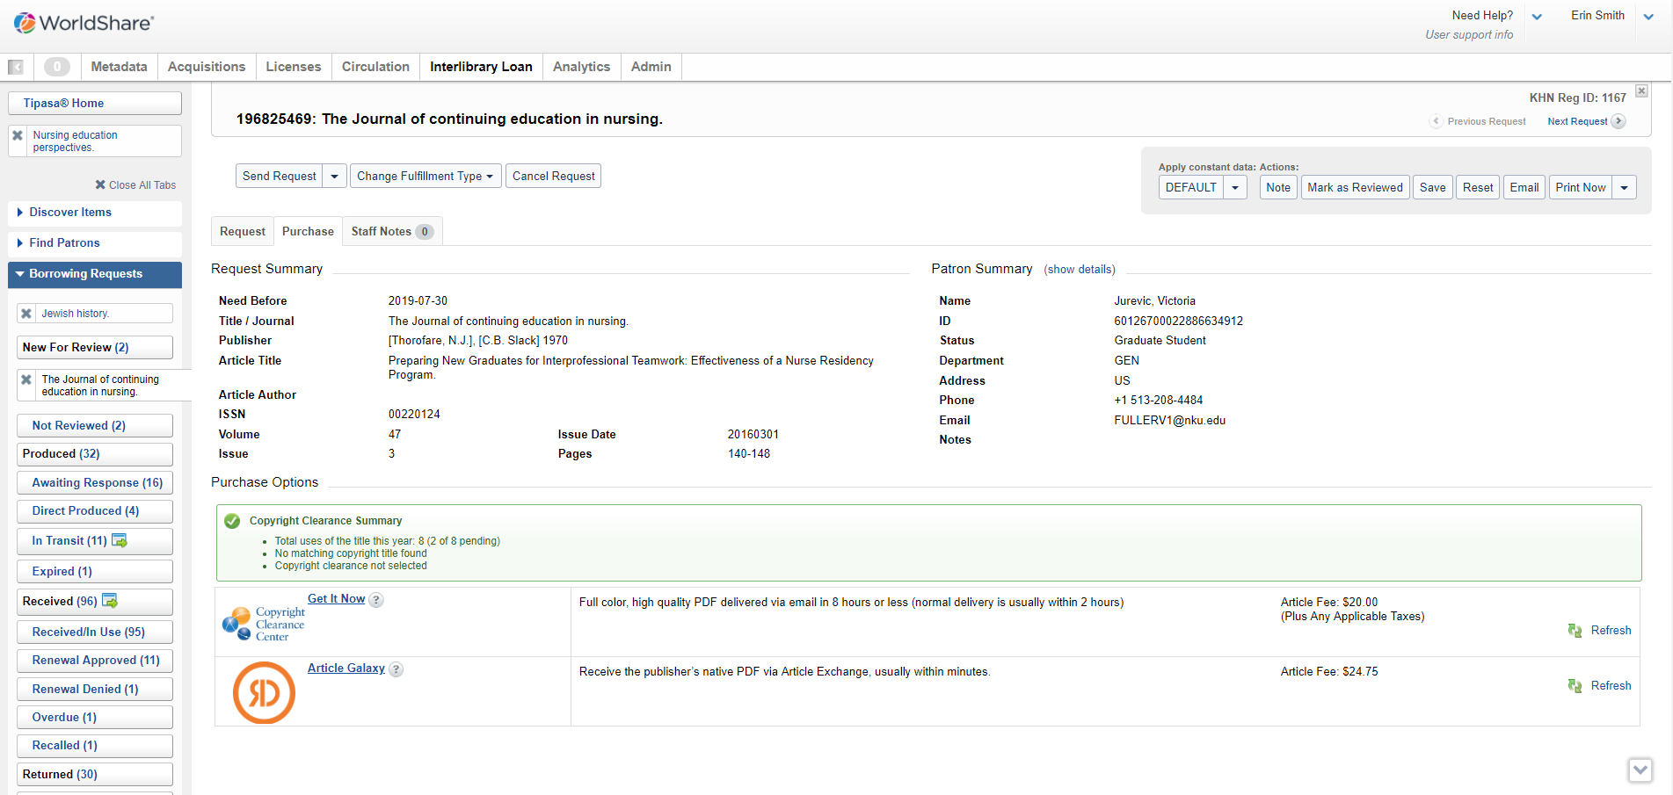
CCC-Get it Now

Slide 24
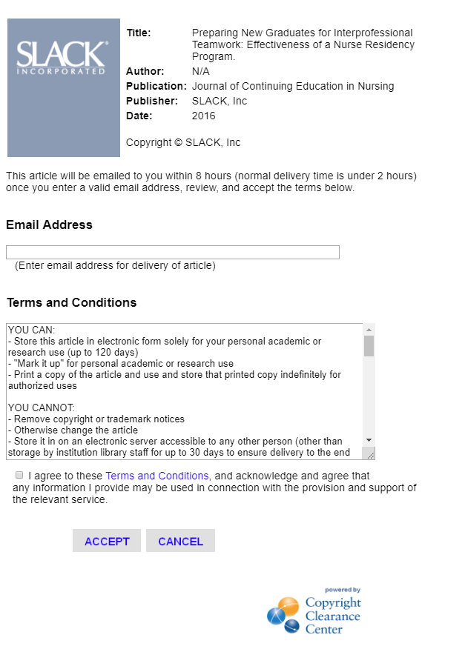
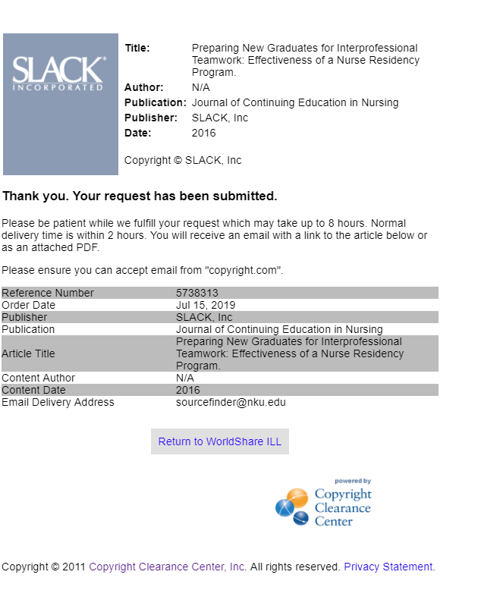

Slide 25
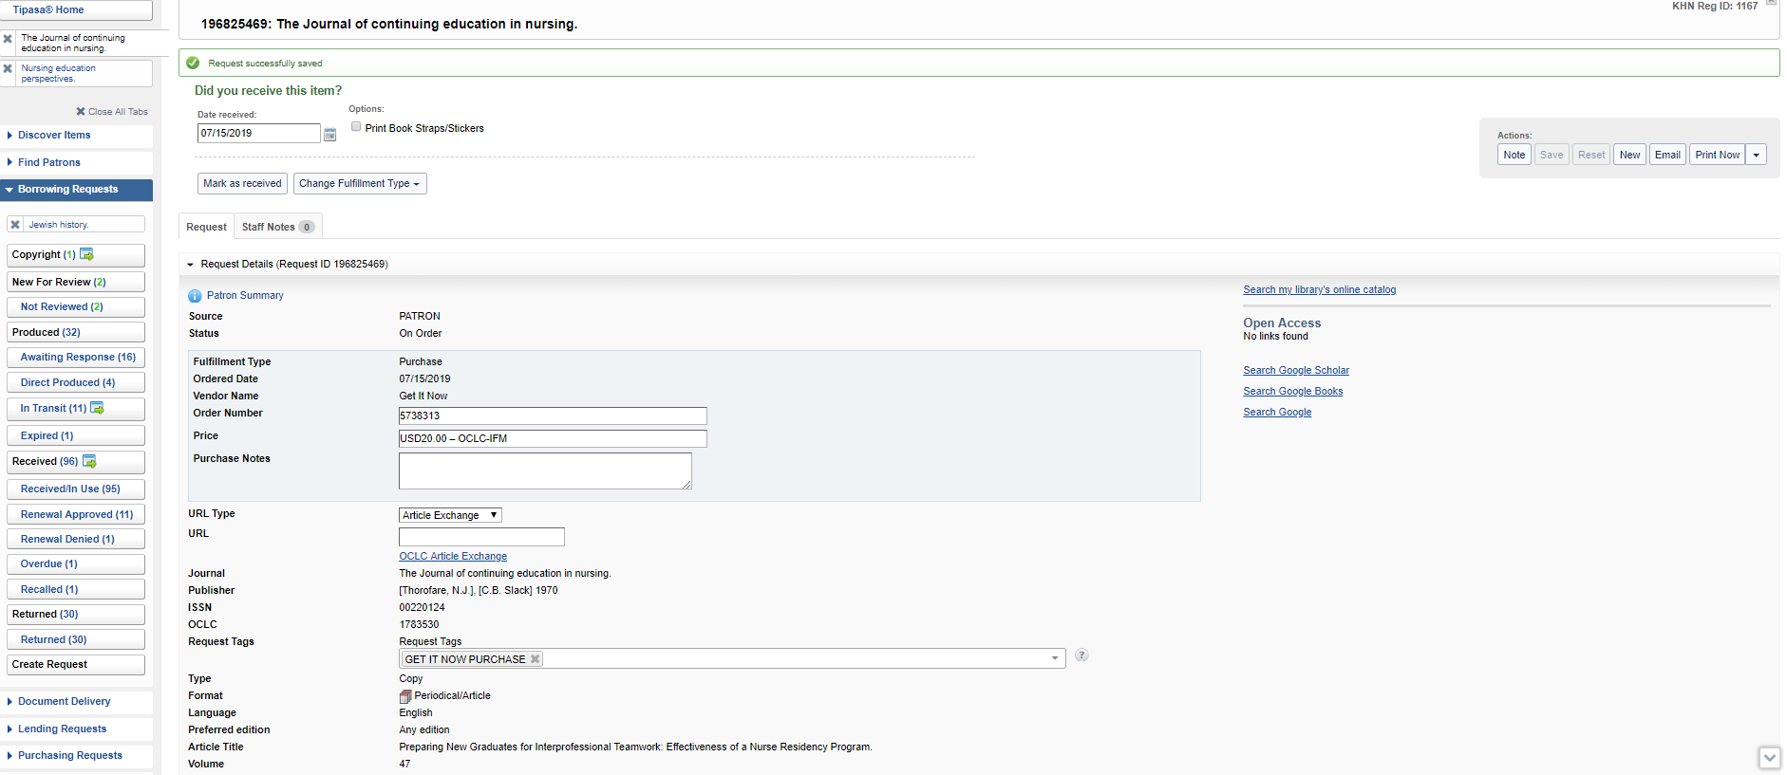
CCC-Get it Now
Notes:
Auto populates purchase order summary – add any add purchase notes
Add a request Tag, save and exit request

Slide 26
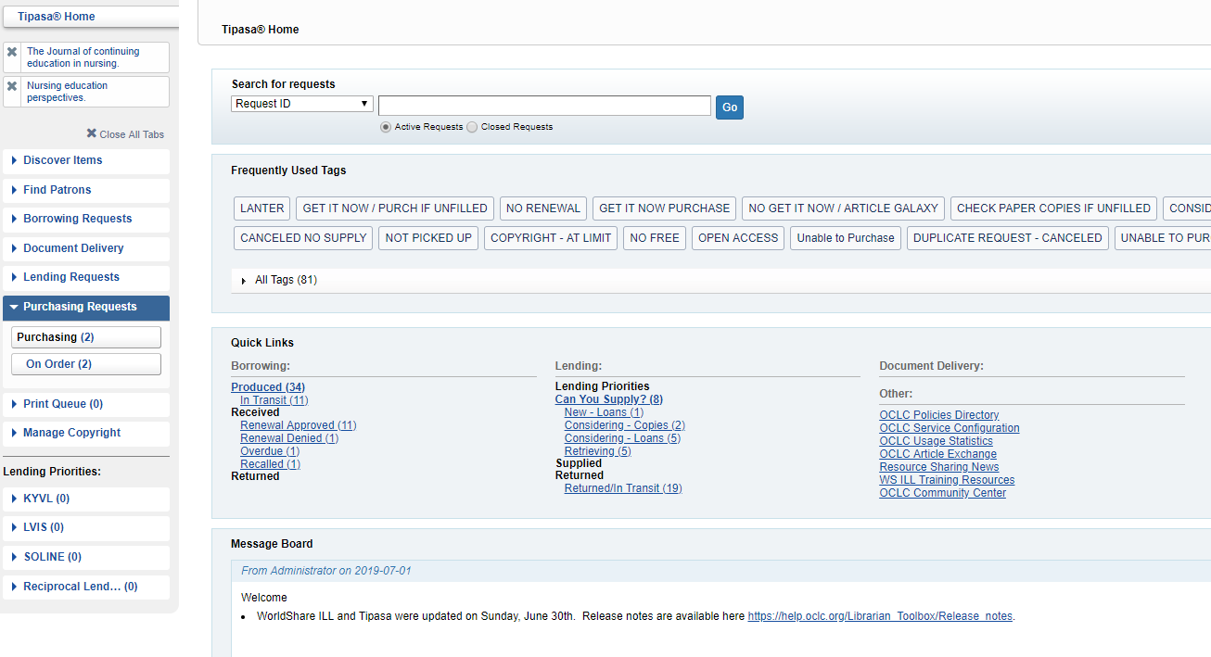
CCC-Get it Now

Slide 27
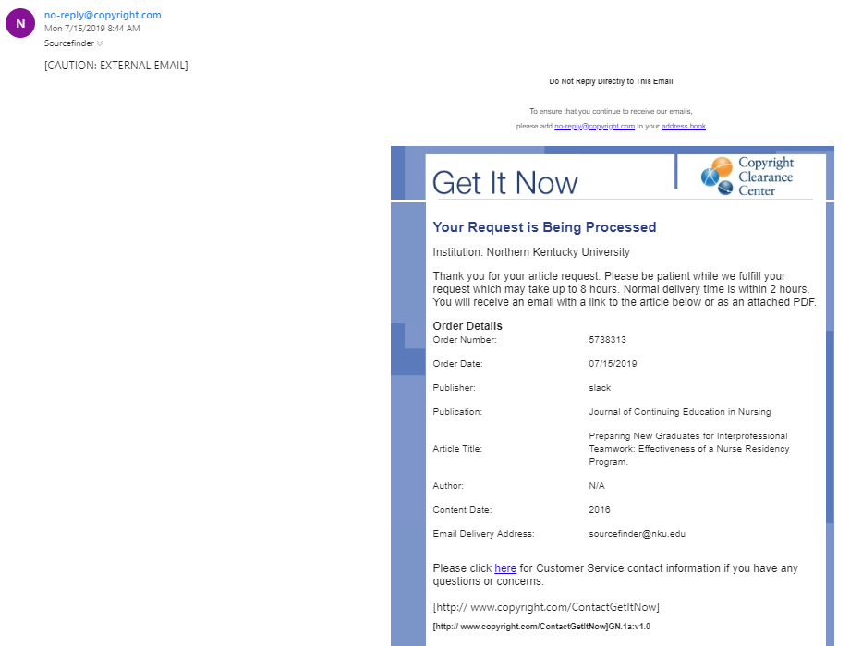
CCC-Get it Now
Notes:
Auto populates purchase order summary – add any add purchase notes
Add a request Tag, save and exit request

Slide 28
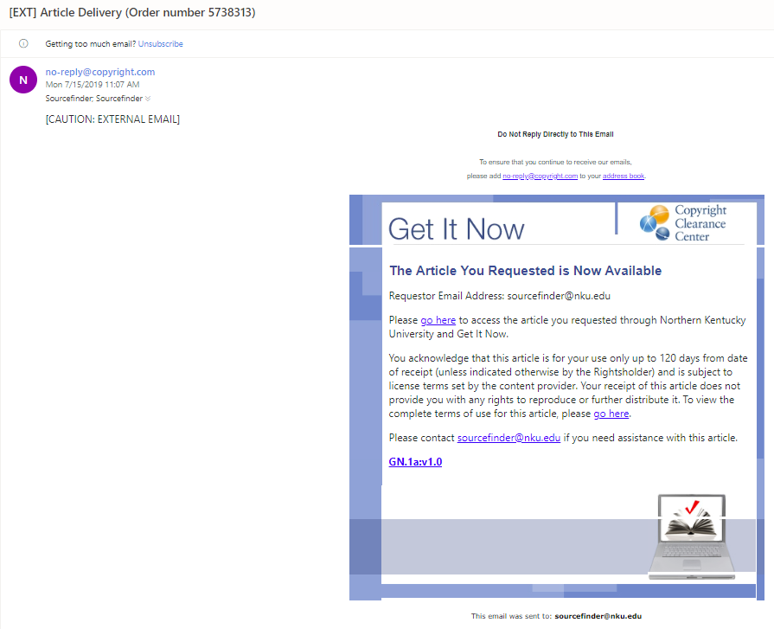
CCC-Get it Now

Slide 29
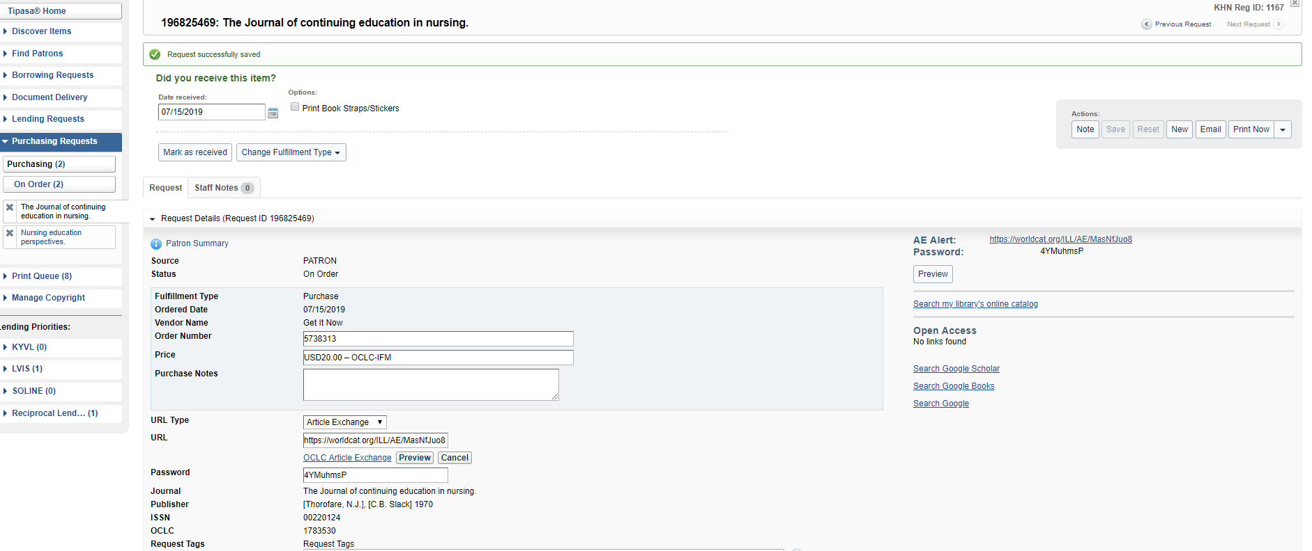
CCC-Get it Now
Notes:
Select Email Tab

Slide 30
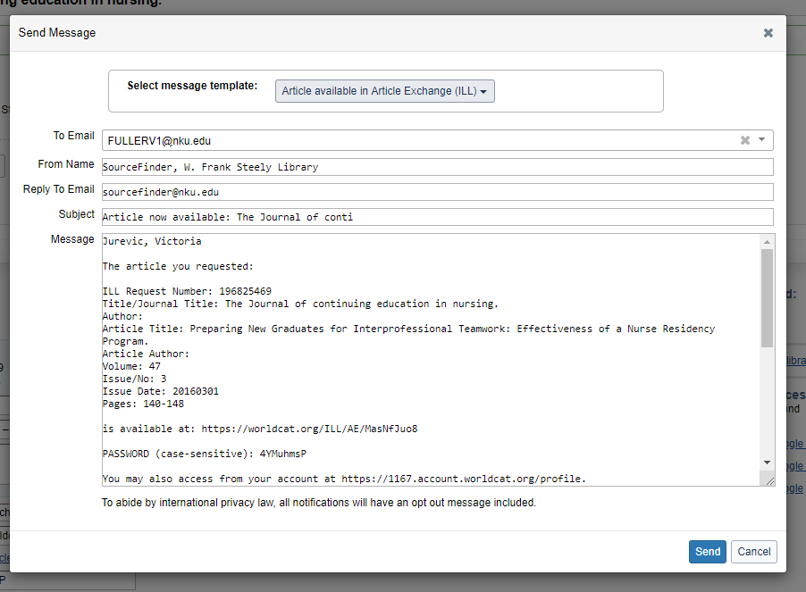
CCC-Get it Now
Notes:
Select Template
Template Auto Fills
Confirmation that Email is Sent

Slide 31
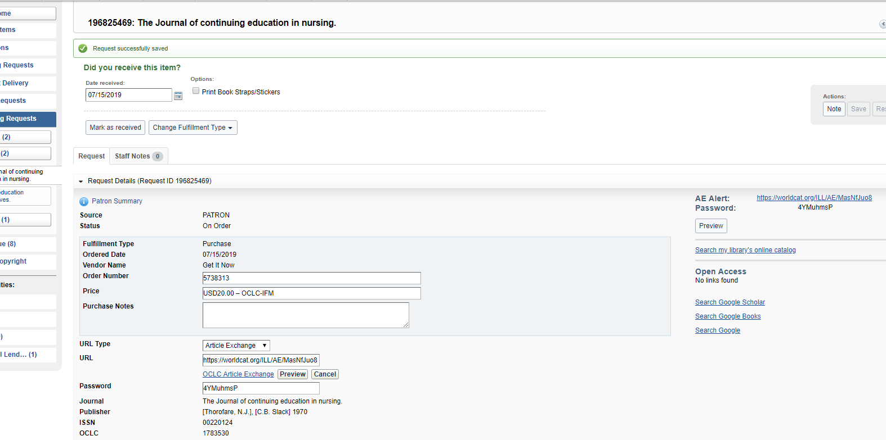
CCC-Get it Now
Notes:
Mark Request as Received

Slide 32
CCC-Get it Now
Notes:
Mark Request as Received

Slide 33
Articles–Other Vendors
Notes:
ERIN STARTS
Article Galaxy/Reprints Desk process
Tipasa opening layout
See Borrowing Request that have copyright questions

Slide 34
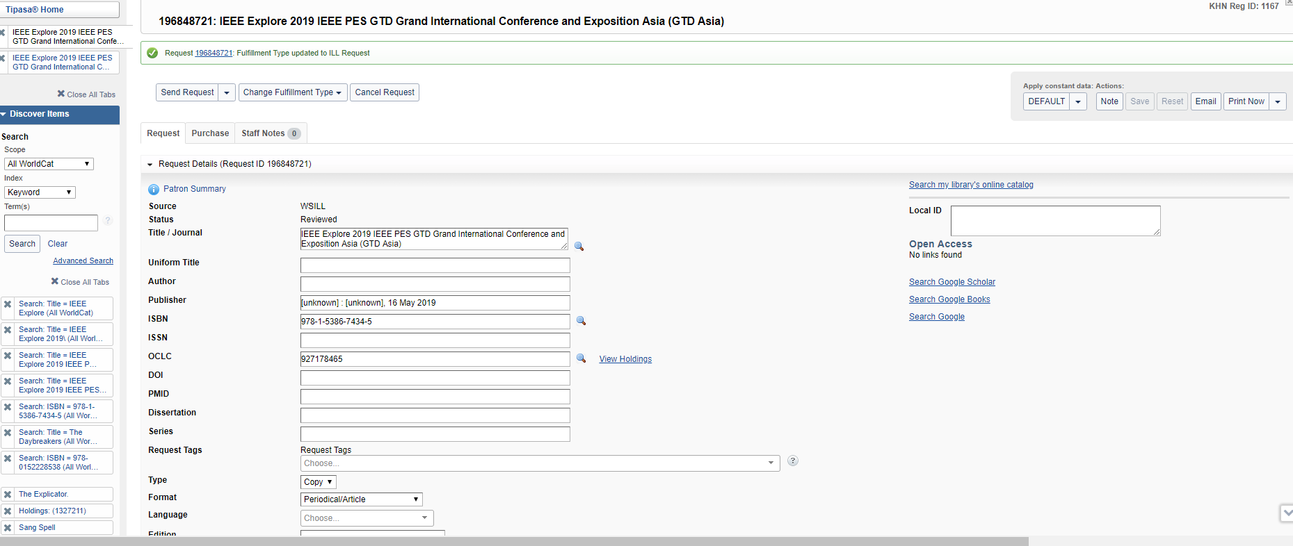
Articles–Other Vendors

Slide 35
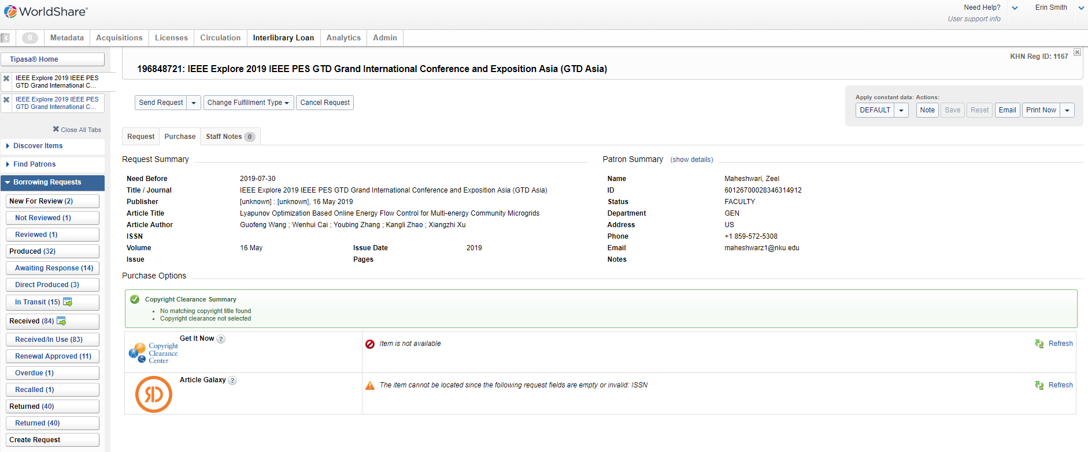
Articles–Other Vendors

Slide 36
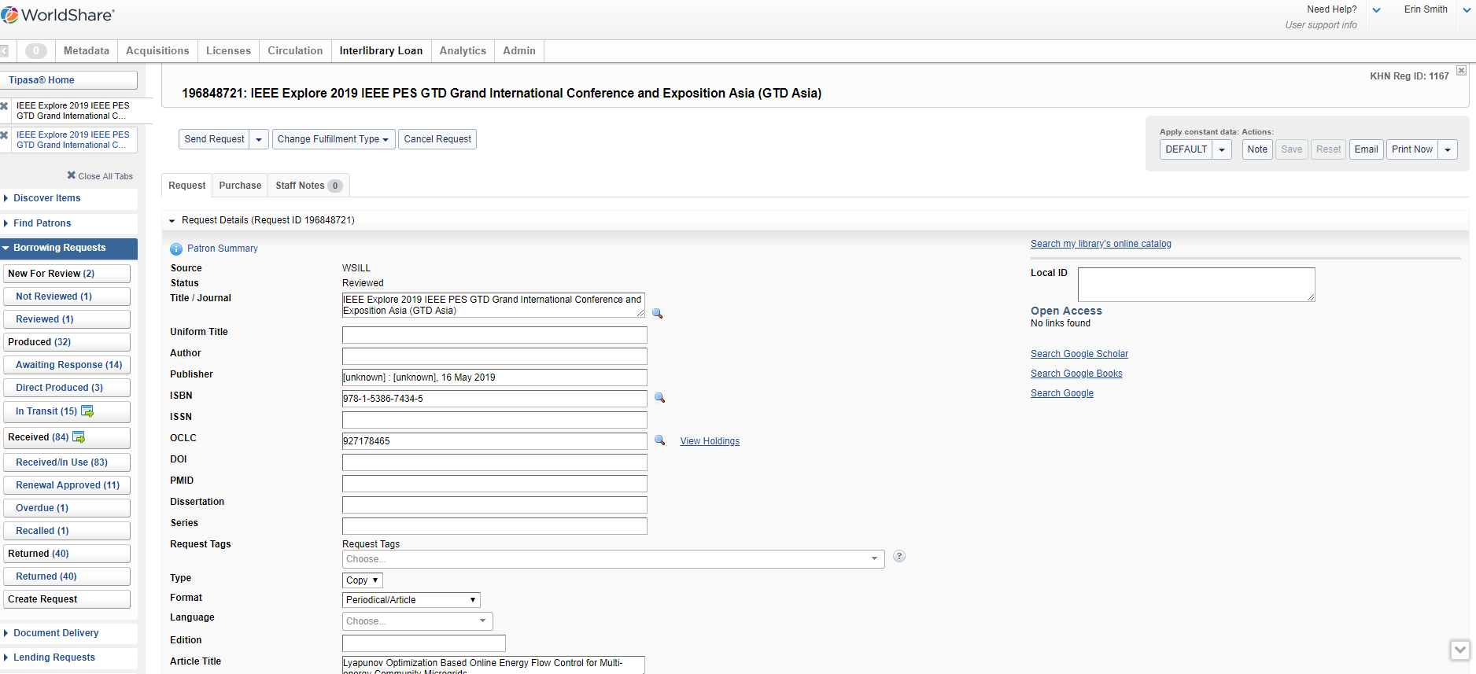
Articles–Other Vendors
Notes:
Email acquisition staff

Slide 37
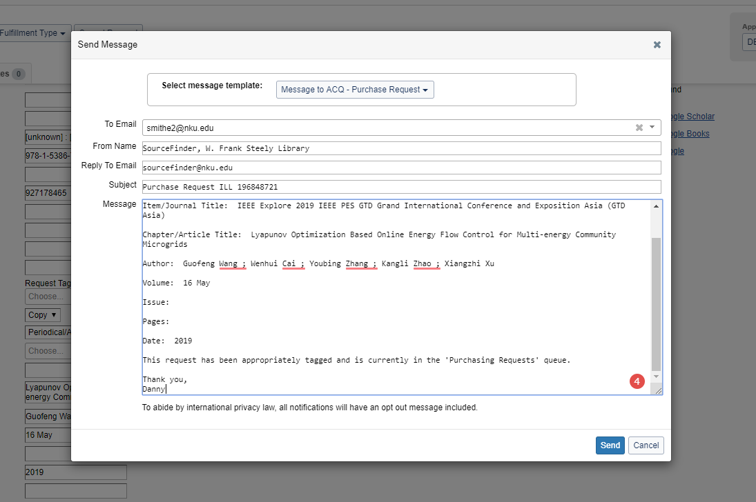
Articles–Other Vendors

Slide 38
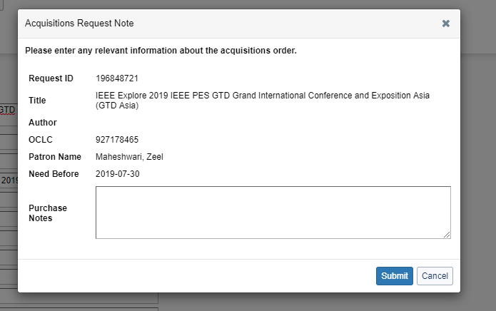
Articles–Other Vendors

Slide 39
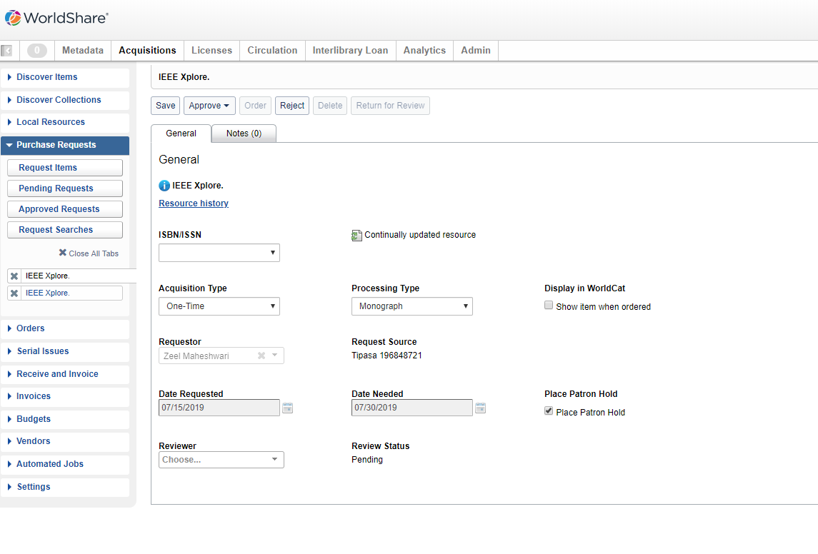
Articles–Other Vendors
Notes:
Here is what the request looks like in ACQ – we will need to discuss further with Lois if she would like us to track this in ACQ for Visa. - I think it’s a good idea!
Right now, I just say decline and work from the ILL side and Joey would manually enter this information when the visa bill arrives.

Slide 40
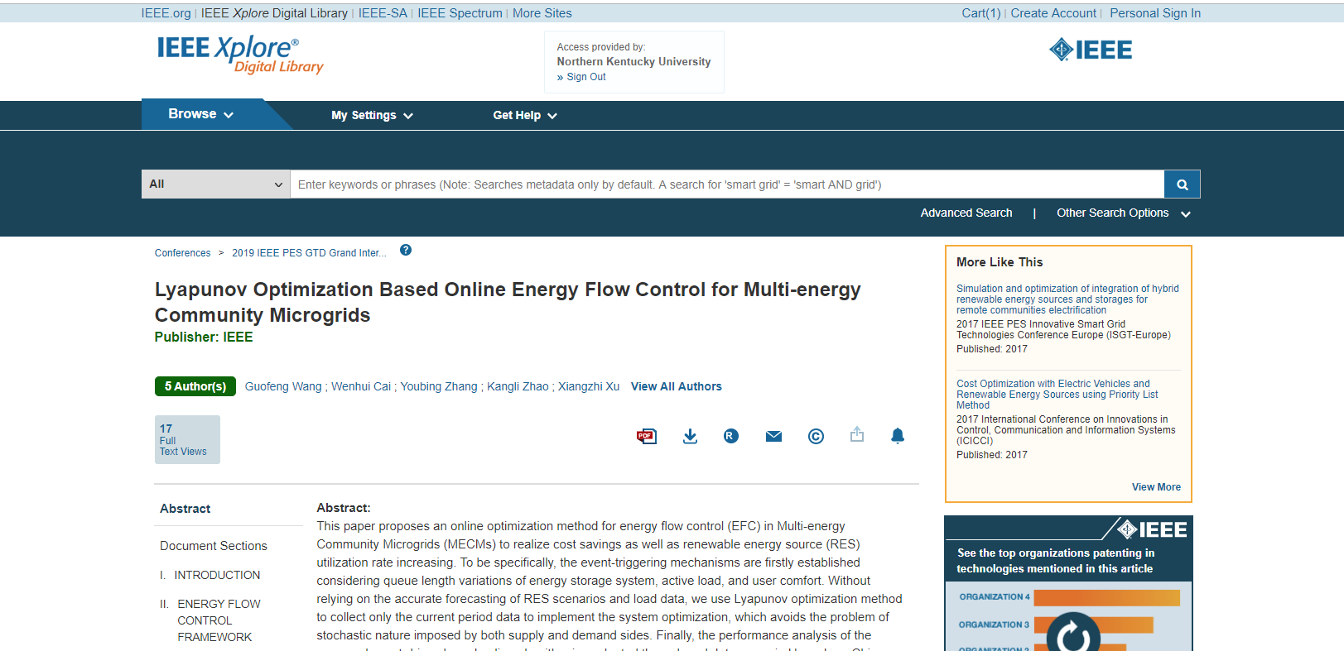
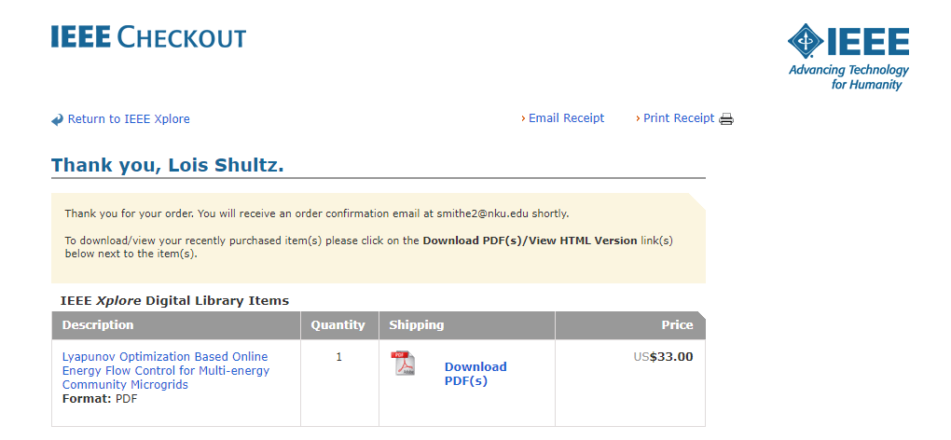
Articles – Other Vendors
Notes:
Purchase from vendor

Slide 41
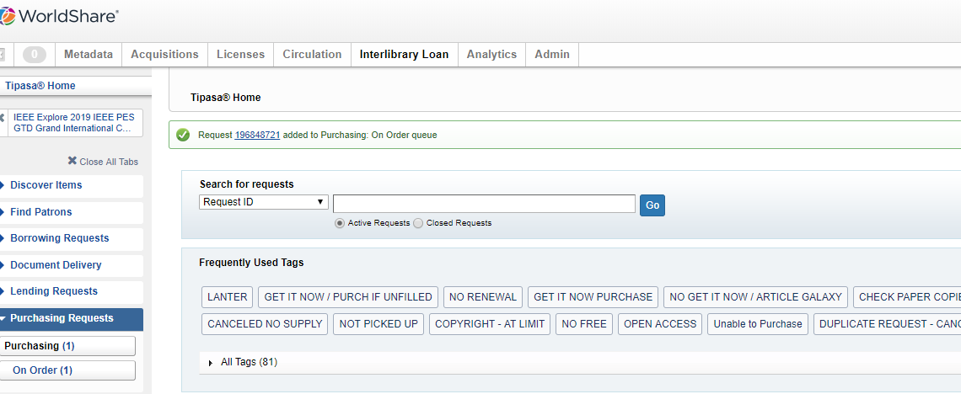
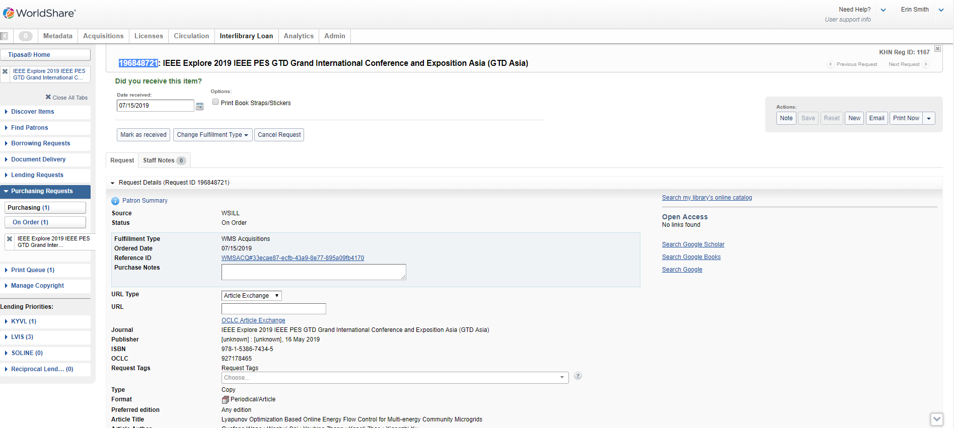
Articles–Other Vendors

Slide 42
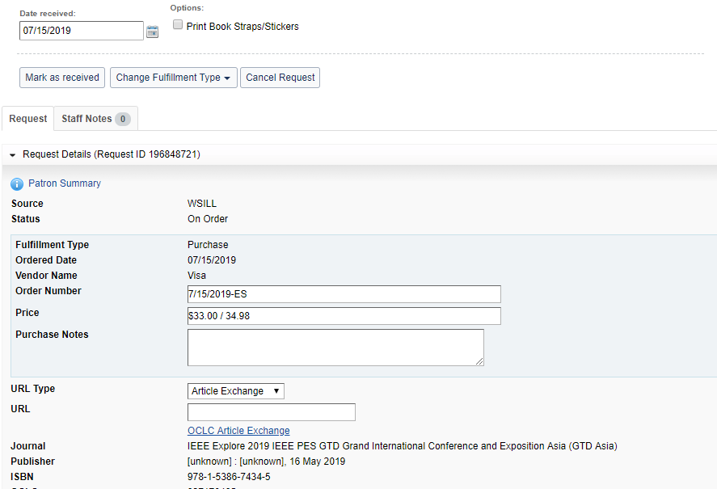
Articles – Other Vendors
Notes:
Open Request
Change Fulfillment types to Purchase Request

Slide 43
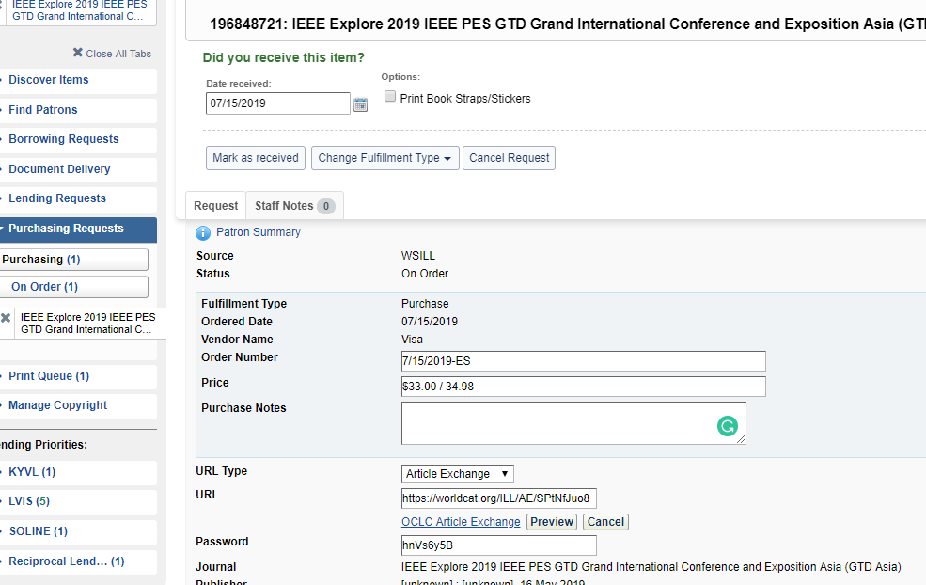
Articles – Other Vendors
Notes:
Upload document

Slide 44
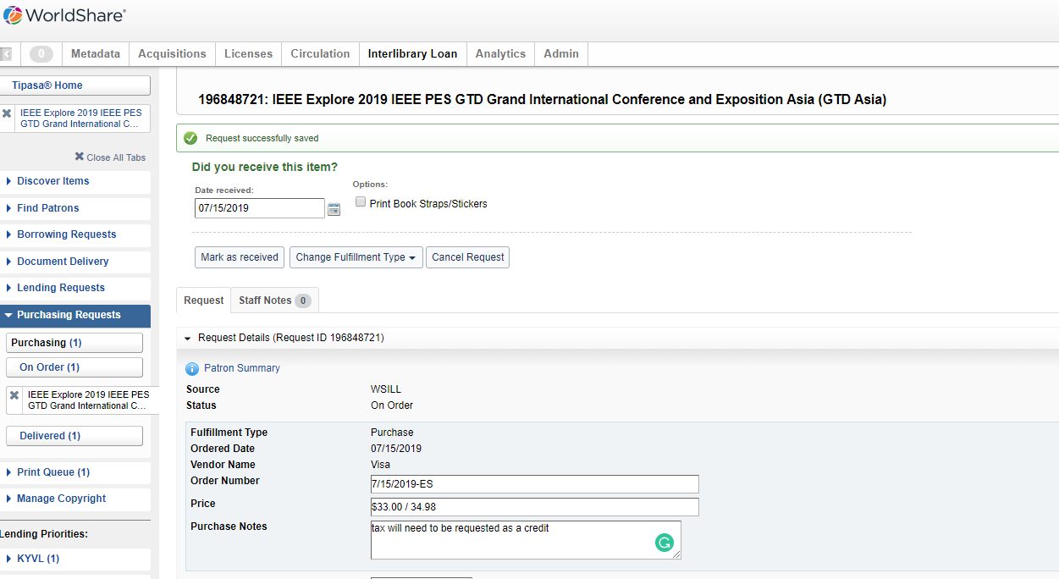
Articles – Other Vendors
Notes:
Add tag and add purchase notes / save progress

Slide 45
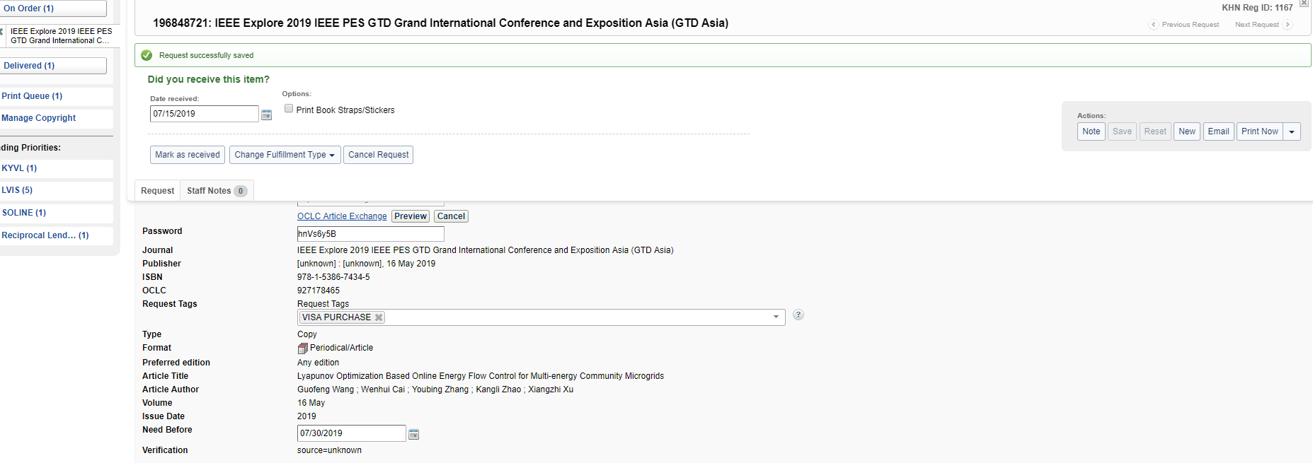
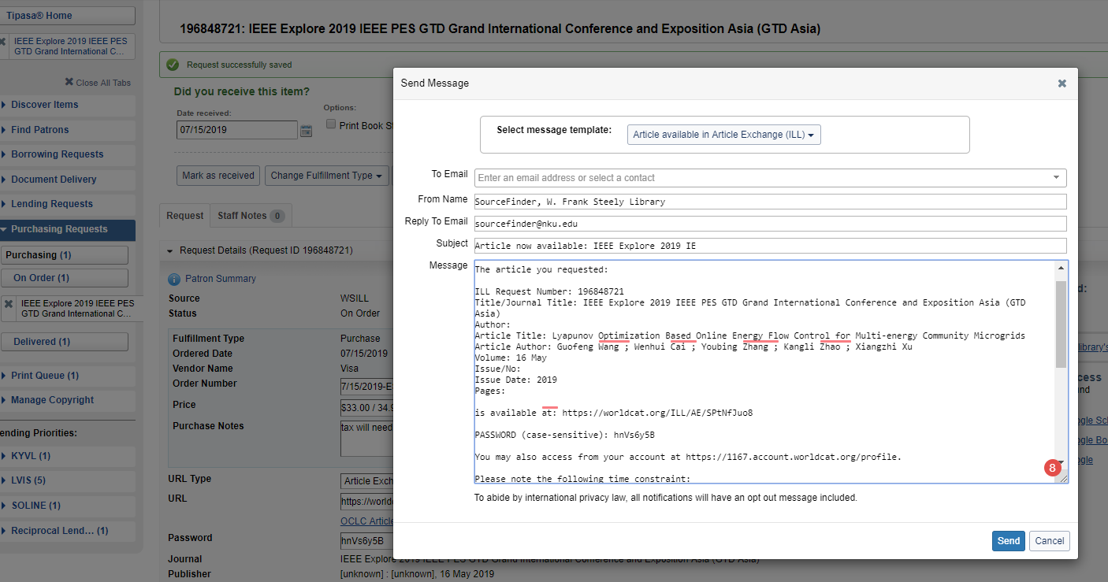
Articles – Other Vendors
Notes:
Use template to email

Slide 46
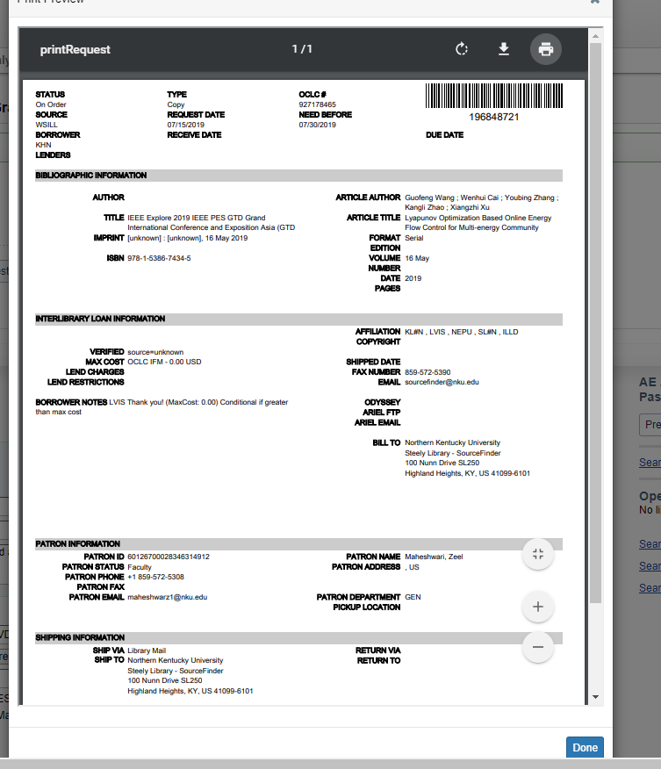
Articles – Other Vendors
Notes:
Print Request for Visa Records

Slide 47
Articles – Other Vendors
Notes:
Mark as Recieved

Slide 48
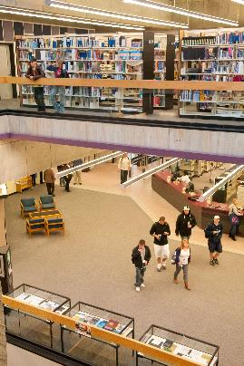
Purchasing Books
Purchasing process would be like other vendor requests for articles
Purchase request feature is working great for us
Like to explore the WMS acquisitions integration with Tipasa

Slide 49
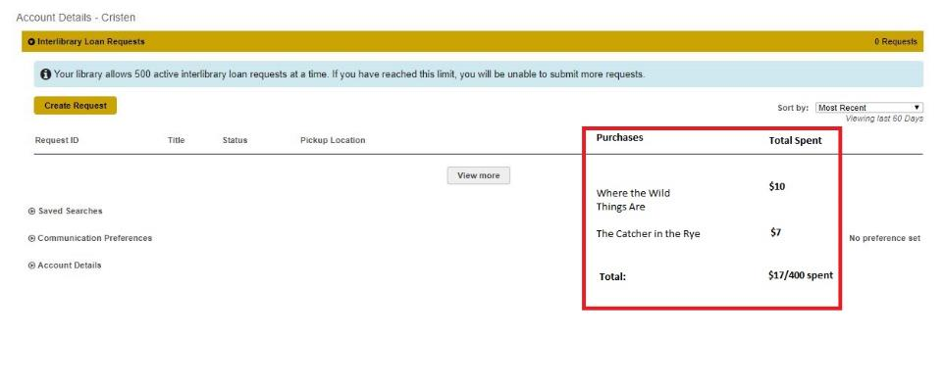
The Future
Notes:
We would love the ability to add acquisitions information into what the user sees in their account. For instance, say a faculty member has used $200 of their allotted SourceFinder budge and also, $325 of their department budget. It would be convenient if faculty could see this information, when they sign in to their accounts.
Would want to see Acquisitions/Tipasa integration for faculty orders
Erin, can faculty see that stuff has been ordered in their account when it goes into AQU? - No these are reports I have to create for each individual if they ask. (ERIN)

Slide 50
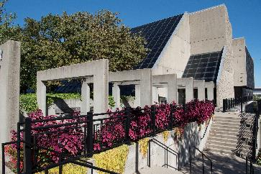
Questions?
Cristen Ross
Extended Collections Librarian
rossc2@nku.edu
Erin Smith
Extended Collections Certified Assistant III
smithe2@nku.edu

