Slide 1
Understanding User Behavior Related to Interlibrary Loan Requests: Insights from the Entire Journey
Heidi Webb
Head of Discovery and Technology Services
Upstate Medical University
IDS Project Summer Conference 2023

Slide 2
Overview
Upstate Medical University and Library Context
ILLiad Authentication and OpenAthens
User Registration in ILLiad
ILLiad Web Pages
Website Tracking and User Journeys
Alma Link Resolver
ThirdIron Products
Primo VE Usage and Alterations
Wrap-Up

Slide 3
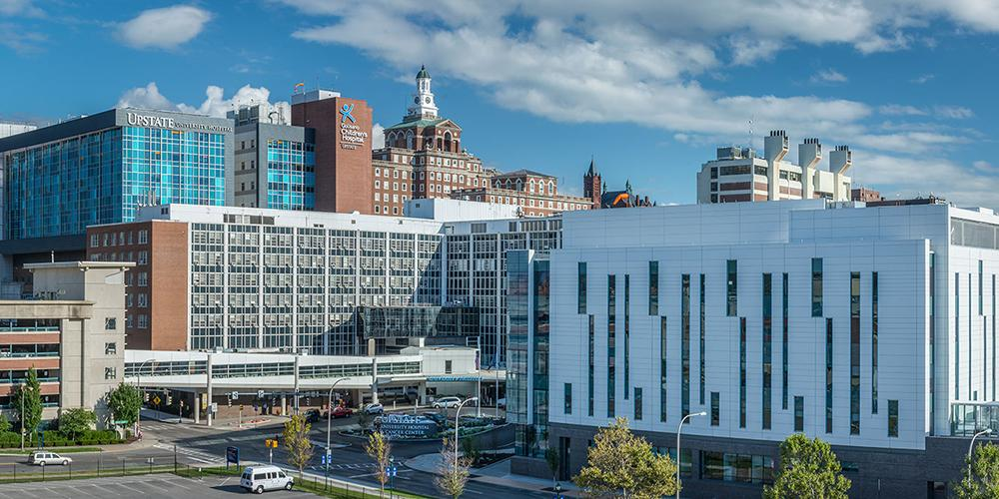
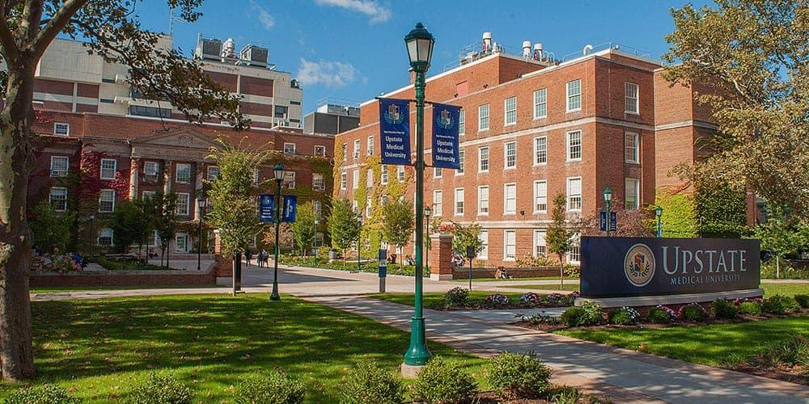
Upstate Medical University
Academic Medical Center
4 Colleges
1,600 Students
11,000 Employees
600 Residents
Two Hospitals
Additional Outpatient Facilities
752 Licensed Beds
https://www.upstate.edu/about/glance.php | https://www.upstate.edu/com/special_opps/md-mba/index.php | https://www.upstate.edu/nursing/units/
Notes:
about 125 Academic Medical Centers in the US - combines education, research, and clinical care at the same institution

Slide 4
System Landscape at Upstate
ILLiad
Alma Resource Sharing
Worldshare ILL
Docline
RapidILL
IDS Logic
OpenAthens
MS Azure
Local
Libkey
Alma (part of SUNY NZ)
Primo VE
Matomo
Databases, etc.
Notes:
11K borrowing, 2K Doc Del, and 3K Lending.

Slide 5
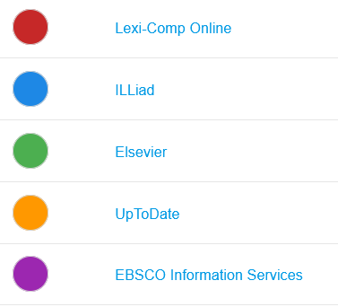
Authentication into ILLiad
Single Sign On through OpenAthens configured September 2022
2023 Access Attempts – Top 5 Resources
14 %
https://pixabay.com/illustrations/medal-silver-award-competition-1622529/
Notes:
1st 6 months of 2023

Slide 6
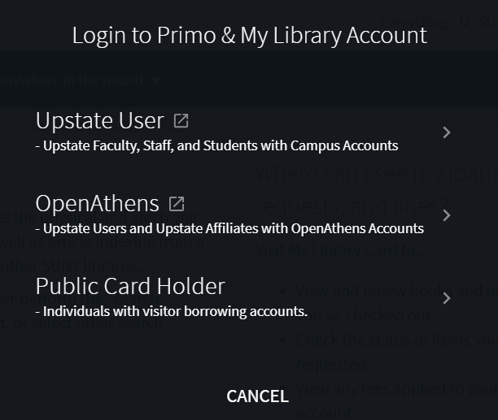
Positive Changes Commenced
Primo Authentication
Azure
OpenAthens
Local
Look and Feel - Generic My Library Account Login
Alma Just in Time User Creation
Permission Sets in OpenAthens
Notes:
Streamlined all the openathens access points - primo, iliad, e-resources – local OA accounts 100-150

Slide 7
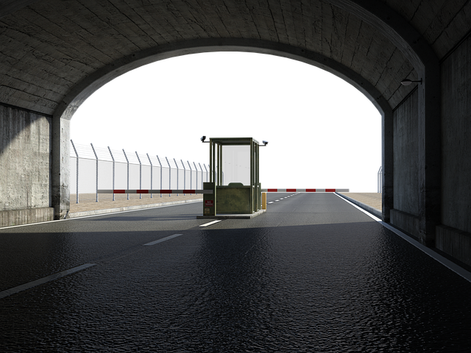
User Registration in ILLiad
Cleared Status = NEW
~ 850 since “unknown” – 2019? And SAML
~ 200 in 10 months since SAML go live
Barrier? New Barrier? Fewer Barriers?
Notes:
142 expired first 6 months of 2023, 240 set to expire in first 6 months of 2024

Slide 8
ILLiad Web Pages

Slide 9
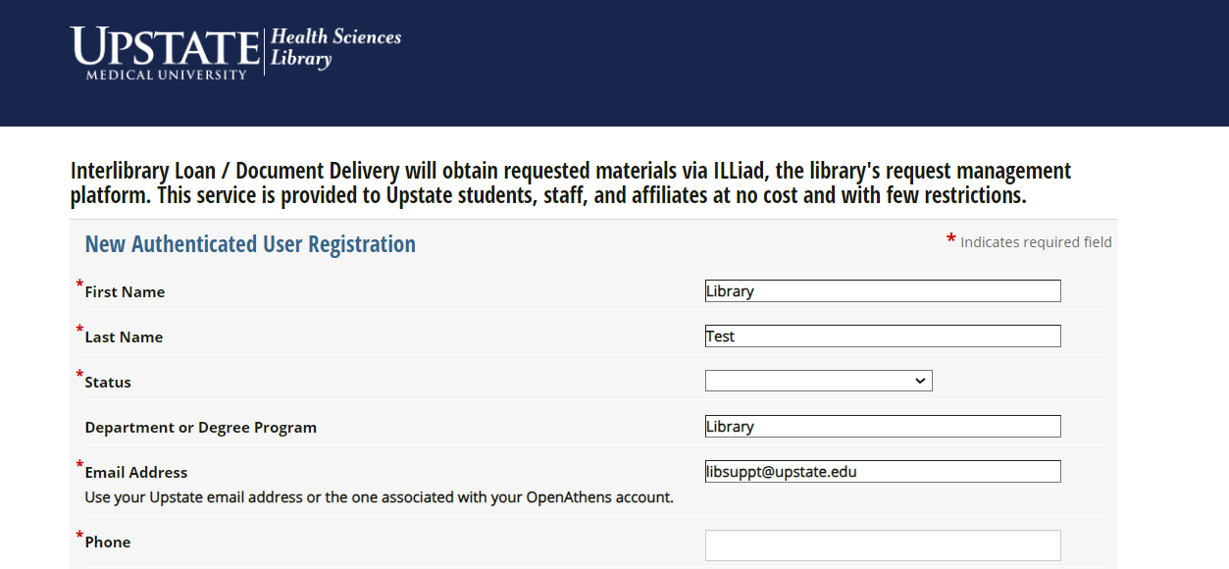
Webpage Changes: Current New User Registration
Added
Notes:
Point out wording change - “new authenticated user registration” and asking for phone

Slide 10
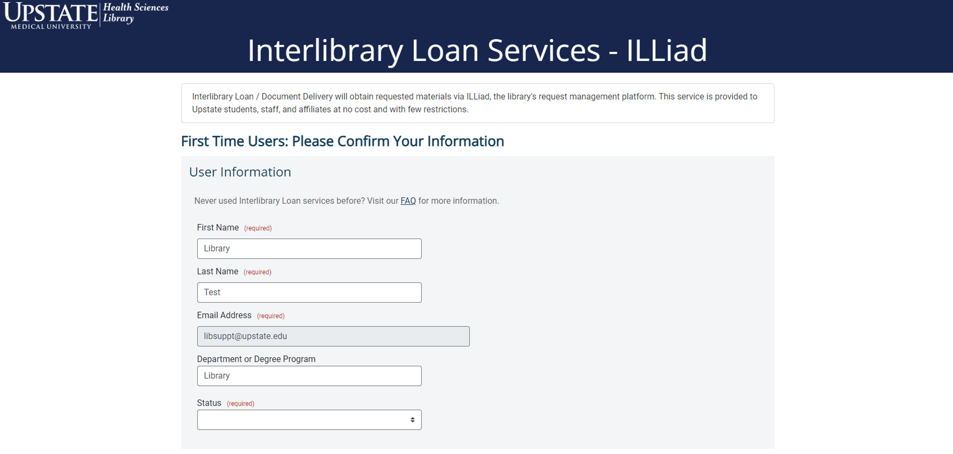
Upcoming New User Registration

Slide 11
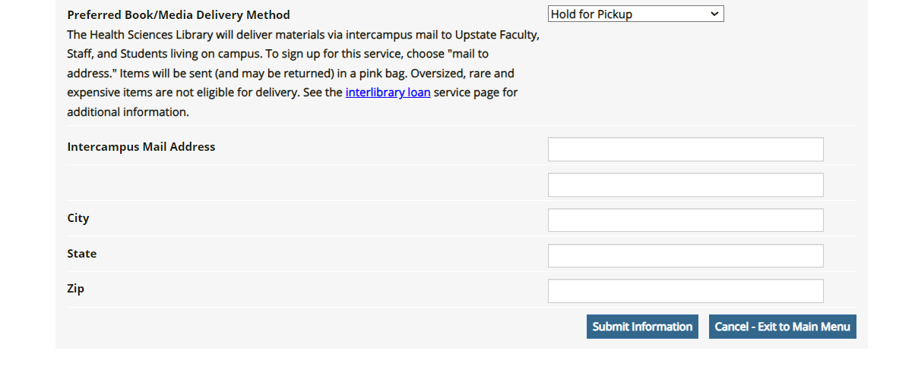
Current New User Registration - continued

Slide 12
Upcoming New User Registration - continued
Notes:
would eliminate user registration all together if the ability to choose delivery method per loan transaction rather than all of them

Slide 13
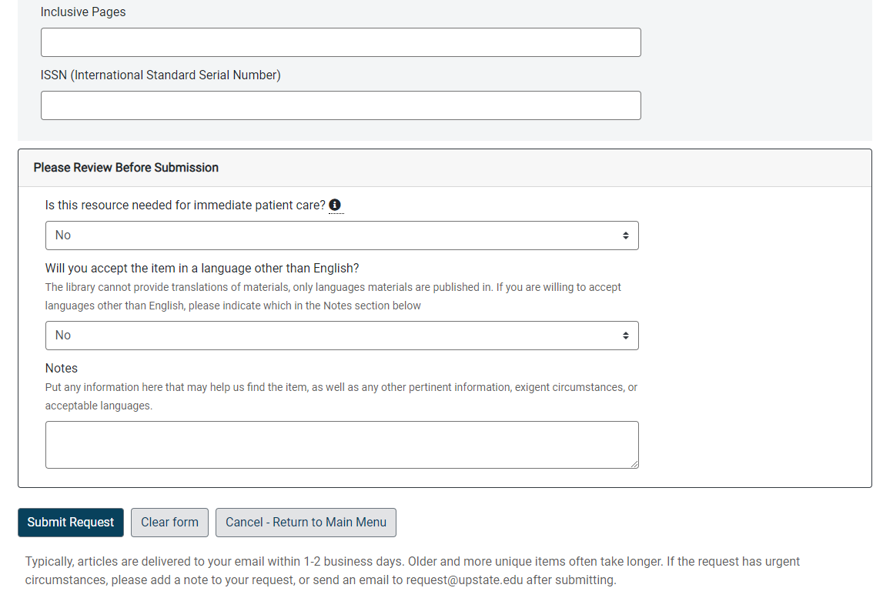
More Website Changes
Links to “My Library Account” in Primo and vice versa
FAQs
DOI & PMID Resolver integrated with Libkey
Delivery Expectations
Review Before Submission

Slide 14
Website Tracking
Benefits
Real World Data
Amount of Traffic a Page Gets
User Flow
Including Incoming and Outgoing Links
Considerations
User Privacy and Confidentiality
3rd Party Cookies
Single Page Applications and Progressive Web Apps (like Primo VE)
Private Browsing
Notes:
real data vs. what you think people should be accessing
3rd party cookies - can be blocked by default, user could block, treat your sites as ‘same site’
single page applications - that load one html file and call functions to load content on the page.

Slide 15
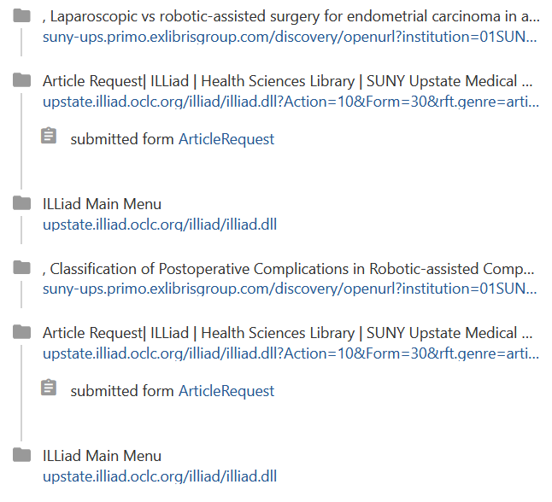
User Journey Example
PubMed
OpenUrl into Primo
Click ILL link
Article Request Page
Submit Article Request
Redirects to ILLiad Web Homepage
Repeat with Multiple Articles

Slide 16
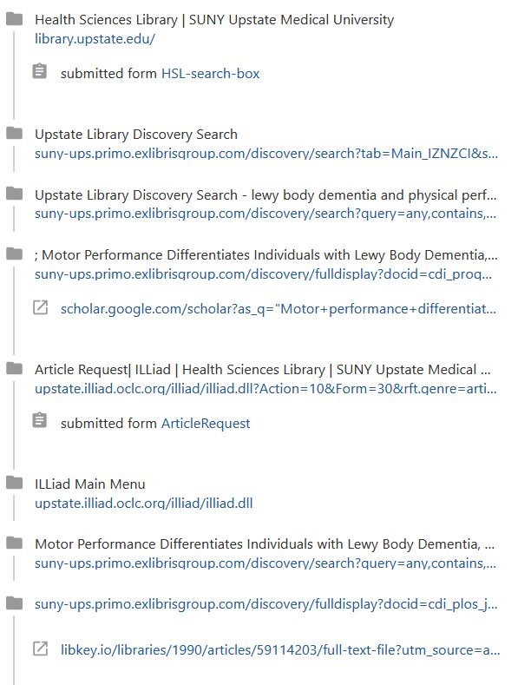
Another User Journey Example
Library Home Page
Used Search Box
Results
Edited Search
Clicked Record
Checked Google Scholar link
Clicked ILL link - Article Request Page
Submitted a Request
Webpage Redirected to Main Menu
Returned to Search Results
Revised Search
Clicked Full Text Link through Libkey

Slide 17
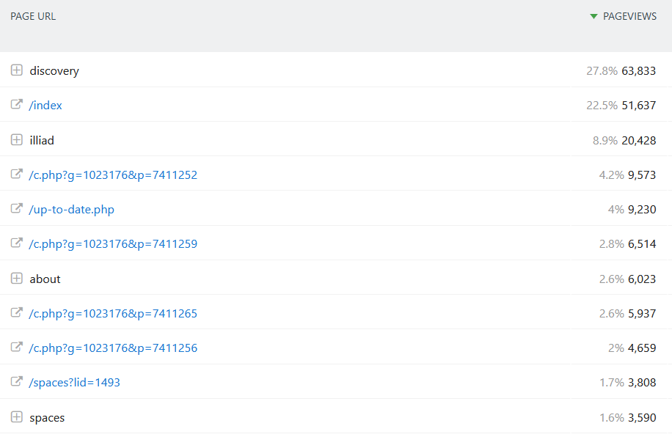
2023 Website PageViews
Notes:
Caveat – discovery will be higher because I just figured out how to track each url change in late June
About – study rooms, library directory, printing, hours

Slide 18
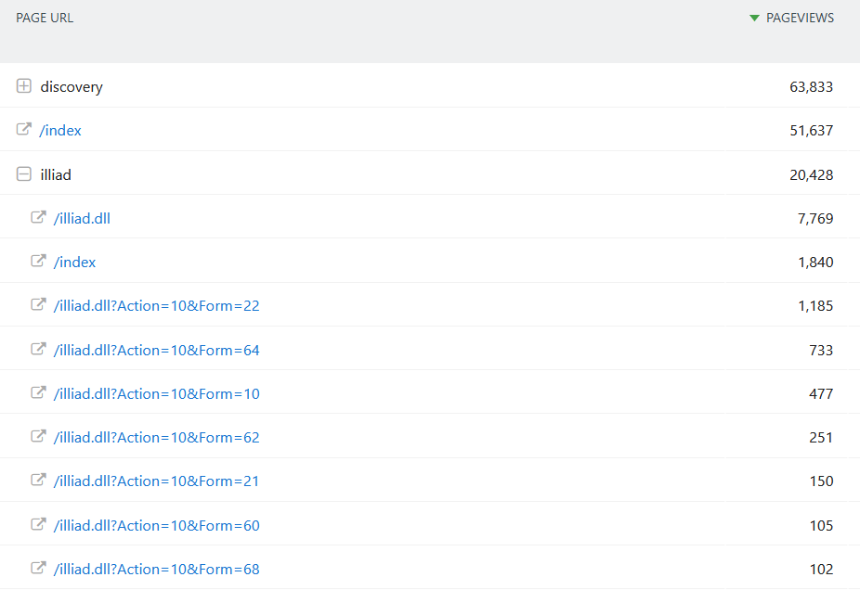
2023 PageViews - Focused On Top ILLiad Pages
OpenUrl Entries > 7,000
Article Request
Electronic Delivery
ILLiad Main Menu
View Outstanding Requests
Loan Request
View All Requests
View Request History
Notes:
openurl entries are at the bottom of list as “other” because they have the full url and are ‘different’ pages
iliad.dll - many of these will be redirects after submitting a request
caveat - we are just about ready to launch new pages so we were going into the pages to login and then switch to testweb

Slide 19
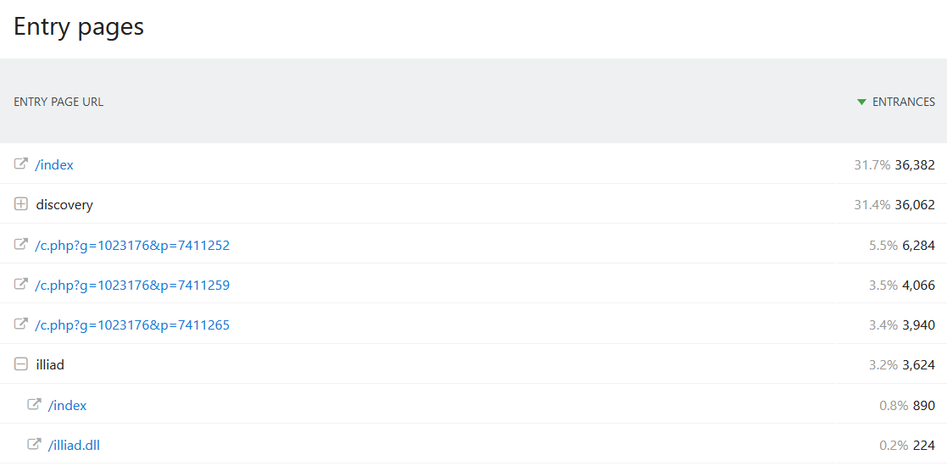
2023 - Users First Page

Slide 20
2023 Top 10 Typical User Flow Paths

Slide 21
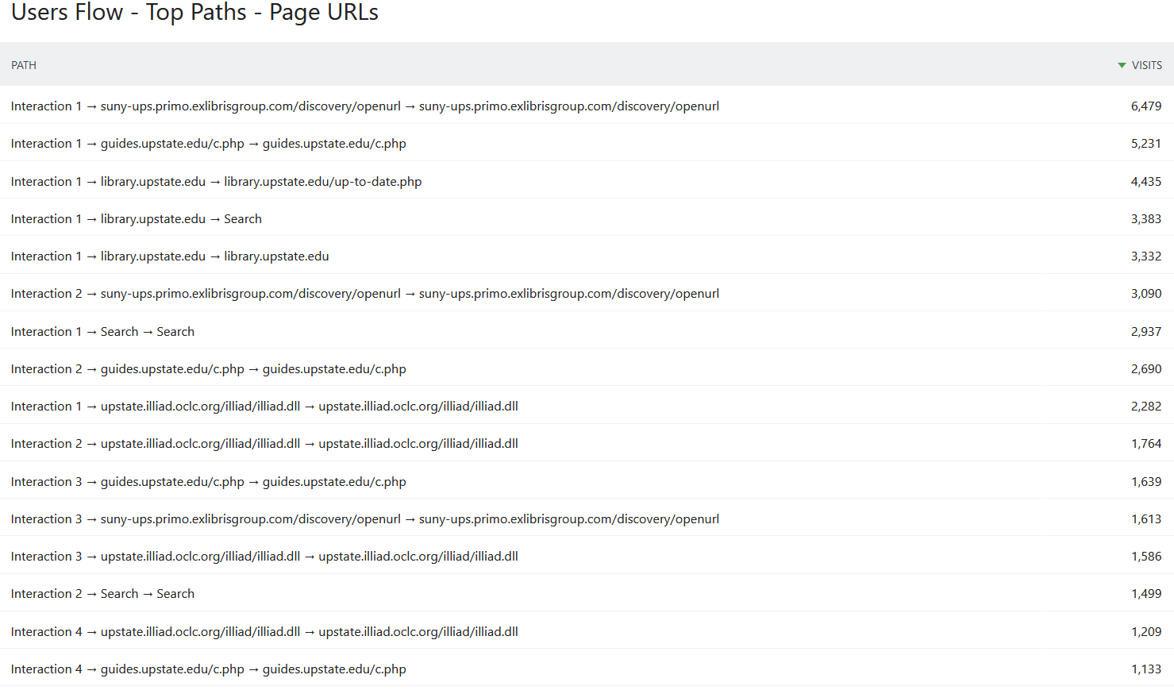
2023 Top 15 Typical User Flow Paths - URL

Slide 22
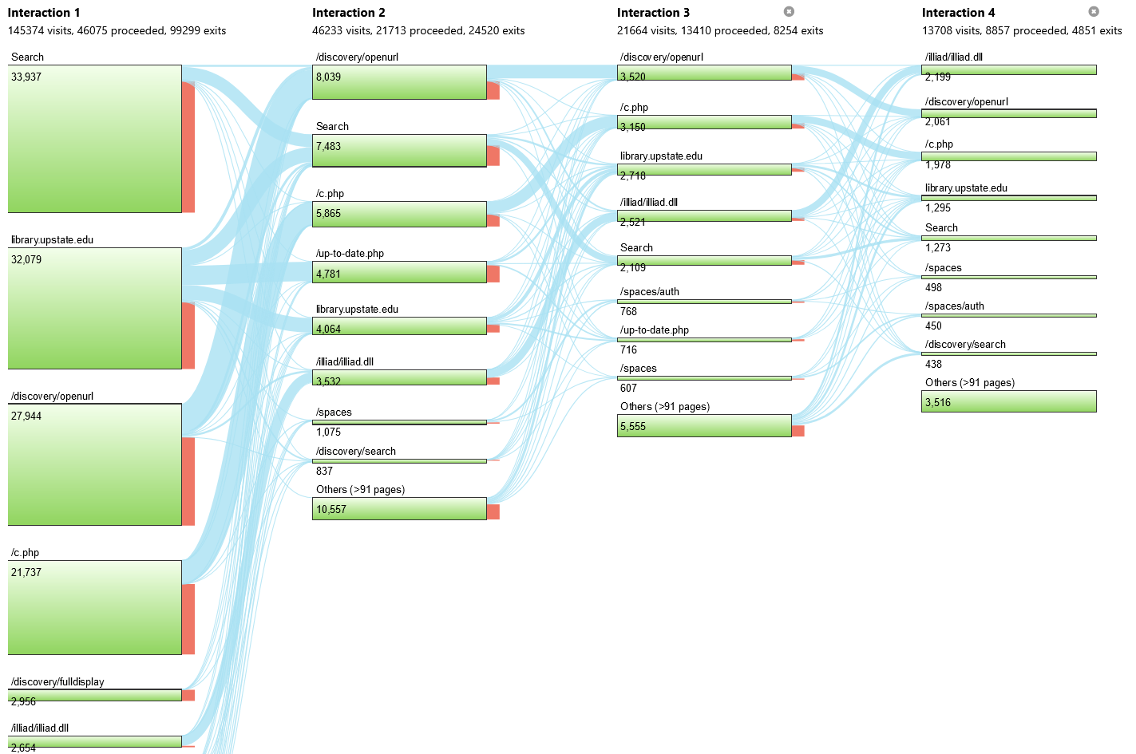
User
Flow

Slide 23
Link Resolver Usage

Slide 24
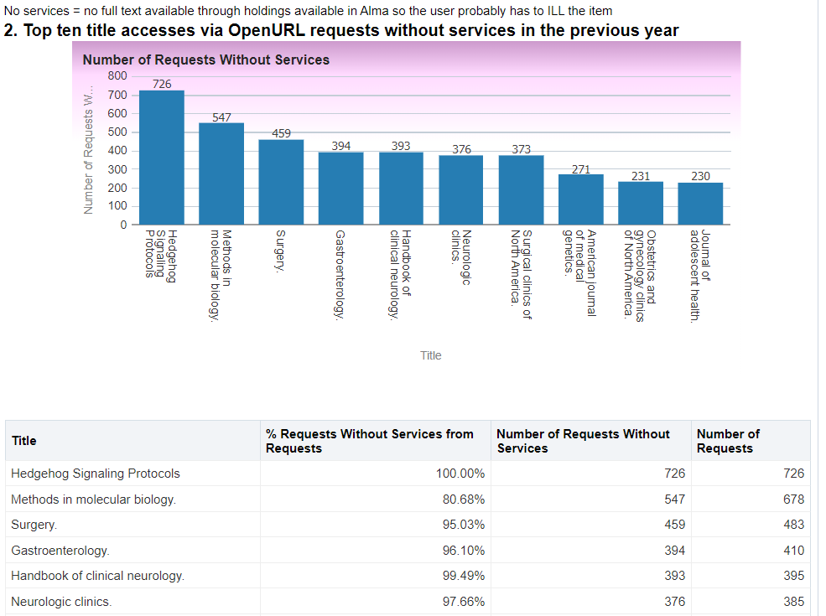
Alma Link Resolver – No Services
Out of the Box Alma Report
No Services = No Full Text
ILL may be the person’s next option
Notes:
Review GES’s and contemplating additional link at bottom with generic illiad link

Slide 25
Libkey / ThirdIron Traffic
Libkey Link is the ‘OpenURL’ from Major Platforms
ie: PubMed, GoogleScholar; ScienceDirect, etc.
Access Point in Several Other Places
Primo, ILLiad Addon, Browser Extension, ILLiad Webpages (coming soon)
Upstate prioritizes Version of Record
“Fallback” is a Primo OpenURL
40% of Full Text Links Considered OpenAccess
ThirdIron Full Text Service | Percentage of Traffic
LibKey Discovery and API Services | 35%
LibKey Link | 39%
LibKey Nomad | 20%
LibKey.io | 2%
BrowZine | 4%
Notes:
3500/4000 full text a month
Impact on user experience with ILL - give users ‘one-click’ type access. RS staff uses addon that has Libkey.io; will soon be in ILLiad webpages;
downfall - sometimes if the link doesn’t work, the user has no easy way to ILL

Slide 26
Discovery Layer Usage

Slide 27
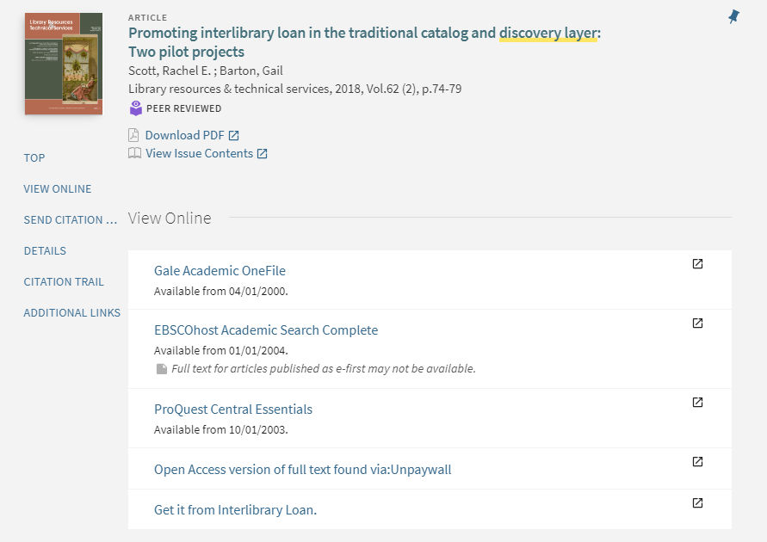
ViewIt Section In Primo
Notes:
Desire to track these outlinks, vendor resources are a ‘primo’ url and considered by website tracking as ‘part of domain’ but there is no tracking code as the link resolves so these need extra code to track

Slide 28
Top Outlinks – First Half of July 2023
“Outlink” | Clicks
hsl.upstate.edu (Short Urls) | 2,150
suny-ups.primo.exlibrisgroup.com (Resource in Primo ViewIt) | 471
libkey.io (Mostly Full Text from Primo) | 392
scholar.google.com (Link in Primo ViewIt) | 117
Bunch of Links
upstate.illiad.oclc.org (Link from Primo ViewIt) | 20
Notes:
view it section now getting tracked - some of the largest exit points besides short url system that mostly goes to databases
Note – people seem to be getting what they need without ILL, people are clicking to get to ILL

Slide 29
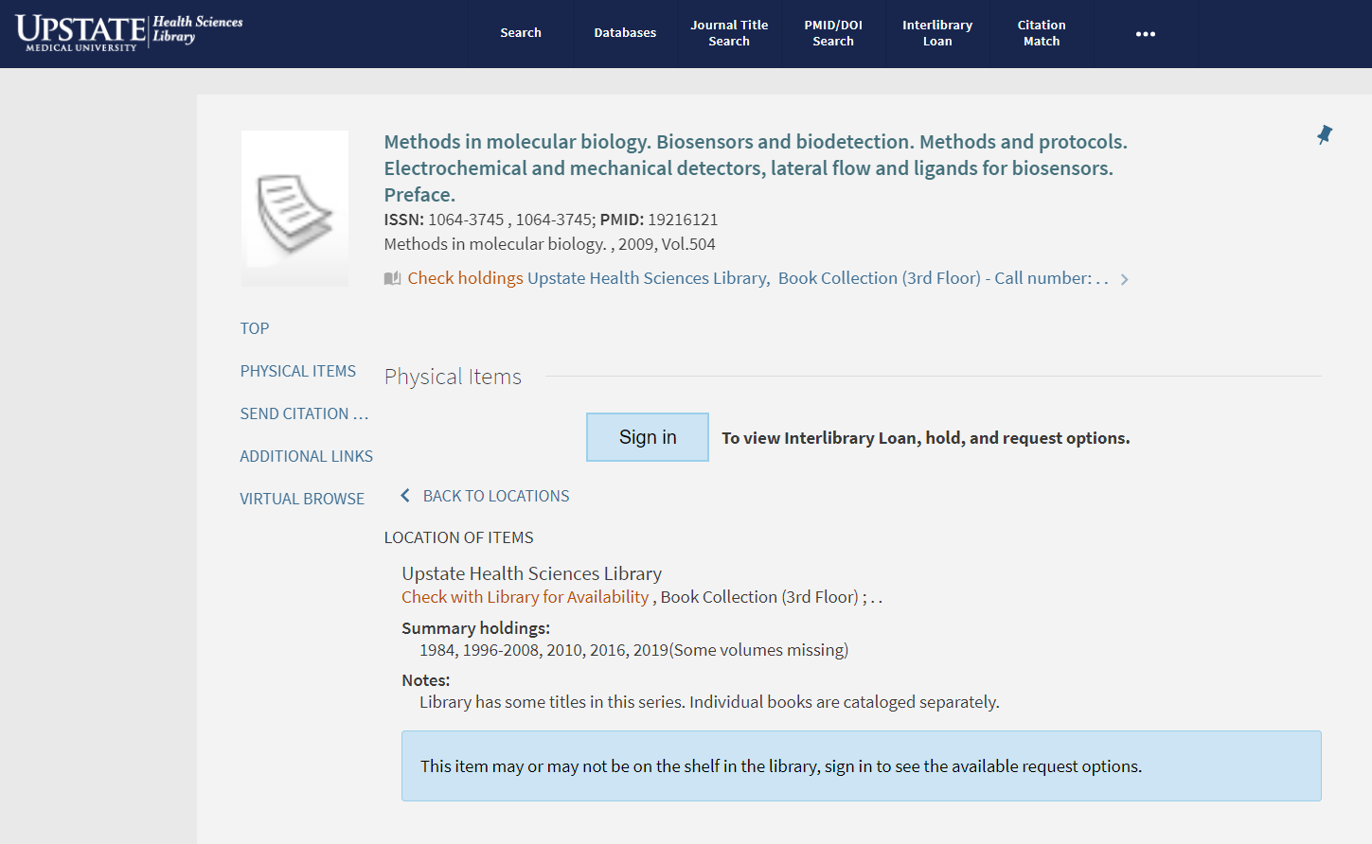
Primo Sign In Location Adjustments
Notes:
E-resources are in front of a login but because of the network zone and hold functionality and such, print is behind a login.
we have part of the record in print, so the link resolver and search results will display the print holdings - without being coverage aware
shortly after go live - I put sign in after holdings because, in my thought, ‘people should look at what we have before placing a hold or requesting’ - but above makes more sense - it’s more visible, less scrolling for open urls. plus, request, holds, other links display above the item details

Slide 30
Monographic Serials
Common Examples at Upstate
Methods in Molecular Biology
Advances in Neurology
Neurologic Clinics
Problems for Resource Sharing
Link resolver
Journal Search? Book Search?
Automation - Misses or Incorrectly Identifies “Owned”
Working to Improve Discovery and Backend Automation
Adding ISSN to all related records (773 local)
Adding Series Related to all related records (490/962 local)
Matching individual bibliographic record location/collection with series bibliographic record location/collection
Catalogers can be your Best
Friends!

Slide 31
Final Thoughts
Multiple Data Sources
Multiple Systems
Multiple Team Members = Collaboration
Ongoing Process
Integrate Library Resources And Enhance Discovery To Create Frictionless User Experiences

Slide 32
Questions
Heidi Webb
webbh@upstate.edu
https://pixabay.com/illustrations/question-mark-a-notice-duplicate-2153533/

