Slide 2
IDS Project Conference • July 26, 2019
Use your ILL system more efficiently
Alena Miller
Product Manager, Resource Sharing

Slide 3
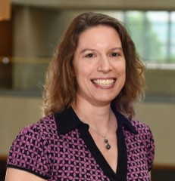
Alena Miller
Product Manager, Resource Sharing

Slide 4
Today’s topics
Why this topic?
Importance of Schedule and Contacts
Using deflections to your advantage
Tips for Constant Data
How Direct Request helps in big ways
Putting it all together
Looking forward

Slide 5
Why this topic?

Slide 6
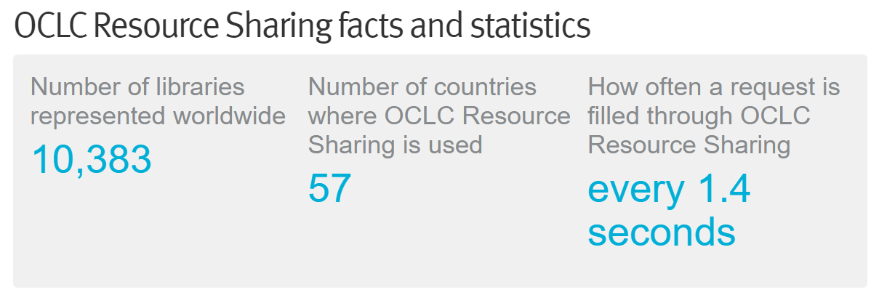

Slide 7
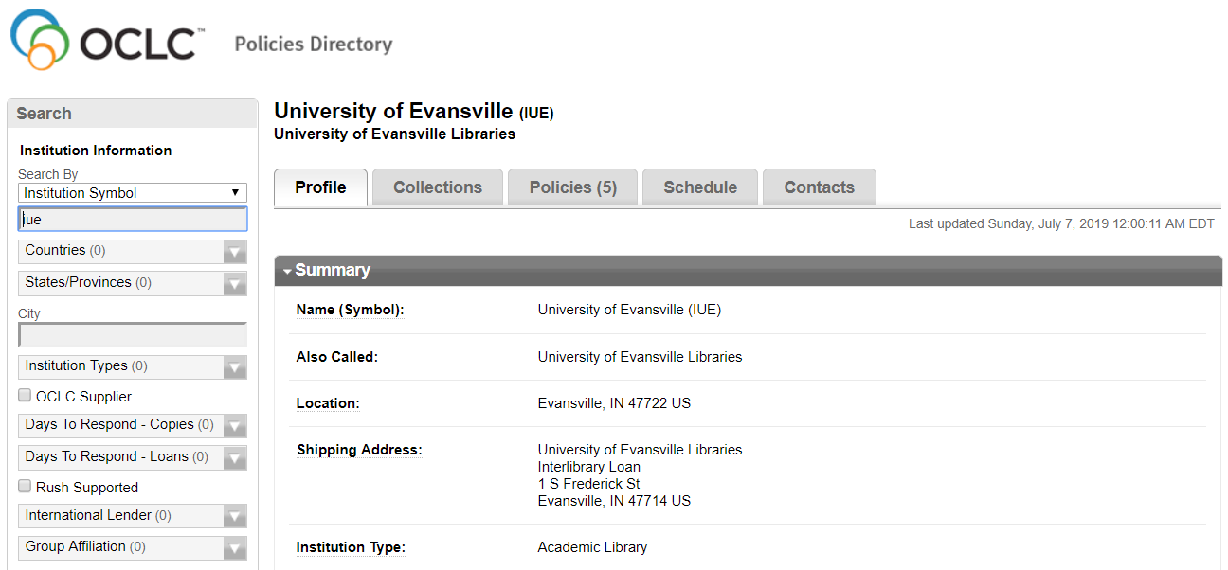
Policies Directory – main profile page

Slide 8
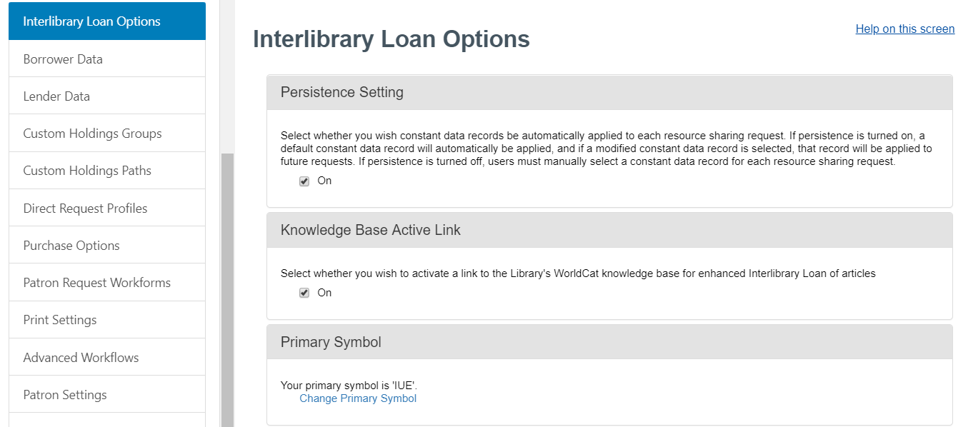
Service Configuration – ILL options

Slide 9
Importance of schedule and contacts

Slide 10
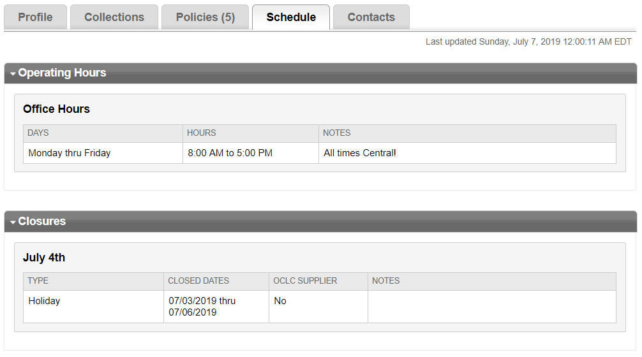
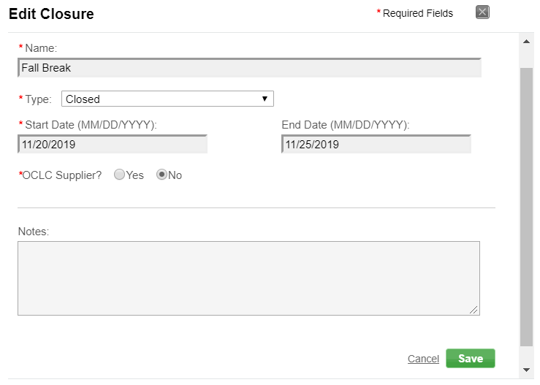
Importance of Schedule

Slide 11
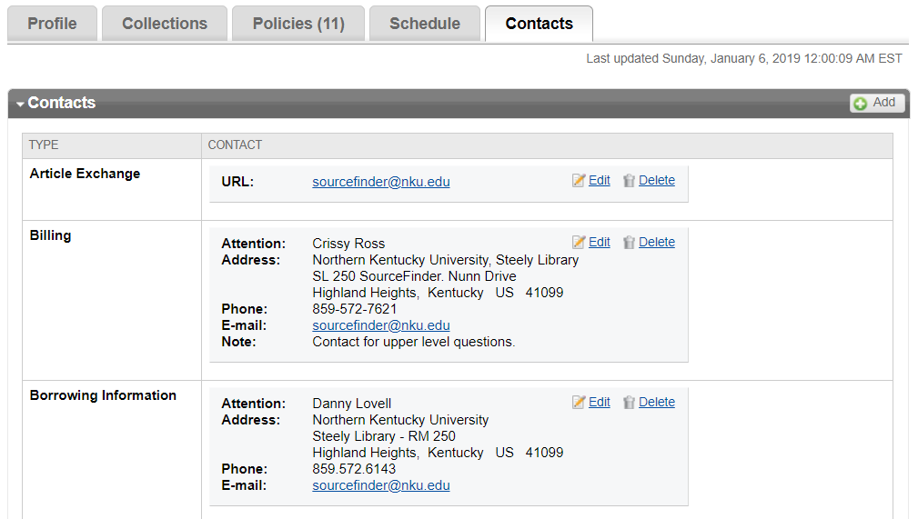
Importance of contacts

Slide 12
Using deflections to your advantage

Slide 13
Deflections vs Policies
Informational only
Actually auto-deflect requests

Slide 14
What can I deflect on?
Service
Loan
Copy
Loan or Copy
Borrowers
OCLC Profile Group
Custom Holdings Group
Fees
Borrower max cost
Item
Format
E-License Terms
Material Age
Combinations

Slide 15
Examples of common deflections
Deflecting very new or very old materials
Deflecting e-books
Deflecting based on max cost
Deflecting knowledge base collections

Slide 16
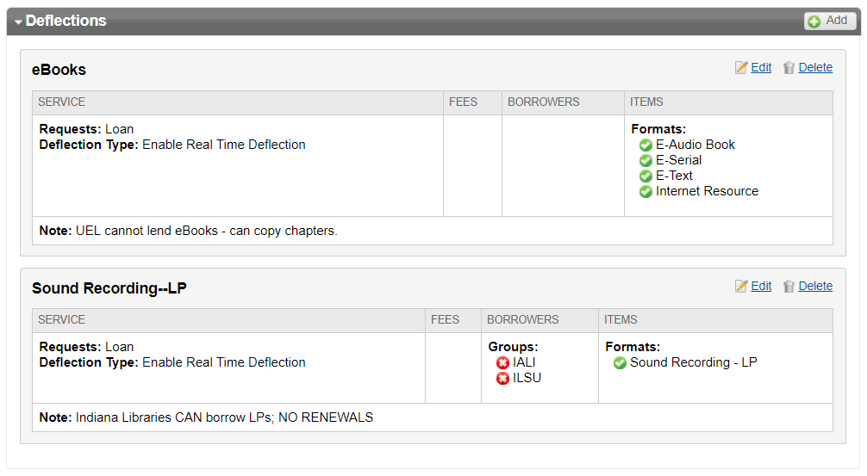

Slide 20
Tips
Base your deflections on request type, item format, fees, groups, or some combination of these
But keep it simple – just one or two attributes per deflection
And review policies periodically
Auto-deflecting helps get requests more quickly into the hands of lenders that can supply them

Slide 21
Tips for Constant Data

Slide 22
Include for borrowing…
Need Before
Request Type
Editions
Shipping and Contact Info
Bill to
Ship Via
Electronic Delivery
IFM
Max Cost
Copyright compliance
Affiliations
Billing Notes
Borrowing Notes
Patron fields

Slide 23
Common borrowing scenarios
Situation | Suggestion
You regularly request both articles and books | Create a CD record for copies and another for loans
A faculty member is a regular ILL customer | Create a CD record that includes patron information
You want lenders to ship materials directly to branches | Create CD records with a different Ship To address for each branch location
The amount you’ll pay differs by type of material | Create a CD record for each material type with the appropriate Max Cost
You require IFM | Check the IFM box for all CD records

Slide 24
Include for lending…
Due Date
Shipped Date
IFM
Lending Charges
Insurance Amount
Lending Notes
Lending Restrictions
Return to
Return Via

Slide 25
Common lending scenarios
Situation | Suggestion
You regularly lend both articles and books | Create a CD record for copies and another for loans
You want borrowers to return materials directly to branches | Create CD records with a different Return To address for each branch location
The amount you charge differs by type of material | Create a CD record for each material type with the appropriate Lending Charges
You lend to some libraries for free but charge others | Create a CD record with no charge and another with Lending Charges
You allow IFM, invoice, IFLA vouchers, etc. | Create separate CD records for each payment type

Slide 26
Common pitfalls
Keeping around old or unused CD records – delete them!
Local addresses (ILLiad) not in sync with borrower CD
Issues with persistence (WorldShare ILL and Tipasa)

Slide 27
Tip – borrowing CD
Ensure borrowing DEFAULT includes only information that applies for most requests:
Shipping and Contact Info
Bill to
Ship Via
Electronic Delivery
IFM – if you charge
Max Cost – if applicable
Copyright Compliance
Affiliations
Billing Notes
Borrowing Notes

Slide 28
How Direct Request helps in big ways

Slide 29
Why use Direct Request profiles?
Automate processing of borrowing requests
Easier requests go through without staff intervention – frees up time for more challenging requests

Slide 30
Match on things like…
Request Type
Patron Status
Patron Department
No Later Than date
Format – use sparingly
Language

Slide 31
Specify whether to…
Check if held by your institution
Check if held by Custom Holdings Group
Route to Review for Purchase
Apply Constant Data
Require minimum number in lender string
Send to New for Review or automatically send to lenders (based on Custom Holdings Path)

Slide 32
Common scenarios
Create a lender string
Check holdings (route for review)
Send book requests to lenders
Route certain requests to your purchase review queue (WorldShare ILL and Tipasa)

Slide 33
Keep in mind
Simple is best!
Create a profile for your most basic LOAN requests
Create a profile for your most basic COPY requests
Fill in only the relevant fields – leave others blank
Add more profiles and test at each step
Name profiles so that the most specific profile is listed first alphabetically
Patron Department and Status must match exactly

Slide 34
Good profiles are simple

Slide 35
Overly complex profile

Slide 36
Benefits
Lets easier requests go unmediated to free up staff time for handling the more challenging requests
Example
Erasmus University Rotterdam (Netherlands) in February 2019: 64% (187 of 293) borrowing requests were produced unmediated
Measure productivity using Borrower Resource Sharing Stats Report

Slide 37
Putting it all together

Slide 38
A powerful combination
Create Custom Holdings Path in Service Configuration
Use Direct Request to automatically build lender strings
Search Policies Directory for Libraries to borrow from

Slide 39
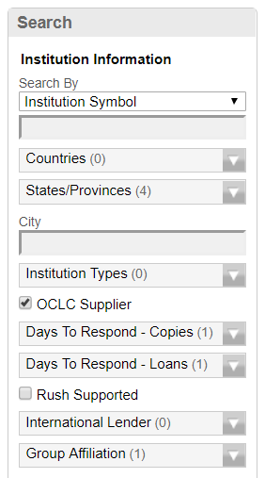
Searching to build lender string
States near me
“Uppercase”
4 days
LVIS

Slide 42
Custom Holdings Groups and Paths
Groups are lists of OCLC symbols of preferred lenders for a particular category of borrowing activities
Identify libraries by searching the OCLC Policies Directory or reviewing your borrowing history (in usage statistics)
Paths are groups listed in order of preference, for example, by geographic distance or amount charged

Slide 43
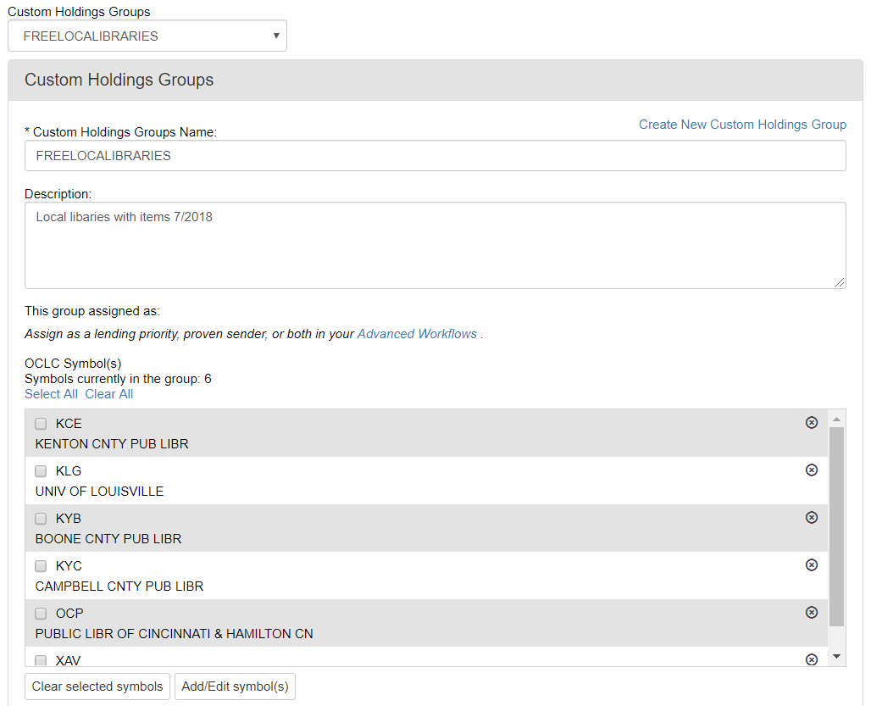

Slide 44
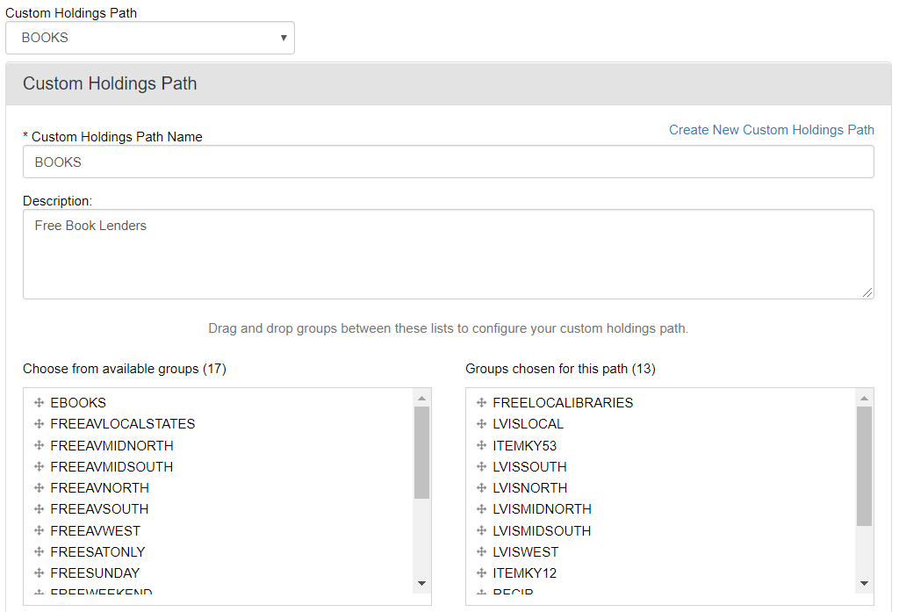

Slide 45
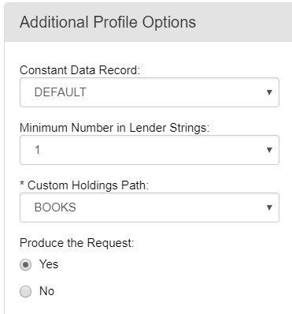
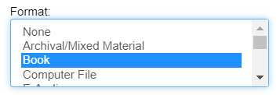
Direct Request
profile

Slide 46
Looking forward

Slide 47
Possible today in Tipasa
Route requests for items you own to Document Delivery
Clear copyright
Route requests to Purchase queue
Provide full unmediated workflow: Direct Request + Article Exchange Proven Senders

Slide 48
Upcoming Tipasa enhancements
Auto-tagging of requests
Improve on existing Direct Request capabilities for borrowing requests
Extend to other workflows like receiving borrowing requests and processing lending requests
Ensure these automations are easy for you to configure and maintain

Slide 49
Getting Assistance

Slide 50
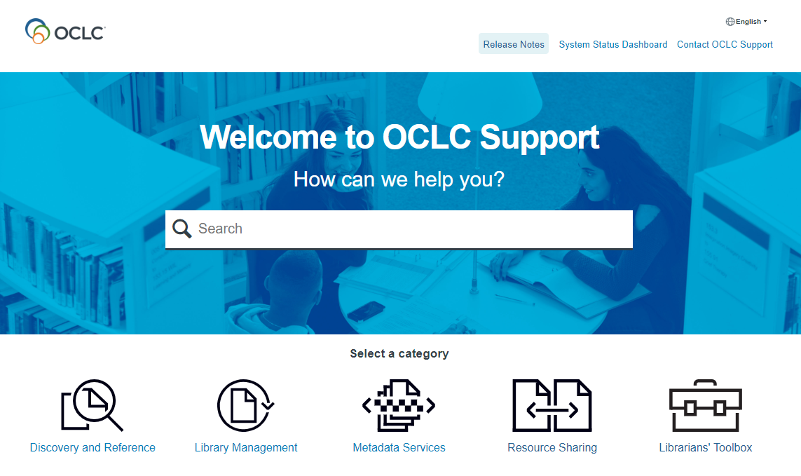
help.oclc.org

Slide 51
OCLC resources
Resource | URL or email
WorldShare ILL support Documentation, training, release notes | help.oclc.org support@oclc.org
OCLC Community Center Discussions, enhancement requests, news, events | oc.lc/community
Product Insights quarterly update webinars | oclc.org
OCLC Resource Sharing Conference San Antonio, TX, March 18-19, 2019 | oc.lc/rsc20
Resource sharing team | oclcresourcesharing@oclc.org
OCLC resources

Slide 52
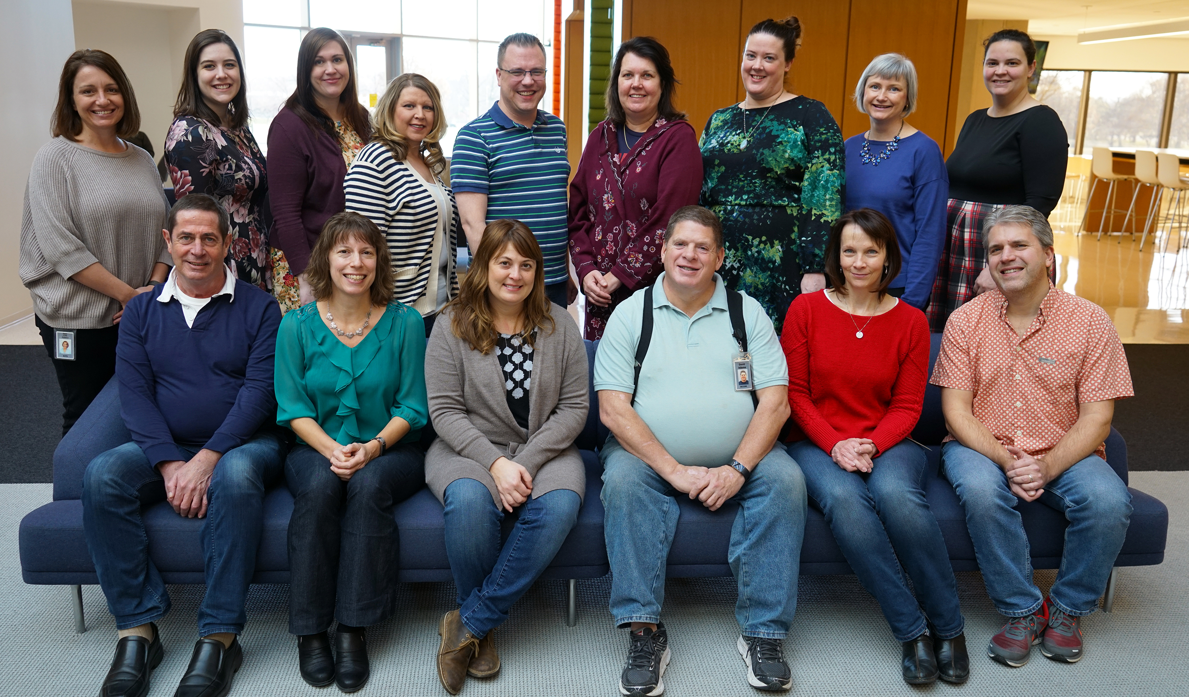
Resource Sharing team

Slide 53
Thank you!
Alena Miller
Product Manager, Resource Sharing
millera@oclc.org, 1-614-764-6119

