Slide 1

Using Custom Logic Rules to Solve Everyday Problems
Timothy Jackson
IDS Project Conference 2018
July 27, 2018
Utica College, Utica, NY

Slide 2
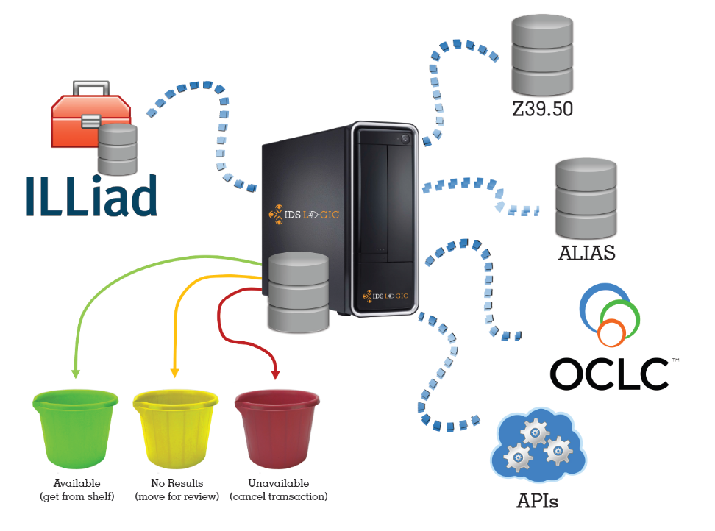
What is IDS Logic?
ILLiad Server Addon that streamlines workflows by automating routine tasks
Four major services
  Article Gateway
  ALIAS
  Borrowing Availability Service
  Lending Availability Service

Slide 3
What is IDS Logic?
Major services are customizable, but they’re limited in their scope
We can use Custom Logic Rules to automate processes that can’t be automated by the major services

Slide 4
Custom Logic Rules
Custom Logic Rules are like Custom Routing Rules but far more powerful
In addition to routing requests, they can:
  Change field values
  Modify due dates
  Add notes
  Add or remove flags
  Send emails
  Cancel OCLC requests
Custom Logic Rules can’t:
  Send or respond to OCLC renewal requests
  Send or respond to OCLC conditionals

Slide 5
Custom Logic Rules
Like Custom Routing Rules they can be based on a request status and query, but they can also be based on:
  Presence of a flag
  Time since request was created
  Time since last status change
  Time before due date
  Time since due date
Custom Logic Rules are applied every time the System Manager runs, so they can be daisy chained

Slide 6
Custom Logic Rule Structure
LogicRule_1
Enabled: “1”
RuleName: “LogicRule1”
PreventReruns: “1”
NVTGCList:
- “ILL”
ProcessTypeList:
- “Borrowing”
RequestTypeList
- “Loan”

Slide 7
Custom Logic Rule Structure
LogicRule_1 (cont)
TransactionStatusList:
- “Awaiting Request Processing”
FlagList:
- “FlagName”
Query: t.DocumentType = ‘Book’
UpdatedMinutes: 1440 (1 day)
Created Minutes: 2880 (2 days)
Due Minutes: 10080 (1 week)
OverdueMinutes: 43200 (1 month)

Slide 8
Custom Logic Rule Structure
LogicRule_1 (cont)
RouteTo: “Awaiting Staff Review”
RouteToBorrowing: “Routed from Doc Del”
RouteToDocDel: “Routed from Borrowing”
AddFlag: “FlagName”
RemoveFlag: “FlagName”
EmailTemplate: “EmailTemplateName”
EmailSubject: “Email Subject”

Slide 9
Custom Logic Rule Structure
LogicRule_1 (cont)
AddNote: “Note text”
SetFields:
- ItemInfo1: “value”
- ItemInfo2: “value”
OCLCUpdate: “Cancel”

Slide 10
IDS Logic Order of Operation
The order in which IDS Logic does things is extremely important
Custom Logic Rules:
  Run after Article Gateway, ALIAS, Borrowing Availability Service, and Lending Availability Service
  Run in numerical order
Custom Routing Rules may be more appropriate in certain situations
Sometimes you’ll need to pair a Custom Routing Rule with a Custom Logic Rule

Slide 11
Problem #1
“When I’m processing lending requests, I keep having to manually match address records for the same libraries over and over.”

Slide 12
Problem #1
The Lending Availability Service cannot route or update a request that doesn’t have an address match, so it’s best to use a Custom Routing Rule to move lending requests lacking an address match to their own queue so the Lending Availability Service doesn’t act on them
ProcessType | Lending
TransactionStatus | Awaiting Lending Request Processing
MatchString | t.LenderAddressNumber is NULL
NewProcessType | Lending
NewTransactionStatus | Awaiting Lender Address Match

Slide 13
Problem #1
Once we have a lending request that needs an address match in a queue where the Lending Availability Service won’t act on it, we can use a Custom Logic Rule to automatically match the addresses
That same Custom Logic Rule can then move that request back to Awaiting Lending Request Processing so the Lending Availability Service can then act on it without issue

Slide 14
Problem #1
  LogicRule_1
  Enabled: “1”
  RuleName: “AddressMatch1”
  PreventReruns: “1”
  NVTGCList:
  - “ILL”
  ProcessType:
  - “Lending”
  RequestType:
  - “Article”
  - “Loan”

Slide 15
Problem #1
  LogicRule_1 (cont)
  Transaction Status List:
  - “Awaiting Lender Address Match”
  Query: t.LendingLibrary in ('YOM','YZA','ZHM','ZLM')
  SetFields:
  - LenderAddressNumber: “1”
  RouteTo: “Awaiting Lending Request Processing”

Slide 16
Problem #2
“My RapidR lending requests already have locations and call numbers. I’d like to send them straight to my print queue, but I can’t because they don’t have due dates.”

Slide 17
Problem #2
ILLiad doesn’t create a due date for a lending request until that request is opened by staff
The Lending Availability Service can add a due date to a lending request, but it will also run an automated z39.50 check
RapidR has already run this check, so there’s no need to have the Lending Availability service run a second check

Slide 18
Problem #2
We can use a Custom Routing Rule to move the request to a queue where the lending Availability Service won’t act on it
ProcessType | Lending
TransactionStatus | Awaiting Lending Request Processing
MatchString | t.SystemID=‘RAPID‘ and t.RequestType=‘Loan’
NewProcessType | Lending
NewTransactionStatus | RapidR Request

Slide 19
Problem #2
Once we have a RapidR request in a queue where the Lending Availability Service won’t act on it, we can use a Custom Logic Rule to add a due date to the request
That same Custom Logic Rule can then move those requests to Awaiting Stacks Searching so they can be printed

Slide 20
Problem #2
  LogicRule_2
  Enabled: “1”
  RuleName: “RapidRDDFixer”
  PreventReruns: “1”
  NVTGCList:
  - “ILL”
  ProcessType:
  - “Lending”
  TransactionStatusList:
  - “RapidR Request”
  DueDateShift: “T|+112|DAY”
  RouteTo: “Awaiting Stacks Searching”

Slide 21
Problem #3
“I want my RapidR Requests to have a 16 week loan period, but the Rapid Manager keeps changing my loan period to 8 weeks.”

Slide 22
Problem #3
All RapidR requests have a default loan period of 8 weeks, so the Rapid Manager automatically changes lending due dates to match the default 8 week loan period once the request has been marked as found
Every time the Rapid Manager does this, it leaves a note that says “Due Date updated to match RAPID due date”
We can use a Custom Logic Rule to edit the due date for requests that have this note

Slide 23
Problem #3
  LogicRule_3
  Enabled: “1”
  RuleName: “RapidRDDFixer2”
  PreventReruns: “1”
  NVTGCList:
  - “ILL”
  ProcessType:
  - “Lending”
  TransactionStatusList:
  - “Item Shipped”
  Query: t.TransactionNumber in (select TransactionNumber from Notes
  where Note like 'Due Date updated to match RAPID due date%')
  DueDateShift: “DD|+56|DAY”

Slide 24
Problem #4
“ILLiad says my RapidR borrowing request has an 8 week loan period, but the lending library’s paperwork says the loan period is 16 weeks, so I keep having to manually change my RapidR due dates.”

Slide 25
Problem #4
All RapidR requests are assigned an 8 week loan period in the borrower’s ILLiad record no matter what the loan period is in the lender’s ILLiad record
We can use a Custom Logic Rule to edit these due dates if the lending library’s loan period is longer than 8 weeks

Slide 26
Problem #4
  LogicRule_4
  Enabled: “1”
  RuleName: “RapidRDDFixer3”
  PreventReruns: “1”
  NVTGCList:
  - “ILL”
  ProcessType:
  - “Borrowing”
  RequestType:
  - “Loan”
  TransactionStatusList:
  - “Request Sent”
  Query: t.LendingLibrary in ('RAPID:BXM','RAPID:WYU','RAPID:DLM')
  DueDateShift: “DD|+56|DAY”

Slide 27
Problem #5
“RapidR requests cannot be renewed, so I have to keep manually unchecking the Allow Renewals box.”

Slide 28
Problem #5
As soon as a Rapid library marks a RapidR lending request as found, the Rapid Manager adds that library’s Rapid symbol to the LendingLibrary field in the borrower’s ILLiad record
We can use a Custom Logic Rule to uncheck the Allow Renewals box as soon as the lender’s Rapid symbol appears in the borrower’s ILLiad record

Slide 29
Problem #5
  LogicRule_5
  Enabled: “1”
  RuleName: “RapidRNoRenewals”
  PreventReruns: “1”
  NVTGCList:
  - “ILL”
  ProcessType:
  - “Borrowing”
  RequestType:
  - “Loan”
  TransactionStatusList:
  - “Request Sent”
  Query: t.LendingLibrary LIKE 'RAPID:%'
  SetFields:
  - RenewalsAllowed: "False"

Slide 30
Problem #6
“ILLiad tells me if I haven’t received an OCLC request that was shipped a while ago, but it doesn’t do that for Rapid requests. I have to either go to the Rapid website or look through the Request Sent queue.”

Slide 31
Problem #6
We’ll need five Custom Logic Rules to solve this problem
Rules 1 and 2 will temporarily change the status of the request once the lender marks the request as found
Rules 3 and 4 will flag the request is it is still in the Request Sent queue after a set period of time
Rule 5 will remove the flag once the item has been received

Slide 32
Problem #6
  LogicRule_6
  Enabled: “1”
  RuleName: “RapidNotReceived1”
  PreventReruns: “1”
  NVTGCList:
  - “ILL”
  ProcessType:
  - “Borrowing”
  TransactionStatusList:
  - “Request Sent”
  Query: t.LendingLibrary LIKE 'RAPID:%'
  RouteTo: “Request Shipped”

Slide 33
Problem #6
  LogicRule_7
  Enabled: “1”
  RuleName: “RapidNotReceived2”
  PreventReruns: “1”
  NVTGCList:
  - “ILL”
  ProcessType:
  - “Borrowing”
  TransactionStatusList:
  - “Request Shipped”
  Query: t.LendingLibrary LIKE 'RAPID:%'
  RouteTo: “Request Sent”

Slide 34
Problem #6
  LogicRule_8
  Enabled: “1”
  RuleName: “RapidNotReceived3”
  PreventReruns: “1”
  NVTGCList:
  - “ILL”
  ProcessType:
  - “Borrowing”
  RequestType:
  - “Article”
  TransactionStatusList:
  - “Request Shipped”
  Query: t.LendingLibrary LIKE 'RAPID:%'
  UpdatedMinutes: 2880
  AddFlag: “Rapid Not Received”

Slide 35
Problem #6
  LogicRule_9
  Enabled: “1”
  RuleName: “RapidNotReceived4”
  PreventReruns: “1”
  NVTGCList:
  - “ILL”
  ProcessType:
  - “Borrowing”
  RequestType:
  - “Loan”
  TransactionStatusList:
  - “Request Shipped”
  Query: t.LendingLibrary LIKE 'RAPID:%'
  UpdatedMinutes: 10080
  AddFlag: “Rapid Not Received”

Slide 36
Problem #6
  LogicRule_10
  Enabled: “1”
  RuleName: “RapidNotReceived5”
  PreventReruns: “1”
  NVTGCList:
  - “ILL”
  ProcessType:
  - “Borrowing”
  FlagList:
  - “Rapid Not Received”
  TransactionStatusList:
  - “Request Shipped”
  Query: t.LendingLibrary LIKE 'RAPID:%'
  RemoveFlag: “Rapid Not Received”

Slide 37
Problem #7
“Users keep requesting articles that we’ve already delivered to them.”

Slide 38
Problem #7
We don’t want Article Gateway to act on duplicate requests, so we’ll need to use a Custom Routing Rule to move duplicate requests out of Awaiting Copyright Clearance
ProcessType | Borrowing
TransactionStatus | Awaiting Copyright Clearance
MatchString | t.RequestType = 'Article' AND t.PhotoArticleTitle IN (SELECT distinct PhotoArticleTitle FROM Transactions WHERE TransactionNumber != t.TransactionNumber AND Username = t.Username TransactionStatus IN ('Delivered to Web')) AND ISNULL(PhotoArticleTitle,'') !=''
NewProcessType | Borrowing
NewTransactionStatus | Duplicate – Delivered to Web

Slide 39
Problem #7
Once we’ve routed these requests to a queue where Article Gateway won’t act on them, we can send the patron an email stating that the article they requested is already available for download
We can also add a reason for cancellation and then route the request to Cancelled by ILL Staff so staff doesn’t have to touch these requests

Slide 40
Problem #7
  LogicRule_11
  Enabled: “1”
  RuleName: “DuplicateCanceller1”
  PreventReruns: “1”
  NVTGCList:
  - “ILL”
  ProcessType:
  - “Borrowing”
  TransactionStatusList:
  - “Duplicate – Deliver to Web”
  EmailTemplate: “Duplicate - Article Already Delivered”
  EmailSubject: “Requested Item Already Delivered Electronically”
  SetFields:
  - ReasonForCancellation: “Duplicate - Article Already Delivered”
  RouteTo: “Cancelled by ILL Staff”

Slide 41
Problem #8
“Sometimes we keep working on borrowing requests even though our user no longer needs the item they requested.”

Slide 42
Problem #8
We can use a Custom Logic Rule to send the user an email asking them if they still need the requested item
We can use this same rule to cancel the OCLC request and route the request to a terminal status

Slide 43
Problem #8
  LogicRule_12
  Enabled: “1”
  RuleName: “UnfilledEmail”
  PreventReruns: “1”
  NVTGCList:
  - “ILL”
  ProcessType:
  - “Borrowing”
  TransactionStatusList:
  - “Awaiting Unfilled Processing”
  CreatedMinutes: 43200
  EmailTemplate: “30 Days Unfilled”
  EmailSubject: “Requested Item Still Needed? Please Respond.”
  SetFields:
  - ReasonForCancellation: “Unfilled After 30 Days”
  RouteTo: “Cancelled by ILL Staff”
  OCLCUpdate: “Cancel”

Slide 44
Problem #8
Questions?

Slide 45
Problem #8
If you’d like us to create a Custom Logic Rule for your library, please email:
logic@idsproject.libanswers.com

