Slide 1
Using the OCLC Search API to clean up ILL data
Matthew Hartman, IDS Conference 2023

Slide 2
Stony Brook Resource Sharing
Three full-time staff members
Two OCLC Symbols (YSM,VZB)
ILLiad, ALMA, Microsoft 365, Google Workspace
21,800+ requests filled across OCLC, ALMA, DOCLINE (AY 22/23)

Slide 3
Cool things about ILL departments
We have lots of data
Much of that data is useful to collections and library administration
We can always choose to blame another library whenever we mess up

Slide 4
Problem! No great way to package our data.
Usage reports are annoying to run
Combining those reports into digestible information takes time
Canned report results are problematic and require clean up

Slide 5
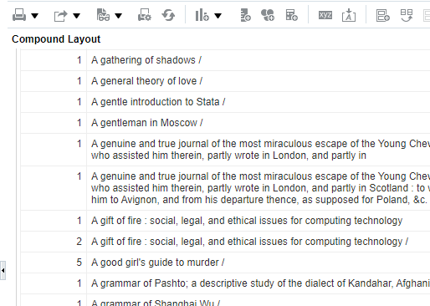
ALMA Example image

Slide 6
OCLC Search API
Prefix + ISxN + WSKey
https://worldcat.org/webservices/catalog/content/issn/13594311?wskey=FsxHGd02

Slide 7
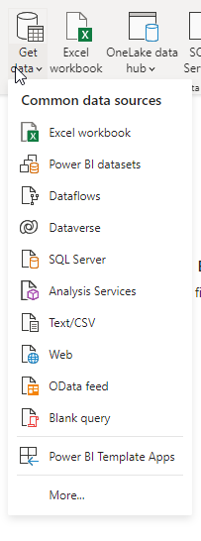
PowerBI
SuperExcel + SQL database + Visualization
Data warehouse
Can automatically import ILLiad tables through ODBC
Can import ALMA data through ALMA’s web API

Slide 8
OCLC Search API + PowerBI

Slide 9
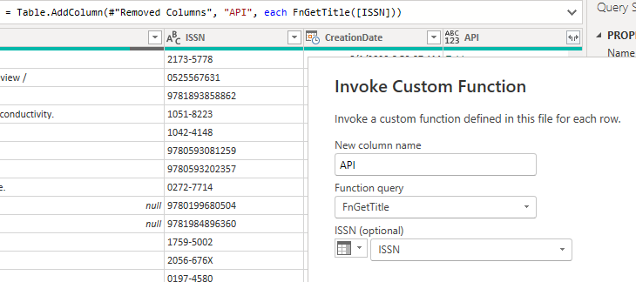

Slide 10
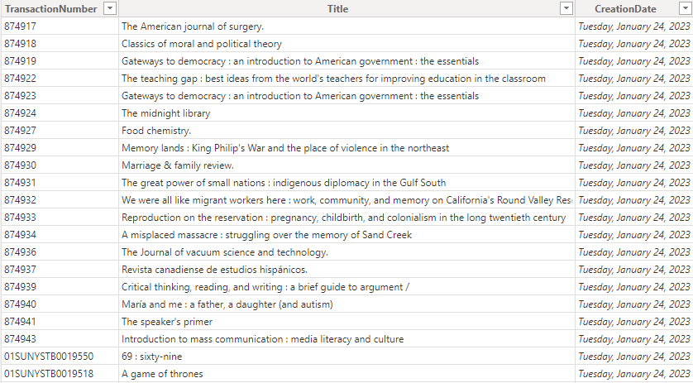

Slide 11
OCLC Search API
Prefix + ISxN + WSKey
https://worldcat.org/webservices/catalog/content/issn/13594311?wskey=FsxHGd02

Slide 12
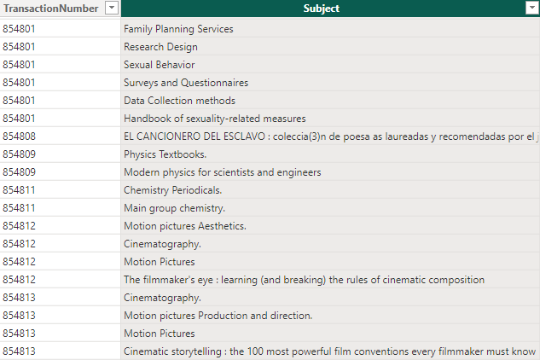
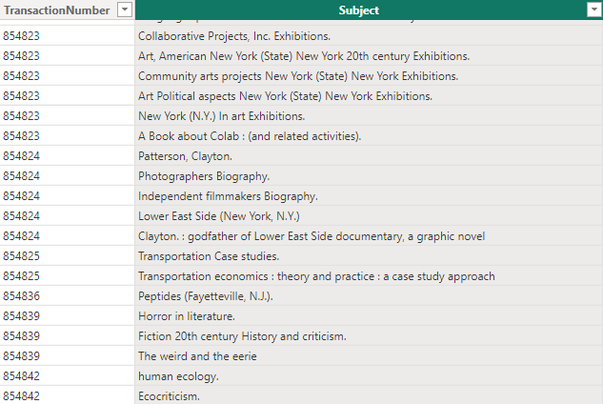

Slide 13
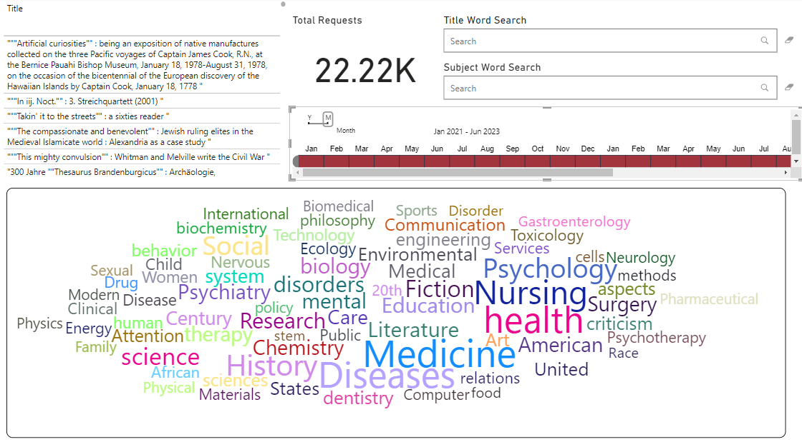

Slide 14
What’s Next
Integrate more info into our model (patron data from our HRMS, financial data, etc.)
Collections interest in gathering subject level data for our general collection
Improve usability
Continue to explore ways to take advantage of the data we gather in ILL

Slide 15
Questions?

Slide 16
Thanks!
IDS Conference 2023
Matt Hartman

