Slide 1
We CAN Still
Adventuring Outside the Norm
Sarah Shank |Ithaca College Library
OCLC Symbol: XIM
Illiad ISO ILL/Alma RS: ITHACARS
IDS Conference: July 27th, 2023

Slide 2
Hello My Name is
It has been
847
days since I’ve used Illiad
It has been
756
days since I’ve used
Worldshare ILL

Slide 3
Today’s Journey
About Ithaca College/ Library/ ILL
Why did we make this switch?
Pathway to change
What’s working well/What’s improving/What’s different
Lifecycle of a borrowing rapido request/Helpful features
Migration and implementation pointers

Slide 4
“If you want to know who we are…”—Mikado by Gilbert & Sullivan
Ithaca College
Private Comprehensive College
~5,000 undergrad & grad students
Strong Communications, Music, & Health Sciences
Recently added PA program
Ithaca College Library
10 Library Staff
8 Librarians
~30 Student workers (circulation & music)
Open ~112 hours per week during semester
Focused shift toward E materials
Creating more student-centered spaces
Image Credits: Muller Chapel: Sarah Shank | Ithaca College Library: IC Communications Assets

Slide 5
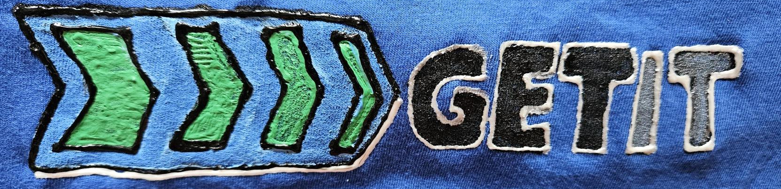
ILL @ Ithaca College
Before Rapido
REQUESTS Sent & Received Via
OCLC Worldshare
Illiad (Self-Hosted)
IDS Logic
ALMA RS w/NCIP Addons
SHIPPING
USPS
UPS
After Rapido
REQUESTS Sent & Received Via
Rapido/RapidILL
ALMA Resource Sharing
ALA Form/Email/ISO ILL
Borrowing Only: Illiad Lending Webpages
SHIPPING
ELD
USPS
UPS
Image Credits: Sarah Shank

Slide 6
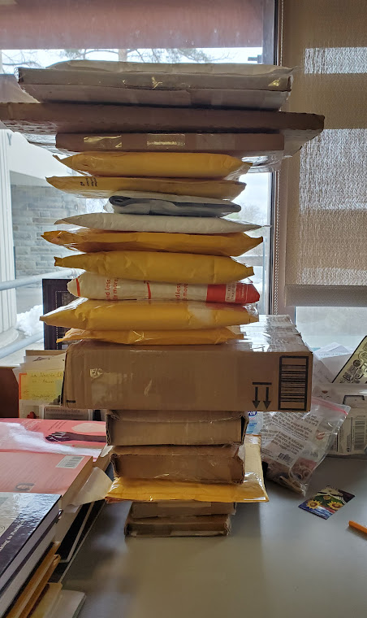
ILL @ Ithaca College
2 Full Time Staff (borrowing/lending)
Currently no dedicated student workers
Can request circulation students to pull, digitize, etc.
Integrated with Access Services
In the past year…
We’ve loaned the most physical items to SUNY STONYBROOK
We’ve borrowed the most physical items from SUNY BINGHAMTON
Image Credit: Sarah Shank

Slide 7
ILL Lending @ Ithaca College
2017
Switched to ALMA/Primo
2020-2021
Loans sent after we reopened from pandemic through end of WS RS.
Notes:
We had already been experiencing a significant decrease in lending requests before the Pandemic. Once we changed over to Rapido—there was a sharp decrease in Lending overall--mostly because we went from hundreds if potential borrowers to those that were only ALMA RS/Rapido/RapidILL partners. We are still willing to lend to those that ask—and as an added bonus… We’ll no longer charge if a library is willing to loan to us reciprocally. Otherwise, we’re adopting a we charge what you charge model.

Slide 8
ILL Borrowing @ Ithaca College
2017
Switched to ALMA/Primo
2020-2021
COVID closures
2021-2022
Switch to Rapido/RapidILL
Notes:
Borrowing numbers had also been on a steady decline. The pandemic sharply impacted physical lending. I think it was good fortune for us to start Rapido when loan numbers were already currently loan—it gave time to think about the best way to request things off system and allowed Exlibris to work on developments like incorporating the ALA request form into the borrowing workflow.

Slide 9
Document Delivery @ Ithaca College
2017-2018
Switch to ALMA
2019-2021
Process blended between
Illiad & ALMA
April 2021
Illiad Sunset
Notes:
Before the Pandemic, a lot of the document delivery was fed through Illiad. When we migrated to ALMA in 2017, numbers decreased a bit. We also had a blend of digitization requests through ALMA and Illiad before the pandemic. Most of the campus deliveries were article requests that were discoverable through publisher websites/or via open access.

Slide 10
Why did we make this switch?
This Photo by Unknown Author is licensed under CC BY-SA
Biggest Motivator:
Save Money
We saved about 50%
Secondary Motivators:
Customer Service
More transparency for patrons
Increased Automation
Most requests should move through the system unmediated
Image Credits: Stock Images
Notes:
One of the major reasons we decided to make this switch was to save money. There was a big push from the College to be saving as much money as we possibly could wherever we could. Joining Rapido ended up saving the Library nearly 50% on its then ILL costs at signing. A secondary reason we made the switch was the push toward patron ease. It would overall be easier for the patron to participate in a one-stop shop for all their library needs. Lastly, the promise of increased automation was enticing.

Slide 11
So, it begins…
October 2020:
Meeting with ExLibris to hear about their new ILL system: Rapido
My Honest Initial Reaction
“I have a very bad feeling about this.”
―Luke Skywalker, as the Millennium Falcon approaches the Death Star. (Episode IV)
Accessed from: https://aminoapps.com/c/star-wars/page/blog/ive-got-a-bad-feeling-about-this/jKFK_uJ3KX7JBvrbmWNQD42NwBxWvx
Notes:
We had our first meeting with ExLibris to hear about Rapido in October of 2020. I left the meeting with a feeling that our then director would be buying into Rapido. I was concerned. Brand new system. No US adopters yet. What would our physical lending base be like? Maybe an approach of the Death Star is a bit dramatic, but coming off an already trying pandemic made this change seem a little more Epic, but at the same time I’m usually someone that likes to try new things. Thankfully, we were already in discussion with SUNY regarding joining their ALMA RS network. This connection was crucial for us to be able to make this switch.

Slide 12
Pathway to Change
April
2021
Sunset Illiad
Weekly Rapido meetings/training setup & config
May
2021
No more renewals on requests through Worldshare ILL
June
2021
No more loan requests through Worldshare ILL
July
2021
August
2021-
Present
All non-ALMA requests manually entered to Worldshare ILL
Increase article borrowing with SUNY
Implementation begins-- using Rapido features wherever possible
RapidILL access begins
Final Worldshare due dates: 6/20. All borrowing items returned by 7/1
Implementation continues
Article cutoff in Worldshare last week of June
Pull any Worldshare stats
Copy any custom holdings groups.
Sunset OCLC Worldshare
Rapido IS LIVE
Work toward broadening borrowing and lending base
Attend monthly update webinars to stay on top of configurations, changes, and enhancements
Illiad Server retired
October-
December
2020
Rapido pitched by ExLibris
Agreement signed
January
2021
Configure & Test ALMA RS with select SUNY Partners
February
2021
Initial Rapido training begins
Initial transition planning begins
Discussion with SUNY re: ALMA Resource Sharing (RS)
Enable Patron RS requesting in Primo
Rapido configuration begins
All articles now delivered via ALMA RS
All requests initiate in ALMA and exported to Illiad
Patron links to Illiad accounts removed from website (patrons request history)
Training librarians on requesting through Primo
March 2021
More Setup: PRIMO, TOU, Profiles
Weekly meetings with ExLibris begin
Article requesting through ALMA RS
Deadline for Patron history requests
Download all data needed from Illiad
Lending: Due Dates Shortened/ No additional renewals
Notes:
Here was our timeline—it was Fast and Furious—we had less than a year to wrap our heads around this change. Sometimes we felt like the amount of information and setup we were trying to do was like being sprayed with a fire hose.

Slide 13
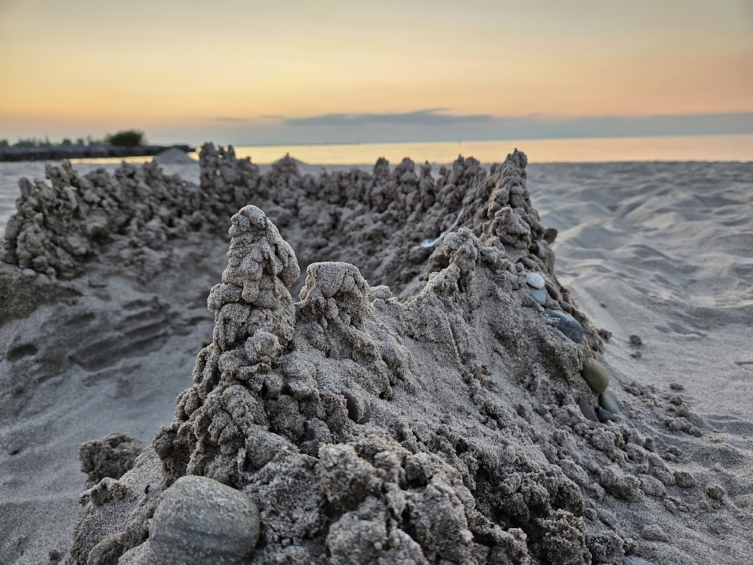
Pointers for Migration & Implementation
Implementation:
Use Rapido for as many steps as possible
Live version is slightly different
Document things as you go
Spend some time in the sand (box)
Migration:
Save any data you *might* need
Illiad and/or Worldshare Resource Sharing
Communicate with patrons
Offer to provide request history
Create a list for Illiad Lending Webpage info
Save any custom holdings group symbols
Take time to acknowledge what a big change this is!
Image credits: IC Library Motif & Dribble Castle at Fair Haven Beach: Sarah Shank
Notes:
These are my biggest take aways from going through this type of migration & implementation with Rapido specifically.
SAVE EVERYTHING COMMUNICATE Start Connecting with libraries you might want to borrow with
Take time for you… For Implementation… Nothing’s mimics going live. Just recognize that some things will be different going live. Take advantage of the sandbox… and if you’re the kind of person that actually likes sand—play it that too.

Slide 14
Other observations about our transition
We were the 1st North American Library to go Live Brandeis soon followed
RAPID ILL is Amazing: 95%+ fill rate for articles
We manually sent >300 ALA forms the first year (almost 1/3 of our physical loans)
Happy for ALA email partners enhancement
Took 6 months to realize we still had access to the OCLC Policies directory. Some library websites are difficult to navigate
RS partnerships with SUNY made this endeavor possible. We couldn’t have done it without them.
Most challenging requests: Newer Materials, Media, Popular Reads, Scores, dissertations
Recently developed a POD budget for newer Items
Notes:
These are mostly self explanatory. We were the 1st North American library to go live.. So in the beginning we were depending 100% on our SUNY partners, and throwing ALA/EMAIL/Illiad Webpage requests at everyone else. That first year, we sent SO MANY ALA request forms. In fact, that worked out to be about 1/3 of our physical loan requests. Some libraries never responded. NOW, we have many more Rapido partners the benefit of RapidR partners and are feeling less dependent on manual request methods. There was definitely a significant improvement in the second year. RapidILL is amazing. I find the most things that are unfilled are foreign language materials.
When we migrated, I didn’t realize we’d still have access to the OCLC policies directory. This makes finding information about libraries so much easier for manual requests, or deciding who to ask for those unusual items. There are some library websites that are very hard to navigate. Thankfully, I don’t have to do site digging as much anymore. The SUNYS are amazing. Our most challenging requests aren’t really much different than challenging requests from before. New materials that won’t be published for another three months, media, popular reads, scores, dissertations… can be challenging for everyone.
One way we decided to ease up on some of these was to develop a POD (Purchase on demand—not to be confused with POD (RapidILL POD)) budget with certain criteria. So, for faculty requests, we will try and purchase if it’s a newer items, falls within a price limit and we can’t easily get it from somewhere else. We’ve also been pretty aggressive about purchasing textbooks (Ben will talk more about that in his presentation. Finally, popular reads aren’t always included in our McNaughton options, so we will consider some for purchase or join the throngs on the waitlists. Students at our College also have the option to trudge down to the public library for some of these things.

Slide 15
Working Well
Rapid ILL integration
Integrates with Reprints & CCC
Improving
Lending base is still growing
Most requests automated
Easy for patrons to request/delivery times & due dates are transparent
Good for high article volume
Customization/Setup (it’s complicated)/Documentation
Steep learning curve for Analytics and letters customization (more out of box options for both in the works)
Sometimes feel disconnected from the larger RS community—different system, different experience
All library items in the same account for patrons
Many libraries use ALMA, but not ALMA Resource Sharing
Very easy to connect with peer-to-peer partners, send email, and [now] ALA requests when needed
Works well for libraries connected to a larger consortia or those able to keep Worldshare
Notes:
There are a lot of things that Rapido has going for it. My favorite part is the RapidILL integration. I think leaving OCLC is most viable when you’re able to connect well with a larger network of libraries (for us it was the SUNYs) and have a larger demand for digital requests. It’s easy to send e-mail & (now) ALA requests through the system. There’s not as much status updates/direct communications with those types of requests, but it’s easier than managing them outside of the system. Most libraries we’ve worked with manually add the requests to their systems (WS, Clio, etc). ExLibris is continuing to develop Rapido and are trying to listen to their customer base. The addition of the ALA form, was a direct result of customers saying this HAS to be integrated. Meghann Weldon is great to work with on the ExLibris team and has been pushing for and working on better documentation. They are actively looking for ways to connect with other libraries.

Slide 16
What’s different: Don’t you miss Illiad?!?
Letters/Notifications
Customization of letters is difficult in ALMA/Rapido
Rapido Uses Labels/Sets/Mediations
These are similar to Illiad queues and mediations but aren’t as flexible.
Individual Lenders vs. POD mentality
Billing
The system chooses lenders for you from a pod
Overall expectation is reciprocity
Statistics
ALMA analytics are incredibly detailed, but much harder [for me] to pull information from.
ExLibris is listening to our feedback and improvements are on the way
It is much easier to push requests through processes in Illiad when there’s a goof up
Difficult to select specific lenders/partners (in some situations)
Rapido currently doesn’t allow for IFM/generation of invoices
Illiad’s statistics access was much easier to manipulate [for me]
Notes:
Yes, of course I miss Illiad, but in the grand scheme of things, the transition would have been immensely more challenging if I continued to pine after what I no longer had. Even if we were to give up Rapido, all we would gain back is Worldshare and perhaps IDS Logic. My philosophy is to try and make the best of what we’ve got.

Slide 17
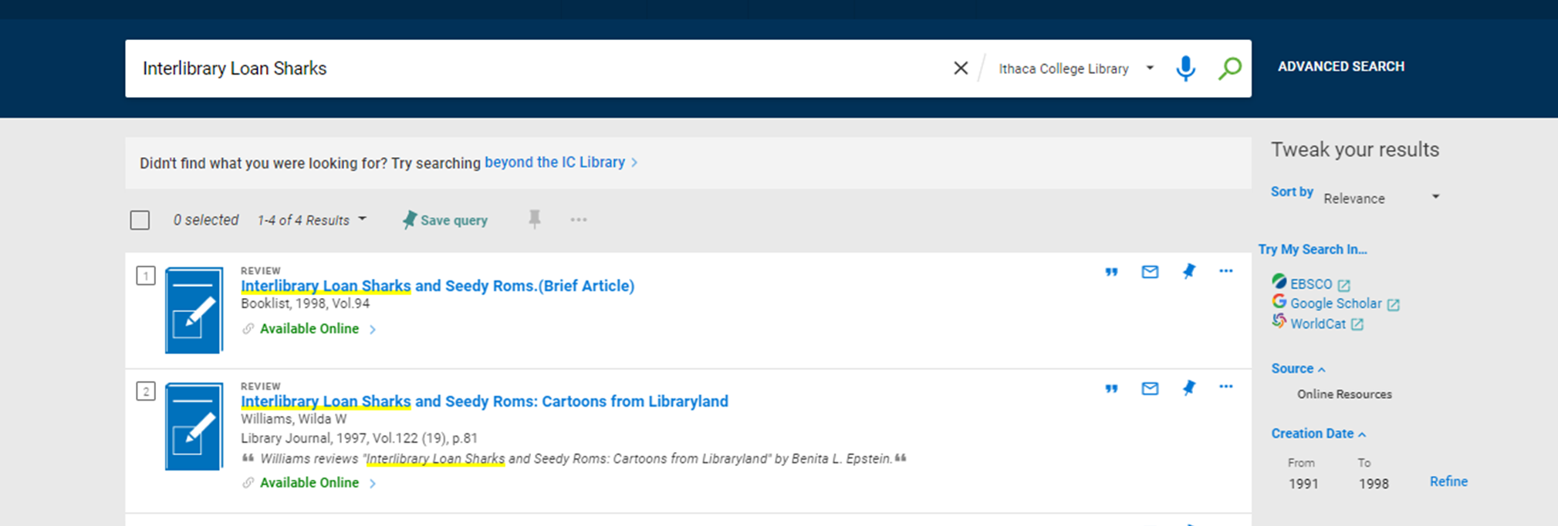
Lifecycle of a Rapido Request: Patron view
Log in to library account
Start @ Library search
Start search –topic or item
Look to see if library owns…
If not, click “Beyond the IC Library”

Slide 18
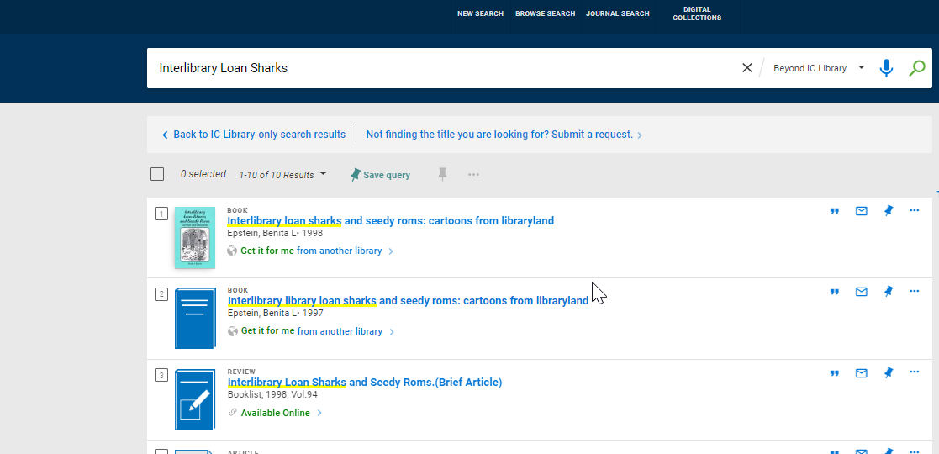
Lifecycle of a Rapido Request: Patron view 2
Look for desired item
Click on the Title
For Items not in the beyond…
Click on the link for blank form
**Note, requests transition better through the system when coming from a record; blank forms always require mediation (for us)**

Slide 19
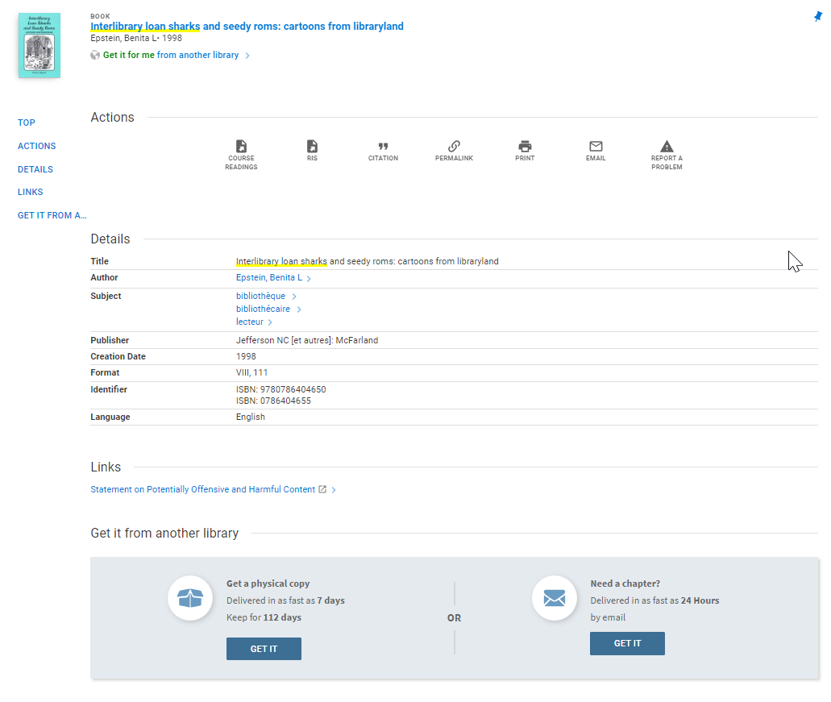
Lifecycle of a Rapido Request: Patron view 3
Option for physical copies or chapters
Estimated delivery times and loan period are displayed depending on partner ownership
We use “as fast as” to imply it could take longer…
Patron clicks on “get it” for either option.

Slide 20
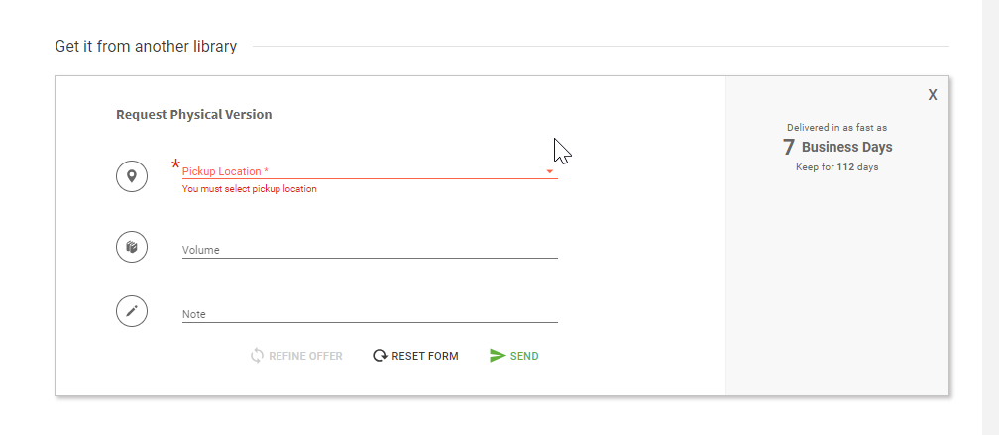
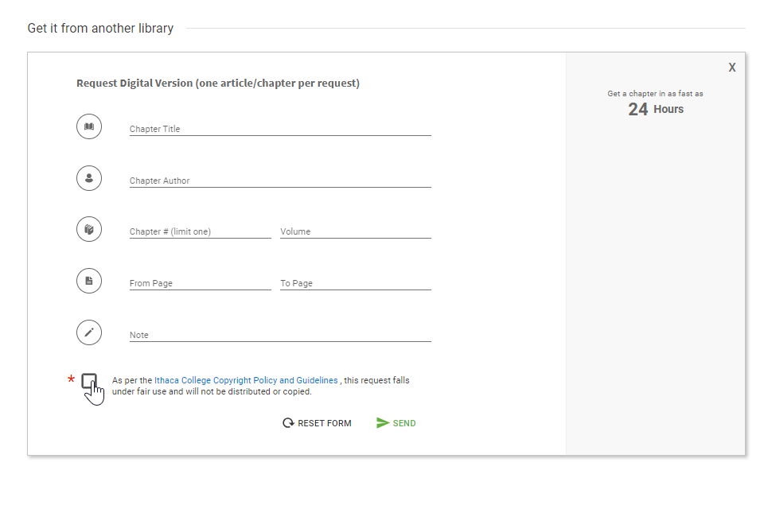
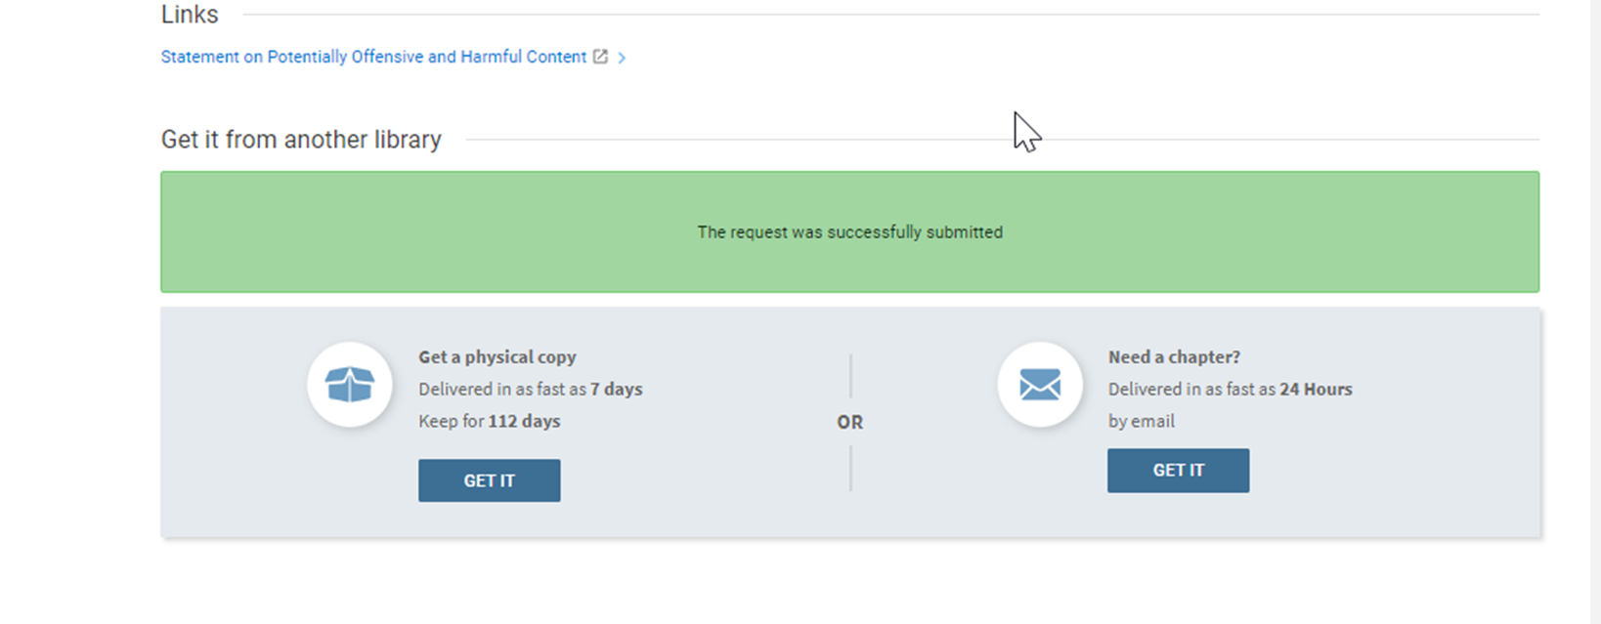
Lifecycle of a Rapido Request: Patron view 4
Physical Request Form
Chapter Request Form
Confirmation
All metadata carries over in the background
Mediation rules can be set up to stop anything with missing metadata (e.g. ISBN) or notes
Faculty can choose delivery to office

Slide 21
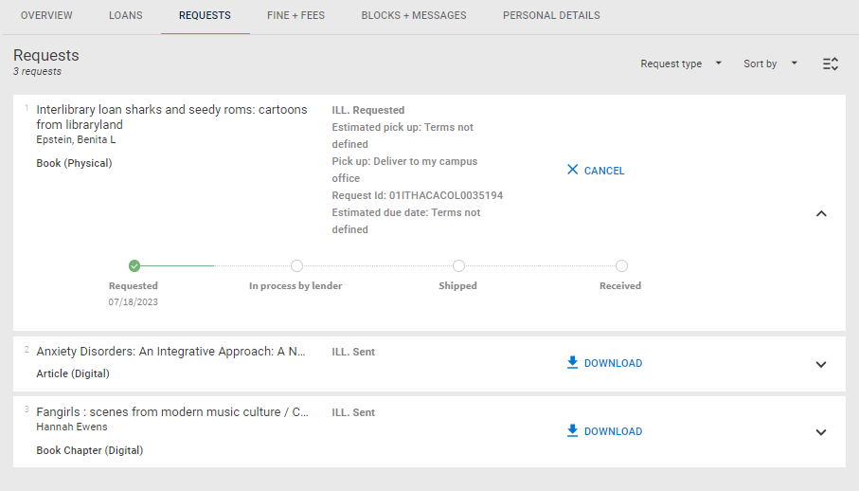
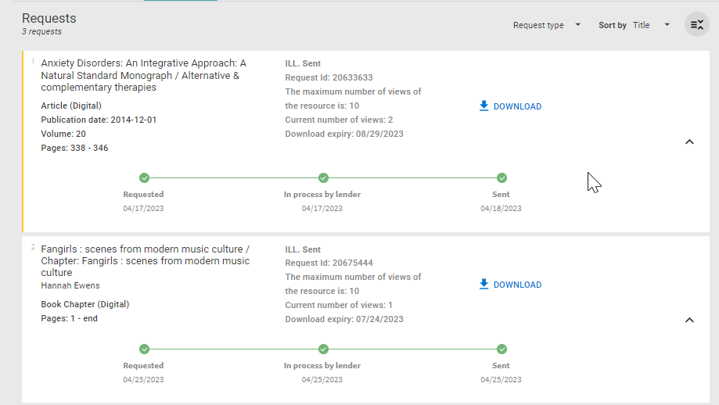
Lifecycle of a Rapido Request: Patron view 5
Check status of requests, submit renewals (if available) and download articles from library account
Loans:
Amazon like feel with the timeline…
After loans are checked out, they move to the loans section and a renewal option appears if they are allowed.
Articles:
Can be downloaded from the library account
Now show expiration and how many times it can be/has been accessed

Slide 22
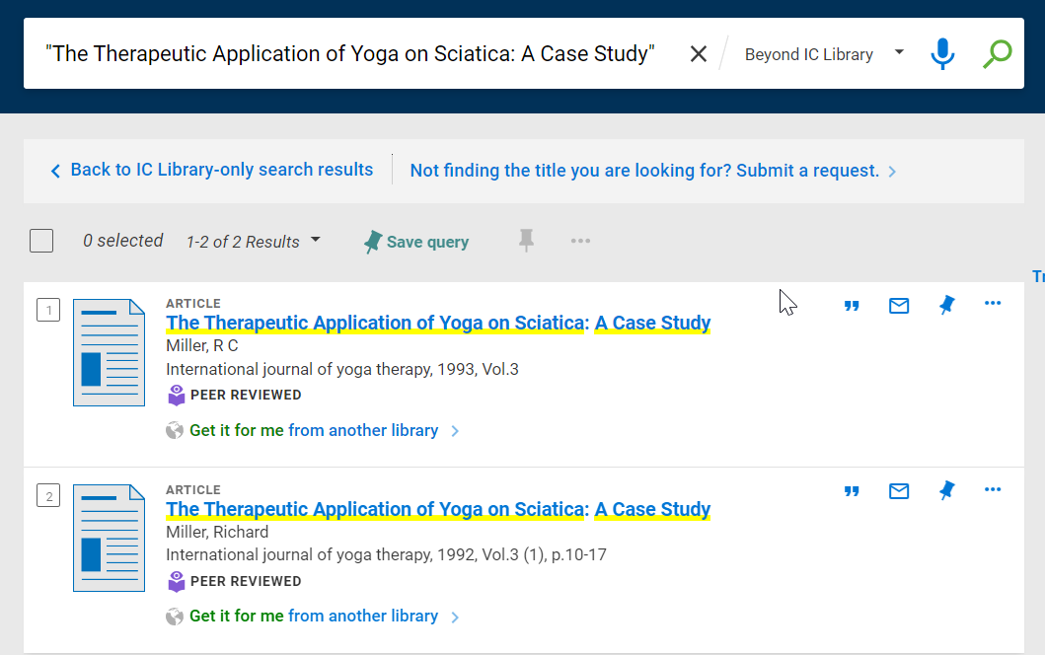
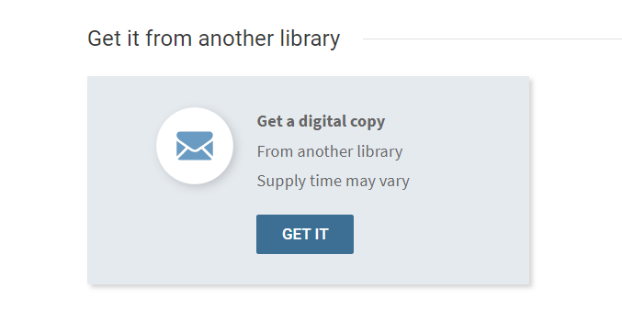
What about article requests?
From Library Search
Search catalog for topic or known article title
Search Beyond for same
Open record and click Get IT on offer

Slide 23
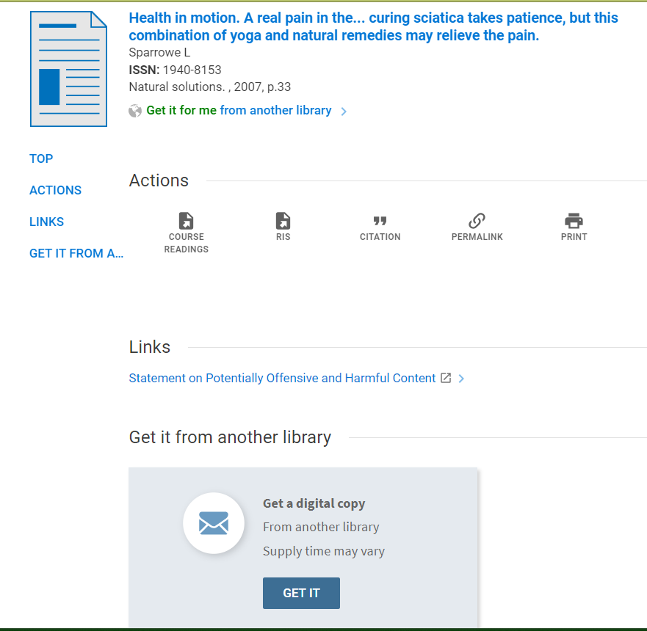
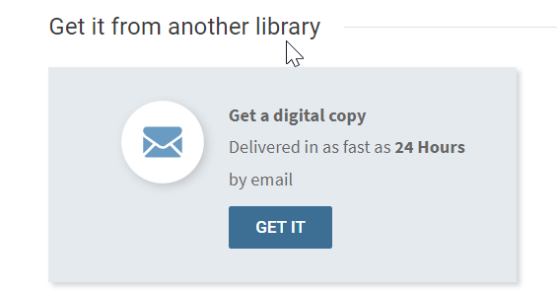
What about article requests?
From Database
Search database for topic or known article title
Click “GET IT” to check library holdings
Click “GET IT” on offer

Slide 24
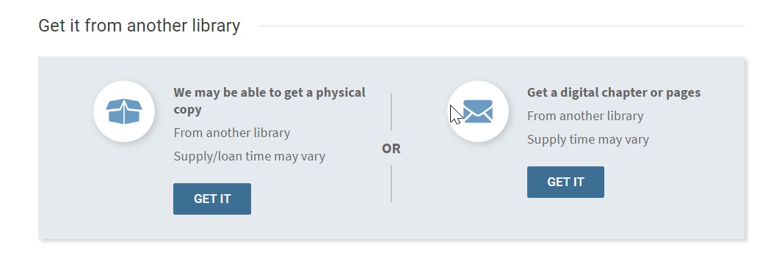
When Rapido can’t determine terms
Other Notes about Rapido Tiles
Rapido Tiles can be turned on or off situationally
On when something we own is in use
Off for journals at the title level
Tiles/Offers become less specific, but still allow patrons to submit a request

Slide 25
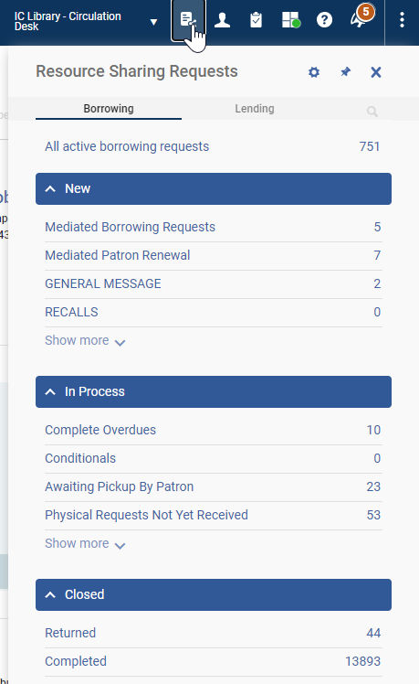
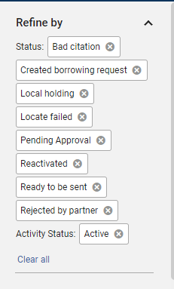
Lifecycle of a Rapido Request: Staff View
Request Organization:
Requests managed in SETS.
Sets can be created based on facets
[My] Main Working Set:
This set includes both physical & digital items
Can include multiple facets
Can add additional facets and save or save as new
Searching & Organizing Requests
Search all requests
Search in set
Notes:
Rapido works sort of like a Plugin into ALMA. Click on the icon to bring down a list of sets (these sets can be modified by clicking on the gear). Certain sets can be listed as public, or mandatory for all individuals with certain privileges.
I’ve chosen to have a main working set of mediated borrowing requests. Everything with the statuses show in the second image fall into that set. I’ve also set up sets for mediated patron renewals, general messages, and a few other things I’d likely miss without a set. Finally, requests can be searched in a variety of different ways (Title, author, external identifier, requester) and you can search ALL borrowing requests from the top search or you can search within a set. Sets can also be organized/sorted in ways that make sense to you. In my main working set most recent requests appear at the top.

Slide 26
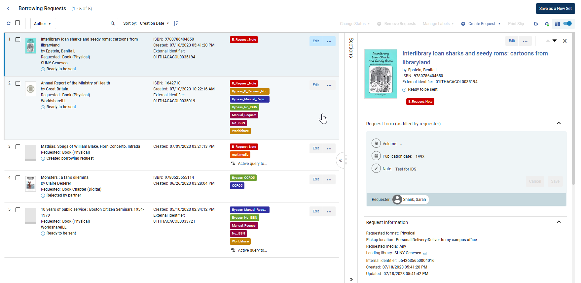
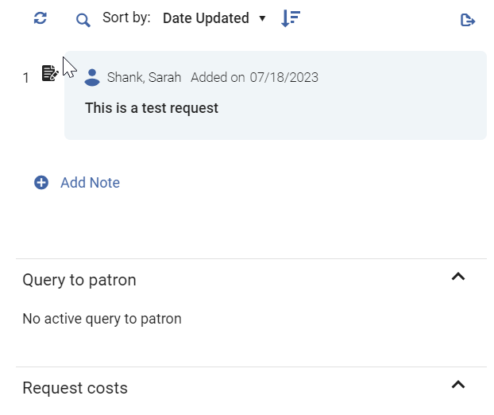
Lifecycle of a Rapido Request: Staff View
Can be filtered by facets
Request List section is customizable
Some changes can be made in the Request details.
Notes/Patron queries show here.
Can also ‘edit’ request to change even more details
“…” offers actions to take
Basic request list
Labels/Mediations
Deeper request details/workspace
← Notes & queries to patron
Notes:
This is the main layout of my main working set. I usually use the split view to view the request more deeply on the right. There are options to view one or the other list. In the Details (right side of the split view), there’s more detailed information about the request. Title, ISBN, OCLC, labels, patron submitted information, Pod information, ID numbers, Any query to patron information and Notes. The notes added here are internal notes and are not visible in the request. Rapido depends heavily on Mediations and Labels. Labels are used to specify which mediations are applied to a request and labels are used to bypass the mediation. The “…” allows certain actions on the request depending on which part of the workflow a request is currently at. The “Edit” allows for more substantial changes to the request.

Slide 27
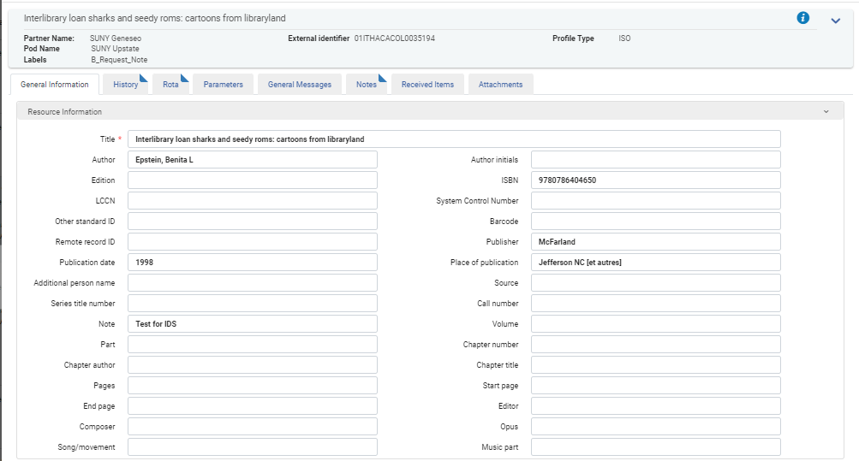
Lifecycle of a Rapido Request: Staff View
Editing a Request
Change the bibliographic info.
Look at history
Add/change ROTAS (partners)
Review notes/attachments
Notes:
When edit is clicked the request is opened. This is where you’d add/change any bibliographic information. You can also review the history of the request, add a Rota/partner, view and send a general message, view received items (later on), or review attachments. There are currently options to save the request and save and close.

Slide 28
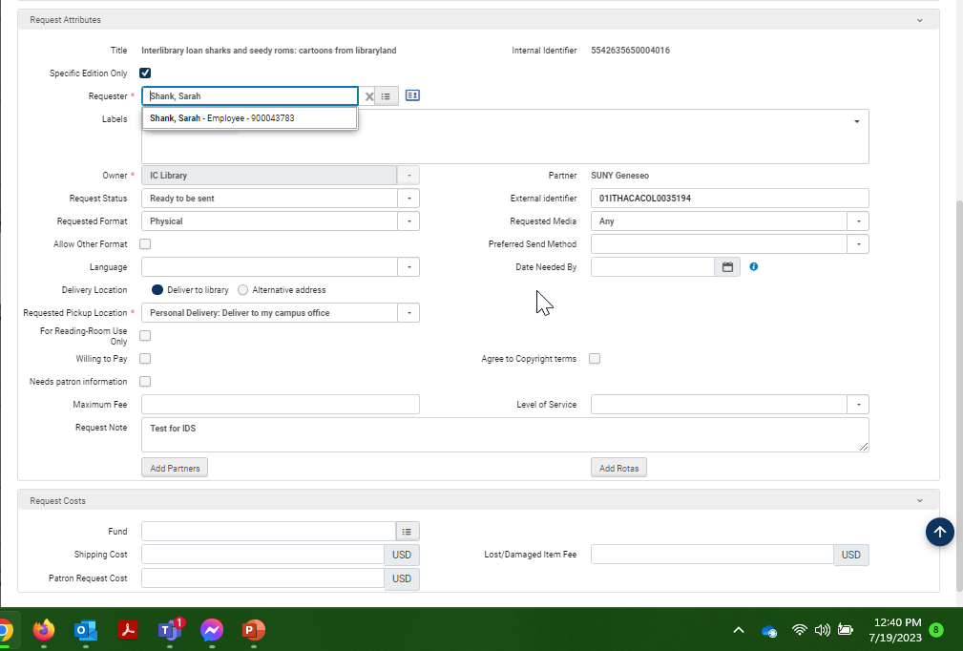
Lifecycle of a Rapido Request: Staff View
Editing a Request/Request attributes
Change Patron
Add/Remove Labels
Change Request Format
Change External ID
Change Delivery options
Add notes—anything in this notes field is sent to partner AND patrons.
Patron can change
Notes:
Another difference between Illiad an Rapido is that a request DOESN’T have to stay with one user. It’s helpful to be able to change the patron on the request when there is a proxy type of situation, or I sometimes do this when I’m troubleshooting for a patron from the PRIMO side (recreating the request). It’s also possible to change the request format from physical to digital (but not from book to article). I’ll also sometimes change the External identifier—especially when I know that a request will becoming from Illiad Lending Webpages. This makes the receive process run more smoothly. There are three different places on any given request to add notes. It’s confusing. The notes field of the Resource Information section is usually imported from the bibliographic record—unless the patron adds a note to the request—then it imports there AND in the notes section on the Request attributes section. Notes added by library staff in the split view don’t show up anywhere else.. The notes in the Request attributes section DO send to the patron AND to the lending libraries. It has been my experience that no notes carry over to RapidILL.

Slide 29
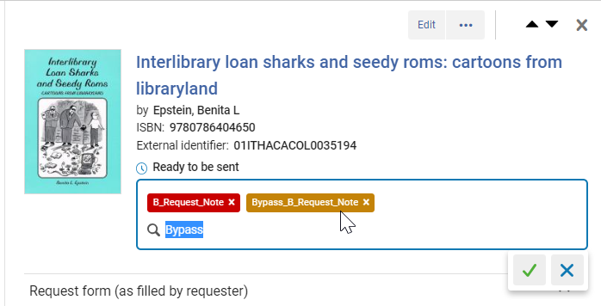
What about the Interlibrary Loan Sharks?
Add the bypass label for the notes mediation
The request sends to SUNY Geneseo, changing the status to “request sent to partner”
If all the possible lenders say “no” it is assigned a “hold partner” or status of “locate failed” and return to my main working set
If a library says yes, request status changes to “shipped physically”, and we’ll receive & print straps when it arrives
On return the item will change to “returned to partner” status
Once received back at lending library status changes to “complete”
Notes:
When a request comes into Rapido, the system first tries to do a locate. It looks for potential suppliers while also looking at any type of mediation available for the request. This particular request was located at Geneseo, but was stopped form automatically going there because there was a mediation rule to stop the request when the notes field isn’t null. Mediation rules work with a label/bypass label type system. We have several different mediation rules that each have a bypass label ---this helps me not overlook something. Other institutions might have one mediation rule, and they look at ALL THE THINGS, and then use one bypass to send the request along. I also tend to use labels for other things as well. Indicating whether something is a score, multimedia, etc. or articles that are tagged as owned, when the system flags them, I indicate whether it’s owned because it’s embargo, ends before or after the date of the request. Labels are available in analytics.

Slide 30
Other options for requesting
ALA Request Forms
Email Partners
Illiad ISO ILL
Illiad Lending Webpages
Then: Each form created Manually
Then: Created templates for regular lenders
Then: Difficult to maintain
Now: Included in workflow (automatically filled and attached)
Now: Sends emails at each step to lender
Now: Attached to request records
Use this method for libraries not requiring ALA forms
Bibliographic information is included in message
Lender receives email at each step of process
Included in attachment section
Lift for lenders –they have to configure/install ISO ILL in Illiad
Lenders have to create a new partner record for the Borrowing library (can’t use old OCLC partner)
Works for BOTH Borrowing & Lending
Requires lender to supply system information
Set-up as external (fewer emails)
Maintain a list of URLS, Usernames, and Passwords
Have to request an initial account
Most manual method —but works fairly well as last resort
Can use the Illiad request ID as the external identifier for easier check in
Notes:
Besides Rapido/RapidILL and Alma Resource Sharing we can borrow from other libraries in the following ways.
ALA forms are required by some libraries that don’t connect directly, Tulane University and Mid-Continent Public Library are examples. When we first began using Rapido, I sent ALA request forms to each new partner I was contacting (along with a here’s why I’m sending this email). Some required ALA forms, some were happy to be an email partner, some weren’t willing to loan at all. Toward the end of 2022, ExLibris added an integrated ALA request form where request information was automatically imported into an ALA form, and then we could just add the partner to the ROTAs and it would send the e-mail and ALA form in one fell swoop. This was an awesome development. Email partners are pretty straight forward. We create a partner record and include the lenders preferred email address. It then sends an e-mail request including bibliographic information, our identifier and any notes we choose to include. Illiad ISO ILL is an option that allows us to connect directly to Illiad libraries without OCLC/ALMA, etc. Unfortunately, ISO ILL isn’t automatically installed on the Illiad side, so there’s a bit of setup that needs to happen on the lender. It feels awkward asking libraries to do all this work on our behalf—but once they’re set up they could encourage other libraries to connect via ISO ILL. Additionally the lender would have to send us their Illiad server address. The other downside to this request method is that the lender has to create a new lending address for our library—it has to be different than the original OCLC record. We actually ended up changing our library symbol within ALMA from XIM to ITHACARS in order to be able to connect with libraries willing to lend this way. We had several libraries that we were using this method with—BUT when we joined RAPID-R earlier this year it turned out that most if not all of them were in our RapidR pods.
Illiad Lending Webpages seem to work well for those that have them enabled. We can either use our old account (having it modified with a new password) or create a new account—depending on the preference of the lending library. This is probably the most manual process left for us because we have to go outside of the system to enter in the information. It’s also challenging to maintain a list of URLS, UNs & PWs. For easier receiving of items, I have gotten in the habit of changing the external identifier to the ILLIAD TN number assigned to the request.

Slide 31
Lending
Sets look and feel similar to borrowing
Requests come into Lending task lists/sets
Requests can be manually created for new or off-system partners
Local information shows in the split view
@IC lending physical item requests move to pick from shelf list
When scanned in they update to shipped physically
Articles automatically upload to RapidILL
New feature to investigate: Organization & Individual Registration
Challenges:
Letters/print slips
Small changes after updates
Lending volume has decreased due to lack of connection
New billing procedures had to be developed (No IFM)
Tracking overdues more difficult

Slide 32
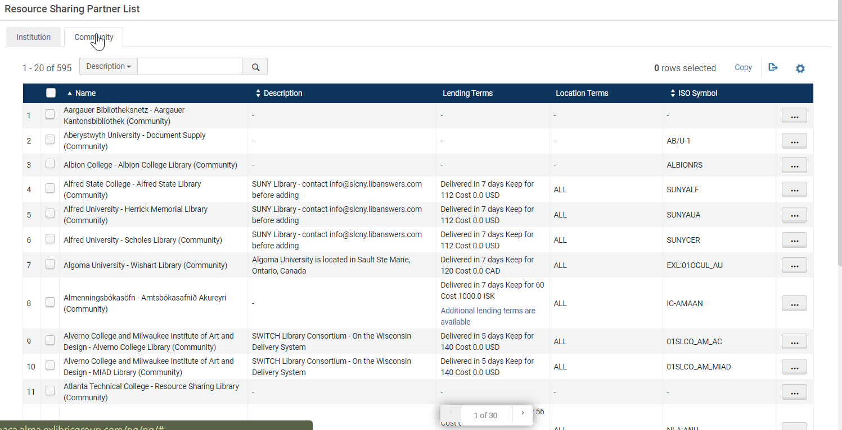
Helpful Features: Community Directory (for ALMA & Illiad Iso ILL libraries)
By participating in the directory
other libraries can find your institution and send requests
reduce the number of requests coming through by email that need to be keyed in manually
Resource Sharing Community Directory FAQs
Notes:
The community directory has been helpful in seeing who else might be a potential partner to connect with. Becoming a member of the directory doesn’t necessarily mean you’ll receive requests right away… it just opens up the potential for partnership with some additional setup.

Slide 33
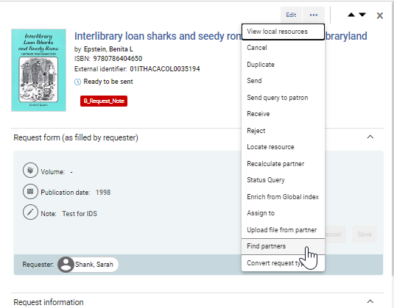
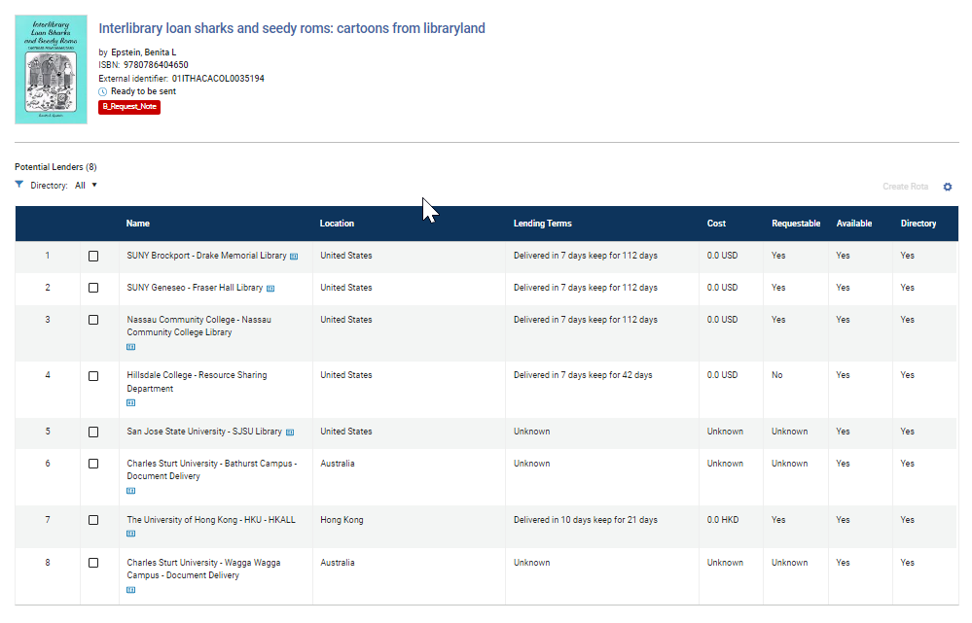
Helpful features: “Find Partners”
Notes:
The find partners feature helps identify potential partners for items that weren’t able to locate or find a partner initially. This is a great place to start to find possible lenders. I also tend to use Firstsearch Worldcat regularly (which we still have a subscription to)

Slide 34
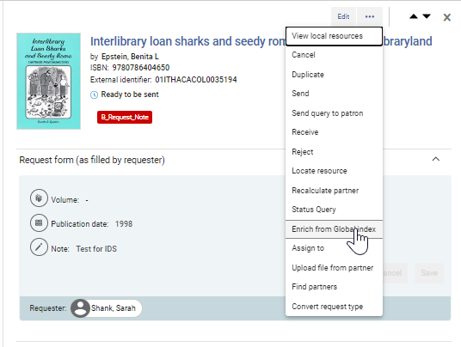
Helpful features: “Enrich from Global Index”
Notes:
Sometimes requests are missing a large amount of metadata, or you’re convinced there might be another records for it. This allows you to search the Global title index to see what other versions/editions there might be, without having to navigate away form primo.

Slide 35
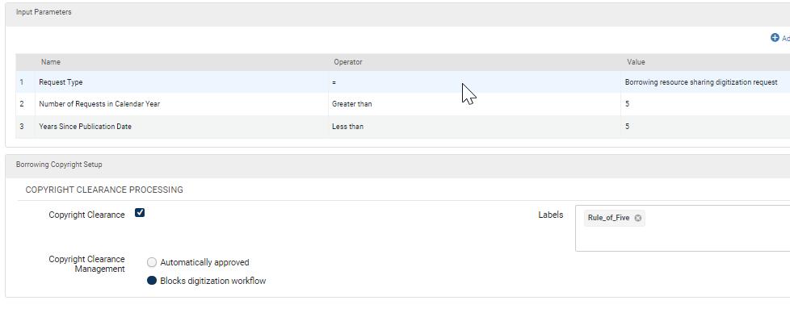
Helpful Features: Copyright Mediation (Rule of 5)
Copyright is handled by mediation rule
Requests are mediated based on the rule set up.
Options are to cancel, purchase, or allow to go through for later payment/reporting
Notes:
The copyright mediation rule is now working! When set up, you’re able to either mediate requests that meet the rule of five, or mark them for easy identification later on for payment. This rule works by adding a label (of your creation) to the request indicating that it falls outside of the rule.

Slide 36
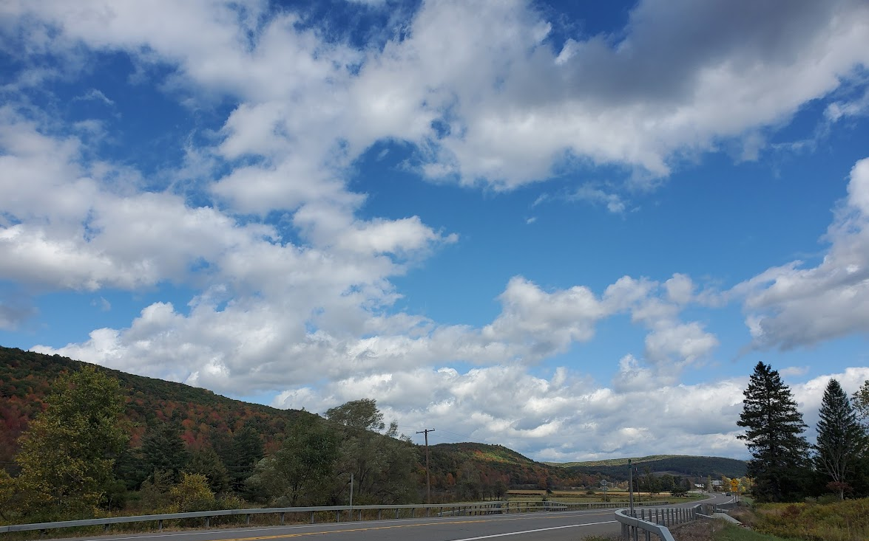
Things I’m looking forward to down the roadmap…
Further Letter enhancements
E-book lending development
Greater peer-to-peer connectivity with other systems
Speaking of roadmaps:
Rapido & RapidILL NERS Enhancement requests for ELUNA/IGELU members are
Due by 8/1/2023!!
Photo Credit: Sarah Shank
Notes:
ExLibris has been working diligently to fill out Rapido more, focusing on areas of Community, Ecosystem, User Experience and analytics. I’m really looking forward to seeing what they come up with for Ebook lending—and whether we’ll successfully be able to connect with OCLC libraries directly.

Slide 37
Responses to my Requests via Emails/ALA forms
“Just wanted to let you know we are packaging this up today. I will follow-up with the Lending Web link and login after I’ve dusted it off.”
“Our ILL is in a bit of disarray. I'm definitely open to loaning outside of OCLC, but we may not be the best reciprocal partner at the moment”
“We do require the ALA request form in order to process the request on our end”
“So, we went ahead and added it manually. We have sent it out to you all.”
“Can you clarify? What ALA form?”
“We send to anyone in the country who asks nicely for free so we have sent the score requested.”
“Unfortunately, we no longer process ALA requests. Hopefully, you can find this book at another library”
“We can absolutely lend this item to you. I have pulled it and it will go out with the mail”
“Please send us a reciprocal partnership contract and we will forward it to our administration team”
Notes:
So many libraries have said yes without batting an eye. Some libraries have sent me lists of questions about our experience and what it’s like being off of OCLC. “Hey, I’ve heard of you… you’re that library…” I am so appreciative to all those libraries that are taking the time to loan to us outside of their normal workflow—those that are willing to experiment and try ISO ILL and ALMA Resource Sharing. Some other reasons people gave for not loaning:: staffing levels are low, We’re renovating, we just don’t lend outside of OCLC.
One other thing I should mention about the switch is membership with OCLC affiliated profile groups. For example, we were LVIS members, for example, but now that we no longer participate with OCLC Worldshare, my assumption is that we are no longer affiliated with that group—however, we would continue to honor the criteria for the group.

Slide 38
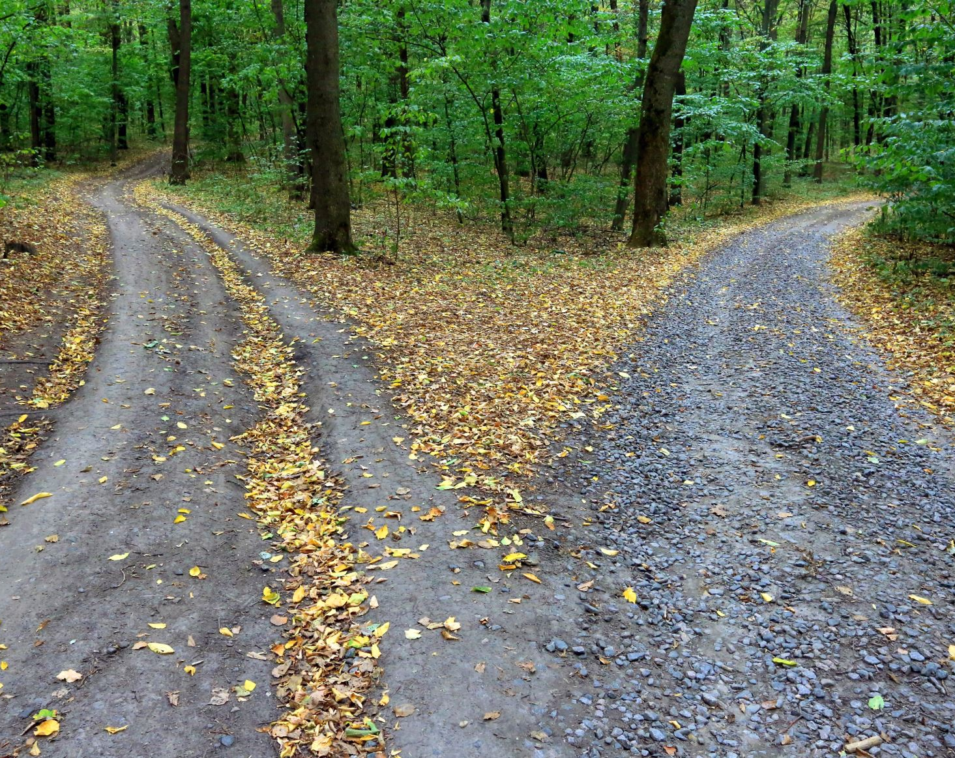
The Road Not Taken
“Two Roads diverged in a yellow wood, And sorry I could not travel both…
I shall be telling this with a sigh Somewhere ages and ages hence: Two roads diverged in a wood, and I— I took the one less traveled by, And that has made all the difference.”
--Robert Frost
Image credit: Stock images
Notes:
So in the beginning I mentioned, “I have a very bad feeling about this”. Is that still true--? Not really. Sometimes moving to a new system can be overwhelming and frustrating. For me though, it’s challenging and keeps things interesting, all the while making me feel like maybe I’ve gone back in time [cough… “what ALA form?”. When I was thinking of ideas for this presentation, Robert Frost’s poem, “The Road Not Taken” kept sneaking into my mind. The last stanza rings especially true… This switch has definitely challenged me to look at some things in a new ways—and sometimes having this ability “makes all the difference”.

Slide 39
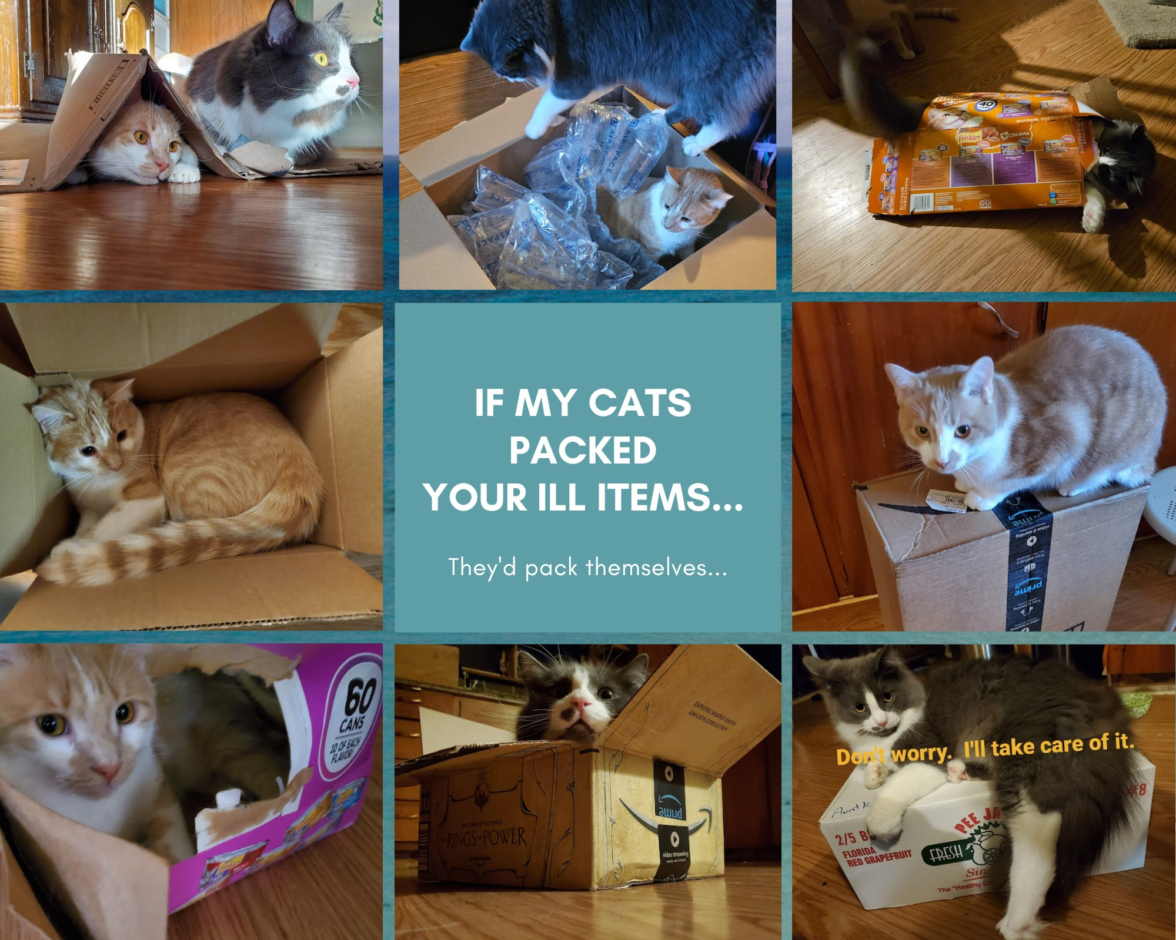
Thank you!
Any Questions?
sshank@ithaca.edu
607-274-3891
OCLC: XIM
ISO ILL: ITHACARS

