Slide 2
IDS Project
120 member resource sharing consortium
Work primarily with ILLiad/Worldshare
IDS Logic provides ILLiad automation
Also development for Alma
Monthly IDS Forums
Online Learning Institute
Annual Conference

Slide 3
IMLS Grant
National Leadership Grants – Libraries
$232,817 to develop new resource sharing system
Awarded July 27th, 2023
Completion, June, 2025

Slide 4
Advisory Committee
John Kiser, University of Pennsylvania
Lucy Harrison, GALILEO
Mallory Kasinec, Index Data
Mark Paris, Brandeis University
Mark Sullivan, IDS Project/SUNY Geneseo
Sebastian Hammer, Index Data
Sarah Shank, Ithaca College
Tim Jackson, SUNY OLIS
Zack Lane, Columbia University

Slide 5
Vision of CrossLink
Improve the efficiency and lower the cost of resource sharing
Help with the issue of reduced staffing at libraries
Making discovery and resource sharing more accessible to smaller libraries
Promote interoperability between different systems
Promote technology that will enable libraries to pursue consortial resource sharing while having flexibility to implement local library ILL workflows in the way that suits them best
Leverage the ISO18626 (ISO ILL standard) functionality which is increasingly becoming available in LSPs and resource sharing management systems

Slide 6
ISO 18626 in Current Systems
Manually configured peer-to-peer relationships
Cannot by themselves support consortial borrowing at scale
Massive overhead in multiple systems to get any large scale resource sharing started
Firewall settings for peer to peer
Multiple libraries need to be configured at each location

Slide 7
Current Discovery Options
WorldCat
Not all libraries are part of WorldCat due to cost
Consortial Union Catalog
High upkeep so many smaller organizations can’t maintain one
Expense for system, support, and potentially staffing
Individual Library Catalog
Does not help with access to external materials

Slide 8
Three critical infrastructure components
a shared index of holdings for the group of libraries wishing to share resources
a directory of services and configuration data, to furnish access information and necessary parameters to guide the choice of, and access to, potential suppliers
broker – the business logic for handling requests between borrower and lender

Slide 9
Public Libraries
Small libraries without a systems person
Small budgets
No union catalog of other public libraries
Some do not have an ILL solution and use ILL-l and regular email to send requests

Slide 10
Academic Libraries
Reduced budgets and staff
Unable to keep multiple systems for working with different consortia
Need to cut back on other systems and focus on one
Have rarely worked closely with local public libraries due to siloed systems
Primary systems currently used are becoming more siloed and reducing options to work together

Slide 11
CrossLink Discovery Flowchart
VuFind
CrossLink
API
API
SOLR
PostgreSQL
Reservoir
OAI-PMH Data
POD MaRC Data

Slide 12
CrossLink Discovery

Slide 13
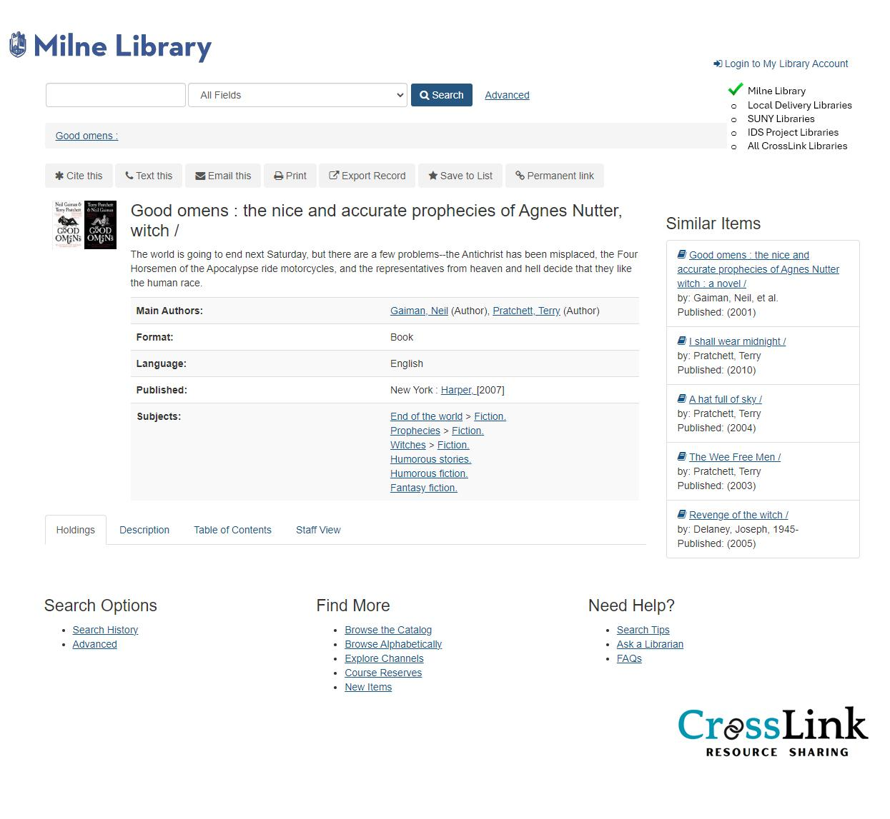
Library Specific Logo
Search Options
Book Covers
Basic Bib Information
Library Search Limits
Local Library
Other Consortia Options
All Libraries in CrossLink

Slide 14
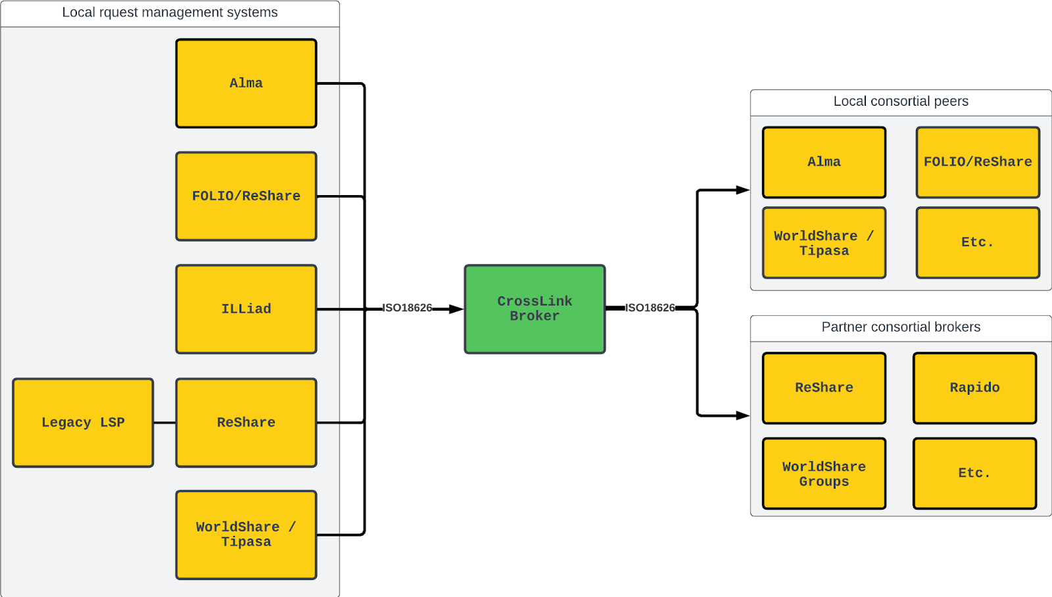
CrossLink Brokering Module
CrossLink will be a broker system that:
Can receive requests from one library
Identify a list of suitable suppliers
Try those suppliers in turn before returning a response to a requesting library

Slide 15
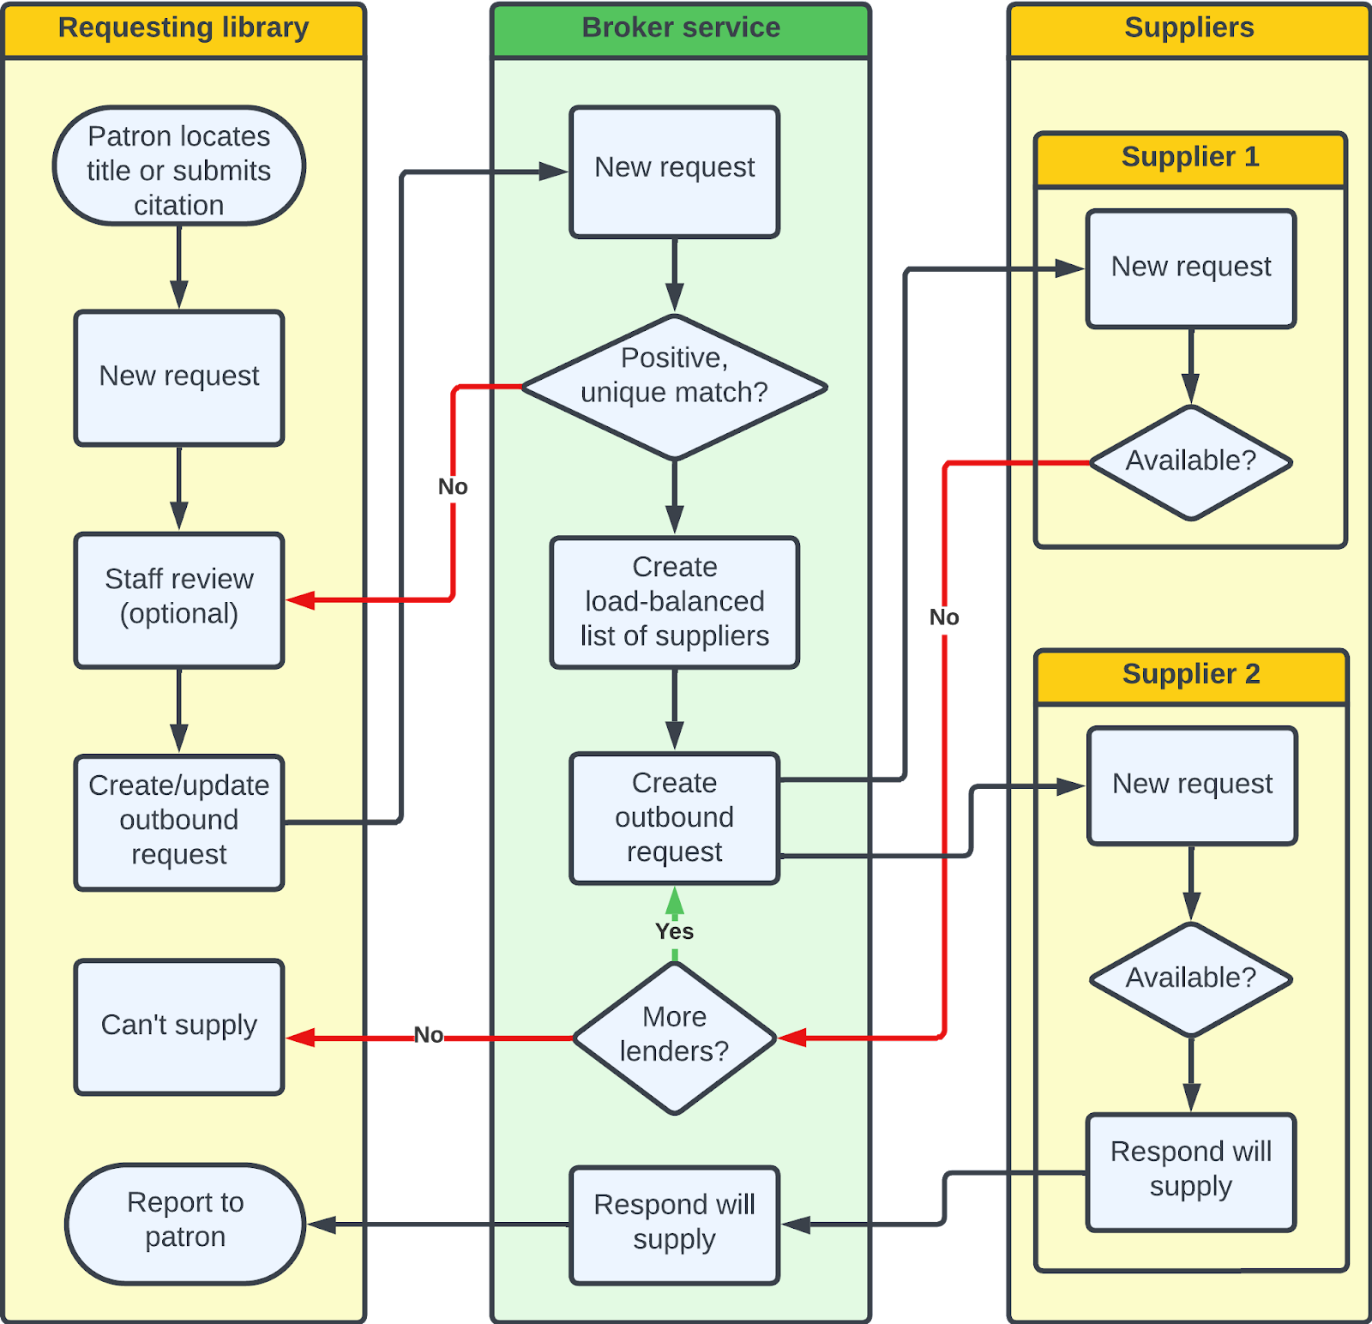
Request Flowchart
Item is discovered through Borrower’s primary discovery system
Request is submitted into Borrower’s request management system

Slide 16
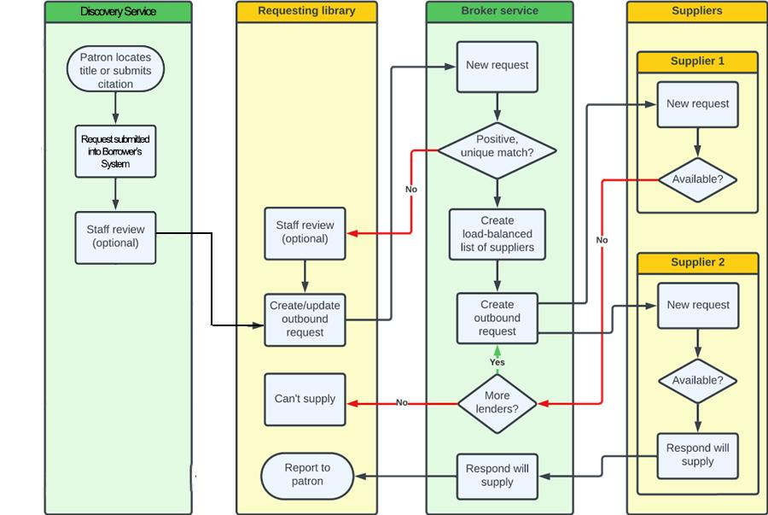
Request Flowchart
Item is discovered through CrossLink’s Discovery System
Request is submitted into Borrower’s request management system

Slide 17
Software vision
A general-purpose ISO18626 “proxy” or broker designed to support many use cases
Physical and digital, returnables and copies
LSP to LSP or Broker to Broker (cross-consortial routing)
Common Shared Index and directory design with Project ReShare to facilitate code share and future interoperability
Lightweight, extensible software architecture

Slide 18
CrossLink Design
Z39.50
NCIP
Workflow
Message queue
State model (YAML)
Req. (JSON)
State
engine
Directory
Rota
(index)
18626

Slide 19
CrossLink Design
Z39.50
NCIP
Workflow
Message queue
State model (YAML)
State
engine
Directory
Rota
(index)
18626
Req. (JSON)

Slide 20
Possible synergies with ReShare
Shared software components mean broader community and more sustainability
Shared vision of flexible, interoperable systems using ISO18626 with library leadership Cross-consortial lending ReShare as possible workflow tool for libraries without a native ISO18626 function in their LSP

Slide 21
Timeline
Discovery System Testing Now until 12/15/2024
CrossLink Config Database Dev Now until 8/15/2024
CrossLink ISO18626 Broker Dev April until 1/1/2025
Iterative Dev of CrossLink Broker November until 2/1/2025
Testing among libraries February until 6/1/2025

